Slide 1
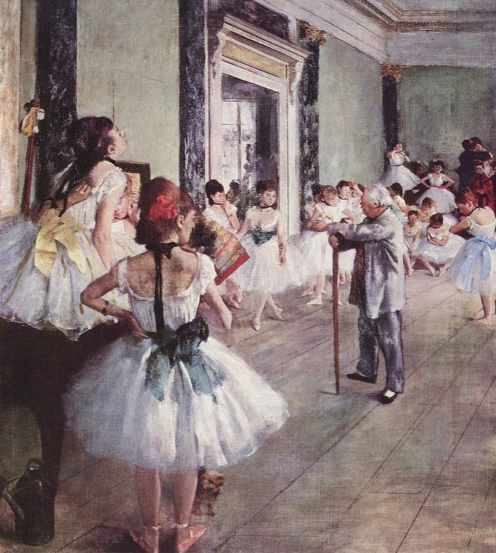
THE CRITICAL ESSAY
Supporting Quotes
Bring in the experts
Yawp! Writing Program · [CLASS] · [DATE]
Edgar Degas
The Dance Class, 1873–76
Oil on canvas · Musée d’Orsay, Paris

Slide 2
Today’s program
Step four, continued: back up your body paragraphs.
i.
Quiz show
ii.
Review: body paragraphs
iii.
Read the sample essay again
iv.
What goes in a body paragraph
v.
Find supporting quotes
vi.
Quote it right

Slide 3
Quiz show.
Five questions from the lessons so far.
Pick your answer before the reveal. Hands up!
Notes:
Optional warm-up. These questions build from lesson to lesson, so you can watch students' answers improve over the unit. Delete this section to skip it.

Slide 4
QUESTION 1 OF 5
What’s the best way to write an essay?
a.
Just start writing and hope some good ideas come out.
b.
Take my ideas and plug them into a formula, like the five-paragraph essay.
c.
Develop my ideas into a thesis statement and build my essay around that.
d.
ChatGPT, duh.
e.
I have never actually written an essay, so I have no idea.

Slide 5
QUESTION 1 OF 5 · ANSWER
What’s the best way to write an essay?
a.
Just start writing and hope some good ideas come out.
b.
Take my ideas and plug them into a formula, like the five-paragraph essay.
c.
Develop my ideas into a thesis statement and build my essay around that.
d.
ChatGPT, duh.
e.
I have never actually written an essay, so I have no idea.
Notes:
Correct answer: c. Optional warm-up. These questions build from lesson to lesson, so you can watch students' answers improve over the unit. Delete this section to skip it.

Slide 6
QUESTION 2 OF 5
Critical thinking is best defined as:
a.
Asking questions and seeking answers about a topic in order to develop a position on it
b.
Finding all of the weaknesses in an argument
c.
Finding all of the strengths in an argument
d.
Arguing a specific point of view in front of an audience
e.
Researching experts’ perspectives and arguments on a topic in order to develop a position on it

Slide 7
QUESTION 2 OF 5 · ANSWER
Critical thinking is best defined as:
a.
Asking questions and seeking answers about a topic in order to develop a position on it
b.
Finding all of the weaknesses in an argument
c.
Finding all of the strengths in an argument
d.
Arguing a specific point of view in front of an audience
e.
Researching experts’ perspectives and arguments on a topic in order to develop a position on it
Notes:
Correct answer: a. Optional warm-up. These questions build from lesson to lesson, so you can watch students' answers improve over the unit. Delete this section to skip it.

Slide 8
QUESTION 3 OF 5
Which of the following is MOST true about a good thesis statement?
a.
It is easy for the reader to agree with.
b.
It contains two or three pieces of support.
c.
It contains observation and analysis.
d.
It contains research and facts.
e.
It is one or two sentences long.

Slide 9
QUESTION 3 OF 5 · ANSWER
Which of the following is MOST true about a good thesis statement?
a.
It is easy for the reader to agree with.
b.
It contains two or three pieces of support.
c.
It contains observation and analysis.
d.
It contains research and facts.
e.
It is one or two sentences long.
Notes:
Correct answer: c. Optional warm-up. These questions build from lesson to lesson, so you can watch students' answers improve over the unit. Delete this section to skip it.

Slide 10
QUESTION 4 OF 5
Your introduction paragraph’s MAIN function is to:
a.
Tell a story that illustrates the topic of your essay
b.
Give specific examples that support your thesis
c.
Define important terms that your reader may need to know
d.
Present questions that your essay will answer
e.
Welcome your reader into your discussion and state the thesis

Slide 11
QUESTION 4 OF 5 · ANSWER
Your introduction paragraph’s MAIN function is to:
a.
Tell a story that illustrates the topic of your essay
b.
Give specific examples that support your thesis
c.
Define important terms that your reader may need to know
d.
Present questions that your essay will answer
e.
Welcome your reader into your discussion and state the thesis
Notes:
Correct answer: e. Optional warm-up. These questions build from lesson to lesson, so you can watch students' answers improve over the unit. Delete this section to skip it.

Slide 12
QUESTION 5 OF 5
Which of the following would probably NOT show up in your body paragraphs?
a.
Supporting quotations about specific points
b.
Your opinions
c.
Your thesis statement
d.
Analysis of other people’s arguments

Slide 13
QUESTION 5 OF 5 · ANSWER
Which of the following would probably NOT show up in your body paragraphs?
a.
Supporting quotations about specific points
b.
Your opinions
c.
Your thesis statement
d.
Analysis of other people’s arguments
Notes:
Correct answer: c. Optional warm-up. These questions build from lesson to lesson, so you can watch students' answers improve over the unit. Delete this section to skip it.

Slide 14


SUPPORTING QUOTES
Review.
Where we left off
Last session we started the middle of the essay: the body paragraphs.

Slide 15
Break your thesis into its parts
THESIS
When schools fail to prioritize creativity in teaching, school becomes boring for both students and teachers, resulting in a lack of shared motivation, excitement, and accomplishment.
1ST ELEMENT
Schools fail to prioritize creativity in teaching
2ND ELEMENT
School becomes boring for both students and teachers
3RD ELEMENT
A lack of shared motivation, excitement, and accomplishment

Slide 16
The basic structure of a body paragraph
1
Transition sentence (optional)
2
Topic sentence: states the element from your thesis you’re discussing
3
Supporting sentences: explain, define, or illustrate
a. Explanations
b. Opinions and analysis
c. Possible causes or effects of the thing you’re discussing
d. Research (only if necessary, and be sure to cite your source)
e. Answers to one of the “5 W’s”: who, what, where, when, why?
4
Concluding sentence: wraps up your thoughts on this element

Slide 17
Read.
The sample essay, again
Each body paragraph picks up one part of the thesis. The colors show you where.

Slide 18
INTRODUCTION
Ending on the thesis
Do you remember trying to learn how to ride a bike? It was exciting, blood rushing, and challenging, but worth it. When you got going but fell, you got back up and went a little further each time. You had more motivation to keep going because it was exciting. Schools today seem to lack this sense of excitement. Students have zero motivation to keep going because there is no excitement from the teachers and no sense of an end goal for the students. Shouldn’t the process of learning be inspiring and exciting for everyone? When schools fail to prioritize creativity in teaching, school becomes boring for both students and teachers, resulting in a lack of shared motivation, excitement, and accomplishment.

Slide 19
BODY PARAGRAPH 1
Element 1
Schools fail to prioritize creativity in teaching
Visit most schools in America today and you’ll see how much creativity they really lack. Handouts, tests, and managing student behavior seem to be the priorities. Many teachers think if they allow creativity in a classroom, it will cause the students to be disruptive, and make it hard to gain control again. Administrators may also be to blame, if they don’t see the value of creative activities and discourage teachers from teaching in this way. However, the truth is that creative activities get students interested in subjects. When they are interested, they ask questions and want to learn more. In some cases, they may even find the thing they want to focus on in college or for a career.

Slide 20
BODY PARAGRAPH 2
Element 2
School becomes boring for both students and teachers
The fact is, when students are not inspired creatively, they get bored. Have you ever walked into a classroom and seen students asleep? What about teachers who never get out of their seats to teach? This is very common in classrooms today. Students aren’t interested in the lessons because the teacher shows no signs of interest either. A lot of the time teachers just slap a packet of worksheets on students’ desks and tell them to do it. This does not sufficiently challenge them or encourage them. According to “The 74,” a nonprofit news organization covering American education, thirty-two percent of American students say they feel bored during class (www.the74million.org). They feel unconnected and unmotivated with the lessons. This affects teachers too, who also show signs of boredom by having a low monotone voice, never changing their teaching routine, and always being serious. This collective boredom between students and teachers makes school painful, when it could be energizing.

Slide 21
BODY PARAGRAPH 3
Element 3
A lack of shared motivation, excitement, and accomplishment
The issue at hand is the lack of shared motivation, excitement, and accomplishment among the teachers and students. Walking into a classroom today, especially after the pandemic, everyone seems so drained and unmotivated. Students got so used to learning everything through a screen for 2 years. Now all you see is students on their phones or asleep. This also severely affects teachers because they feel that there is no hope in teaching students while battling the students’ desire to constantly be connected with social media. Furthermore, many teachers appear to be disengaged with the students and even their profession. To remedy this, administrators should support teachers in teaching creatively. Projects instead of tests, fun activities instead of worksheets, and physical movement instead of sitting still can make class more engaging and fun. Not only would this increase student involvement, but it would also help teachers rediscover their love for teaching again. Making learning fun truly motivates everyone.

Slide 22
What to include in your body paragraphs
i.
Your original opinions, reactions, and reflections on the main point of the paragraph. (Answer a “5 W” question.)
ii.
Specific examples and details that show the reader exactly what you’re talking about.
iii.
Quotations that help illustrate or support your point.
Remember: focus on one thesis point at a time in each body paragraph. Don’t veer off course!

Slide 23
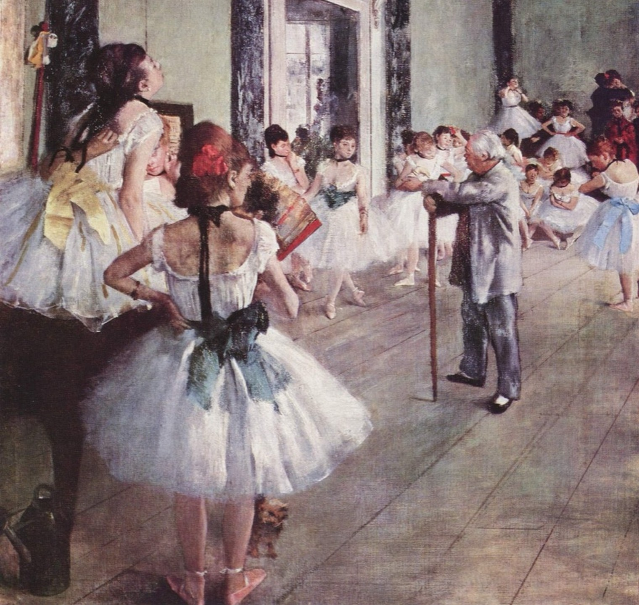
Step 4, part 2.
Find supporting quotes.
Edgar Degas, The Dance Class (detail), 1873–76

Slide 24
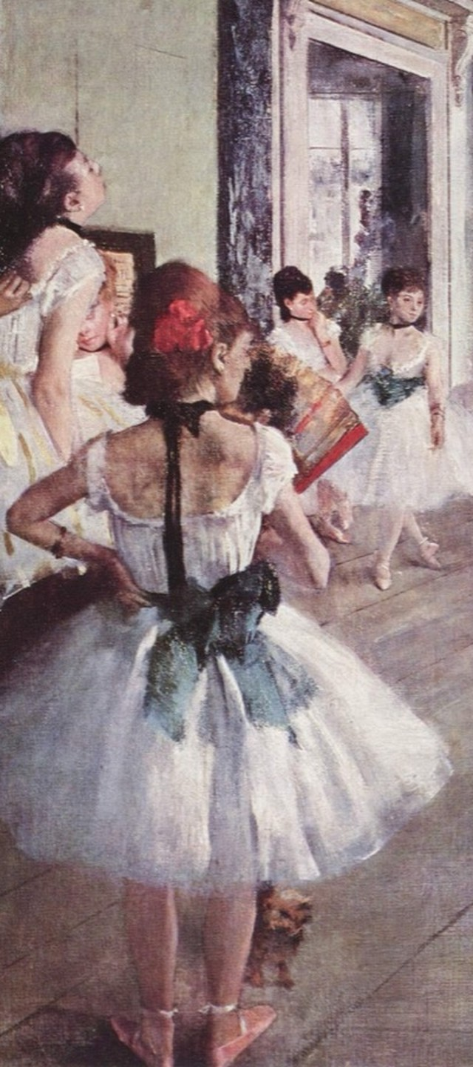
SUPPORTING QUOTES
Now that you’ve developed some authority on your subject, it’s a great power play to refer to other experts to support your points.
Make sure your sources are credible.

Slide 25
Know this.
Supporting evidence and quotes
Critical essays should almost always include supporting evidence, often as direct quotes from the text, speech, film, or work you’re discussing, or to bring in an expert opinion on your topic.
Open the quotes handout →
Quoting and Citing Sources: how to use (and format) quotes in MLA style

Slide 26
Every quote gets four moves
1
Introduce it.
Lead in with your own words, in the same sentence.
2
Quote it.
The source’s exact words, inside quotation marks.
3
Explain it.
Say what it means for your argument.
4
Cite it.
Tell the reader where it came from.
They don’t have to be in this order, and you can combine some of these steps.
Never drop a quote in on its own. Every quotation needs your own words in the same sentence.

Slide 27
When to quote
Most of the time, use your own words. Quote when:
a.
You’re using the statement as evidence for your own argument
b.
You’re establishing another person’s position
c.
Someone said it better and more clearly than you can

Slide 28
Introduce it.
Templates for introducing a quote
With “that,” skip the comma: the quote becomes part of your sentence. Article titles go in quotation marks; book titles in italics.
X states, “__________.”
As the scholar X explains it, “__________.”
As claimed by X, “__________.”
In her article “_____,” X suggests that “_____.”
In X’s perspective, “__________.”
X concurs when she notes, “__________.”

Slide 29
Explain it.
Templates for explaining a quote
Don’t assume the meaning is obvious. Your explanation is where your own thinking shows.
In other words, X asserts __________.
In making this claim, X argues that __________.
X insists that __________.
What X really means is that __________.
The basis of X’s argument is that __________.

Slide 30
Cite it.
Three ways to give credit
PARENTHESES AT THE END
“…there really isn’t much evidence of it in practice” (Richardson).
The period goes after the parentheses.
NAME THE SOURCE IN YOUR SENTENCE
Richardson states, “Our world and our economy are changing rapidly…”
Comma, then a capital letter.
USE “THAT”
Richardson states that “our world and our economy are changing rapidly…”
No comma, and the quote starts lowercase.

Slide 31
What goes in the parentheses
A BOOK OR PRINTED ARTICLE
(Richardson 42)
Last name and page number, no comma
A WEBSITE WITH NO PAGE NUMBERS
(Richardson)
Last name only
A VIDEO OR RECORDED TALK
(Richardson 00:04:12)
Last name and the time it starts
ENDS WITH A QUESTION MARK OR EXCLAMATION POINT?
“…Shouldn’t we be making it as engaging and effective as possible?” (Richardson).
Keep the question mark inside the quotes. Then add the citation and a period.

Slide 32
Two more things
Long quotations
More than four lines? Start it on a new line, indent the whole quote half an inch, and leave off the quotation marks. The citation goes after the final period. Use these rarely (and maybe never in a short essay).
Works Cited
At the end of your essay, list every source you quoted or referred to, in alphabetical order by last name. Check any citation generator’s work against Purdue OWL’s MLA guide.

Slide 33
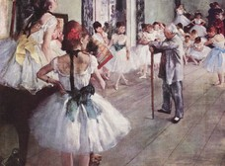
Before you go.
Your voice leads. The experts back you up.
A good quote supports your point. It doesn’t make it for you.
Next time: [NEXT LESSON TITLE]

