Slide 1
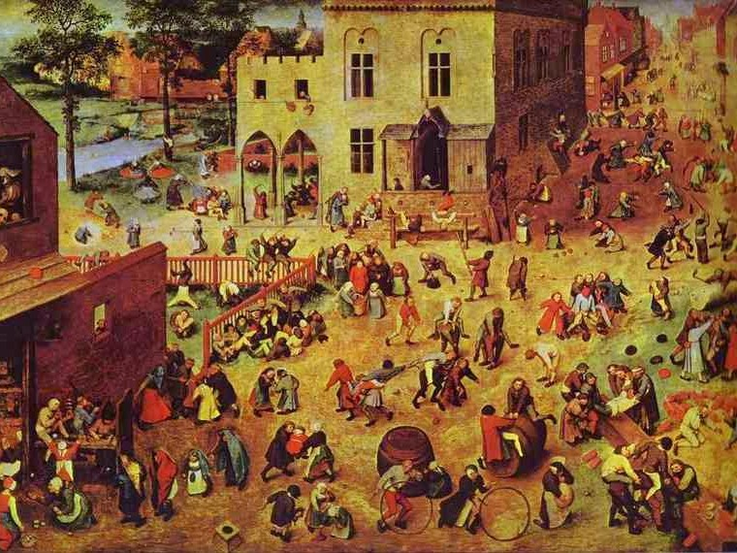
THE CRITICAL ESSAY
Pre-Writing
Know what you’ll say before you say it
YAWP! Writing Program · [CLASS] · [DATE]
Pieter Bruegel the Elder
Children’s Games, 1560
Oil on oak panel · Kunsthistorisches Museum, Vienna

Slide 2
Today.
i.
Look closely at a photograph
The program
ii.
The prompt
iii.
The shape of a critical essay
Step one of the writing process: think before you write.
iv.
Pre-writing: what it is and why
v.
Pre-write for five minutes
vi.
Find the diamonds

Slide 3
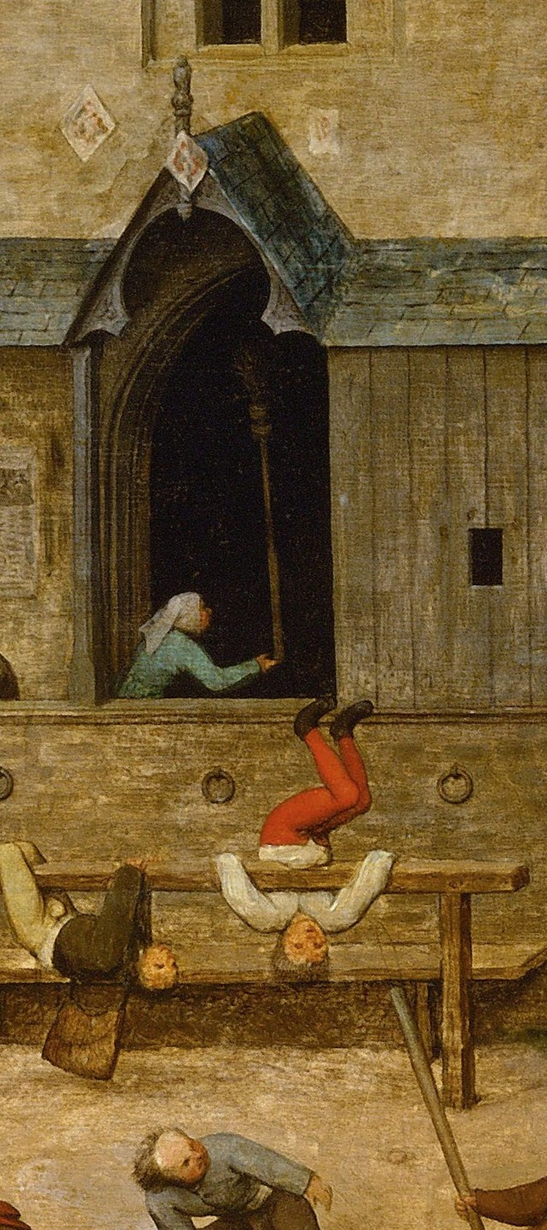
PRE-WRITING
Why we’re here.
Over our sessions, you’ll learn to write a thoughtful, original, critical essay.
Talk through our opinions about the topic
Learn a writing process
Write a lot

Slide 4
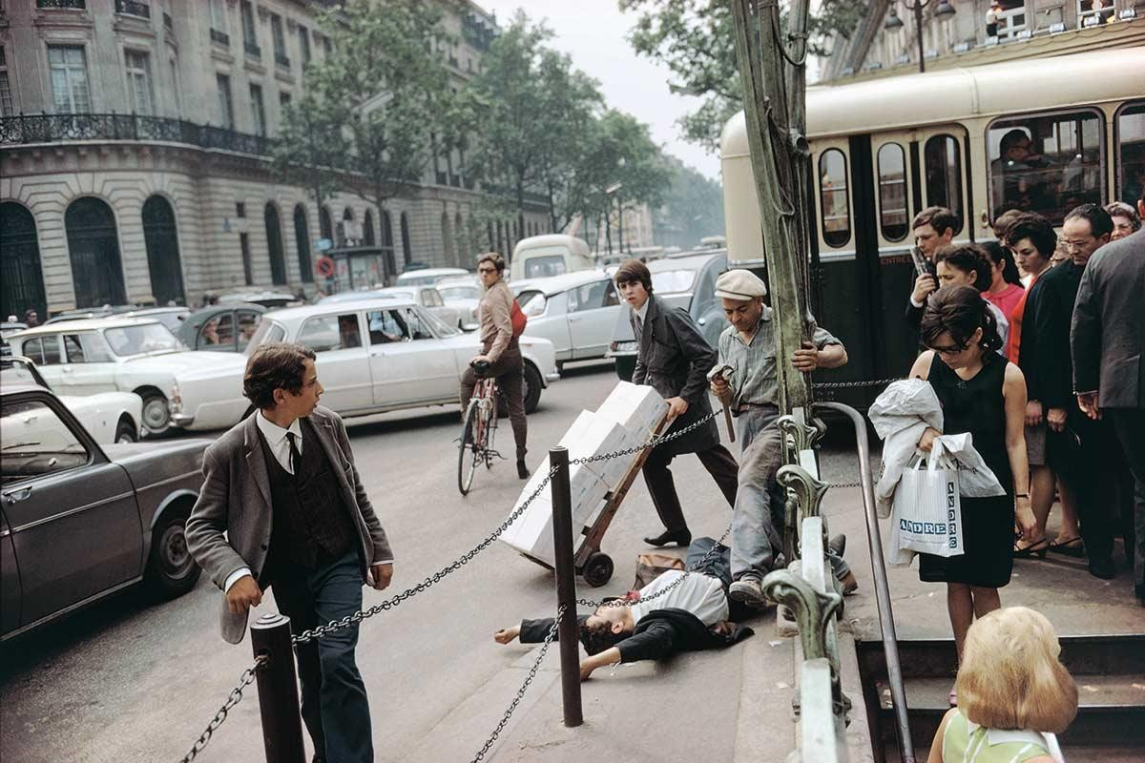
Look.
What do you see?
Photograph · who took it, and when? We’ll find out.

Slide 5
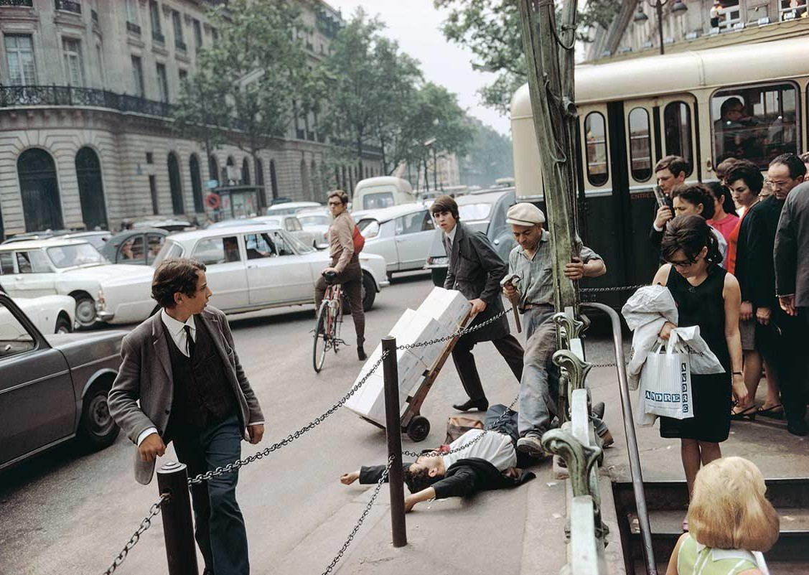
PRE-WRITING
Analyze.
What has happened here?
What time of day is it?
Where might this be?
When in history are we?
What is anyone feeling?

Slide 6
In his words.
“I was out on the Right Bank just strolling … and came to this Metro stop and noticed a crowd and a man down and as I inserted myself into the space to get closer this worker with the hammer came quickly around the pole to make his way to some construction going on behind me, and BOOM! as he stepped over the man it all came together ….”
Joel Meyerowitz
Fallen Man, Paris, France, 1967
Photograph

Slide 7
The prompt.
Option A · Your community
Write an essay about a problem in your community and how we might solve it. “Community” might refer to your neighborhood, school, grade, city, state, country, age group, race, gender, or any other group you belong to. Your essay can focus on any problems that you see or feel. Use your personal experience and observations to develop your position, and evidence from your own experience to support your ideas. How do you propose we solve this problem? Your essay should be organized formally, with an introduction, thesis statement, body paragraphs, and a conclusion.

Slide 8
The prompt.
Option B · The Great Gatsby
Write a critical essay about The Great Gatsby. You can choose any aspect of the novel that interests you. Consider the themes we’ve discussed, the characters, the settings, or anything you’ve noticed about the story that you think is worthy of discussion.
Use your observations and opinions to develop your position, and quotations from the book to support your ideas. Your essay should be organized formally, with an introduction, thesis statement, body paragraphs, and a conclusion.

Slide 9
Think.
So, how do you begin writing a critical essay?
Like the one we read together?
Let’s look at the form →

Slide 10

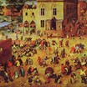
PRE-WRITING
Know.
The critical essay form
Wide at the top, narrow to a thesis, build through the body, then widen again to close.

Slide 11
Hold this.
Without it, your essay will probably ramble and lose its way.
Your thesis statement is the MVP of your essay.
Great thesis statements lead to great essays.
Don’t ever start an essay until you know what you’re going to say.
But how do you develop one?

Slide 12
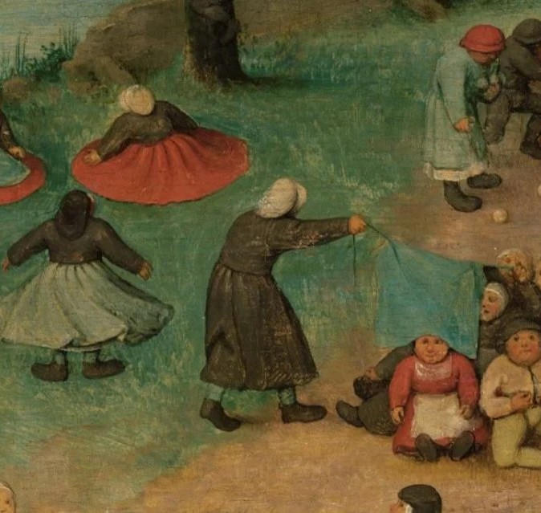
Step 1.
Pre-writing.
How you find out what you think
Pieter Bruegel the Elder, Children’s Games (detail), 1560

Slide 13
The problem.
The solution: pre-writing.
Most people just start writing without knowing what they’re going to say.
Before you write, think critically about the prompt and develop a thesis statement.
The result: rambling essays that may not make sense at all, to you or to the reader.
This simple act is the difference between a focused, effective essay and a big, hot mess.

Slide 14
Hold this.
Critical thinking is simply asking questions and seeking answers about a topic.
PICTURE THIS
Three friends go see a movie …
A five-year-old child …

Slide 15
Example.
A pre-write about the Creed movies
Every answer becomes the next question.
I love the Creed movies. Why? Because they’re amazing! Why? They’re really uplifting. How? In that Cinderella story, underdog way. Are they uplifting in other ways? Yes, the love story between Adonis and Bianca is really touching, and the relationship between Adonis and Rocky is really moving. So it’s more than just a sports story? Definitely—it’s really a movie about relationships and overcoming things. Like what? Well, Adonis overcomes the fact that he didn’t really have a dad—Apollo Creed was not really in his life that much, even though he was like this huge celebrity back in the day. How does he overcome that? I think his relationship with Rocky becomes like the dad he never had. And Rocky is having trouble with his own son—their relationship is pretty broken. So Rocky and Adonis both kind of fill these father-son roles for each other. The movies become redemptive for them. And then Adonis gets to be a dad! So there’s that too. The movies are about boxing but they’re also about fatherhood and the power of the father-son relationship.

Slide 16
Example.
A pre-write about Disney movies
Watch where it ends up.
I love Disney movies. Why? They make me feel so happy! Why? I really love how in most of the stories the characters go through something hard and challenging. Like what? In a lot of them, they lose a parent early in the movie. This leaves them feeling sad and alone. Then what happens? Then they usually face some other challenge, like a mean stepmother (Cinderella) or someone trying to hurt them (Lion King) or trying to find a treasure (Aladdin). How do they handle these challenges? Almost always someone comes along and helps them—the Fairy Godmother, Simba’s friends, the Genie. How do they help? They guide them and show them the way, but they also usually show the main character the gifts/talents they have inside of them. That’s interesting—the main character is the hero, but they almost always need a helper character to show them their hero qualities.

Slide 17
THE GOAL:
Narrow your thinking and find a specific topic for your essay.

Slide 18
How to pre-write
Pro tip: stay off the internet!
Do.
Don’t.
Flesh out ideas
Worry about grammar
Keep writing!
Try to organize your essay
Ask and answer as many questions as possible
Stop writing!
Unleash the five-year-old within!

Slide 19
Write.
Pre-write.
Ask a question. Answer it. Ask the next one. Don’t worry about grammar, and don’t stop.
5 MINUTES
Stay off the internet · Use the prompt you chose

Slide 20
A lot of your pre-write will ramble, and might feel kind of random.
Reread.
Find the diamonds.
But some parts will stand out: interesting, sharp and worth more discussion.
Those are the diamonds, and one could become the focus of your essay.

Slide 21
i.
Critical thinking is simply asking and answering questions in a smart way.
Remember.
ii.
The more questions you ask, the more ideas and theories you start to form.
What have we learned today?
iii.
Pre-writing is one of the most important steps in the writing process.
iv.
The internet destroys originality when you’re developing a topic. Stay off it while you pre-write!
v.
Generating ideas takes effort and time. It’s not always easy, but it pays off.

Slide 22
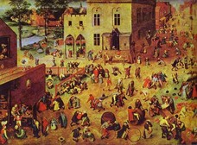
Before you go.
Generating ideas takes energy. Don’t expect it to be easy.
Critical thinking + Time = Original ideas
Next time: [NEXT LESSON TITLE]

