Slide 1
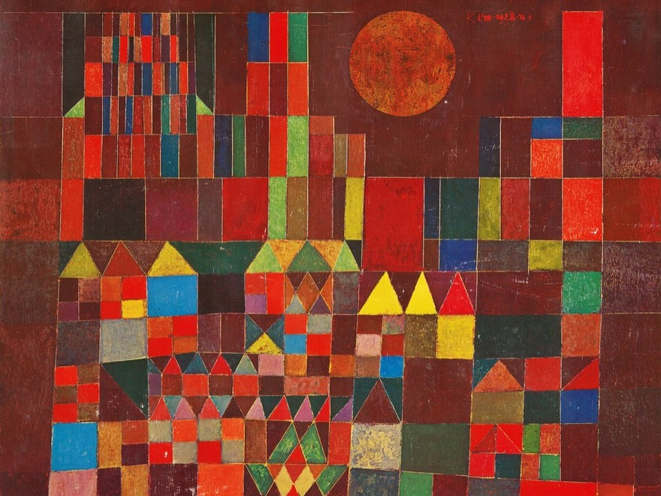
THE CRITICAL ESSAY
Body Paragraphs
Build on your thesis
YAWP! Writing Program · [CLASS] · [DATE]
Paul Klee
Castle and Sun, 1928
Oil on canvas · Private collection

Slide 2
Today’s program
Step four of the writing process: build the middle of your essay.
i.
Quiz show
ii.
Your thesis is your map
iii.
Break it into parts
iv.
Build a body paragraph
v.
Read a sample essay
vi.
The house analogy

Slide 3
Quiz show.
Five questions from the lessons so far.
Pick your answer before the reveal. Hands up!
Notes:
Optional warm-up. These questions build from lesson to lesson, so you can watch students' answers improve over the unit. Delete this section to skip it.

Slide 4
QUESTION 1 OF 5
What’s the best way to write an essay?
a.
Just start writing and hope some good ideas come out.
b.
Take my ideas and plug them into a formula, like the five-paragraph essay.
c.
Develop my ideas into a thesis statement and build my essay around that.
d.
ChatGPT, duh.
e.
I have never actually written an essay, so I have no idea.

Slide 5
QUESTION 1 OF 5 · ANSWER
What’s the best way to write an essay?
a.
Just start writing and hope some good ideas come out.
b.
Take my ideas and plug them into a formula, like the five-paragraph essay.
c.
Develop my ideas into a thesis statement and build my essay around that.
d.
ChatGPT, duh.
e.
I have never actually written an essay, so I have no idea.
Notes:
Correct answer: c. Optional warm-up. These questions build from lesson to lesson, so you can watch students' answers improve over the unit. Delete this section to skip it.

Slide 6
QUESTION 2 OF 5
Critical thinking is best defined as:
a.
Asking questions and seeking answers about a topic in order to develop a position on it
b.
Finding all of the weaknesses in an argument
c.
Finding all of the strengths in an argument
d.
Arguing a specific point of view in front of an audience
e.
Researching experts’ perspectives and arguments on a topic in order to develop a position on it

Slide 7
QUESTION 2 OF 5 · ANSWER
Critical thinking is best defined as:
a.
Asking questions and seeking answers about a topic in order to develop a position on it
b.
Finding all of the weaknesses in an argument
c.
Finding all of the strengths in an argument
d.
Arguing a specific point of view in front of an audience
e.
Researching experts’ perspectives and arguments on a topic in order to develop a position on it
Notes:
Correct answer: a. Optional warm-up. These questions build from lesson to lesson, so you can watch students' answers improve over the unit. Delete this section to skip it.

Slide 8
QUESTION 3 OF 5
Which of the following is MOST true about a good thesis statement?
a.
It is easy for the reader to agree with.
b.
It contains two or three pieces of support.
c.
It contains observation and analysis.
d.
It contains research and facts.
e.
It is one or two sentences long.

Slide 9
QUESTION 3 OF 5 · ANSWER
Which of the following is MOST true about a good thesis statement?
a.
It is easy for the reader to agree with.
b.
It contains two or three pieces of support.
c.
It contains observation and analysis.
d.
It contains research and facts.
e.
It is one or two sentences long.
Notes:
Correct answer: c. Optional warm-up. These questions build from lesson to lesson, so you can watch students' answers improve over the unit. Delete this section to skip it.

Slide 10
QUESTION 4 OF 5
Your introduction paragraph’s MAIN function is to:
a.
Tell a story that illustrates the topic of your essay
b.
Give specific examples that support your thesis
c.
Define important terms that your reader may need to know
d.
Present questions that your essay will answer
e.
Welcome your reader into your discussion and state the thesis

Slide 11
QUESTION 4 OF 5 · ANSWER
Your introduction paragraph’s MAIN function is to:
a.
Tell a story that illustrates the topic of your essay
b.
Give specific examples that support your thesis
c.
Define important terms that your reader may need to know
d.
Present questions that your essay will answer
e.
Welcome your reader into your discussion and state the thesis
Notes:
Correct answer: e. Optional warm-up. These questions build from lesson to lesson, so you can watch students' answers improve over the unit. Delete this section to skip it.

Slide 12
QUESTION 5 OF 5
Which of the following would probably NOT show up in your body paragraphs?
a.
Supporting quotations about specific points
b.
Your opinions
c.
Your thesis statement
d.
Analysis of other people’s arguments

Slide 13
QUESTION 5 OF 5 · ANSWER
Which of the following would probably NOT show up in your body paragraphs?
a.
Supporting quotations about specific points
b.
Your opinions
c.
Your thesis statement
d.
Analysis of other people’s arguments
Notes:
Correct answer: c. Optional warm-up. These questions build from lesson to lesson, so you can watch students' answers improve over the unit. Delete this section to skip it.

Slide 14


BODY PARAGRAPHS
Where we are.
The critical essay form
Your introduction ends with your thesis. Next comes the middle of the essay: the body paragraphs.

Slide 15
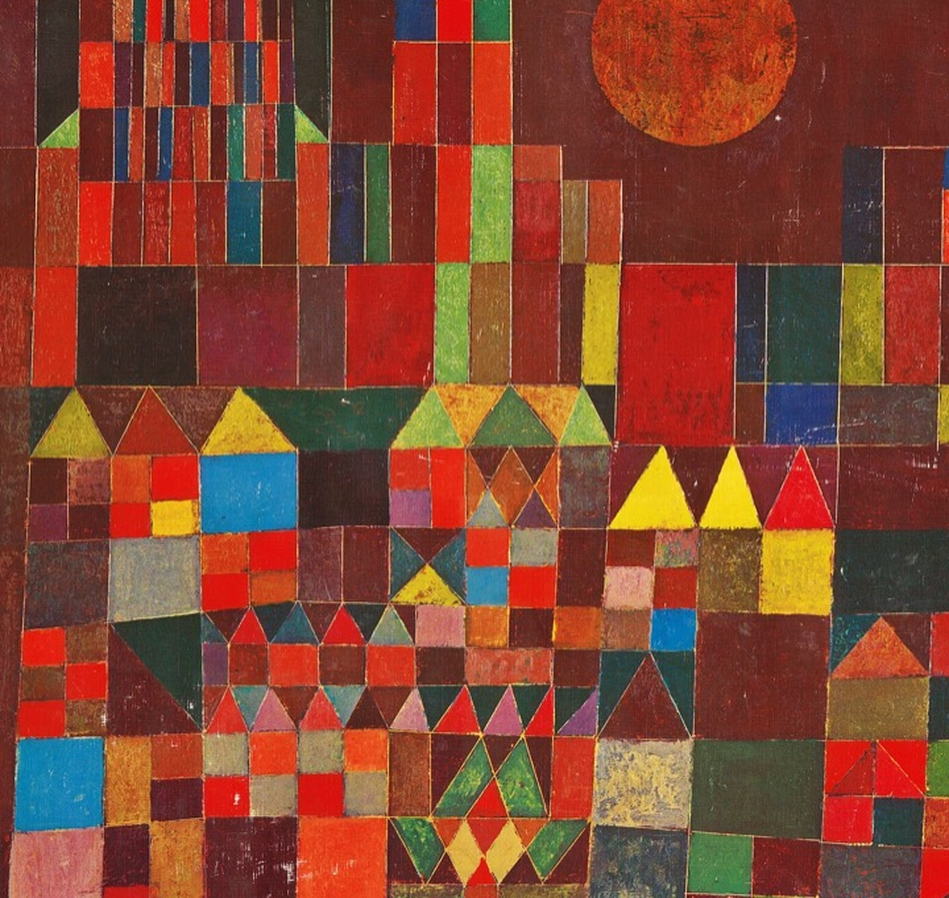
Step 4.
Write the body paragraphs.
Also called supporting paragraphs
Paul Klee, Castle and Sun (detail), 1928

Slide 16

BODY PARAGRAPHS
Once you’ve dropped your thesis at the end of your introduction, everything you write must in some way support, define, explain, or illustrate the elements within your thesis.

Slide 17
The good news.
Your thesis statement tells you exactly where to go from here.

Slide 18
OUR THESIS
When schools fail to prioritize creativity in teaching, school becomes boring for both students and teachers, resulting in a lack of shared motivation, excitement, and accomplishment.

Slide 19
Break your thesis into its parts
THESIS
When schools fail to prioritize creativity in teaching, school becomes boring for both students and teachers, resulting in a lack of shared motivation, excitement, and accomplishment.
1ST ELEMENT
Schools fail to prioritize creativity in teaching
2ND ELEMENT
School becomes boring for both students and teachers
3RD ELEMENT
A lack of shared motivation, excitement, and accomplishment

Slide 20
These become your body paragraphs
THESIS
When schools fail to prioritize creativity in teaching, school becomes boring for both students and teachers, resulting in a lack of shared motivation, excitement, and accomplishment.
BODY PARAGRAPH 1
Schools fail to prioritize creativity in teaching
BODY PARAGRAPH 2
School becomes boring for both students and teachers
BODY PARAGRAPH 3
A lack of shared motivation, excitement, and accomplishment

Slide 21
The basic structure of a body paragraph
1
Transition sentence (optional)
2
Topic sentence: states the element from your thesis you’re discussing
3
Supporting sentences: explain, define, or illustrate
a. Explanations
b. Opinions and analysis
c. Possible causes or effects of the thing you’re discussing
d. Research (only if necessary, and be sure to cite your source)
e. Answers to one of the “5 W’s”: who, what, where, when, why?
4
Concluding sentence: wraps up your thoughts on this element

Slide 22
Read.
A sample essay
Watch how each body paragraph picks up one part of the thesis. The colors show you where.

Slide 23
INTRODUCTION
Ending on the thesis
Do you remember trying to learn how to ride a bike? It was exciting, blood rushing, and challenging, but worth it. When you got going but fell, you got back up and went a little further each time. You had more motivation to keep going because it was exciting. Schools today seem to lack this sense of excitement. Students have zero motivation to keep going because there is no excitement from the teachers and no sense of an end goal for the students. Shouldn’t the process of learning be inspiring and exciting for everyone? When schools fail to prioritize creativity in teaching, school becomes boring for both students and teachers, resulting in a lack of shared motivation, excitement, and accomplishment.

Slide 24
BODY PARAGRAPH 1
Element 1
Schools fail to prioritize creativity in teaching
Visit most schools in America today and you’ll see how much creativity they really lack. Handouts, tests, and managing student behavior seem to be the priorities. Many teachers think if they allow creativity in a classroom, it will cause the students to be disruptive, and make it hard to gain control again. Administrators may also be to blame, if they don’t see the value of creative activities and discourage teachers from teaching in this way. However, the truth is that creative activities get students interested in subjects. When they are interested, they ask questions and want to learn more. In some cases, they may even find the thing they want to focus on in college or for a career.

Slide 25
BODY PARAGRAPH 2
Element 2
School becomes boring for both students and teachers
The fact is, when students are not inspired creatively, they get bored. Have you ever walked into a classroom and seen students asleep? What about teachers who never get out of their seats to teach? This is very common in classrooms today. Students aren’t interested in the lessons because the teacher shows no signs of interest either. A lot of the time teachers just slap a packet of worksheets on students’ desks and tell them to do it. This does not sufficiently challenge them or encourage them. According to “The 74,” a nonprofit news organization covering American education, thirty-two percent of American students say they feel bored during class (www.the74million.org). They feel unconnected and unmotivated with the lessons. This affects teachers too, who also show signs of boredom by having a low monotone voice, never changing their teaching routine, and always being serious. This collective boredom between students and teachers makes school painful, when it could be energizing.

Slide 26
BODY PARAGRAPH 3
Element 3
A lack of shared motivation, excitement, and accomplishment
The issue at hand is the lack of shared motivation, excitement, and accomplishment among the teachers and students. Walking into a classroom today, especially after the pandemic, everyone seems so drained and unmotivated. Students got so used to learning everything through a screen for 2 years. Now all you see is students on their phones or asleep. This also severely affects teachers because they feel that there is no hope in teaching students while battling the students’ desire to constantly be connected with social media. Furthermore, many teachers appear to be disengaged with the students and even their profession. To remedy this, administrators should support teachers in teaching creatively. Projects instead of tests, fun activities instead of worksheets, and physical movement instead of sitting still can make class more engaging and fun. Not only would this increase student involvement, but it would also help teachers rediscover their love for teaching again. Making learning fun truly motivates everyone.

Slide 27
BODY PARAGRAPHS
Talk.
The house tour analogy
How is an essay like a house?

Slide 28
The house tour
You’re the realtor. Your reader is the buyer.
LIVING ROOM
KITCHEN
BEDROOMS
1
2
3
4
THE NEIGHBORHOOD
Introduction
Drive in and get your bearings. Context first.
THE FRONT DOOR
Thesis
A handshake, and you’re in. Now you know where you are.
EACH ROOM
Body paragraphs
Bring us into each room that sells it. Point out the details: the wood floors, the fireplace, the new appliances. Skip the family photos or other irrelevant details.
THE BACK DECK
Conclusion
Widen the view. From here you can see the neighbors’ houses or the larger context.
Not a conclusion: touring every room again (repeating yourself), or pushing the buyer out a second-story window (no ending at all).

Slide 29

Before you go.
Every body paragraph points back to your thesis.
One element, one paragraph. Your thesis already told you what to write.
Next time: [NEXT LESSON TITLE]

