Slide 1



Thesis-Driven Essay · Lesson 5
Body Paragraphs
YAWP!
WRITING PROGRAM
Let your thesis be your guide
Notes:
A turning point: with a solid intro ending on a strong thesis, students start to realize they’re actually writing a great essay. Before class, read their intros and comment; some will need a transition sentence linking the intro to the thesis. Start class with them opening their YAWP! docs and rereading their intro and thesis. A little show-and-tell helps: have a few students read theirs aloud. Being read gives them a sense of audience, and that lifts them up.

Slide 2
OPTIONAL
Quick Review
What we’ve learned so far, one question at a time.
Notes:
The review quiz starts here: this divider and the question-and-reveal pairs after it. Brian: "If that’s not your gig, delete the slides." Delete them together, or skip ahead to the lesson.

Slide 3

Review · 1 of 5
What’s the best way to write an essay?
a
Just start writing and hope some good ideas come out.
b
Take my ideas and plug them into a formula, like the 5-paragraph essay.
c
Develop my ideas into a thesis statement and build my essay around that.
d
ChatGPT, duh.
e
I have never actually written an essay, so I have no idea.
Notes:
Optional review quiz. Brian: "If that’s not your gig, delete the slides." If you keep it, make it a game: read the question, take answers, then click to the reveal. Candy or other small prizes help. Answer: Develop my ideas into a thesis statement and build my essay around that.

Slide 4
Review · 1 of 5
What’s the best way to write an essay?
a
Just start writing and hope some good ideas come out.
b
Take my ideas and plug them into a formula, like the 5-paragraph essay.
c
Develop my ideas into a thesis statement and build my essay around that.
d
ChatGPT, duh.
e
I have never actually written an essay, so I have no idea.
Notes:
The reveal. Develop my ideas into a thesis statement and build my essay around that.

Slide 5
Review · 2 of 5
Critical thinking is best defined as:
a
Asking questions and seeking answers about a topic in order to develop a position on it
b
Finding all of the weaknesses in an argument
c
Finding all of the strengths in an argument
d
Arguing a specific point of view in front of an audience
e
Researching experts’ perspectives and arguments on a topic in order to develop a position on it
Notes:
Optional review quiz. Brian: "If that’s not your gig, delete the slides." If you keep it, make it a game: read the question, take answers, then click to the reveal. Candy or other small prizes help. Answer: Asking questions and seeking answers about a topic. The same thing they did with the photo and in their pre-write.

Slide 6
Review · 2 of 5
Critical thinking is best defined as:
a
Asking questions and seeking answers about a topic in order to develop a position on it
b
Finding all of the weaknesses in an argument
c
Finding all of the strengths in an argument
d
Arguing a specific point of view in front of an audience
e
Researching experts’ perspectives and arguments on a topic in order to develop a position on it
Notes:
The reveal. Asking questions and seeking answers about a topic. The same thing they did with the photo and in their pre-write.

Slide 7
Review · 3 of 5
Which of the following is MOST TRUE about a good thesis statement?
a
A good thesis statement is easy for the reader to agree with.
b
A good thesis statement contains 2–3 pieces of support.
c
A good thesis statement contains observation and analysis.
d
A good thesis statement contains research and facts.
e
A good thesis statement is 1–2 sentences long.
Notes:
Optional review quiz. Brian: "If that’s not your gig, delete the slides." If you keep it, make it a game: read the question, take answers, then click to the reveal. Candy or other small prizes help. Answer: Observation and analysis. Some students (and some of us) will pick B, the 5-paragraph-essay answer; our thesis is going to be more complex than a three-pronged list.

Slide 8
Review · 3 of 5
Which of the following is MOST TRUE about a good thesis statement?
a
A good thesis statement is easy for the reader to agree with.
b
A good thesis statement contains 2–3 pieces of support.
c
A good thesis statement contains observation and analysis.
d
A good thesis statement contains research and facts.
e
A good thesis statement is 1–2 sentences long.
Notes:
The reveal. Observation and analysis. Some students (and some of us) will pick B, the 5-paragraph-essay answer; our thesis is going to be more complex than a three-pronged list.

Slide 9
Review · 4 of 5
Your introduction paragraph’s MAIN function is to:
a
Tell a story that illustrates the topic of your essay
b
Give specific examples that support your thesis
c
Define important terms that your reader may need to know
d
Present questions that your essay will answer
e
Welcome your reader into your discussion and state the thesis
Notes:
Optional review quiz. Brian: "If that’s not your gig, delete the slides." If you keep it, make it a game: read the question, take answers, then click to the reveal. Candy or other small prizes help. Answer: Welcome the reader in and state the thesis. A, C and D are styles an intro can use, not its job.

Slide 10
Review · 4 of 5
Your introduction paragraph’s MAIN function is to:
a
Tell a story that illustrates the topic of your essay
b
Give specific examples that support your thesis
c
Define important terms that your reader may need to know
d
Present questions that your essay will answer
e
Welcome your reader into your discussion and state the thesis
Notes:
The reveal. Welcome the reader in and state the thesis. A, C and D are styles an intro can use, not its job.

Slide 11
Review · 5 of 5
Which of the following would probably NOT show up in your body paragraphs?
Supporting quotations about specific points
a
Your opinions
b
Your thesis statement
c
Analysis of other people’s arguments
d
Notes:
Optional review quiz. Brian: "If that’s not your gig, delete the slides." If you keep it, make it a game: read the question, take answers, then click to the reveal. Candy or other small prizes help. Answer: Your thesis statement. It lives at the end of the introduction; the body paragraphs support, define and illustrate its parts.

Slide 12
Review · 5 of 5
Which of the following would probably NOT show up in your body paragraphs?
Supporting quotations about specific points
a
Your opinions
b
Your thesis statement
c
Analysis of other people’s arguments
d
Notes:
The reveal. Your thesis statement. It lives at the end of the introduction; the body paragraphs support, define and illustrate its parts.

Slide 13
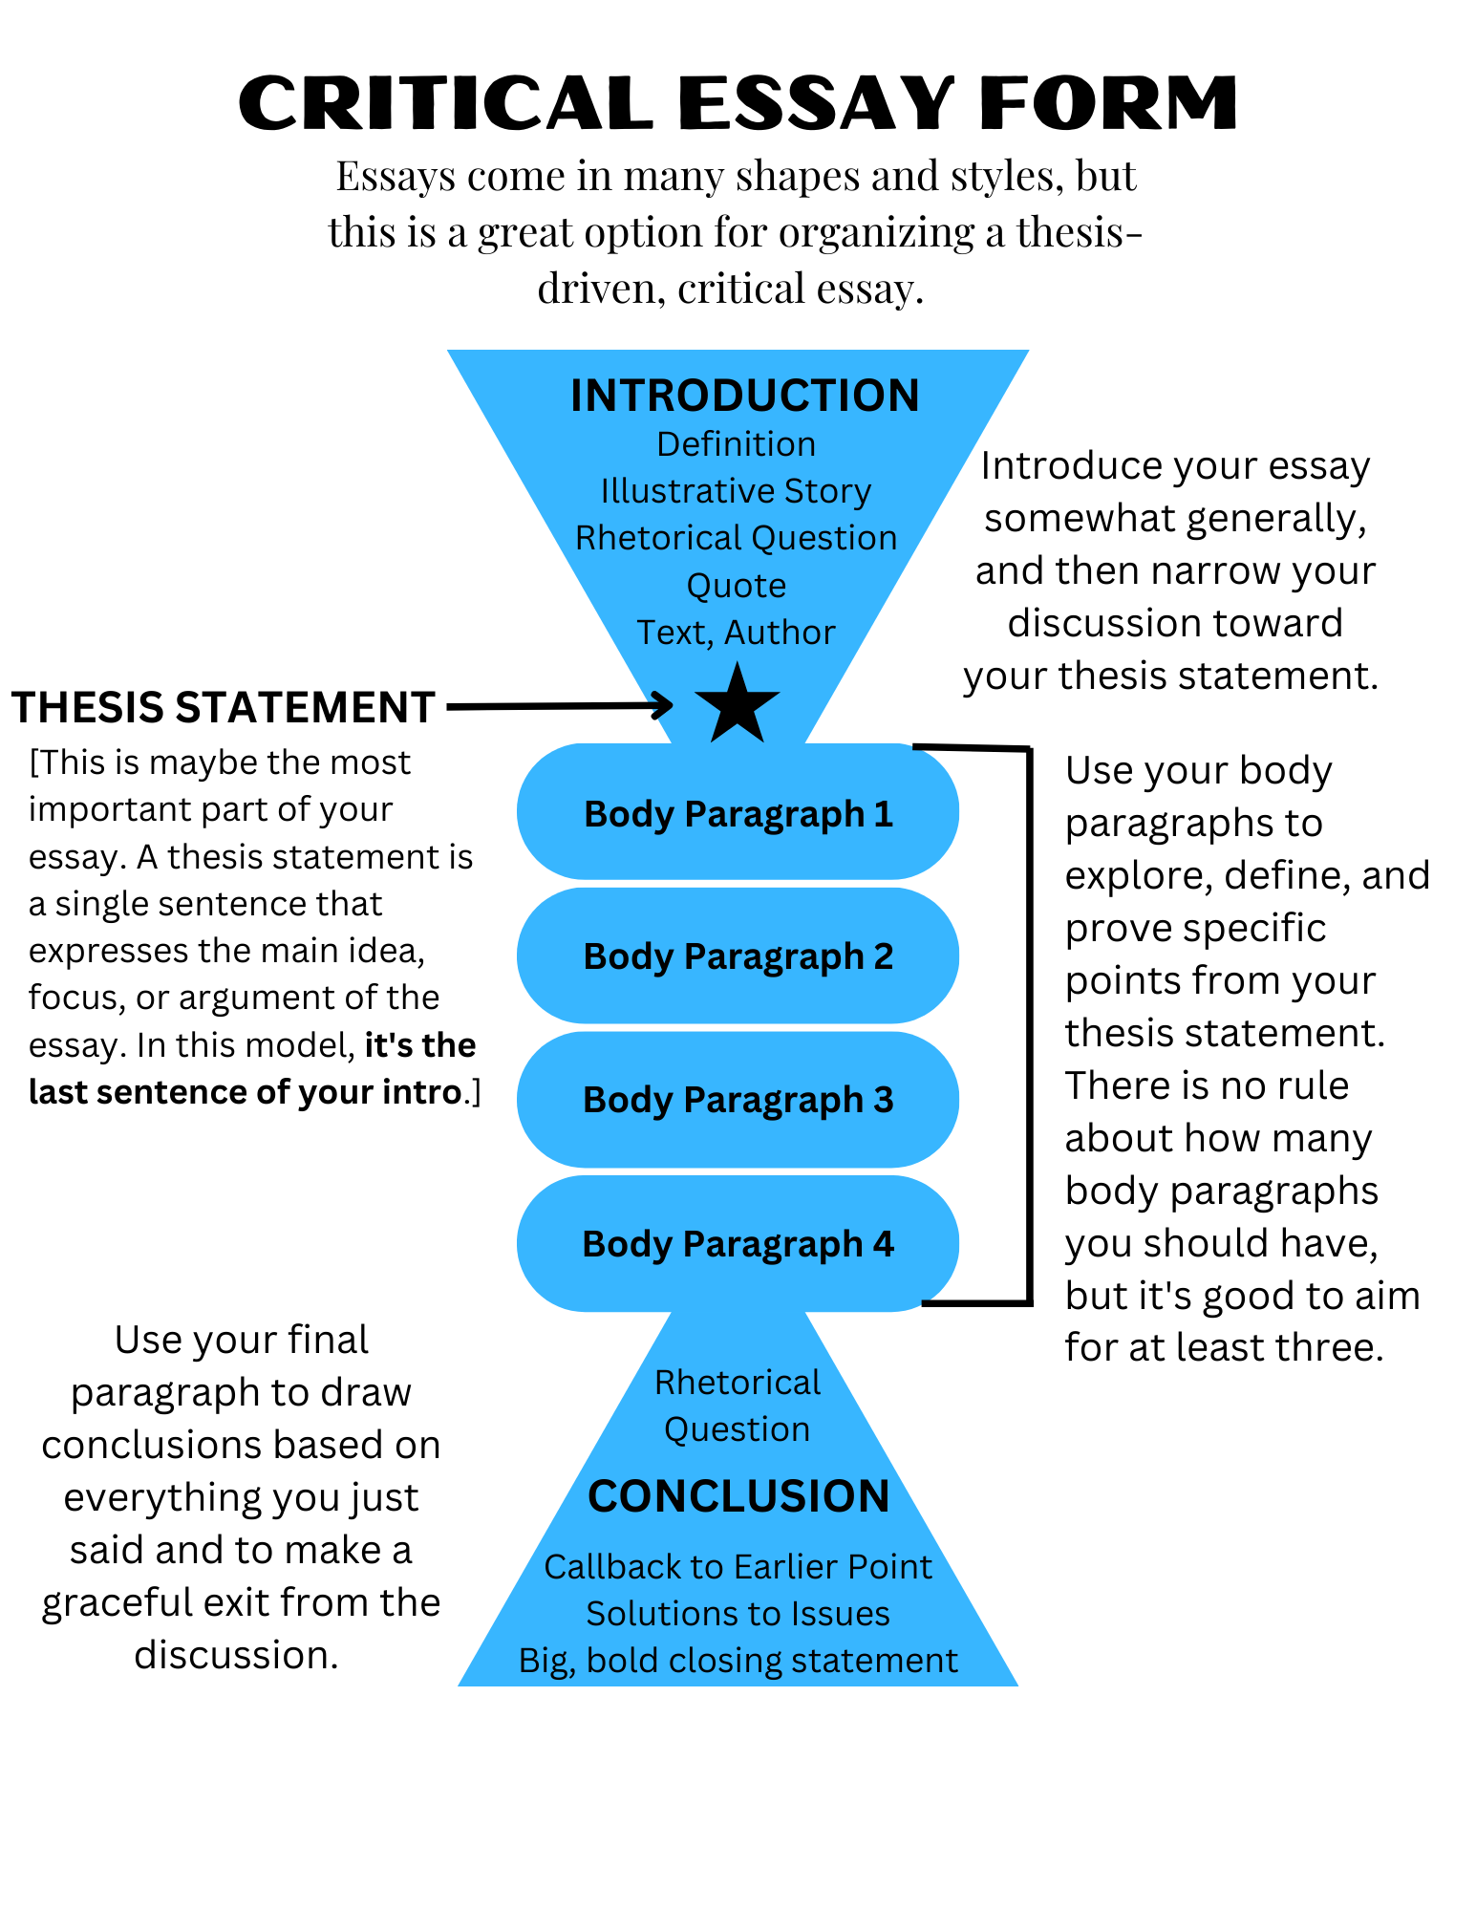
The form
The Critical Essay Form
1
Introduction
1
2
Thesis statement ★
2
3
Body paragraphs ← today
3
4
Conclusion
4
Notes:
Keep reinforcing the shape, so later in the year (or in other classes) they already carry the structure of a critical academic essay. Ask where the thesis goes: the last sentence of the intro. Not a hard rule for all writing, but it is for this essay.

Slide 14
STEP 4
Supporting Paragraphs
Let your thesis be your guide.
Notes:
Today: the body of the essay, the bulk of the work. It may take several class periods.

Slide 15
The rule
Everything after the thesis serves the thesis
Once you’ve dropped your thesis at the end of your introduction, everything you write must in some way support, define, or illustrate the elements within your thesis.
Notes:
Your job now that the thesis is down: illustrate, support and define the argument you put forth.

Slide 16
The good news
Your thesis is a roadmap
The good news is that your thesis statement tells you exactly where to go from here.
Notes:
It’s kind of amazing, actually. Let’s look at the sample essay’s thesis.

Slide 17
The sample essay’s thesis
Haley’s thesis
“
When schools fail to prioritize creativity in teaching, school becomes boring for both students and teachers, resulting in a lack of shared motivation, excitement, and accomplishment.
— Haley, “Bored in the USA”
Notes:
Read it aloud. Ask: how many distinct parts can you hear in this sentence?

Slide 18
Let your thesis be your guide
Break your thesis into its parts
THESIS
When schools fail to prioritize creativity in teaching, school becomes boring for both students and teachers, resulting in a lack of shared motivation, excitement, and accomplishment.
1
1st element: schools fail to prioritize creativity in teaching
2
2nd element: school becomes boring for both students and teachers
3
3rd element: a lack of shared motivation, excitement, and accomplishment
Notes:
Three distinct parts in Haley’s thesis. The first is her original observation; the second and third are her analysis. Now have students do the same on their own thesis: make sure they’re on the Body Paragraphs step and follow the Tutor’s instructions for breaking it into parts. Have them check they agree with how it’s split, and highlight each part in its own colour in their doc; the visual keeps them organized.

Slide 19
Let your thesis be your guide
These become your body paragraphs
THESIS
When schools fail to prioritize creativity in teaching, school becomes boring for both students and teachers, resulting in a lack of shared motivation, excitement, and accomplishment.
1
Body paragraph 1: schools fail to prioritize creativity in teaching
2
Body paragraph 2: school becomes boring for both students and teachers
3
Body paragraph 3: a lack of shared motivation, excitement, and accomplishment
Notes:
Body paragraph 1 is devoted only to how schools fail to prioritize creativity: examples, comments, analysis, "why is this the case?" Then paragraph 2 shows the consequence, school becomes boring, for both teachers and students. Then paragraph 3, the result. A very logical flow. Important: not every thesis has three parts. Two to four is usual, occasionally five, and one complex part can need two or three paragraphs. Don’t teach it like a required number of paragraphs, or students will think this is the 5-paragraph essay.

Slide 20

Basic structure of a body paragraph
One paragraph at a time
1
Transition sentence (optional)
2
Topic sentence: the element from your thesis you’re discussing
3
Supporting sentences: explanations, opinions and analysis, causes or effects, research (only if needed, and cite it), the 5 W’s
4
Concluding sentence: wrapping up your thoughts on this element
Notes:
Tell them: you’re not just writers, you’re thinkers who write; and you’re the architects of your essay, building it paragraph by paragraph. Not everyone believes they can write 2–4 pages, but everyone can write a paragraph when they know what it’s about. The topic sentence calls back to that part of the thesis. A transition can bridge from the paragraph before: "Not only does this lack of creativity exist in schools, but it also…" For support, the 5 W’s (who, what, where, when, why) are a quick way to analyze. Brian’s preference for the concluding sentence: a consequence of the point, not a "but wait, there’s more" tease of the next one. Leave this slide up while they write.

Slide 21
READ TOGETHER
Read Sample Essay
Watch each paragraph call back to one part of the thesis.
Notes:
Reread the sample essay together so students see exactly how Haley used her body paragraphs to expand each element of her thesis.

Slide 22
Sample essay
Introduction
THE THESIS IS IN ITALICS
Do you remember trying to learn how to ride a bike? It was exciting, blood rushing, and challenging, but worth it. When you got going but fell, you got back up and went a little further each time. You had more motivation to keep going because it was exciting. Schools today seem to lack this sense of excitement. Students have zero motivation to keep going because there is no excitement from the teachers and no sense of an end goal for the students. Shouldn't the process of learning be inspiring and exciting for everyone? When schools fail to prioritize creativity in teaching, school becomes boring for both students and teachers, resulting in a lack of shared motivation, excitement, and accomplishment.
Notes:
Start where the reader does: the introduction, ending on the thesis. Have students point to each of its three parts before you move on; each one gets a body paragraph.

Slide 23
Sample essay
Body paragraph 1
THESIS PART 1 · SCHOOLS FAIL TO PRIORITIZE CREATIVITY IN TEACHING
Visit most schools in America today and you’ll see how much creativity they really lack. Handouts, tests, and managing student behavior seem to be the priorities. Many teachers think if they allow creativity in a classroom, it will cause the students to be disruptive, and make it hard to gain control again. Administrators may also be to blame, if they don’t see the value of creative activities and discourage teachers from teaching in this way. However, the truth is that creative activities get students interested in subjects. When they are interested, they ask questions and want to learn more. In some cases, they may even find the thing they want to focus on in college or for a career.
Notes:
The first body paragraph calls back to the first element: "Visit most schools in America today and you’ll see how much creativity they really lack." Then: what are the priorities instead? Why don’t teachers prioritize creativity (fear of disruption)? Who else is to blame (administrators)? Finally, why it matters.

Slide 24
Sample essay
Body paragraph 2
THESIS PART 2 · SCHOOL BECOMES BORING FOR BOTH STUDENTS AND TEACHERS
The fact is, when students are not inspired creatively, they get bored. Have you ever walked into a classroom and seen students asleep? What about teachers who never get out of their seats to teach? This is very common in classrooms today. Students aren’t interested in the lessons because the teacher shows no signs of interest either. A lot of the time teachers just slap a packet of worksheets on students’ desks and tell them to do it. This does not sufficiently challenge them or encourage them. According to “The 74,” a nonprofit news organization covering American education, thirty-two percent of American students say they feel bored during class (www.the74million.org). They feel unconnected and unmotivated with the lessons. This affects teachers too, who also show signs of boredom by having a low monotone voice, never changing their teaching routine, and always being serious. This collective boredom between students and teachers makes school painful, when it could be energizing.
Notes:
Body paragraph 2: the consequence. Rhetorical questions, a real statistic with its source cited (The 74), and both halves of the element: students AND teachers.

Slide 25
Sample essay
Body paragraph 3
THESIS PART 3 · A LACK OF SHARED MOTIVATION, EXCITEMENT, AND ACCOMPLISHMENT
The issue at hand is the lack of shared motivation, excitement, and accomplishment among the teachers and students. Walking into a classroom today, especially after the pandemic, everyone seems so drained and unmotivated. Students got so used to learning everything through a screen for 2 years. Now all you see is students on their phones or asleep. This also severely affects teachers because they feel that there is no hope in teaching students while battling the students’ desire to constantly be connected with social media. Furthermore, many teachers appear to be disengaged with the students and even their profession. To remedy this, administrators should support teachers in teaching creatively. Projects instead of tests, fun activities instead of worksheets, and physical movement instead of sitting still can make class more engaging and fun. Not only would this increase student involvement, but it would also help teachers rediscover their love for teaching again. Making learning fun truly motivates everyone.
Notes:
Body paragraph 3: the result, and a turn toward a remedy (administrators supporting creative teaching), which sets up the conclusion nicely.

Slide 26
The house analogy
Your essay is a house, and you’re showing it
1
The neighborhood · Driving in, your reader gets a sense of where they are. That’s your introduction: context.
2
The front door · They step into the foyer and see the whole house at once. That’s your thesis statement.
3
The rooms · You walk them through, pointing out what makes each room worth it. Those are your body paragraphs.
4
Back at the door · You step out, point at the neighborhood, and leave gracefully. That’s your conclusion.
Notes:
Brian’s telling: imagine you’re a real estate agent and the goal is to sell the house. As the buyer drives in they notice the street, the sidewalks, the other houses; that’s the introduction creating context. They walk up the path and into the foyer: the thesis, where they can see the whole argument. You’d never stop there, so you walk them room by room (the body paragraphs), pointing out specific things that make the house worth buying. At the end you walk them back to the front door and point out the neighborhood again, maybe a neighboring house you won’t go into: new ideas you acknowledge without exploring. You place the house in the wider world and make a graceful exit. That’s the conclusion.

Slide 27
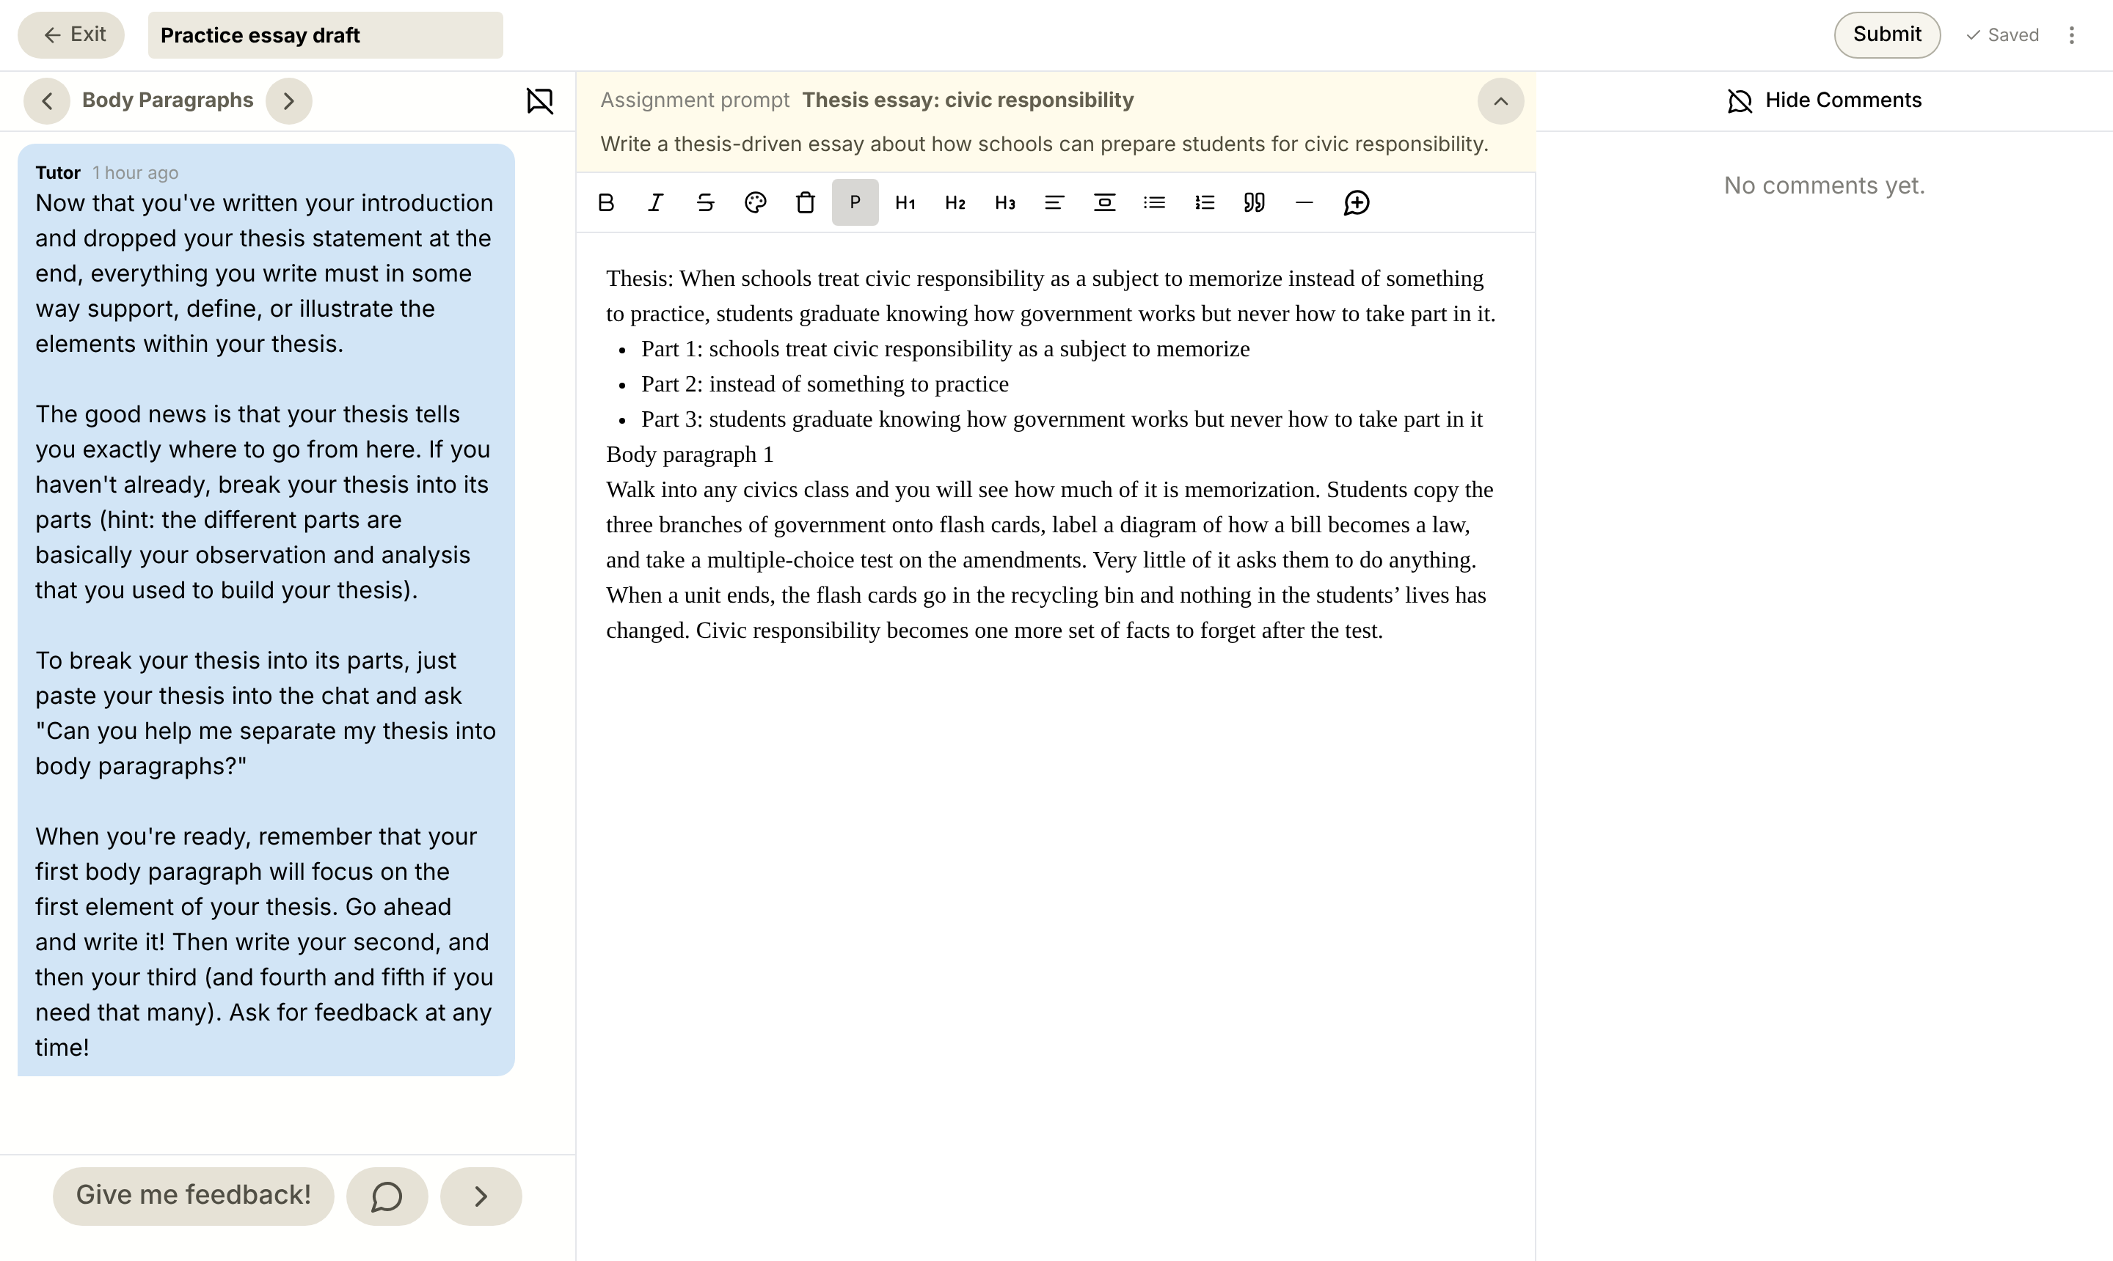
Your turn
What it looks like
1
The Tutor says Body Paragraphs
1
2
3
Your thesis, in its parts
2
One paragraph per part
3
Written one? Ask the Tutor for feedback
4
4
Notes:
Today’s YAWP! editor on the Body Paragraphs step. Students start with the first element of their thesis only. Work the room, read paragraphs, encourage; you’ll see confidence rise as the essays take shape. Celebrate it.

Slide 28
YAWP!
WRITING PROGRAM
Next time: conclusions.
Notes:
Body paragraphs can take several class periods. Before next class, read what students have and comment; check every paragraph calls back to one part of its thesis.

