Slide 1



Thesis-Driven Essay · Lesson 6
Conclusion
YAWP!
WRITING PROGRAM
Go beyond restating: draw a conclusion
Notes:
Most students should be near or at the end of their body paragraphs; make sure they’ve moved their documents to the "Conclusion Paragraph" step. Some will still be on body paragraphs, and that’s fine: teach this now so they know what to do when they get here. Students move at different paces at this point.

Slide 2
OPTIONAL
Quick Review
What we’ve learned so far, one question at a time.
Notes:
The review quiz starts here: this divider and the question-and-reveal pairs after it. Brian: "If that’s not your gig, delete the slides." Delete them together, or skip ahead to the lesson.

Slide 3

Review · 1 of 6
What’s the best way to write an essay?
a
Just start writing and hope some good ideas come out.
b
Take my ideas and plug them into a formula, like the 5-paragraph essay.
c
Develop my ideas into a thesis statement and build my essay around that.
d
ChatGPT, duh.
e
I have never actually written an essay, so I have no idea.
Notes:
Optional review quiz. Brian: "If that’s not your gig, delete the slides." If you keep it, make it a game: read the question, take answers, then click to the reveal. Candy or other small prizes help. Answer: Develop my ideas into a thesis statement and build my essay around that.

Slide 4
Review · 1 of 6
What’s the best way to write an essay?
a
Just start writing and hope some good ideas come out.
b
Take my ideas and plug them into a formula, like the 5-paragraph essay.
c
Develop my ideas into a thesis statement and build my essay around that.
d
ChatGPT, duh.
e
I have never actually written an essay, so I have no idea.
Notes:
The reveal. Develop my ideas into a thesis statement and build my essay around that.

Slide 5
Review · 2 of 6
Critical thinking is best defined as:
a
Asking questions and seeking answers about a topic in order to develop a position on it
b
Finding all of the weaknesses in an argument
c
Finding all of the strengths in an argument
d
Arguing a specific point of view in front of an audience
e
Researching experts’ perspectives and arguments on a topic in order to develop a position on it
Notes:
Optional review quiz. Brian: "If that’s not your gig, delete the slides." If you keep it, make it a game: read the question, take answers, then click to the reveal. Candy or other small prizes help. Answer: Asking questions and seeking answers about a topic. The same thing they did with the photo and in their pre-write.

Slide 6
Review · 2 of 6
Critical thinking is best defined as:
a
Asking questions and seeking answers about a topic in order to develop a position on it
b
Finding all of the weaknesses in an argument
c
Finding all of the strengths in an argument
d
Arguing a specific point of view in front of an audience
e
Researching experts’ perspectives and arguments on a topic in order to develop a position on it
Notes:
The reveal. Asking questions and seeking answers about a topic. The same thing they did with the photo and in their pre-write.

Slide 7
Review · 3 of 6
Which of the following is MOST TRUE about a good thesis statement?
a
A good thesis statement is easy for the reader to agree with.
b
A good thesis statement contains 2–3 pieces of support.
c
A good thesis statement contains observation and analysis.
d
A good thesis statement contains research and facts.
e
A good thesis statement is 1–2 sentences long.
Notes:
Optional review quiz. Brian: "If that’s not your gig, delete the slides." If you keep it, make it a game: read the question, take answers, then click to the reveal. Candy or other small prizes help. Answer: Observation and analysis. Some students (and some of us) will pick B, the 5-paragraph-essay answer; our thesis is going to be more complex than a three-pronged list.

Slide 8
Review · 3 of 6
Which of the following is MOST TRUE about a good thesis statement?
a
A good thesis statement is easy for the reader to agree with.
b
A good thesis statement contains 2–3 pieces of support.
c
A good thesis statement contains observation and analysis.
d
A good thesis statement contains research and facts.
e
A good thesis statement is 1–2 sentences long.
Notes:
The reveal. Observation and analysis. Some students (and some of us) will pick B, the 5-paragraph-essay answer; our thesis is going to be more complex than a three-pronged list.

Slide 9
Review · 4 of 6
Your introduction paragraph’s MAIN function is to:
a
Tell a story that illustrates the topic of your essay
b
Give specific examples that support your thesis
c
Define important terms that your reader may need to know
d
Present questions that your essay will answer
e
Welcome your reader into your discussion and state the thesis
Notes:
Optional review quiz. Brian: "If that’s not your gig, delete the slides." If you keep it, make it a game: read the question, take answers, then click to the reveal. Candy or other small prizes help. Answer: Welcome the reader in and state the thesis. A, C and D are styles an intro can use, not its job.

Slide 10
Review · 4 of 6
Your introduction paragraph’s MAIN function is to:
a
Tell a story that illustrates the topic of your essay
b
Give specific examples that support your thesis
c
Define important terms that your reader may need to know
d
Present questions that your essay will answer
e
Welcome your reader into your discussion and state the thesis
Notes:
The reveal. Welcome the reader in and state the thesis. A, C and D are styles an intro can use, not its job.

Slide 11
Review · 5 of 6
Which of the following would probably NOT show up in your body paragraphs?
Supporting quotations about specific points
a
Your opinions
b
Your thesis statement
c
Analysis of other people’s arguments
d
Notes:
Optional review quiz. Brian: "If that’s not your gig, delete the slides." If you keep it, make it a game: read the question, take answers, then click to the reveal. Candy or other small prizes help. Answer: Your thesis statement. It lives at the end of the introduction; the body paragraphs support, define and illustrate its parts.

Slide 12
Review · 5 of 6
Which of the following would probably NOT show up in your body paragraphs?
Supporting quotations about specific points
a
Your opinions
b
Your thesis statement
c
Analysis of other people’s arguments
d
Notes:
The reveal. Your thesis statement. It lives at the end of the introduction; the body paragraphs support, define and illustrate its parts.

Slide 13
Review · 6 of 6
True or False: a good conclusion restates your thesis and main ideas.
True
a
False
b
Notes:
Optional review quiz. Brian: "If that’s not your gig, delete the slides." If you keep it, make it a game: read the question, take answers, then click to the reveal. Candy or other small prizes help. Answer: False. Restating can feel very repetitive. A good conclusion offers final reflection, arguments, or a call to action based on everything you just said.

Slide 14
Review · 6 of 6
True or False: a good conclusion restates your thesis and main ideas.
True
a
False
b
Notes:
The reveal. False. Restating can feel very repetitive. A good conclusion offers final reflection, arguments, or a call to action based on everything you just said.

Slide 15
STEP 5
Conclusion Paragraph
A graceful exit.
Notes:
Ah, the conclusion. So difficult and annoying for so many students, largely because we were all taught to restate the thesis and main ideas.

Slide 16
Myth
Myth
A good conclusion restates the thesis and main ideas of the essay.
Notes:
Even if you were taught this (or taught it yourself), accept that it’s a bland, unimaginative ending. It makes sense for a speech or a sales pitch, where an audience retains a fraction of what they hear: "my floors look better, cost less, and are greener… so in conclusion, my floors are the best." A critical essay is on the page, for an intelligent reader who can reread.

Slide 17

Fact
Fact
Restating your thesis and main ideas can make you seem like an alien.
Notes:
"Yeah, man, I was there with you. I just read your whole essay, and now you’re repeating it to make sure I got it?"

Slide 18
Let’s reassess the word
Conclusion (noun)
DEFINITION 1
DEFINITION 2
An ending.
A deduction drawn from available information.
Notes:
Our conclusion paragraph does mark the end of the essay, but it’s more than an ending: it’s a deduction from everything we just said.

Slide 19
Conclusion paragraph
So, what can you deduce?
By the end of your essay, you should have exhaustively defined, illustrated, and proven the elements of your thesis. And your reader should be right there with you. So if everything you just said is true, then what deductions, or conclusions, can you draw from it all?
Notes:
Let the class sit with the question for a moment before moving on.

Slide 20
Conclusion paragraph
Is your essay about a problem?
If your essay discusses a problem, this could be a great place to discuss solutions to that problem.
Notes:
Especially relevant for the "problem in your community" prompt.

Slide 21
Pro-tip
Begin with a rhetorical question
Rhetorical questions can create a nice shift in a discussion or argument. For example, in the sample essay on education, Haley began her conclusion paragraph with the following…
Notes:
Remind them what a rhetorical question really is: a question asked so the writer can supply the answer they want the reader to hear.

Slide 22
Haley’s question
How the sample essay’s conclusion begins
“
If we assume that teachers don’t like to be boring, then why doesn’t the education system teach them how to prioritize creative thinking in classrooms?
— Haley, “Bored in the USA” (read the conclusion together)
Notes:
Read Haley’s whole conclusion together: a shared reference point for what comes next.

Slide 23
Pro-tip
Many a good conclusion begins with “Perhaps”
It’s assertive and smart without being aggressive, and it fits a conclusion’s tone: comfortable and confident. With “perhaps,” you can offer ideas (even new ones) without new support. The support is already in your essay.
Notes:
"Perhaps this… but maybe not. I’m just throwing it out there." Students may introduce a new idea here as food for thought on the way out; they don’t need to write a whole new essay about it.

Slide 24
Statement of “perhaps”: example
The question, then “perhaps”
FROM THE SAMPLE ESSAY
If we assume that teachers don’t like to be boring, then why doesn’t the education system teach them how to prioritize creative thinking in classrooms?
Perhaps the way teachers are taught today is wrong. They put too much pressure on teachers to increase scores, and this trickles down to the students, and suddenly everything we do in school is about “the test.”
Notes:
Haley hasn’t talked about how teachers are taught anywhere in her essay. It’s a new idea, offered as she exits. She could write a separate essay about it; she doesn’t have to. Really thoughtful.

Slide 25
Suggested conclusion structure
A conclusion that works
1
Rhetorical question
2
Answer it directly (“Perhaps…”)
3
2 sentences of opinion or analysis
4
Supporting quote (if working with a text)
5
Final, concluding sentence: the big, final point
Notes:
Five moves, in order. The question creates a shift; "Perhaps" lets students offer a deduction (even a new idea) confidently without having to prove it all over again; then two sentences of their own analysis, a quote if they have a text, and one big closing line.

Slide 26
Putting it together
Haley’s conclusion
QUESTION AND BIG FINAL POINT IN COLOUR · “PERHAPS” HIGHLIGHTED
If we assume that teachers don’t like to be boring, then why doesn’t the education system teach them how to prioritize creative thinking in classrooms? Perhaps the way teachers are taught today is wrong. They put too much pressure on teachers to increase scores, and this trickles down to the students, and suddenly everything we do in school is about “the test.” No one can learn under those conditions. However, if administrators and teachers prioritized creative lessons, we could build engagement and excitement between the teachers and students. Imagine the impact this could have on student learning and the teaching profession!
Notes:
Walk the structure: the rhetorical question; the "perhaps"; a few sentences of opinion and reaction; the solution ("if administrators and teachers prioritized creative lessons…"), the antidote to everything she has argued; then the big final sentence. On the Critical Essay Form the conclusion is the upside-down funnel: specific back out to big. "Imagine the impact this could have on student learning and the teaching profession!"

Slide 27
The house analogy
End the tour gracefully
DON’T
DO
Walk them back through every room: “Remember the kitchen?”
Push them out a second-floor window and yell “Tour’s over!”
Take them out to the back deck, or back to the front door.
Point out the neighborhood, maybe a house next door you won’t visit. Then say a thoughtful goodbye.
A graceful exit
Notes:
You’ve toured them through the living room, the kitchen, the bedrooms. You wouldn’t scream and run away (what many students do), and you wouldn’t repeat the tour. Instead, a back deck: there’s a little bit more. Or the front door, pointing at the neighborhood: some ideas, even new ones, you acknowledge without exploring, placing your house in the greater neighborhood and world. Leave this slide up while students write.

Slide 28
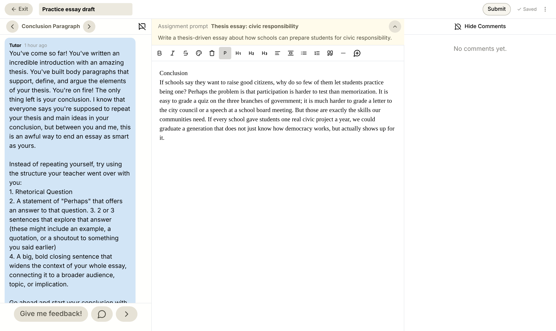
Your turn
What it looks like
1
The Tutor says Conclusion Paragraph
1
2
3
Start with a rhetorical question
4
2
3
Answer it: “Perhaps…”
End on your big, final point
4
Notes:
Today’s YAWP! editor on the Conclusion Paragraph step. This part usually goes fast: once body paragraphs are done they’re in the home stretch. As you work the room, watch the rhetorical questions. Some will be too simple or lead nowhere; help them find a relevant question that springboards their final thoughts. For many students this is the first conclusion like this they have ever built.

Slide 29
YAWP!
WRITING PROGRAM
Next time: titles and finishing touches.
Notes:
Students who finish can reread their whole essay from the top.

