Slide 1
Check-In Nuggets
RX 2026
2
1
3
4
Tips from the Trenches
5
Jim Michael | The Crossing | St. Louis, MO

Slide 2
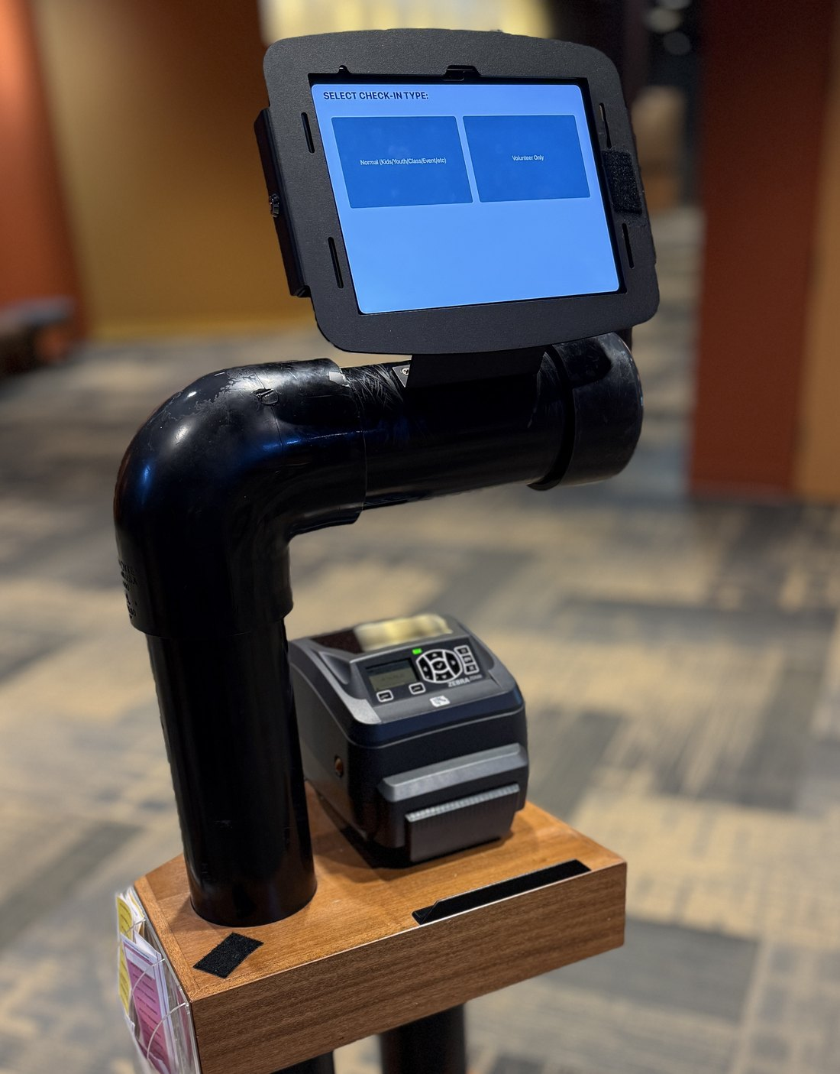



Ten+ years running Rock check-in
4
2015
iPad
campuses near St. Louis
on Rock RMS since
20 kiosks

Slide 3




Where are you with check-in?
Classic
Nextgen
Evaluating
On borrowed time
Already made the move
Not on Rock yet, just looking

Slide 4


Where we’re headed
This session IS
This session IS NOT
Lessons and tips the docs don't cover
Things we find useful: take the ones that fit, forget the ones that don’t
Most apply to both Classic and Nextgen check-in
A tutorial on configuring check-in
(every church does it different)
A Classic-vs-Nextgen sales pitch
(or is it?)
A live demo: everything here is screenshots

Slide 5
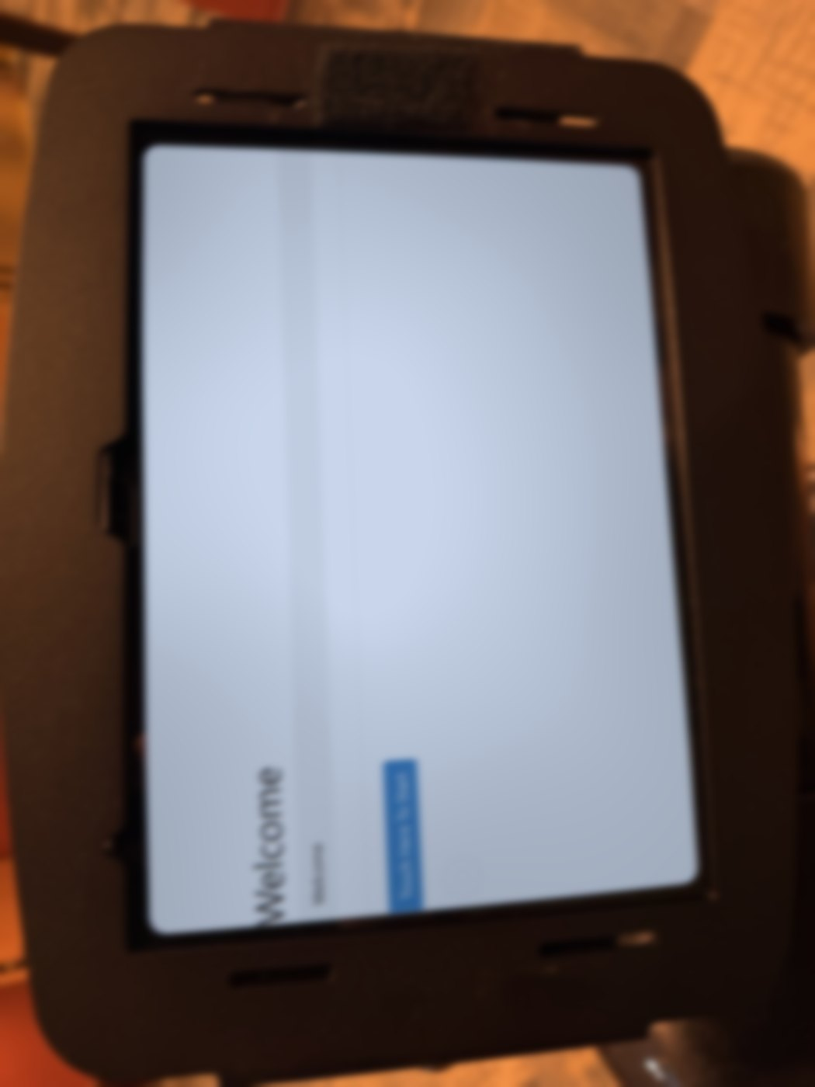
Ever gotten this text?
8:52
Done
KV
KidsCrossing Volunteer ›
iMessage
Sun 8:52 AM
Hey Jim, sorry to bother you on a Sunday
What's up?
CHECK-IN IS DOWN!! Everything looks weird
Sunday, 8:52 AM. Service starts at 9:00.
Oh no. What are you seeing?
Uh… any chance the Theme got changed?
Yeah it wouldn't print, so I tried a different theme
So is it just this one kiosk, or all of them?
Just this one
Ok. So, try this…
+
iMessage

Slide 6
Front-End Launcher
NUGGET 1
1
Automatic kiosk configuration without user error

Slide 7
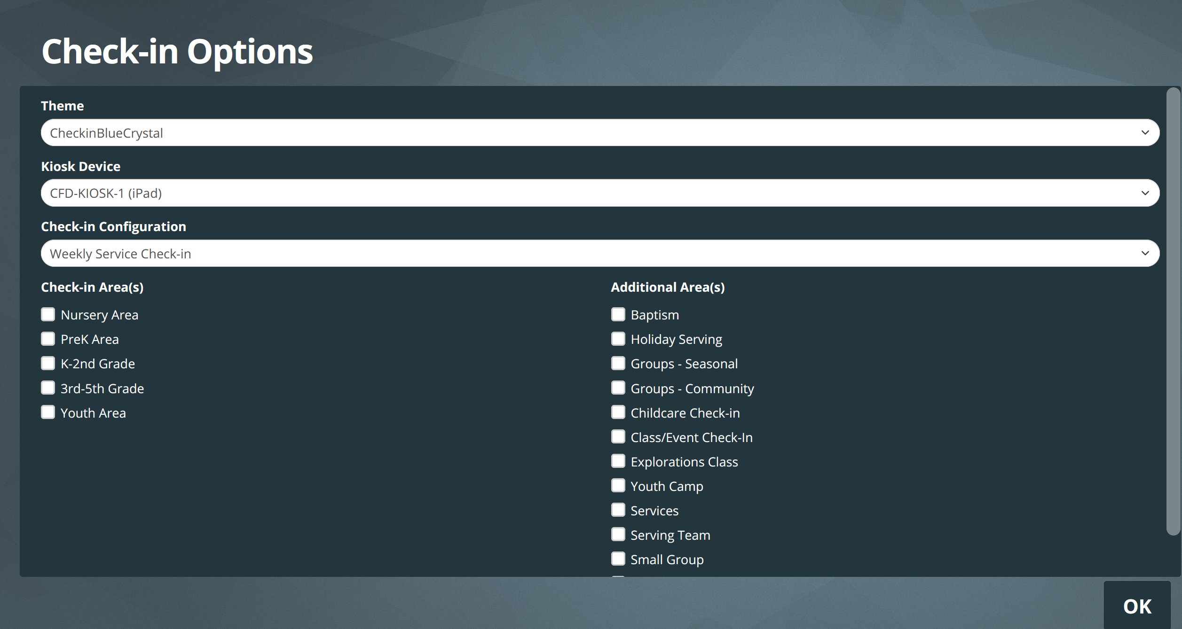
Classic: Every kiosk set up by hand
1
Any theme, anytime
Remember our volunteer's “fix”?
1
2
2
Pick the wrong kiosk
Labels print on another station's printer
3
4
Pick the wrong config
A kids' kiosk runs volunteer check-in, or the reverse
3
4
Check the right boxes
Miss one and a class vanishes. Add one and the wrong groups appear.
Every kiosk is set up from scratch, by whoever is standing there.
Every dropdown and checkbox is a chance to get it wrong.

Slide 8
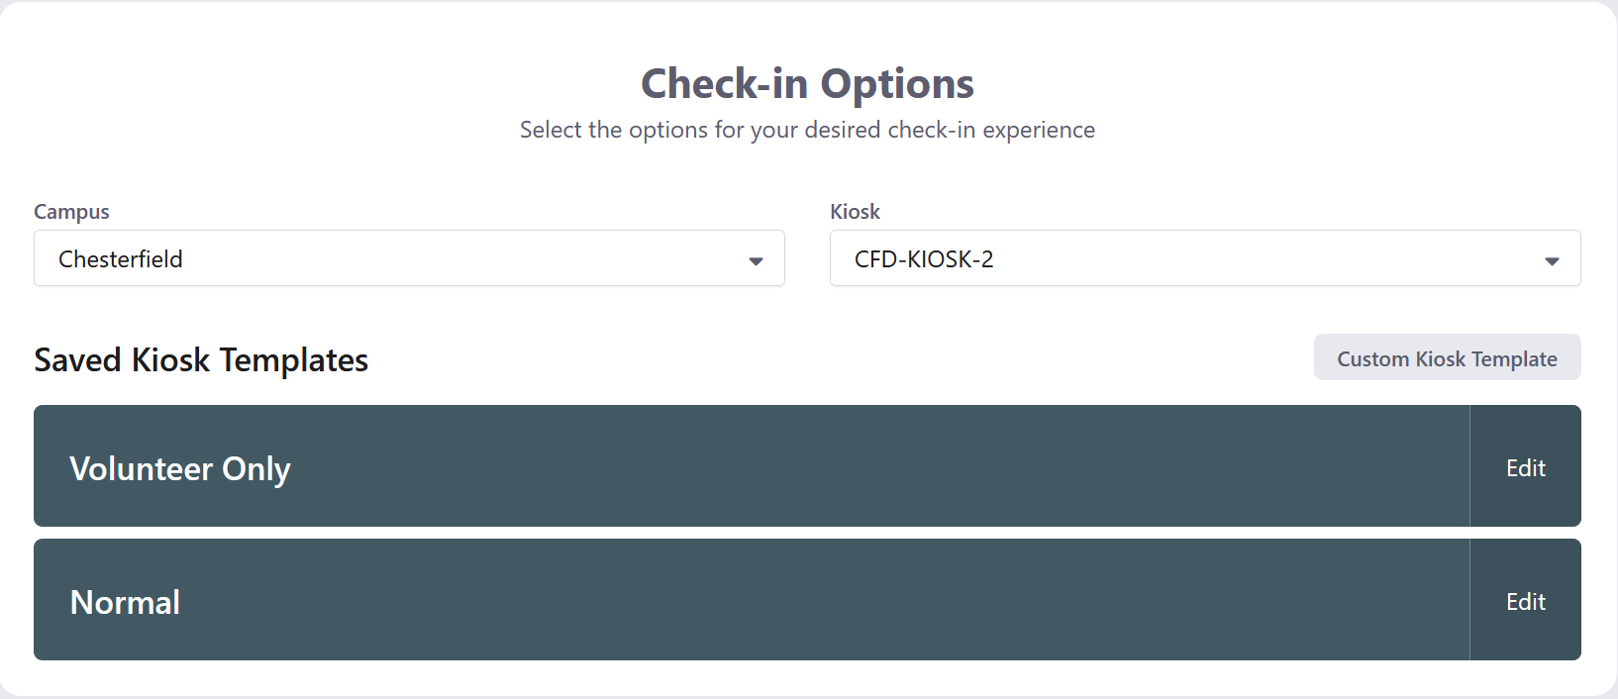
Nextgen: Saved Kiosk Templates help, but…
1
Chosen on every device
Campus and kiosk are still picked by hand
1
2
Editable at the kiosk
Anyone can change a saved template's options
3
2
3
Or skip templates
Build a custom setup with any options
Better than Classic, but staff or volunteer can still change (mess up) almost everything.

Slide 9
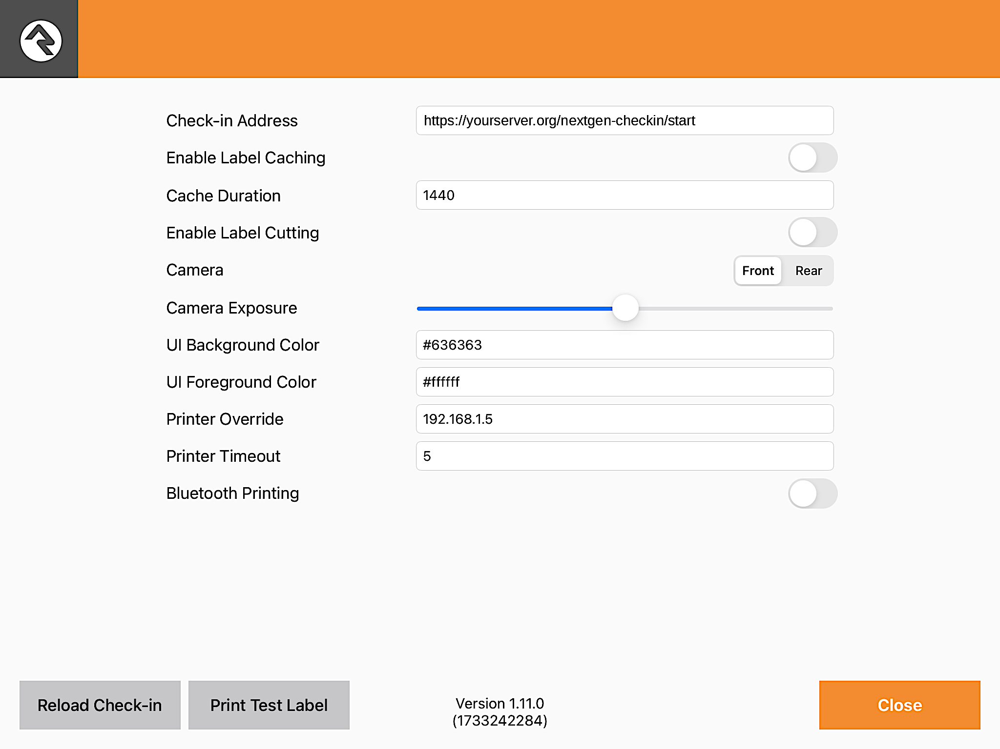
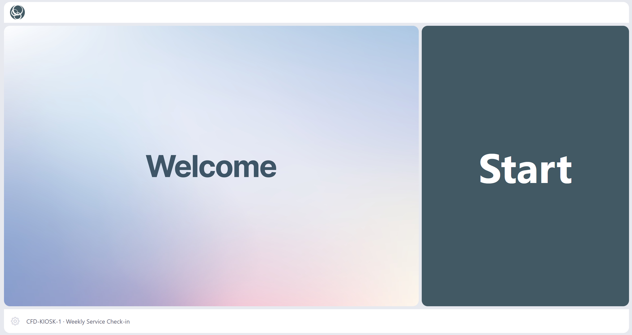
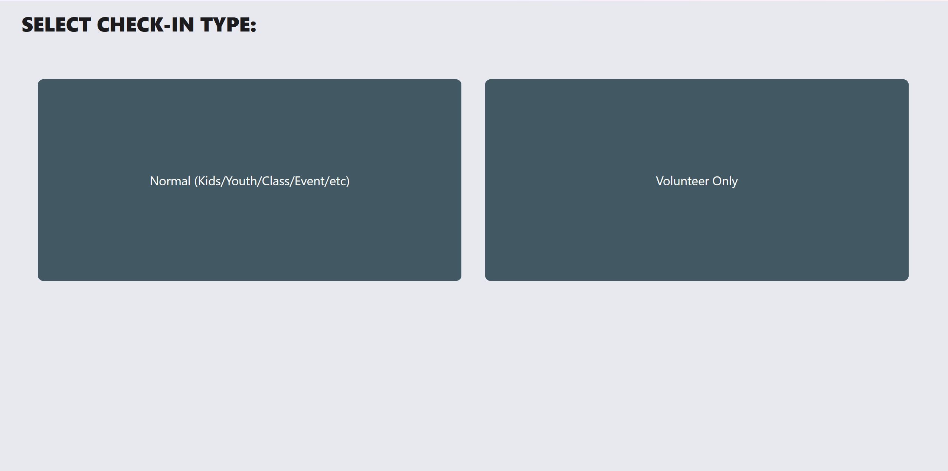



A better way
iPad
Launcher page
Check-in
Rock check-in app, pointed at the launcher page
( /nextgen-checkin/start )
A Rock page; buttons come from a Defined Type
Opens fully configured via URL parameters
No way for someone to choose the wrong settings. (Unless they click the wrong button)

Slide 10
The key: check-in reads its setup from the URL
Parameter | What it sets | Required?
KioskId | Which kiosk (Device record Id) | No, if Rock can identify the kiosk itself (next slide)
CheckinConfigId | Check-in configuration | Yes, unless KioskId and GroupTypeIds are both passed
GroupTypeIds | Check-in areas, comma-separated | Yes
Theme | Check-in theme | Optional
Pass a complete set and check-in skips the setup screen. Each launcher button is just one of these URLs.

Slide 11
No KioskId? Rock guesses by IP
CAMPUS NETWORK
Rock (cloud)
Request from:
203.0.113.10
INFORMAL POLL · 19 ROCK STARS · #ROCK-STARS CHAT, OCT 2026
iPad 1
10.10.66.41
How do you run your kiosks?
KioskId=12
iPad 2
10.10.66.42
Firewall / NAT
203.0.113.10
DEVICES IN ROCK
CLIENTS
CLOUD PRINT
KioskId=13
10 vs 9
18
2
Which kiosk is this?
All three look the same.
KioskId=12
That’s iPad 1. ✓
iPad 3
10.10.66.43
3 kiosks → 1 public IP
KioskId=14
one per kiosk vs shared
of 19 run iPads
of 19 use it
Windows or browser at manned stations
The rest: IP Override, VPN, or local printing
Pass KioskId. Rock never has to guess. IP lookup can only tell kiosks apart when Rock sees each one’s own IP (on-prem or VPN).

Slide 12
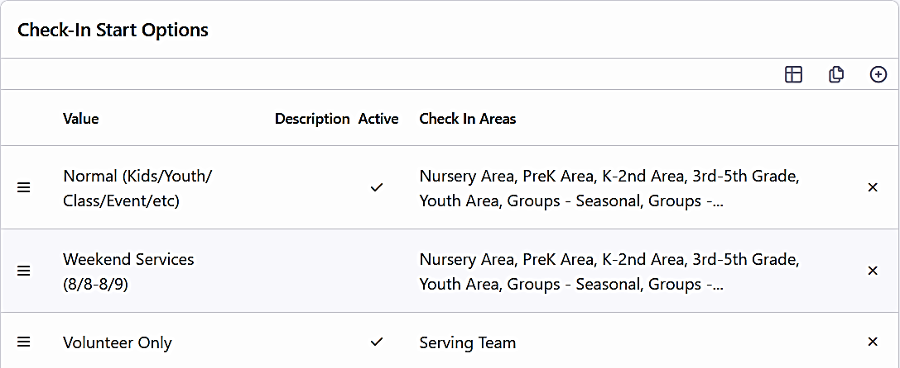
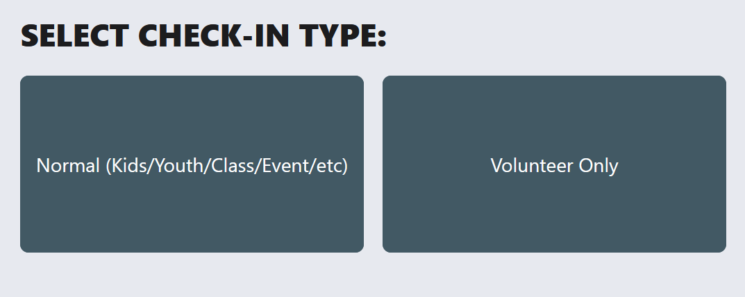
How it actually works
1
The list
2
The button
3
The link
/nextgen-checkin/setup
?KioskId=12
&CheckinConfigId=14
&GroupTypeIds=18,19
&Theme=NextGenCheckin
A Defined Type in Rock. Each row is one check-in setup.
The launcher page draws one button per row.
Behind each button: a link with the setup built in.
Point each client at the launcher once. After that, every new setup is just a new row in Rock.

Slide 13
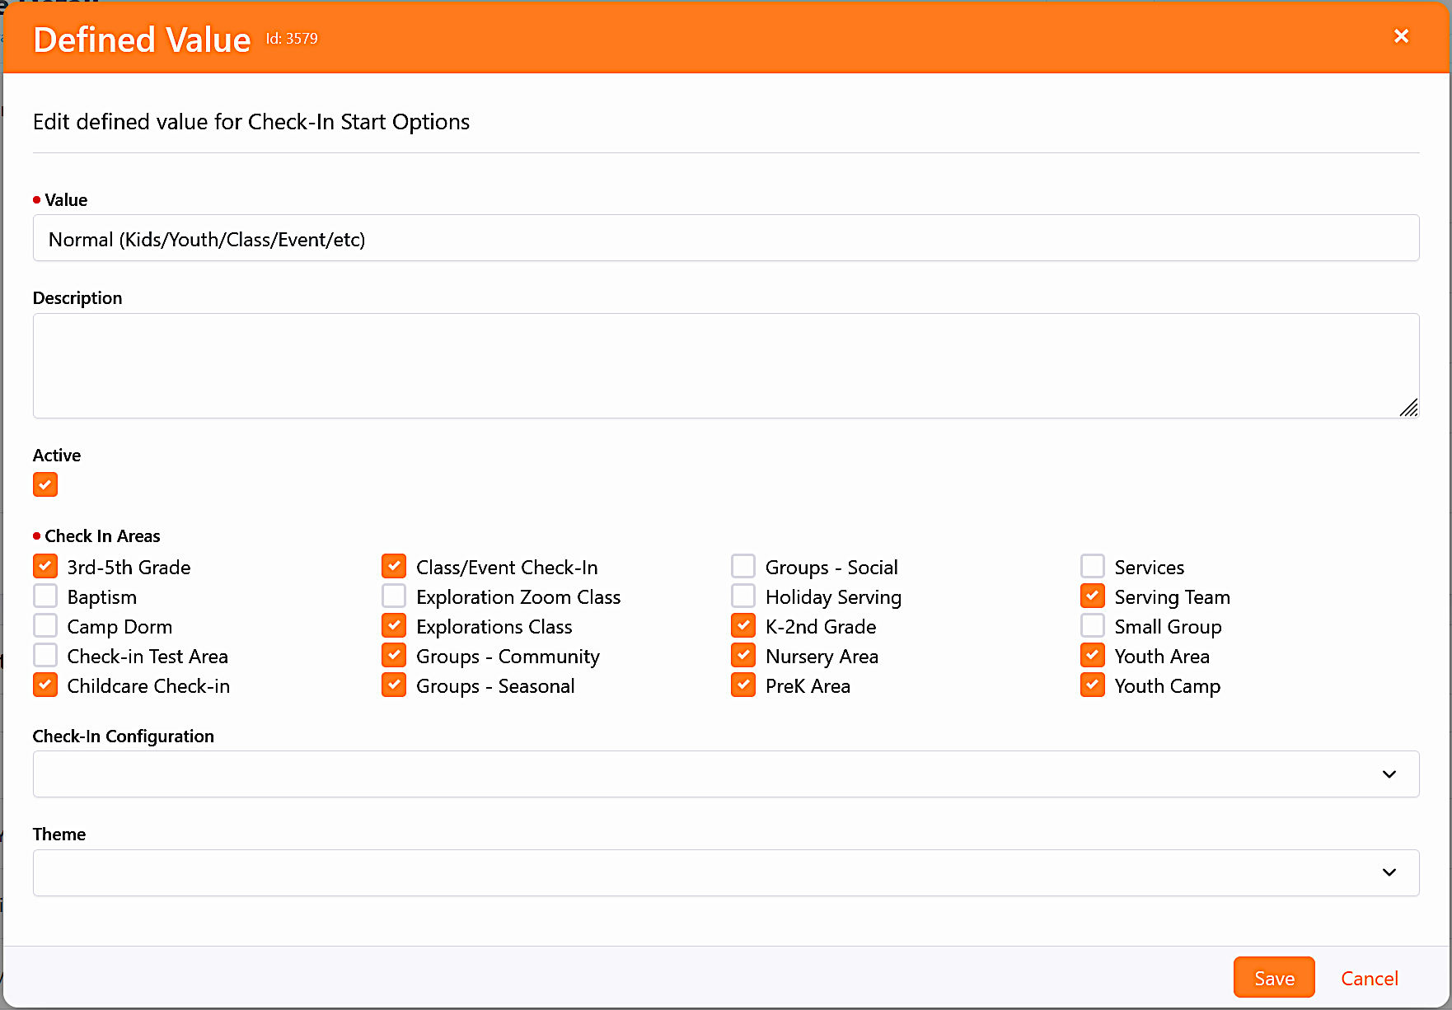
Adding a button is easy
1
Name the button
This text is the button volunteers tap
1
2
Pick the areas
Becomes GroupTypeIds in the link
2
Pick the configuration (optional)
Becomes CheckinConfigId
3
3
Pick the theme (optional)
Becomes Theme
4
4
Save it. Every kiosk has the new button on its next tap. No page edits, no trips to the kiosks.

Slide 14
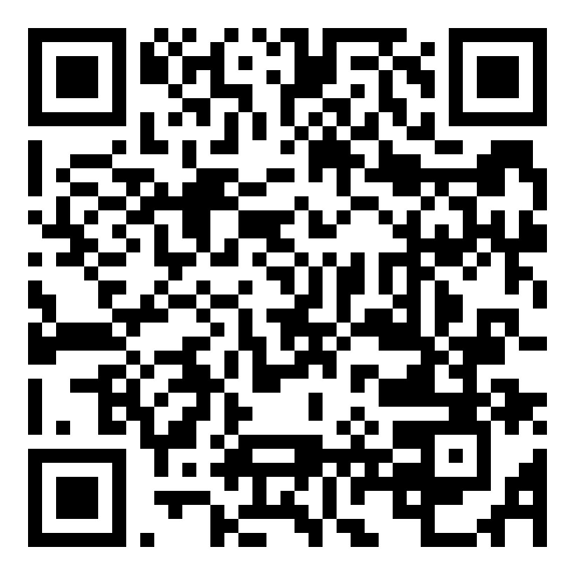
Here’s the Launcher we use
The Carrot? It’s Nextgen-only ☺
Classic (WebForms) check-in is removed in Rock v21, planned for the first half of 2027.
You have to move anyway. You might as well get the launcher out of it.
Source: community.rockrms.com/feature-retirement
GET THE CODE
github.com/The-Crossing-Rock-Community/
rock-checkin-nuggets

Slide 15
Tokenize the Check-In Login
NUGGET 2
2
Kiosks that never ask for a password at 8:45 on Sunday

Slide 16



Idle kiosks can forget who they are
Day 0
Weeks pass
~30+ days
Sunday 8:45
Kiosk logged in and working
Kiosk sits in a closet (VBS, Christmas, a spare)
Auth expires on the idle device
Login prompt. Volunteer has no idea what the password is
Passwords also (potentially) expire, get rotated, or get locked out.

Slide 17



Put a long-lived token in a ShortLink
Check-in user
Multi-year token
ShortLink
Every iPad
A dedicated account used only by kiosks
Generated once for that account
Token appended to the target URL
Logs in automatically on launch
Decoupled
Kiosk auth no longer depends on any password
Centralized
Rotate the token in one place: the ShortLink
Silent
No prompts, even after months on a shelf

Slide 18
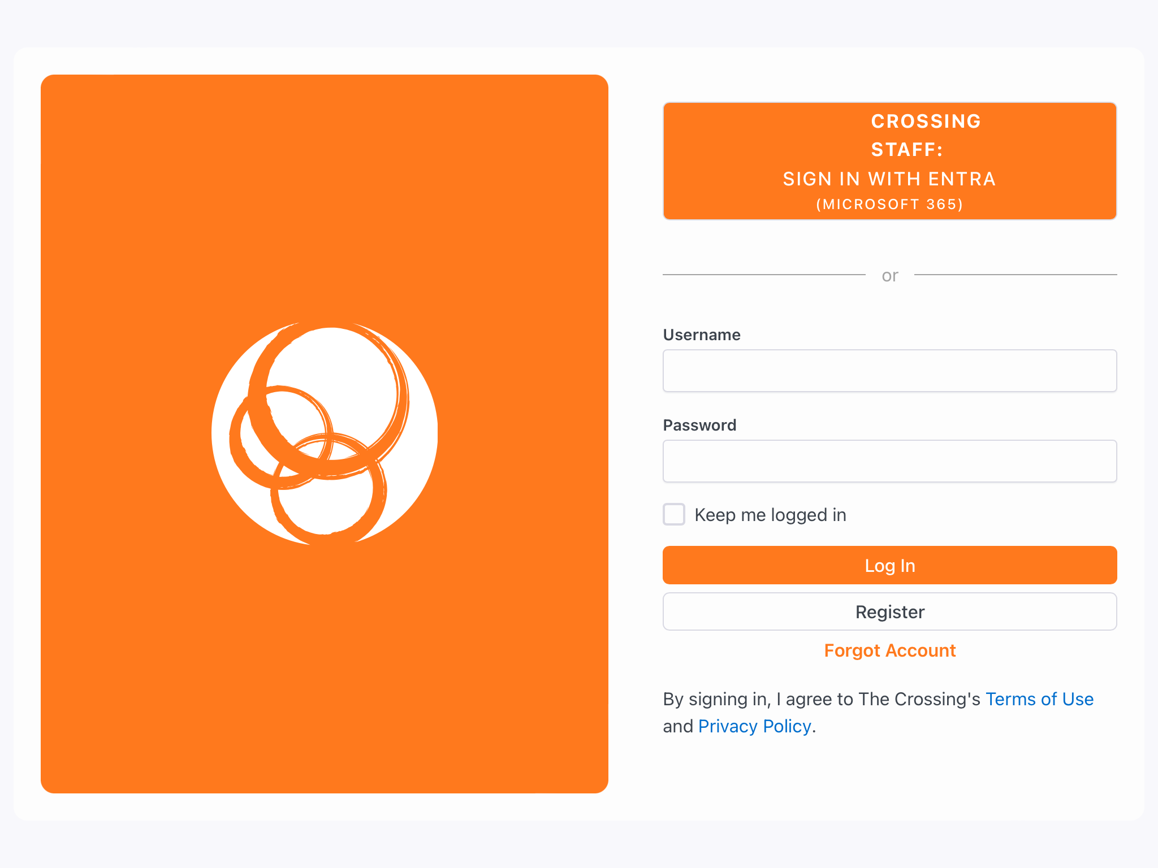
Why we went back to Keep Me Logged In
iPadOS 26 broke it
Check-in apps began randomly asking for a login again, especially if they’d been sitting a few days.
(Claude’s) Best guess: iPadOS 26 “evicts” session cookies more aggressively.
It was a security hole
To hand a client its token, the page/shortlink that serves the link must be unauthenticated.
Anyone who knows that URL is logged in to check-in. 😱
Saved Logins just work
A normal login stays signed in as long as the kiosk is used within 30 days (super-rare).
Only check-in clients have the auth cookie stored.

Slide 19
One Character
NUGGET 3
3
How a single character can make or break your check-in printers

Slide 20
Sunday, 8:30 a.m.
The first label of the morning jams in the cutter.
Clear it, reprint, and everything after prints fine.
Intermittent
Not every printer, not every morning
Looks like hardware
So the printer gets blamed, or replaced
It isn't hardware
It's one character in a setting

Slide 21
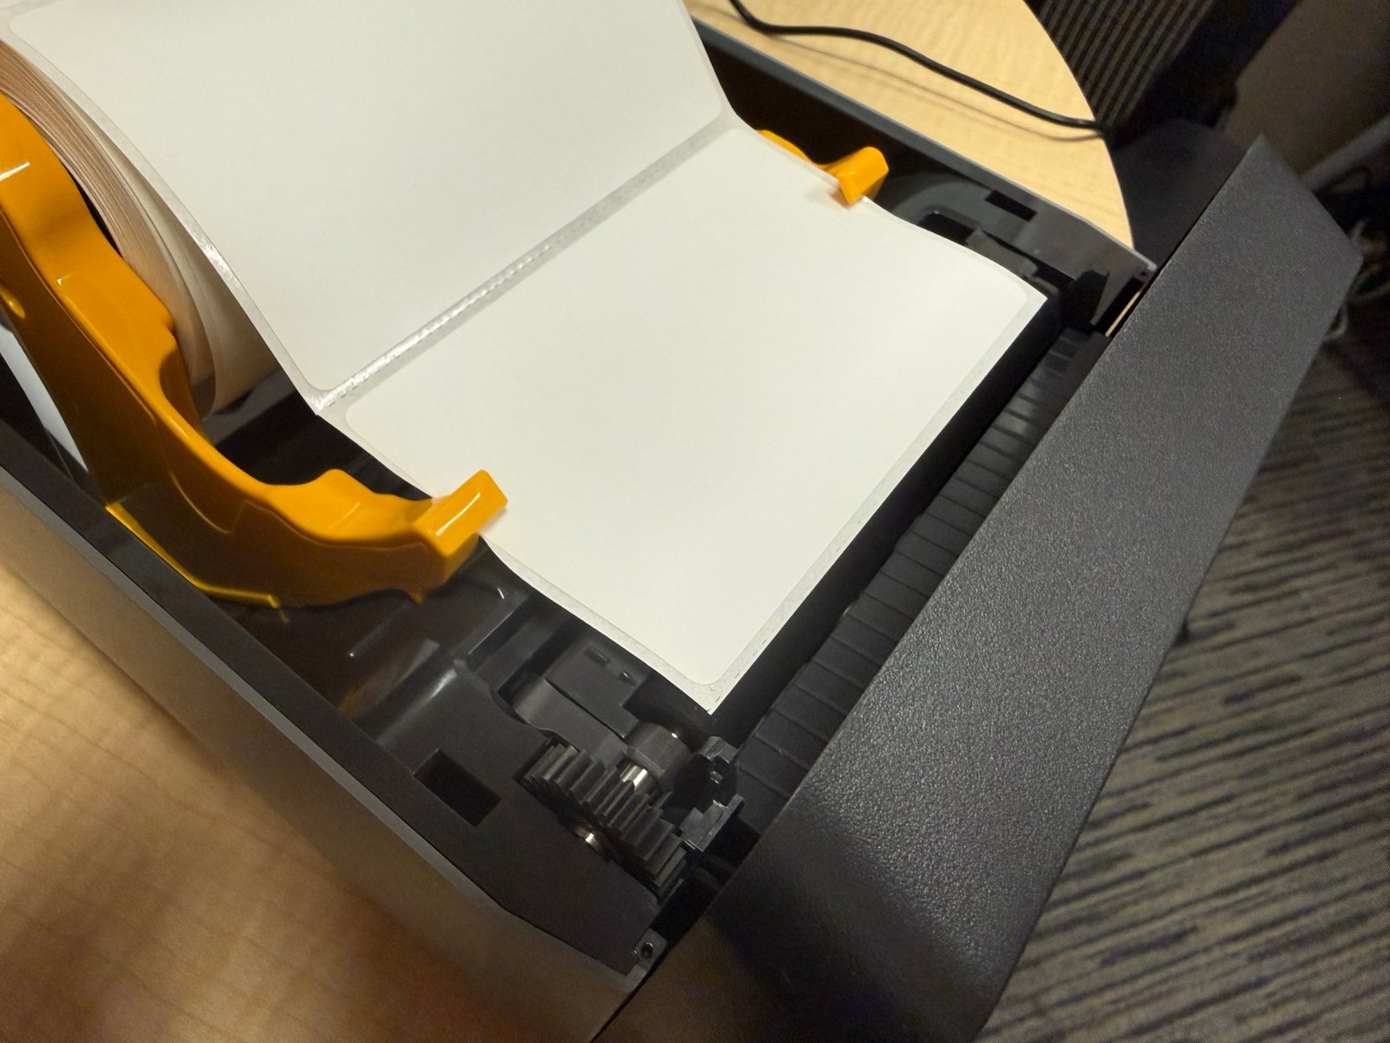
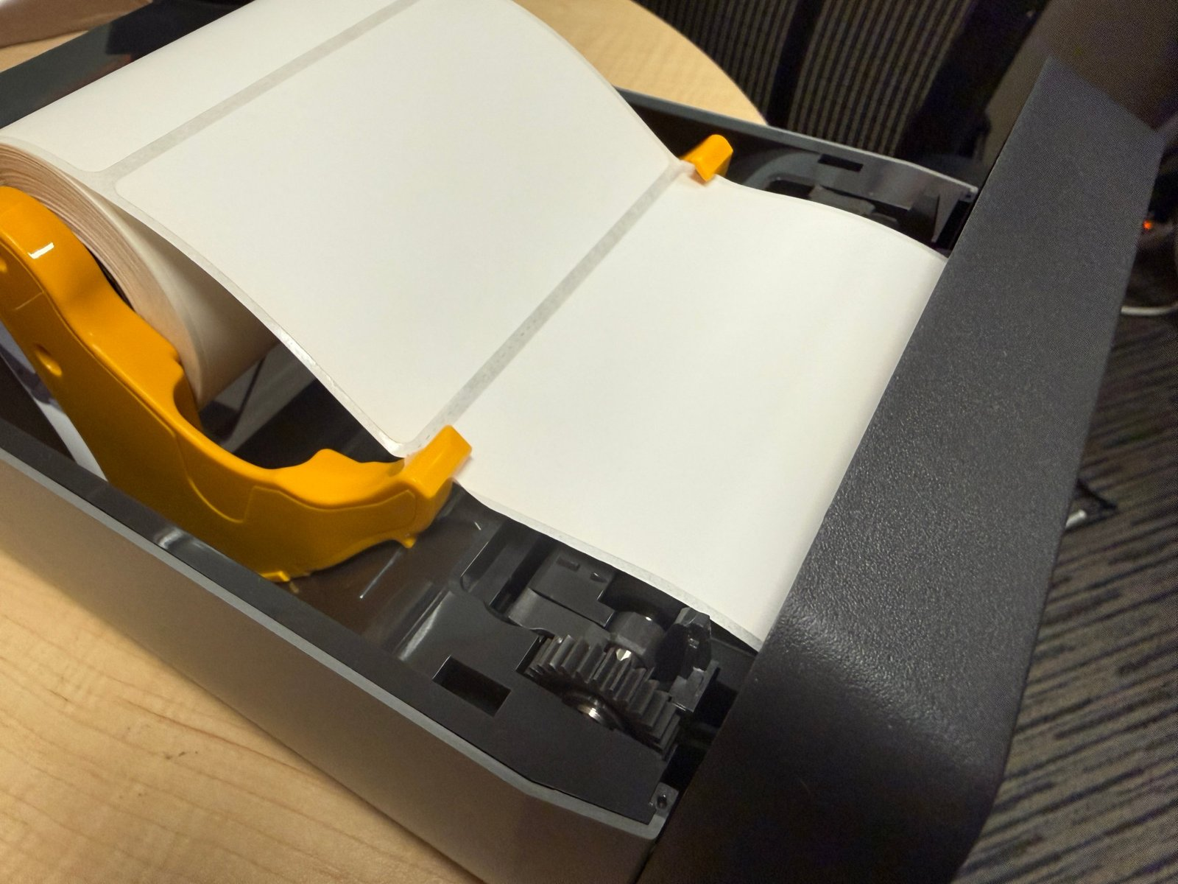
Where the next label waits matters
Zebra factory default – Backfeed After
Backfeed before
Parked on the platen
Parked in the cutter
Overnight, a label parked on the rubber platen takes a curl. The curl is what jams the cutter.

Slide 22

How a parked label becomes a jam
1
2
3
Parks
Curls
Hits
Label sits on the platen roller between prints
Within a day or even hours
Next print feeds the curled edge into the cutter
First label of the morning, every time
Where the label sits prior to the next print makes a big difference in how it performs.

Slide 23
The Classic fix: change one character
~JS
N
~JSB
Find ~JSN in every (Classic) label that prints to a cutter (usually near the top) and change N to B
It works because Classic labels send it with every print

Slide 24
But Nextgen…
What a Nextgen designed label sends
Tested on a brand-new ZD621
Out of the box
Parks on the platen (~JSN)
^XA^CI28^PW812^LL406
...your fields...
^XZ
~JSB, then power cycle
Works until reboot, then back on the platen
No ~JSx
~JSB + ^JUS, then power cycle
Still parks in the cutter (yay)
The printer uses whatever setting it already has.

Slide 25
The fix that sticks: a printer config label
PRINT IT FROM ROCK (NEXTGEN)
^XA
^FX Backfeed before: label waits in the cutter^FS
~JSB
^FX Cutter mode. No cutter: use MMT^FS
^MMC
^FX Gap labels. Black-mark stock: use MNM^FS
^MNW
^FX Direct thermal (no ribbon)^FS
^MTD
^FX Print and feed speed, inches/second^FS
^PR6,6
^FX Darkness 0-30: adjust for your stock^FS
~SD10
^FX Front-panel passcode (optional). Use your own^FS
^KP8888
^FX Save it all to the printer's memory^FS
^JUS
^FO30,30^A0N,40,40^FDPrinter configured^FS
^XZ
1
New check-in label, Label Format: ZPL
Pick any label type, doesn’t matter.
2
Paste the config ZPL into label
Adjust the settings to meet your needs. Save
3
Edit → Preview → pick printer → Print
Once per printer. Done.
Keep the printable line. Nextgen's preview won't enable Print for a label with nothing to render, and the printout confirms it worked.

Slide 26
Classic vs. Nextgen
NUGGET 4
4
What changes when you move

Slide 27
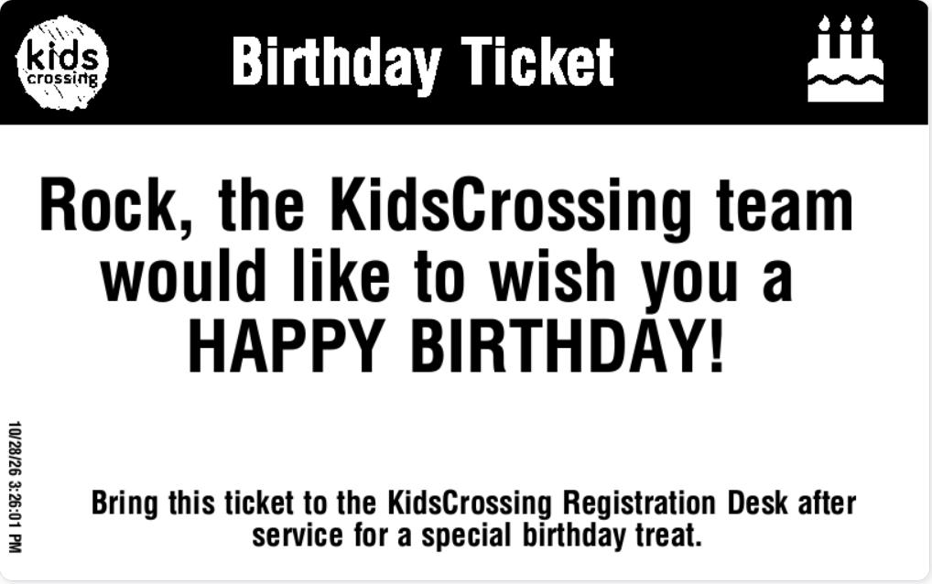
Classic vs. Nextgen: what changes
CLASSIC
NEXTGEN
Label design
ZPL from Zebra Designer
Built-in label designer (ZPL still an option)
Label data
Everything comes from Label Merge Fields
Drag-in fields; far less Lava
Conditional
Lava if/else inside merge fields
Conditional fields + conditional printing
Icons
Rock icon font installed on each printer
About 5 icons; add your own images

Slide 28



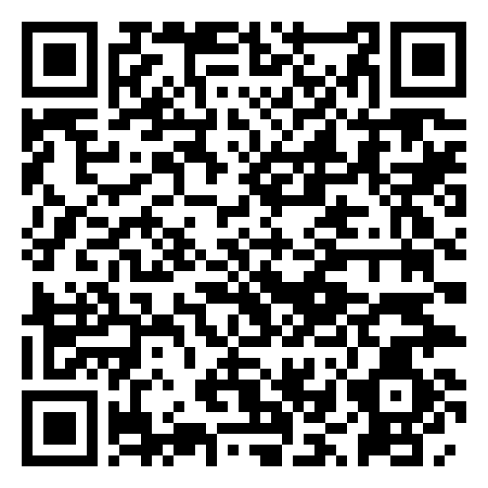
Lava: A simple example
Family
Person
Attendance
Checkout
Person Location
CLASSIC · MERGE FIELD ON THE LABEL
NEXTGEN · DYNAMIC TEXT, ATTENDANCE LABEL
{% for member in GroupMembers %}
{{ member | Attribute:'TagNumber' }}
{% endfor %}
{{ Attendance.GroupMembers[0]
| Attribute:'TagNumber' }}
Pick the label type first. It decides which objects your Lava can reach. The filter is the same; where the data lives is not.
Rock docs: Check-in › Labels › Label Types
community.rockrms.com/documentation → Check-in → Labels

Slide 29


Migrating to Nextgen without surprises
Inventory first
Run in parallel
Document every custom Lava merge field you own before you migrate
You might be surprised that some things no longer need Lava at all.
Keep Classic and Nextgen side by side during testing and compare printed output
No need to migrate every kiosk and every campus on the same day.

Slide 30
Use an MDM
NUGGET 5
5
More than 2–3 kiosks? It's worth every dollar

Slide 31




What an MDM gives you
Central config push
Remote Wipe / Redeploy
Wifi, wallpaper, daily reboot, and other settings on every kiosk at once
Super easy re-deployment of a device that’s acting weird.
Apps & kiosk mode
Inventory & OS control
Install Rock app and enforce App Lock or similar “Single App Mode” lockdown.
Know every device's OS version, battery level, config status, and control update timing

Slide 32
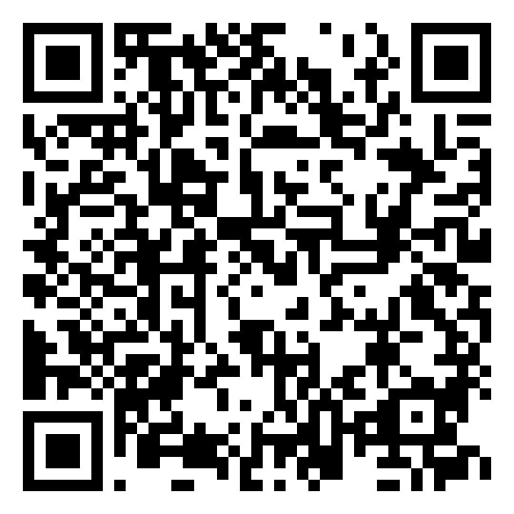
MDM: Getting started
OPTIONS
FIRST STEPS
Mosyle Apple-focused; what we use
1
Start small
Mosyle and Jamf Now have free tiers for a handful of devices
Jamf The other popular Apple choice
2
Pair it with the launcher
MDM deploys the check-in app to every kiosk (Nugget 1)
Intune May already be in your Microsoft 365
3
Enroll early
Set up enrollment before your next device purchase
COMMUNITY RECIPE · LEAH JENNINGS
Set up the iPad check-in app via MDM
https://community.rockrms.com/recipes/436/how-to-setup-the-ipad-rock-check-in-app-via-mdm

Slide 33
Recap
1
Automate kiosk setup
Your weekend volunteers will thank you
2
Skip the tokenized login
Keep Me Logged In is simpler, and safer
3
Set ~JSB on the printer, and save it
One config label with ^JUS, once per printer
4
What’s different in Nextgen
You’ll need to redo custom merge fields… but might not even need them
5
Get on an MDM
Manage devices like the infrastructure they are

Slide 34
Questions?
?
Jim Michael · jimm@thecrossing.church · @jimmichael
Karen Rossi · karenr@thecrossing.church · @karenrossi
RESOURCES
Rock Community: community.rockrms.com
Check-in docs: rockrms.com/learn
Slides & code: github.com/The-Crossing-Rock-Community/rock-checkin-nuggets

