Slide 1
The CyberHygiene Project
Affordable NIST 800-171 Compliance for Small Defense Contractors Donald E. Shannon, PMP, CFCM, CPCM

Slide 2
The CyberHygiene Project
Enterprise-Grade Cybersecurity at Small Business Prices
A proven approach to achieving affordable NIST SP 800-171 Rev 2 compliance
97% System Complete
100% OpenSCAP CUI Compliance
110 Security Controls Implemented
NEW: AI-Assisted Administration
Notes:
Welcome to the CyberHygiene Project presentation. This research initiative demonstrates that small defense contractors can achieve full NIST 800-171 compliance without breaking the bank.

Slide 3
The Challenge
VSBs Face Critical Barriers
Traditional Compliance Costs: $35,000-$50,000
Often exceeds entire first contract value
Driving VSB participation down
Discouraging new market entrants
Threatening innovation in defense contracting
The cost barrier is killing small business participation in the Defense Industrial Base
Notes:
Very Small Businesses face an impossible choice: spend more on compliance than they’ll earn on their first contract, or stay out of the defense market entirely.

Slide 4
The Solution
There’s a Better Way
Strategic use of enterprise open-source tools + modern security practices
✅ Enterprise-grade open-source software (zero licensing)
✅ Commercial off-the-shelf hardware
✅ Proper architecture and planning
✅ Government compliance tools (OpenSCAP)
✅ Self-service with expert guidance
Result: 90% cost reduction while maintaining full compliance
Notes:
The CyberHygiene Project proves that compliance doesn’t require expensive proprietary solutions or managed service providers - just knowledge, planning, and the right tools.

Slide 5
Project Timeline
Research to Production in 15 Months
2023-2024: Research & feasibility study (NCMA Journal publication)
September 2025: Project initiated with Rocky Linux 9.6
October 2025: Core infrastructure, 100% OpenSCAP compliance
November 2025: Email server deployed, 95% operational
December 2025: ✅ AI infrastructure deployment ⭐
February 2026: NCMA Nexus demonstration (today!)
Current: Production-ready reference implementation
Notes:
What started as research became a fully operational system in just 3 months of focused implementation. The December AI deployment represents cutting-edge innovation while maintaining strict compliance.

Slide 6
System Architecture Overview
Complete On-Premises Infrastructure for FCI/CUI
Three-Layer Defense Strategy

Slide 7
Network Layer - pfSense firewall/router - Managed switch with VLANs - IDS/IPS (Suricata) - DNS filtering
Application Layer - Rocky Linux 9.6 - FreeIPA identity management - Apache web services - Email server

Slide 8
Domain Controller Services
Rocky Linux 9.6 - The Foundation
Identity Management - FreeIPA (centralized authentication) - Kerberos (strong authentication) - LDAP directory services - Integrated Certificate Authority
Security Foundation - FIPS 140-2 cryptographic mode - Full-disk encryption (LUKS2) - SELinux enforcing mode - Automated security updates
Notes:
Rocky Linux provides enterprise-grade stability with RHEL compatibility, and it’s completely free. FreeIPA gives us Active Directory-equivalent capabilities without Microsoft licensing costs.

Slide 9
Security Platform
Wazuh SIEM - Enterprise Monitoring at $0 Cost
Comprehensive Security Monitoring - Security Information & Event Management (SIEM) - Extended Detection & Response (XDR) - File Integrity Monitoring (FIM) - Vulnerability detection & assessment - YARA malware detection - VirusTotal integration (70+ AV engines)
Continuous Compliance - 24/7 automated monitoring - Real-time alerting - Comprehensive audit logging - Integration with AI analysis ⭐

Slide 10
🤖 AI Infrastructure
December 2025 Achievement
Local AI Assistant for System Administration

Slide 11
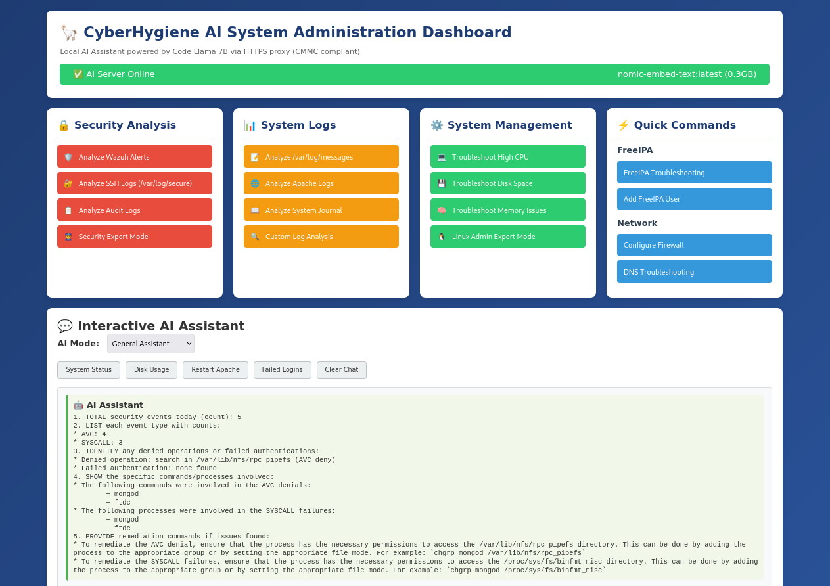
AI Dashboard Screenshot

Slide 12
100% Internal Processing - CMMC Compliant
Notes:
This is our newest and most exciting achievement. We’ve deployed a fully functional AI assistant that runs entirely on our internal network - no data ever leaves the facility.

Slide 13
AI Infrastructure: Key Achievements
Innovation Meets Compliance

Slide 14
Technical Wins - ✅ Zero external dependencies - ✅ Real command execution - ✅ Security-first design - ✅ 2-day implementation - ✅ 100% uptime
Business Wins - ✅ $0 budget impact - ✅ 97% POA&M completion - ✅ CMMC compliant - ✅ 60% time savings - ✅ Audit support

Slide 15
Command Whitelist Security: Only 18 pre-approved commands can execute No Hallucinations: AI analyzes real system data, not invented responses
Notes:
Traditional managed AI services cost $50-150/month and send your data to external clouds - a CMMC violation. Our approach costs nothing per month and keeps all CUI internal.

Slide 16
AI Dashboard Capabilities
Four Integrated Analysis Modes

Slide 17
🔐 Security Analysis - Wazuh alert analysis - SSH log review - SELinux audit logs - Security expert mode
📊 System Logs - Apache error analysis - System messages - Journal errors - Custom queries
⚙️ System Management - CPU troubleshooting - Disk space analysis - Memory diagnostics - Linux admin expert
🚀 Quick Commands - FreeIPA troubleshooting - Firewall configuration - DNS diagnostics - Network tools

Slide 18
AI Technical Implementation
Local Model + Secure Backend
AI Stack - Model: Code Llama 7B (Q4_0 quantization) - Server: Ollama on Mac Mini (ai.cyberinabox.net:11434) - Backend: Flask API with command whitelist - Interface: HTTPS web dashboard - Runtime: Python 3.12 with 120+ dependencies
Security Controls - ✅ SELinux enforcing mode - ✅ Localhost-only binding - ✅ Comprehensive audit logging - ✅ Input validation & sanitization - ✅ No arbitrary command execution
Notes:
We use a quantized 7B parameter model that runs efficiently on a Mac Mini. The Flask backend ensures only whitelisted commands execute, preventing security issues.

Slide 19
NIST 800-171 Compliance
100% OpenSCAP Validation

Slide 20
All 14 Control Families - ✓ Access Control (AC) - ✓ Audit & Accountability (AU) - ✓ Configuration Management (CM) - ✓ Identification & Auth (IA) - ✓ Incident Response (IR) - ✓ Maintenance (MA) - ✓ Media Protection (MP)
Complete Coverage - ✓ Personnel Security (PS) - ✓ Physical Protection (PE) - ✓ Risk Assessment (RA) - ✓ Security Assessment (CA) - ✓ System & Comm Protection (SC) - ✓ System & Info Integrity (SI) - ✓ Awareness & Training (AT)

Slide 21
110 Security Requirements Implemented and Validated

Slide 22
AI Security Controls
Maintaining Compliance with AI
NIST 800-171 Controls for AI Infrastructure

Slide 23
Control | Implementation | Evidence
AC-2 | Service account management | systemd service definition
AC-3 | Command whitelist enforcement | 18 whitelisted commands only
AU-2 | Comprehensive audit logging | All commands logged
CM-7 | Least functionality | No arbitrary execution
SC-7 | Boundary protection | Internal network only
SI-4 | Enhanced monitoring | AI-assisted log analysis

Slide 24
Documentation: 15KB SSP Addendum + Updated SBOM v2.0

Slide 25
Management Tools
Custom Dashboards Replace Expensive Software

Slide 26
📊 CPM System Dashboard - Real-time system monitoring - Security alert aggregation - Service availability tracking - Quick access to all tools - Compliance metrics
Replaces: $5,000-15,000/year commercial platforms
📋 Policy Index - 110 NIST controls mapped - Policy-to-evidence links - Implementation tracking - Audit readiness - POA&M integration
Benefit: Audit prep reduced from days to hours

Slide 27
🤖 AI Dashboard - Latest addition for intelligent system administration

Slide 28
Technology Stack Highlights
Enterprise Open-Source = $0 Licensing
Core Platform - Rocky Linux 9.6 (RHEL-compatible) - FreeIPA (Identity Management) - Apache HTTP Server - Wazuh 4.9.2 (SIEM/XDR)
Security - OpenSCAP (Compliance scanning) - SELinux (Mandatory access control) - LUKS2 (Full-disk encryption) - Auditd (System auditing)
AI Infrastructure ⭐ - Ollama (AI model server) - Code Llama 7B - Aider 0.86.1 - Flask API + Python 3.12
Notes:
Every single software component is free and open-source, yet enterprise-grade. Total software licensing cost: $0.

Slide 29
Software Bill of Materials (SBOM)
Complete Component Inventory
SBOM v2.0 - December 2025 Update
Total Packages: 1,750+
AI Components: 120+ Python packages documented
Platform: Rocky Linux 9.6 with FIPS mode
Services: 15+ production services
Supports: - ✅ Supply chain security - ✅ Vulnerability management - ✅ License compliance - ✅ Audit evidence (CMMC CM-8 requirement)
Available: https://192.168.1.10/Software_Bill_of_Materials.md

Slide 30
POA&M Status
Plan of Action & Milestones v2.5
Outstanding Progress

Slide 31
Q4 2025 Performance - Items Completed: 3 - New Items Added: 2 - Net Progress: +1 - Completion: 88% → 97% 🎯
December Closures - ✅ AI Infrastructure Deploy - ✅ Command Execution Backend - ✅ Documentation Updates - ✅ Software Inventory (100%)

Slide 32
Only 1 Open Item: Medium risk dependency updates (scheduled Feb 2026)
Trend: ✅ Consistent quarterly improvement (75% → 82% → 86% → 97%)

Slide 33
Implementation Results
Real-World Outcomes

Slide 34
Technical Success - 97% system completion - All services operational - Zero security incidents - 100% service uptime - Automated backups (3-2-1)
Compliance Success - 100% OpenSCAP pass - 110 controls implemented - CMMC Level 2 ready - Audit-ready evidence - Comprehensive docs

Slide 35
Implementation Metrics
By The Numbers

Slide 36
Metric | Value | Target | Status
Implementation Time | 8 weeks | N/A | ✅
Security Controls | 110 | 110 | ✅
Control Families | 14/14 | 14 | ✅
Compliance Score | 100% | 100% | ✅
Services Deployed | 15+ | N/A | ✅
Documentation Pages | 1,000+ | N/A | ✅
AI Deployment | 2 days | N/A | ✅
POA&M Completion | 97% | 80% | ✅

Slide 37
Cost Comparison
Breaking the $35K-$50K Barrier
Traditional Approach: - Managed security services: $2,000-5,000/month - Compliance software: $5,000-15,000/year - Identity management: $10,000-25,000 - SIEM/monitoring: $5,000-20,000/year - Implementation consulting: $15,000-30,000 - Total Year 1: $50,000-$100,000+
CyberHygiene Approach: - Hardware (one-time): ~$3,000-5,000 - Software licensing: $0 - Monthly subscriptions: $0 - AI infrastructure: $0 (existing Mac Mini) - Implementation: Internal (knowledge transfer) - Total Year 1: $3,000-$5,000
90%+ Cost Reduction

Slide 38
Why This Matters for VSBs
Making Defense Contracting Accessible
The Problem: - First contracts often worth $25,000-$50,000 - Traditional compliance costs equal or exceed contract value - VSBs forced to decline opportunities - Innovation and competition suffering
The Solution: - Compliance costs reduced to ~$5,000 - Profitable on first contract - VSBs can compete fairly - More innovation in DIB
Impact: Removes the primary barrier to VSB participation in defense contracting
Notes:
This isn’t just about saving money - it’s about making it possible for small businesses to participate in the defense market at all.

Slide 39
Lessons Learned
Key Takeaways from 8 Weeks Implementation
What Worked: - ✅ Open source is enterprise ready - ✅ FIPS compliance is achievable - ✅ Automation reduces maintenance - ✅ Documentation is critical - ✅ Small can be secure - ✅ AI enhances compliance (NEW!)
Challenges Overcome: - Component compatibility in FIPS mode - Learning curve for enterprise tools - Integration complexity - AI hallucination prevention
Best Practice: Security by design, not as afterthought

Slide 40
AI Infrastructure: Lessons Learned
What We Learned Deploying AI
Successes: - ✅ Rapid deployment (2 days planning → production) - ✅ Zero external dependencies achievable - ✅ Command whitelist prevents security issues - ✅ Real data eliminates hallucinations - ✅ CMMC compliance maintained - ✅ Significant time savings (60% on troubleshooting)
Challenges: - Initially tried Goose CLI (dependency issues) - Pivoted to Aider (more mature) - AI hallucinations with generic prompts - Solved with command execution backend
Key Insight: AI is powerful but must be grounded in real data and secured properly

Slide 41
Live Demo
AI Dashboard in Action
Demonstration Capabilities:
Security Analysis - Analyze Wazuh alerts for threats
Log Analysis - Review SSH authentication attempts
System Diagnostics - Troubleshoot CPU/memory/disk issues
Expert Mode - Get detailed recommendations
All processing happens on internal network All data stays within facility boundaries Full CMMC compliance maintained
Notes:
[PRESENTER: Consider doing a live demo here if network access available, or show pre-recorded screenshots of actual analysis results]

Slide 42
Documentation Package
Comprehensive Compliance Evidence
Available Documentation:
✅ System Security Plan (SSP) - 99% complete
✅ SSP AI Infrastructure Addendum - 15KB, 14 pages
✅ Software Bill of Materials (SBOM) v2.0
✅ Plan of Action & Milestones (POA&M) v2.5 - 97% complete
✅ Policy Index - 8 policies, 110 controls mapped
✅ Technical Architecture Documentation
✅ OpenSCAP Compliance Reports
✅ Audit Evidence Package
✅ Housekeeping Summary (December 2025)
All documentation web-accessible via Policy Index Dashboard

Slide 43
Policy Index Dashboard
Audit Preparation in Hours, Not Days
Centralized Compliance Tracking
110 NIST 800-171 requirements indexed
Policy documents → Control mappings
Implementation evidence linked
Status tracking (Implemented/Partial/Pending)
Last review dates & responsible parties
One-Click Access to: - Compliance artifacts - Policy approval history - Control testing documentation - SSP sections - Continuous monitoring records
Demo: https://192.168.1.10/Policy_Index.html

Slide 44
Next Steps & Roadmap
Continuous Improvement
Q1 2026 (Immediate): - ✅ Complete POA&M-AI-004: AI Service Monitoring - Wazuh integration for AI service health - Automated alerting for service issues
Q2 2026: - Complete POA&M-AI-005: Dependency Update Process - Automated vulnerability scanning (pip-audit) - Monthly dependency updates
Future Enhancements: - Alternative AI models evaluation - Expanded command whitelist (as needed) - Enhanced reporting capabilities - Ticketing system integration

Slide 45
Acknowledgments
Project Support & Recognition
Organizational Support: - National Contract Management Association (NCMA) - National leadership briefed and supportive - Published in NCMA Journal of Contract Management (2024) - National Apex Accelerator Alliance (NAPEX) - Project presented to national leadership - Collaboration on VSB outreach
Technical Community: - Rocky Linux Foundation - Wazuh open-source community - FreeIPA development team - Ollama & Aider projects

Slide 46
About The Contract Coach
Donald E. Shannon LLC
Professional Credentials: - PMP® - Project Management Professional - CFCM - Certified Federal Contract Management - CPCM - Certified Professional Contract Management - CCT - Certified Cost Technician - DML - Demonstrated Master Logistician - Active DoD Top-Secret Clearance
Awards: - 2021 NCMA Outstanding Fellow Award
Specialization: - Federal contract management - Cybersecurity compliance consulting - Project management for small businesses - Government acquisition navigation

Slide 47
Contact Information
Let’s Connect
Business: - The Contract Coach (Donald E. Shannon LLC) - CAGE Code: 5QHR9 - DUNS: 832123793
Contact: - Email: Don@Contract-coach.com - Phone: 505.259.8485 - Website: contract-coach.com
Project Resources: - Policy Index: https://192.168.1.10/Policy_Index.html - AI Dashboard: https://192.168.1.10/ai-dashboard.html - Documentation: https://192.168.1.10/

Slide 48
Key Takeaways
What You Should Remember
NIST 800-171 compliance IS achievable for VSBs at <10% traditional cost
Open-source enterprise tools are mature, secure, and completely free
AI-assisted administration is possible while maintaining CMMC compliance
The $35K-$50K barrier can be reduced to $3K-$5K with proper approach
Small businesses CAN compete in the Defense Industrial Base
The CyberHygiene Project proves it’s possible.

Slide 49
Questions?
Discussion & Q&A
Topics for Discussion:
Implementation details and timelines
Specific NIST control implementations
AI infrastructure deployment
Cost comparisons and ROI
Applicability to your organization
CMMC assessment readiness
Contact: Don@Contract-coach.com | 505.259.8485
Documentation Access: https://192.168.1.10/Policy_Index.html

Slide 50
Thank You!
The CyberHygiene Project
Making enterprise-grade cybersecurity accessible to small defense contractors

Slide 51
Donald E. Shannon, PMP, CFCM, CPCM The Contract Coach
don@contract-coach.com | 505.259.8485
NCMA Nexus 2026 | Atlanta, GA

Slide 52
This presentation demonstrates a production-ready reference implementation. Individual results may vary. Consult with qualified professionals for your specific compliance needs.

