Slide 1
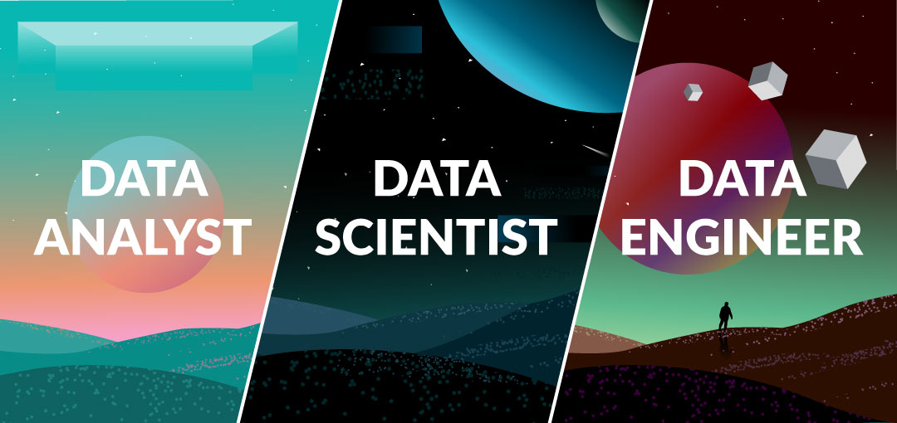
Presentation by:
Keely Wright
Lisa Modenbach
Francis Olave
Mark Schiffour

Slide 2
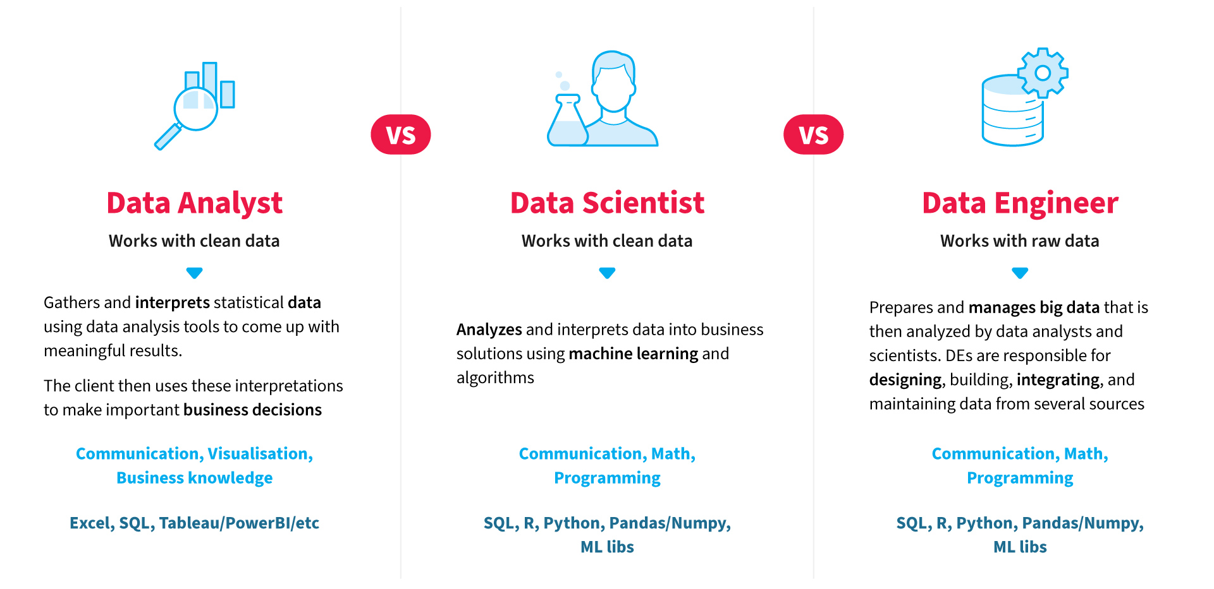
Notes:
We found similar trends in the tools and skills used.

Slide 3
Exploring the differences in Data Careers
Define differences in Data Careers
Compare the 3 different roles in the field for the following:
Identify the frequently used tools by role to prepare for employment
Compare and contrast salaries both in the US and International markets
Data sets were taken from Glassdoor, Indeed and LinkedIn

Slide 4


Slide 5
Data Behind Data Scientists
This data collection contained 150 job listings for Data Scientist.
The job listings are scraped from Glassdoor.com in Indonesia on 10 October 2020
Glass door is our international data set. Focus was on Data Scientist and the types of companies that employ them.
Limitations of the data set
150 rows
Data Scientist is the only role presented in data.
No salary information
Notes:
https://www.kaggle.com/defrinogionaldo/glassdoor-jobs-data-analysis?select=glassdoor+job+posting.csv
Glass Door Data
DESCRIPTION
The data behind data scientists
SUMMARY
A look into what skills data scientists need and what programs they use. A part of our 2015 data scientist report which you can download. Added: January 25, 2015 by CrowdFlower | Data Rows: 974 Download Now
Source: https://www.crowdflower.com/data-for-everyone/

Slide 6


Slide 7
Indeed Dataset (Data Scientist / Analyst / Engineer)
We cleaned and sorted rows of data for:
Salary
Tools
Languages
We realized we needed to add latitude and longitude for the following locations
US and International sites
Nulls and incomplete data were removed
Totals adjusted in the percentage calculation
Notes:
https://www.kaggle.com/elroyggj/indeed-dataset-data-scientistanalystengineer

Slide 8
Indeed Dataset (Data Scientist / Analyst / Engineer)
Salary for Scientist, Analyst and Engineer
Salary was averaged based on high and low range
Skills and languages were cleaned to create:
Tools : Machine Learning, Tableau and Hadoop
Skills: SQL, Python, SAS, Java, Spark, R

Slide 9


Slide 10
LinkedIn Dataset
This data set required extensive cleaning and formatting
From the data set we used the following:
Job title
Range of the salary
Location which included all over the world
Salary range had to be reformatted by splitting data into separate columns then getting the average for each.

Slide 11
Final Database, Tables/Collections and Why This Was Chosen
Type of final production database to load the data into:
Non relational data base (MongoDB)
Other technologies used:
Flask
Leaflet
D3

Slide 12
PUT SCREENSHOT OF WHAT WE USED

Slide 13

THANKS!

