Slide 1
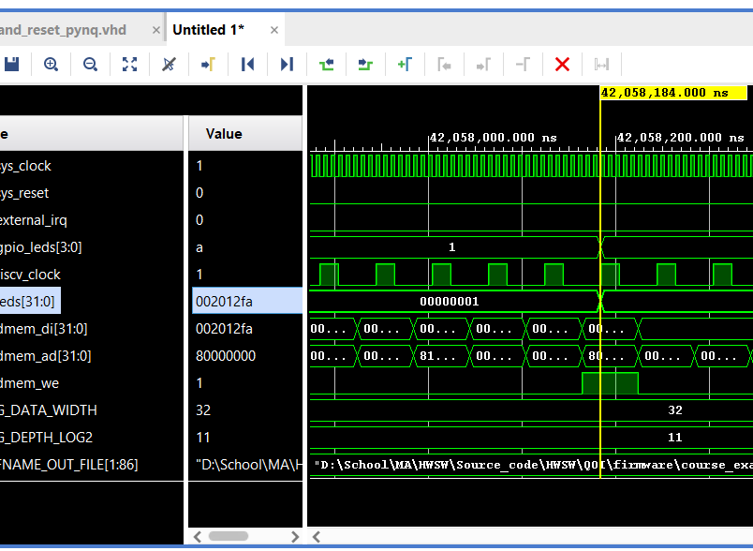
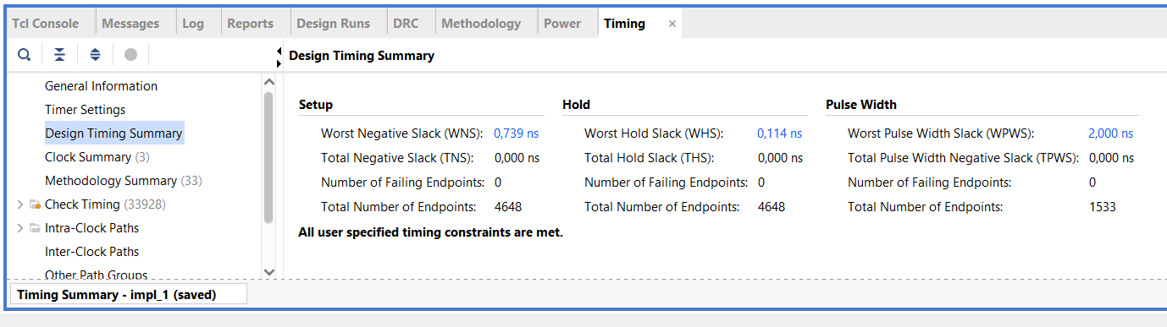
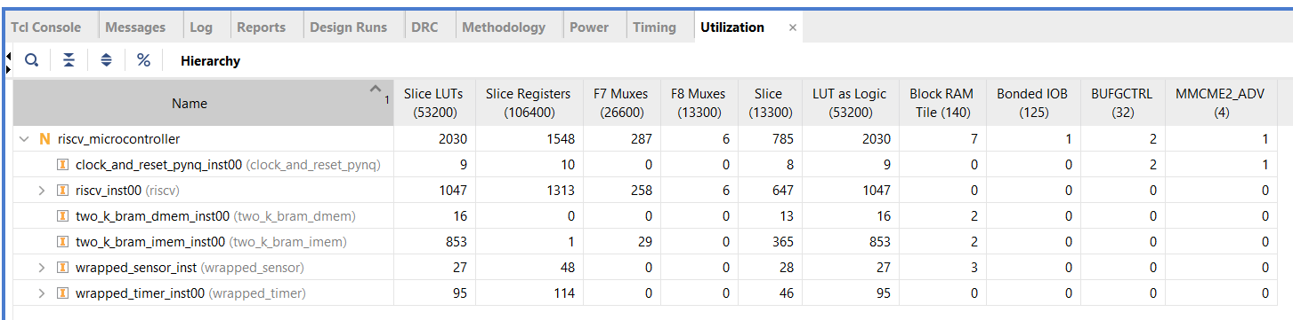
No optimalisations
FPS: 23,77 frames/s
Throughput: 2,853 Mb/s or 356KB/s

Slide 2
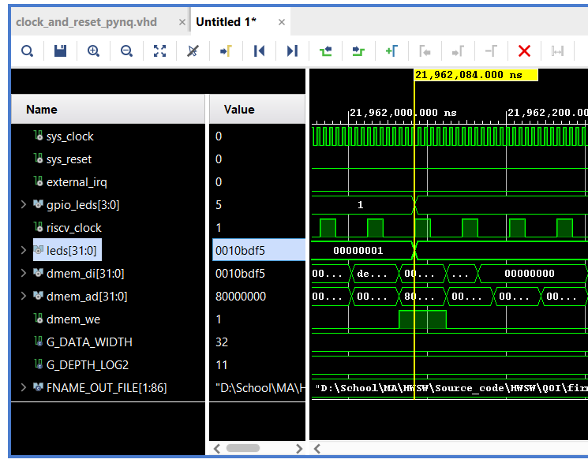
FPS: 45,53 frames/s
Throughput: 5,463 Mb/s or 628KB/s
Compiler optimalisation (-O3)

Slide 3
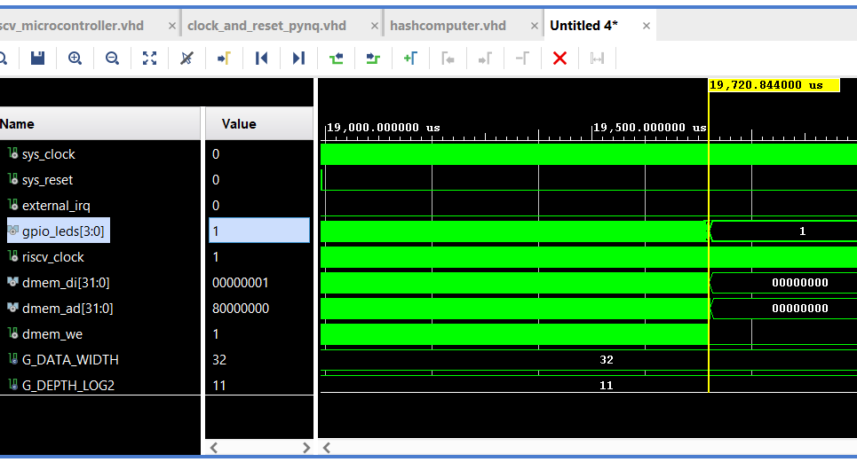
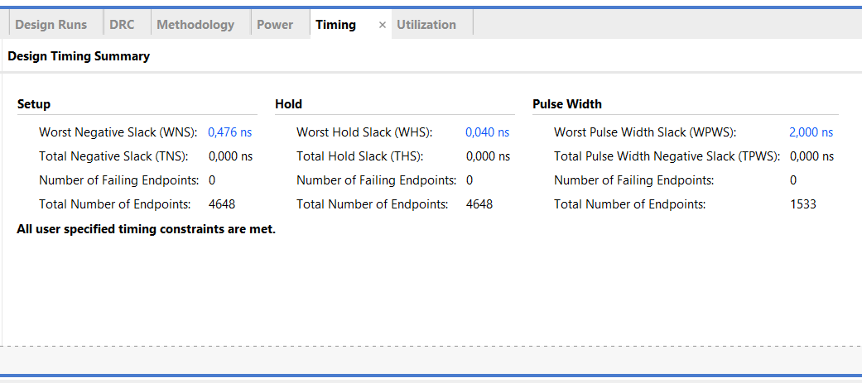
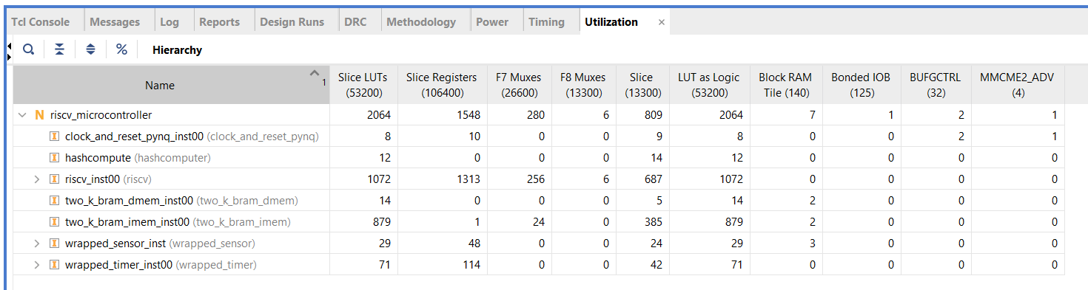
FPS: 50,70 frames/s
Throughput: 6,085 Mb/s or 760KB/s
Separate Hashfunction Block

Slide 4
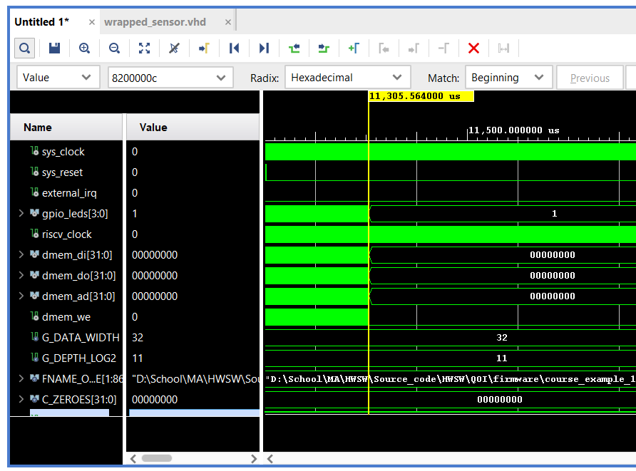
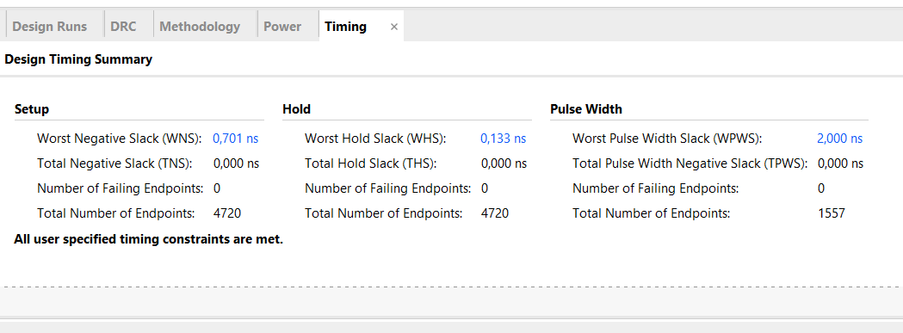
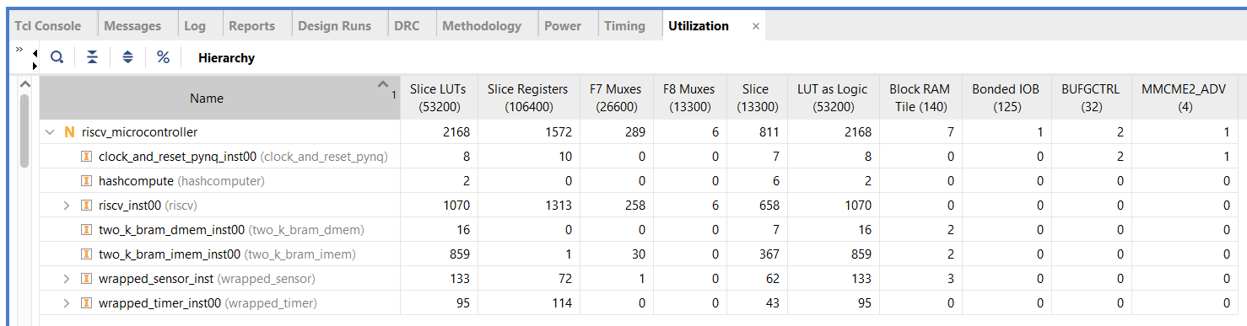
f
FPS: 88,45 frames/s
Throughput: 10,614 Mb/s or 1,326MB/s
.c file: …
In Sensor Computing

