Slide 1
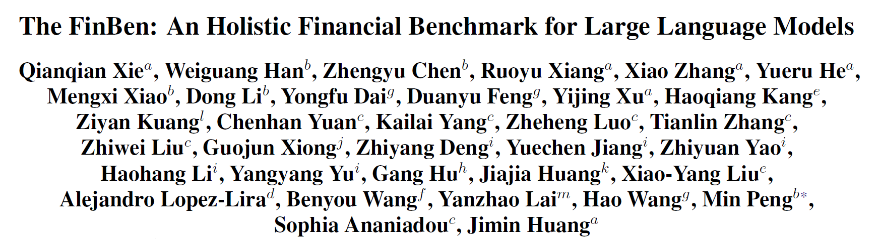













ª The Fin AI, ^{b} Wuhan University,
^{c} The University of Manchester, ^{d} University of Florida,
^{e} Columbia University, ^{f} The Chinese University of Hong Kong, Shenzhen,
^{g} Sichuan University, ^{h} Yunnan University,
^{I} Stevens Institute of Technology, ^{j} Stony Brook University,
^{k} Nanjin Audit University, ^{l} Jiangxi Normal University,
^{m} Jiangxi Normal University

Slide 2
OUTLINE
Introduction
The FinBen
Results
Conclusions

Slide 3
Introduction

Slide 4

Background
The advanced LLMs exhibit remarkable capabilities on financial text analysis and prediction tasks
The fast development of LLM highlights the need for financial evaluation benchmarks

Slide 5
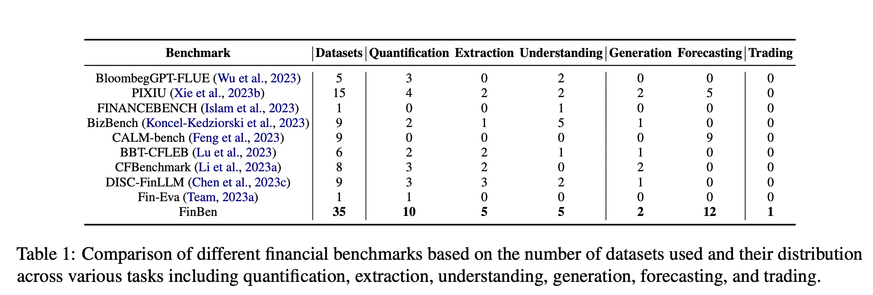
Existing Method
Financial-domain evaluation benchmarks: FLUE, BBTCFLEB, PIXIU
General-domain benchmarks: MMLU, HELM, BIG-bench
Challenges:
Broad coverage: to cover a broad spectrum of tasks to capture the financial domain complexity
Real-world application orientation: to focus on real-world scenarios
Inclusion of financial domain-specific characteristics: to demand specific knowledge, terminology, and concepts
Consideration of human-level cognition: to evaluate LLMs on decision-making, problem-solving, and abstract reasoning within financial contexts

Slide 6
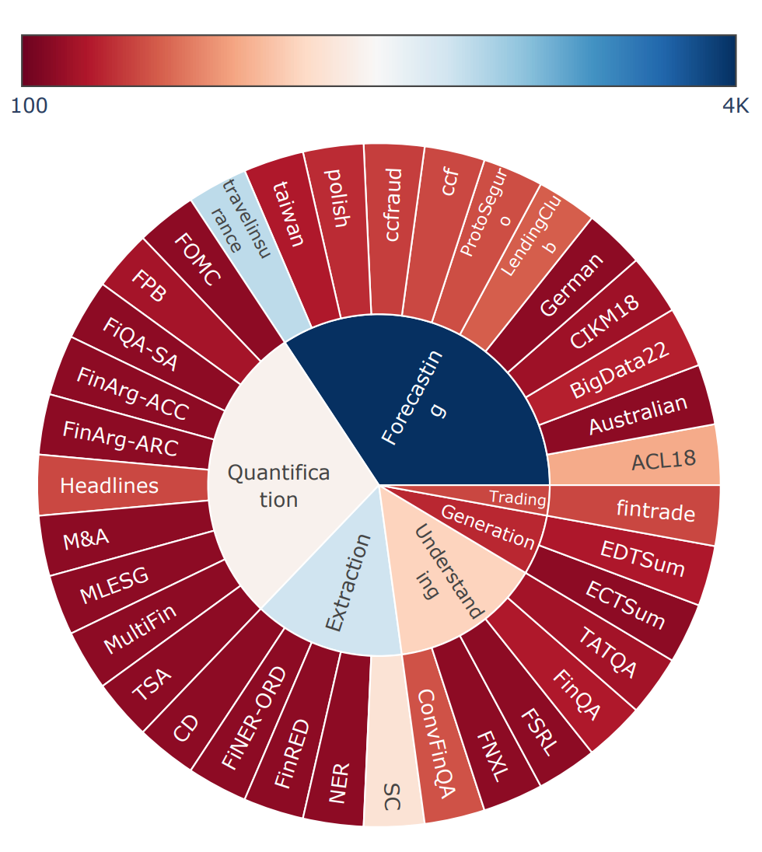
Contributions
First Comprehensive FinLLMs Benchmark
35 datasets spanning 23 financial tasks
Features
Wide coverage
Multi-data modality and diversity of text types
Diverse cognitive difficulty levels
Classic NLP tasks (text analysis, knowledge extraction, question answering)
Finance-specific challenges (numeric labeling)
Real-world financial applications (stock prediction, credit scoring)
Real-world trading: The first time directly assess the trading performance of LLMs
Including news, tweets, earnings calls, financial documents, tables, and time-series data
Specturm I: Fundamental Tasks (classification, NER, etc.)
Specturm II: Advanced Cognitive Engagement (stock movement prediction, etc.)
Spectrum III: General Intelligence (stock trading, etc.)
Organized into three Spectrums of cognitive difficulty

Slide 7
FinBen

Slide 8
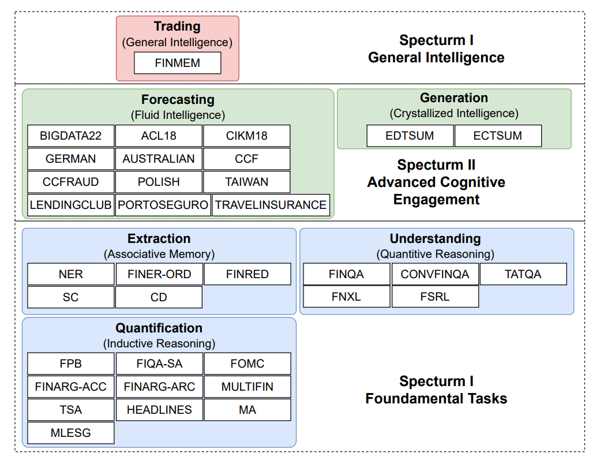
Overview
The first holistic evaluation benchmark for LLMs in financial domain.
A hierarchy inspired by the CattellHorn-Carroll (CHC) theory
Spectrum I: Fundamental Tasks
Spectrum II: Advanced Cognitive Engagement
Spectrum III: General Intelligence

Slide 9
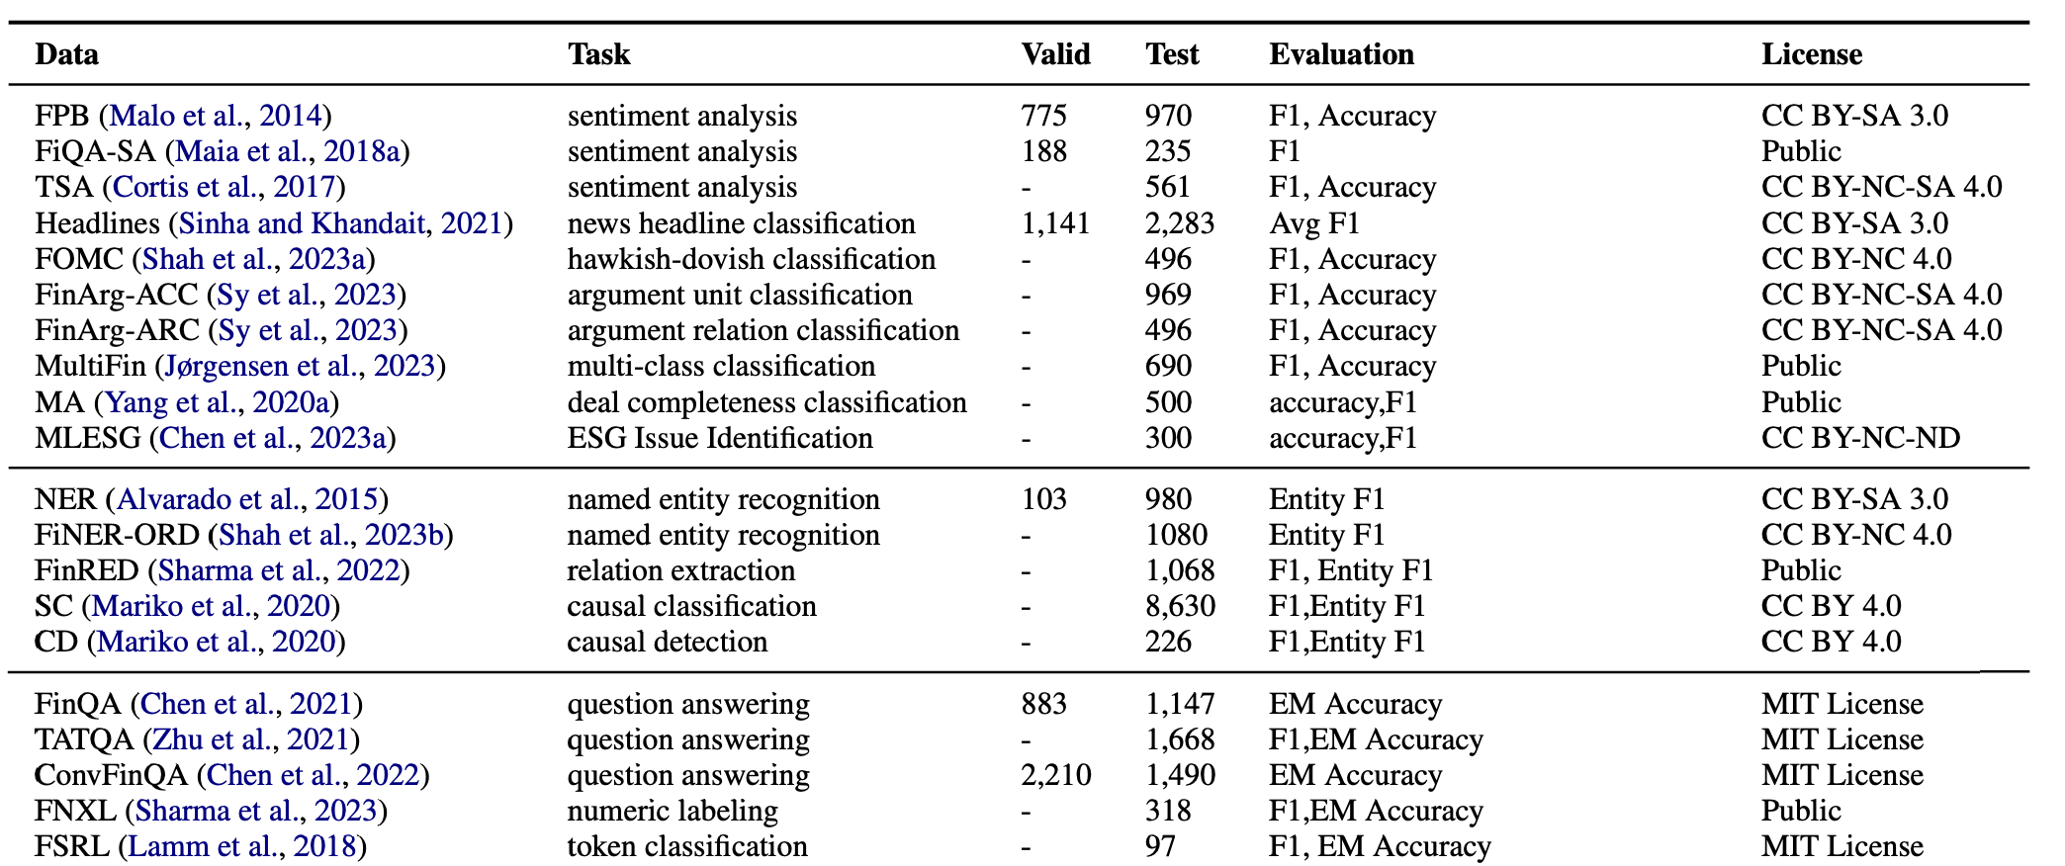
Spectrum I: Fundamental Tasks
Quantification (Inductive Reasoning):
Sentiment analysis: the Financial Phrase Bank (FPB), FiQA-SA, TSA
News headline classification: Headlines
Hawkish-Dovish classification: FOMC
Argument unit classification: FinArg AUC
Argument relation detection: FinArg ARC
Multi-class classification: MultiFin
Deal completeness classification: MA
ESG issue identification: MLESG
Extraction (Associative Memory):
Named entity recognition: NER, FINER-ORD
Relation Extraction: FINRED
Causal Classification: SC
Causal detection: CD
Numerical Understanding (Quantitative Reasoning):
Question answering: FinQA, ConvFinQA, TATQA
Numeric labeling: FNXL
Token classification: FSRL

Slide 10
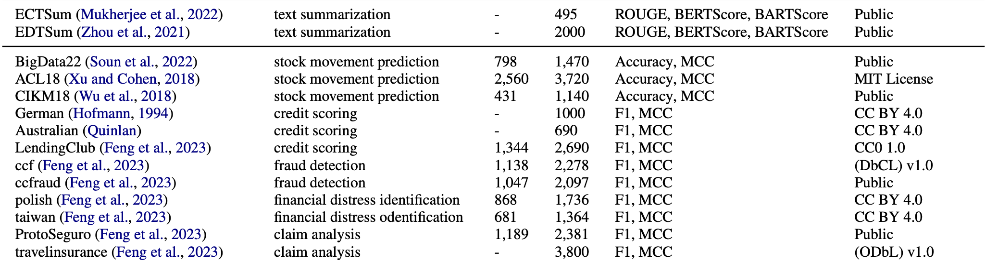
Spectrum II: Advanced Cognitive Engagement
Generation (Crystallized Intelligence）
Text summarization: ECTSUM, EDTSUM
Forecasting (Fluid Intelligence)
Stock movement prediction: BigData22, ACL18, CIKM18
Credit scoring: German, Australia, LendingClub
Fraud detection: ccf, CCFraud
Financial distress identification: Polish, Taiwan
Claim analysis: PortoSeguro, travelinsurance

Slide 11
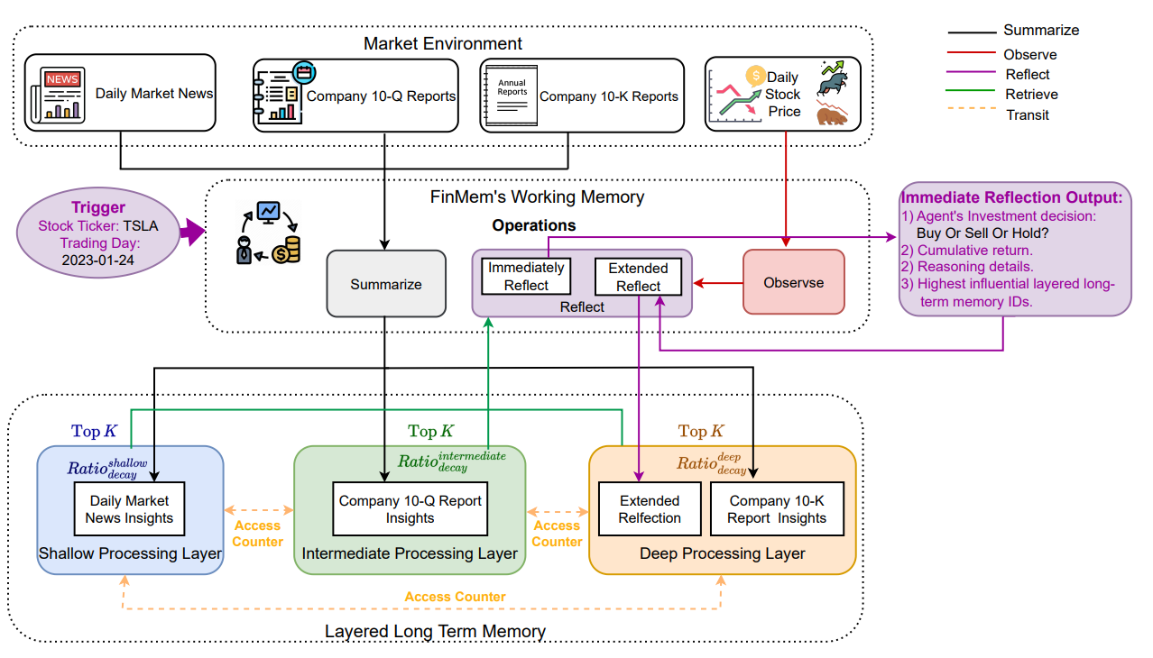
Spectrum III: General Intelligence
Trading
First Agent-based Trading Evaluation Task
7 major stocks with cleaned news, company filings, and stock prices

Slide 12
Results

Slide 13

Evaluation Settings
15 representative general LLMs and financial LLMs
General LLMs:
Commercial APIs: ChatGPT, GPT-4, Gemini Pro
Open-source: LLaMA2-70B, ChatGLM3-6B, Baichuan2-6B, InternLM-7B, Falcon7B, Mixtral 8×7B, Code Llama-7B,
Financial LLMs: FinGPT, FinMA-7B. DISCFinLLM, CFGPT
16 A100 80GB GPUs x 20400 GPU hours

Slide 14
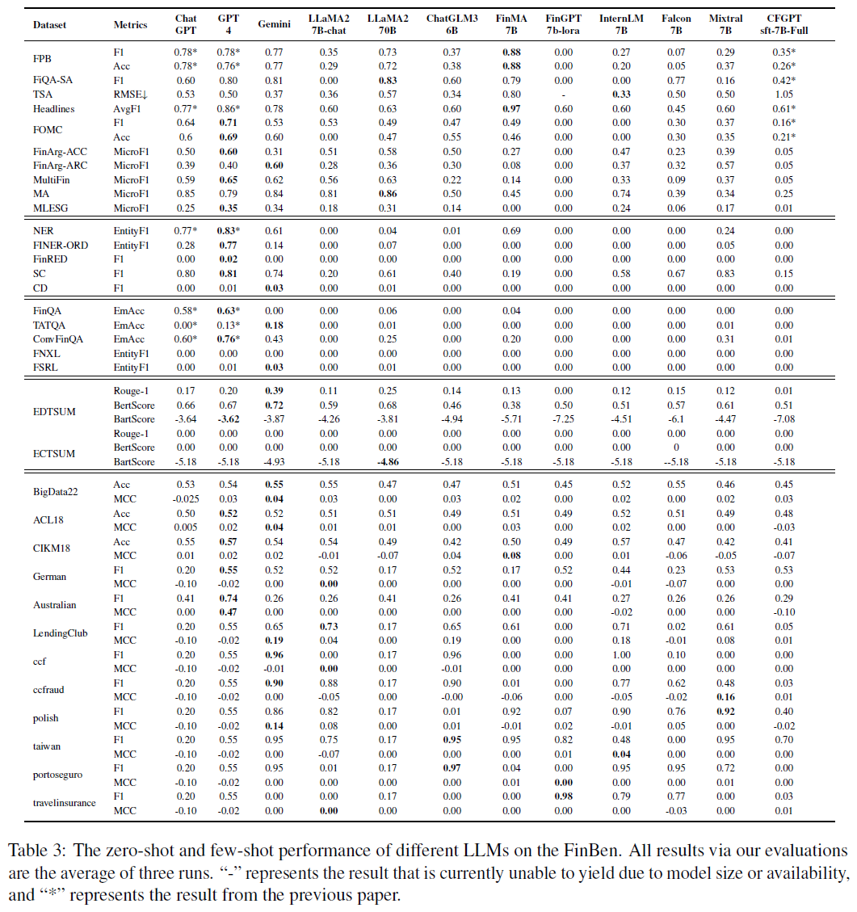
Overall Results
Fundamental Tasks Analysis:
GPT-4 stands the best
FinMA-7B is the best open-source LLMs, even better than GPT-4 on Quantification tasks due to domain fine-tuning
A significant gap in Numeric Reasoning tasks between general and financial fine-tuning models, indicating the limitation of domain fine-tuning
Advanced Cognitive Engagement Tasks Analysis：
Gemini-pro is the best in both Generation and Forecasting
All LLMs fail to show superior performance compared with random guess in Forecasting
Financial fine-tuned models continue to lag behind general domain models, revealing another bottleneck for domain fine-tuning in finance

Slide 15
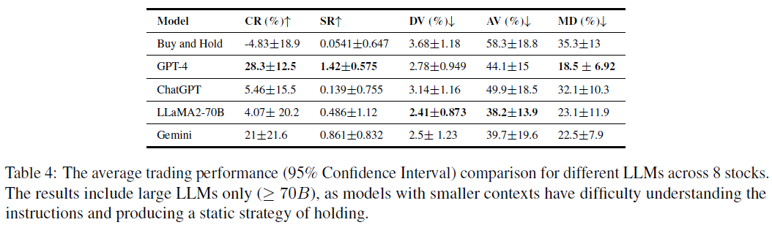
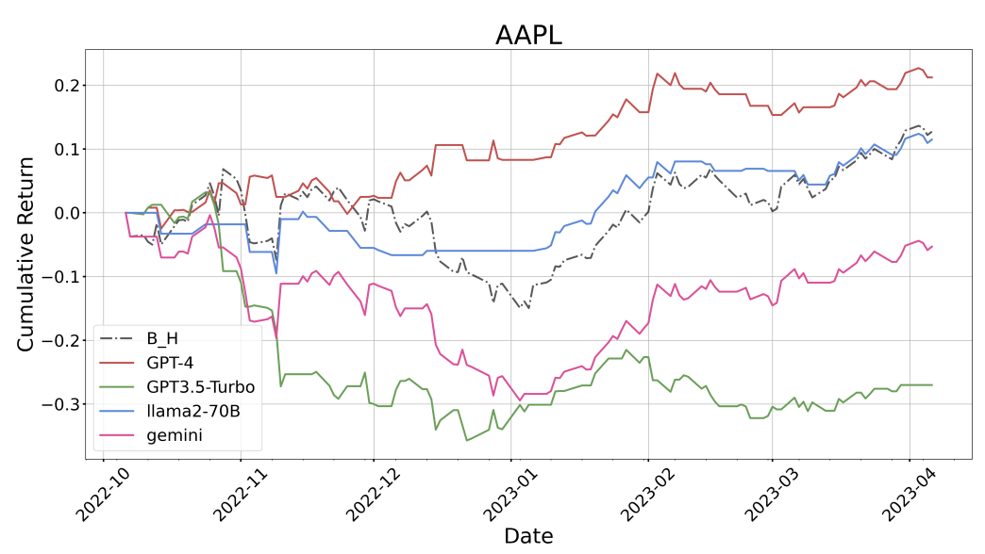
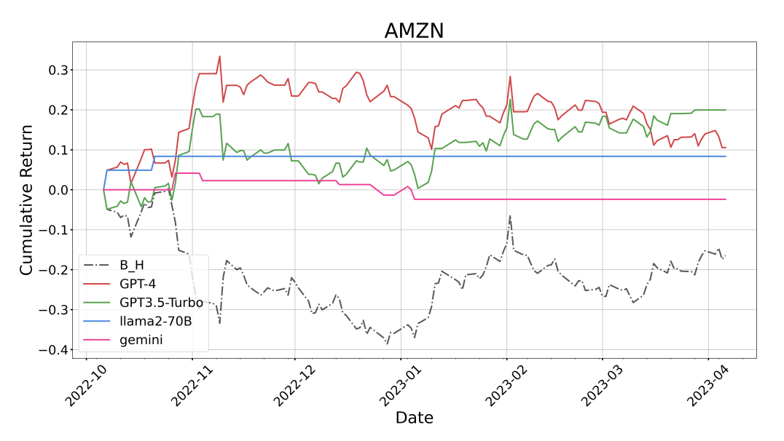
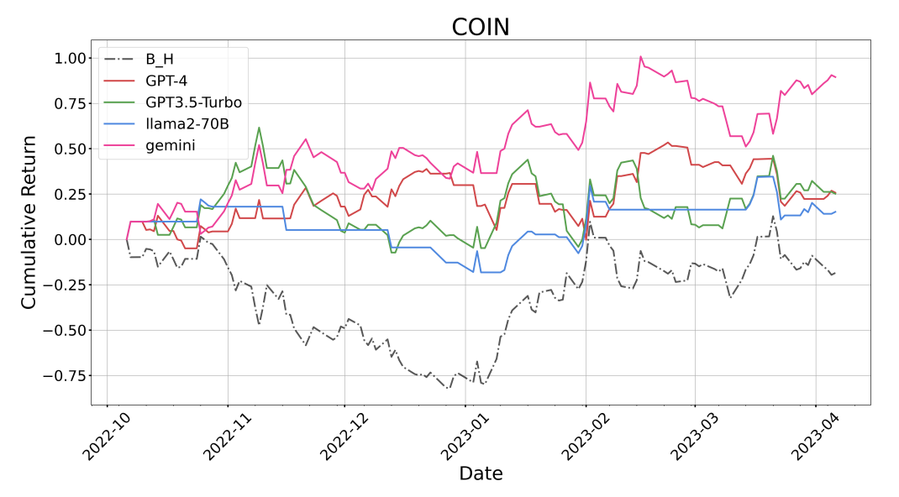
General Intelligence Results
GPT-4 shows superior trading performance with a >1 Sharpe Ratio
All LLMs show better performance than Buy & Hold
Only Large LLMs (>70B) can generate trading actions while small models (7/13B) fail to handle multiple input sources and complex instructions

Slide 16
Conclusion
Introduces FinBen, including defining cognitive abilities in three Spectrums, the first comprehensive evaluation benchmark for LLMs in finance
FinBen extends its evaluation to encompass a broad spectrum of tasks, including quantification, extraction, understanding, generation, forecasting
FinBen first incorporates a direct trading task through an agent-based evaluation framework
Perform evaluations on 15 general and domain LLMs, in the first time revealing the potential and bottleneck of LLMs in financial tasks and applications
Aims to expand FinBen to encompass additional languages and a wider array of financial trading tasks to become the domain-level benchmark

Slide 17
Thanks
Stay tuned with TheFinBen (the-finai.github.io)

