Slide 1
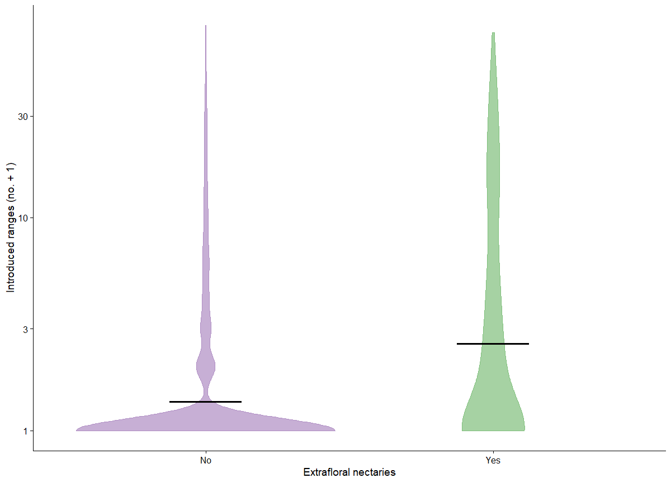

Slide 2
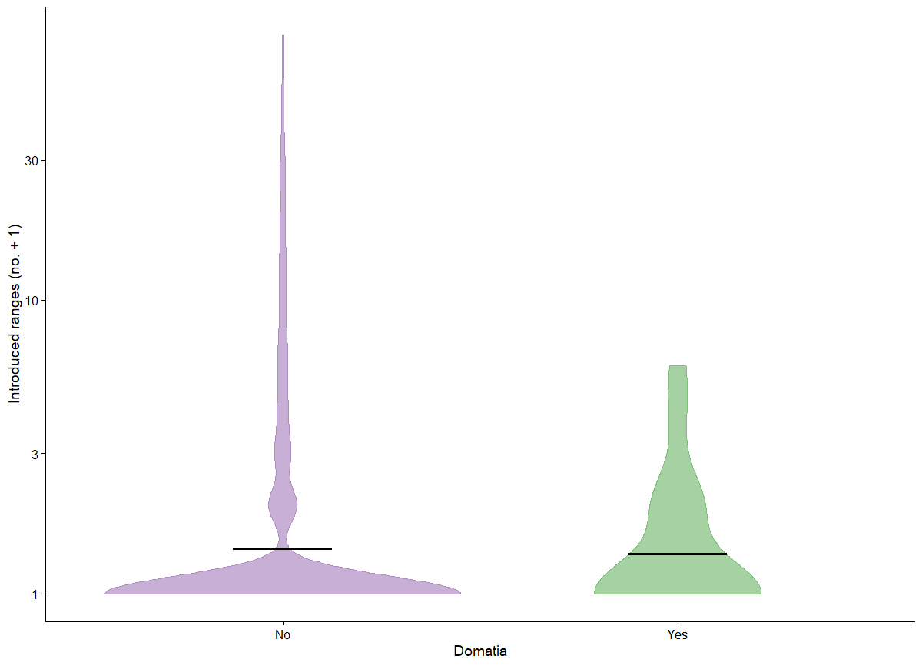

Slide 3
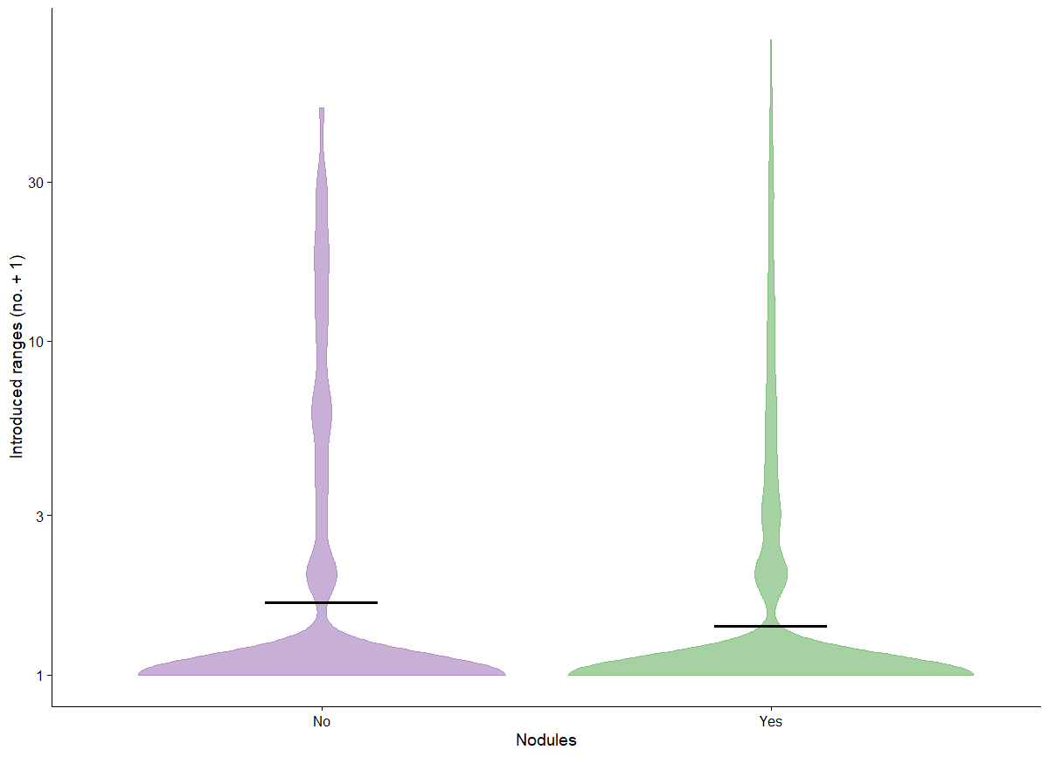

Slide 4
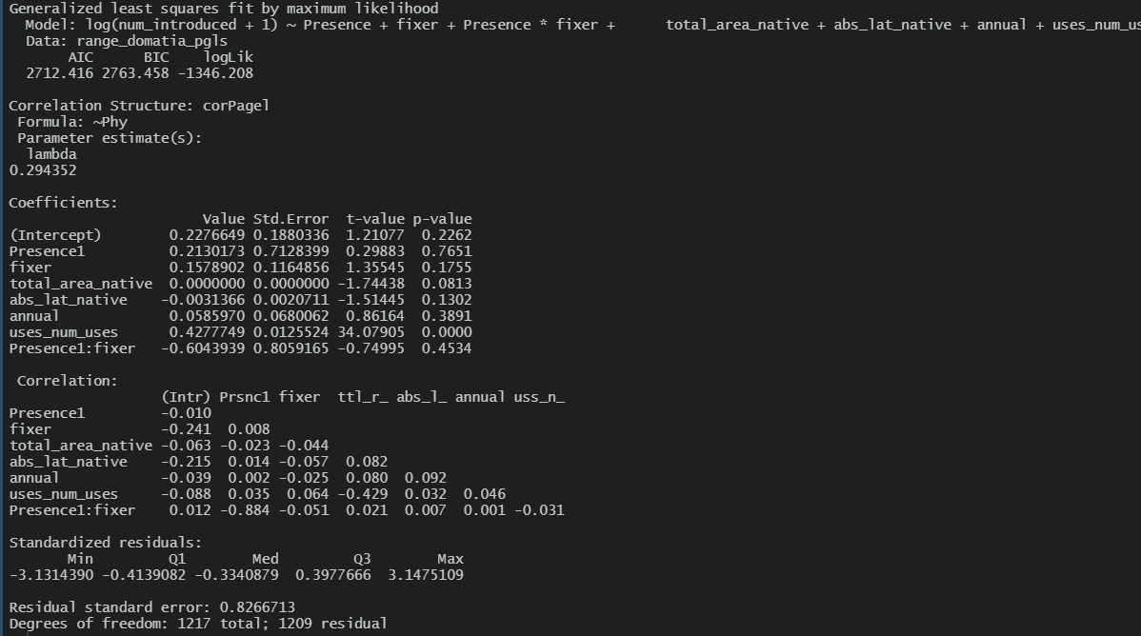

Slide 5
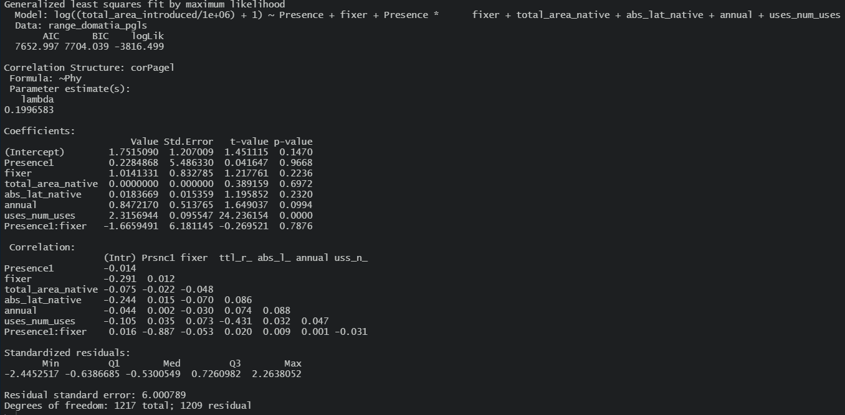

Slide 6
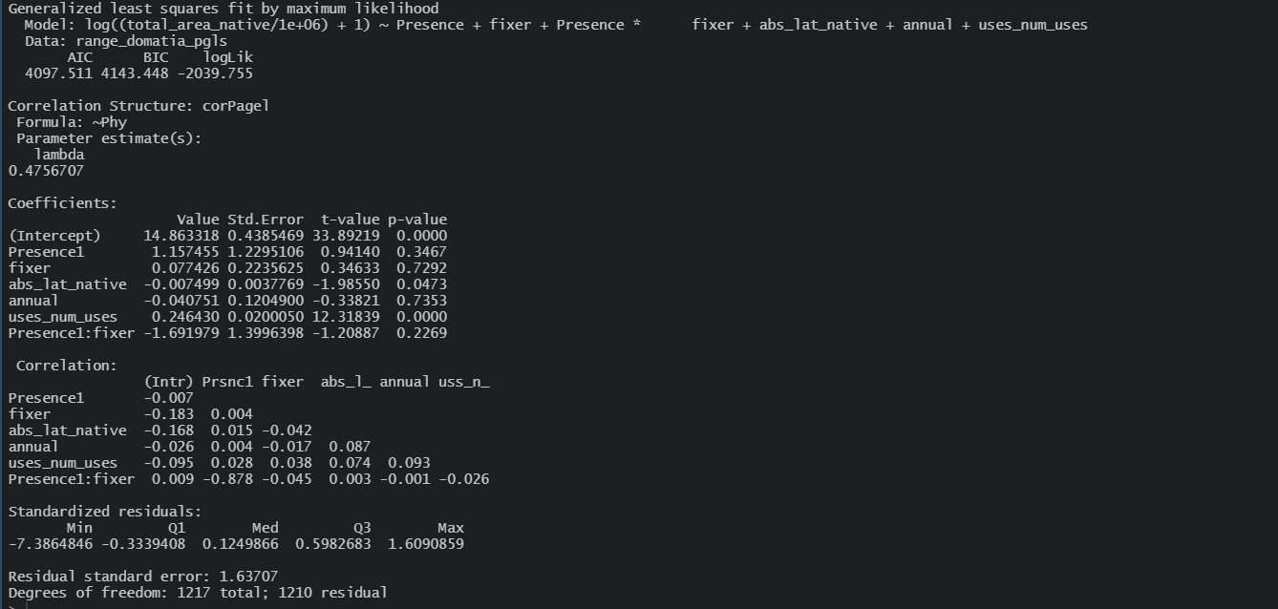

Slide 7
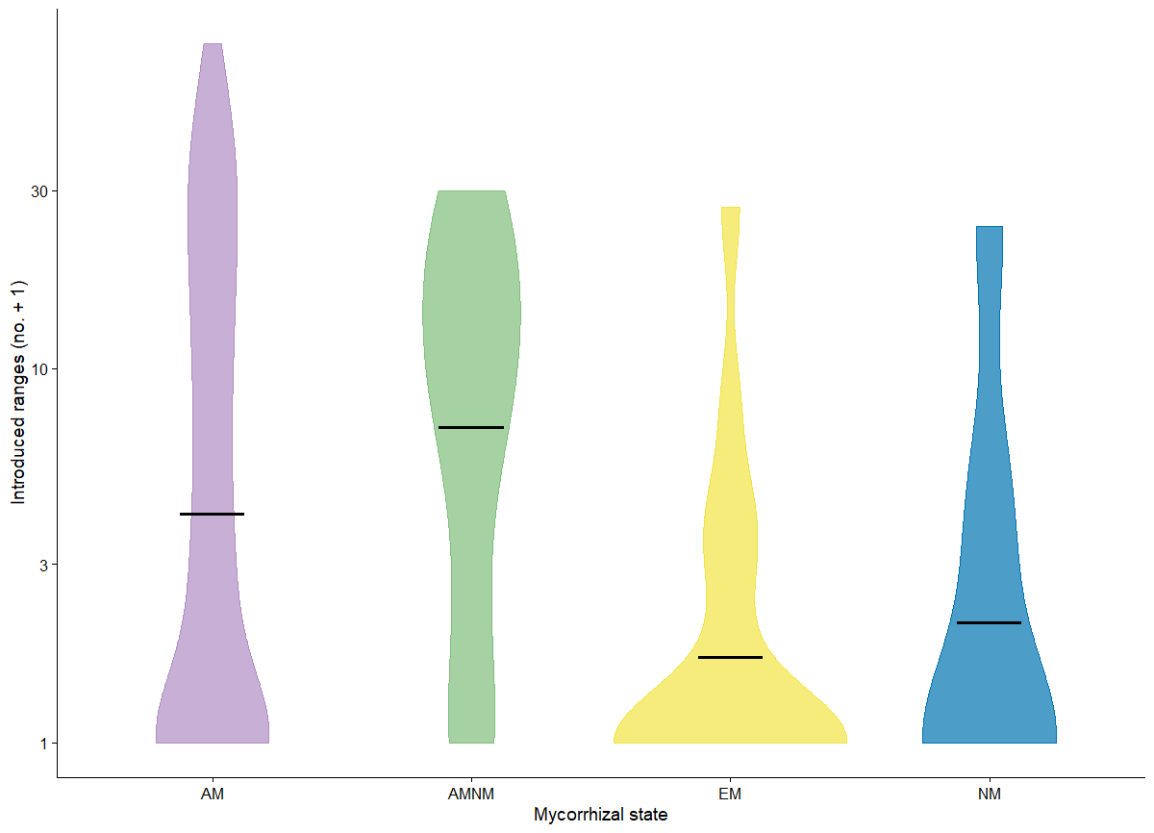

Slide 8
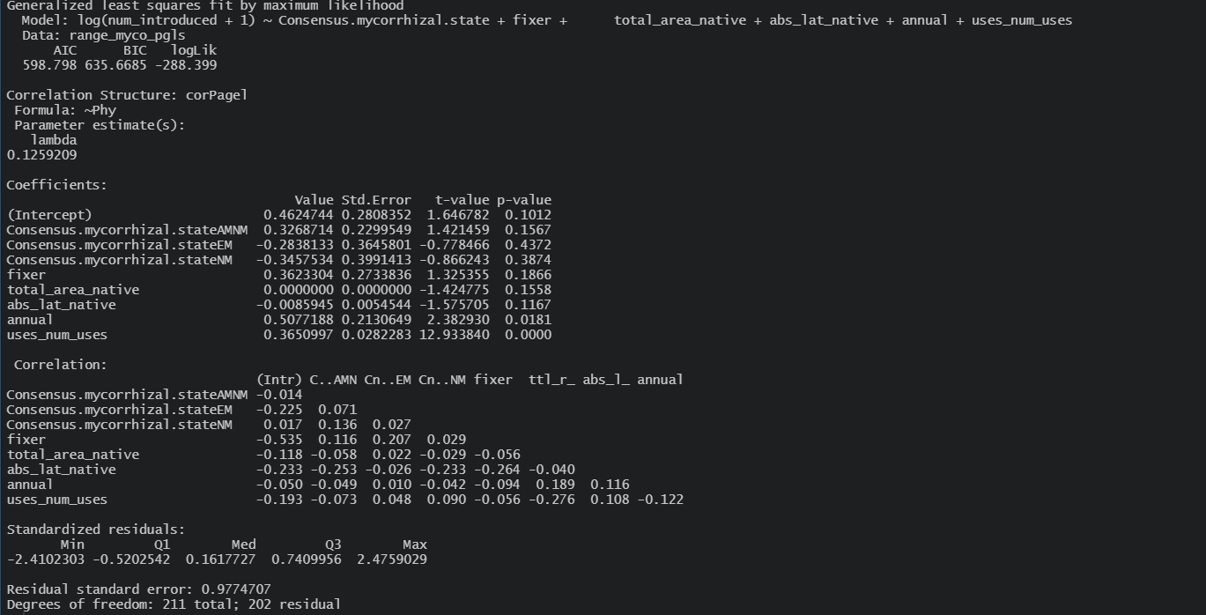

Slide 9
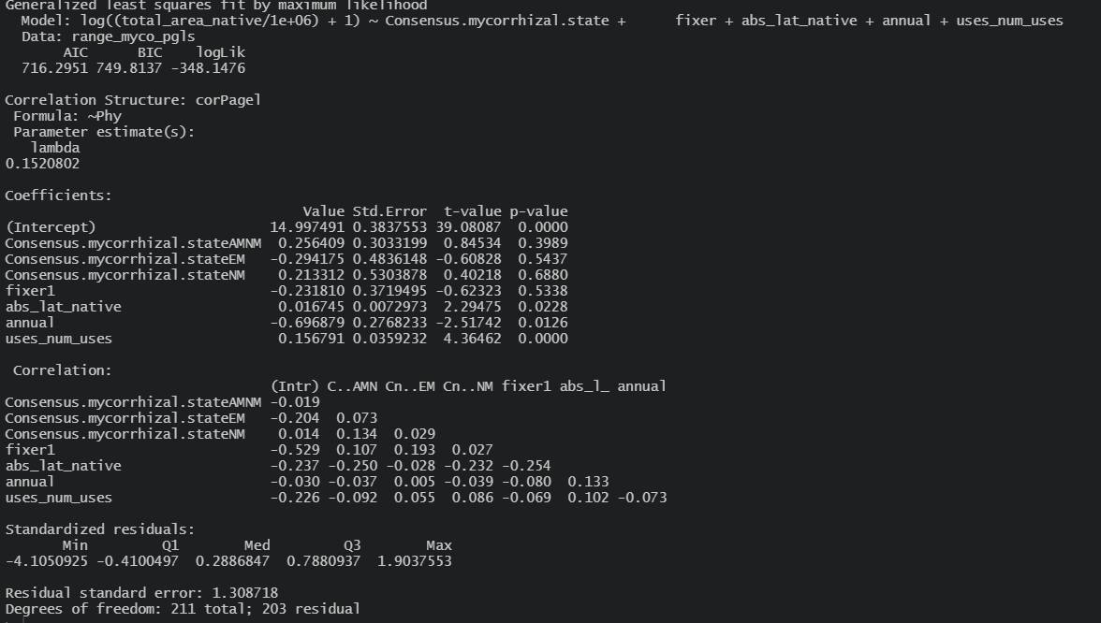

Slide 10
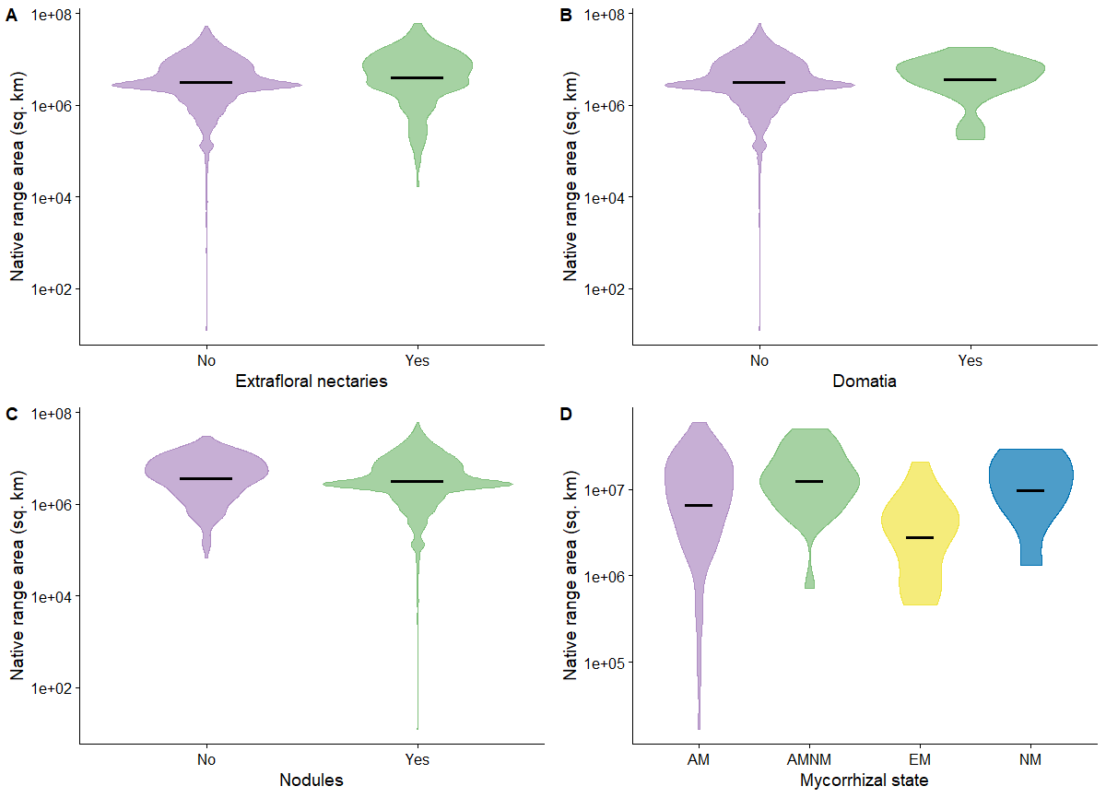

Slide 11
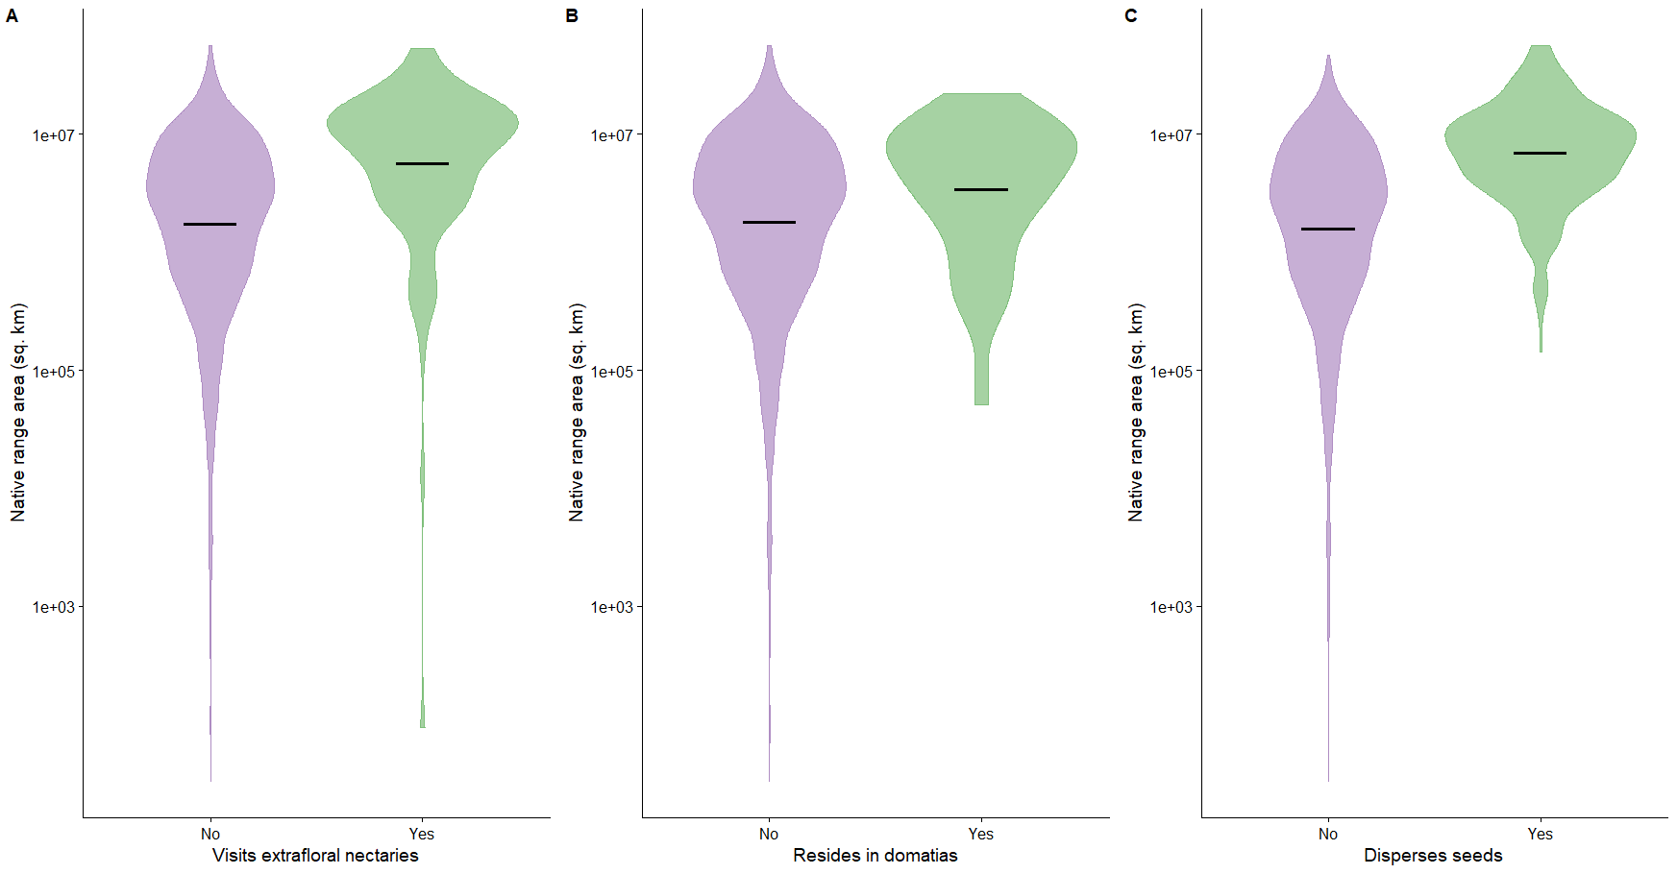

Slide 12
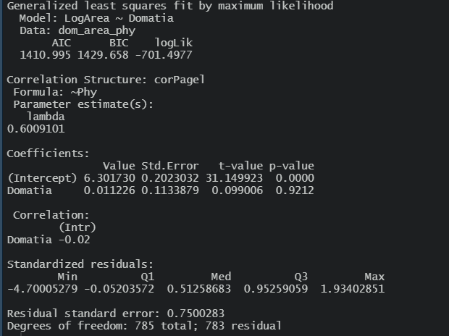
Native range – domatia – no effect

Slide 13
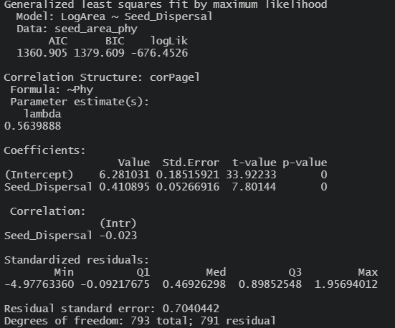
Native range – seed dispersal – positive effect

Slide 14
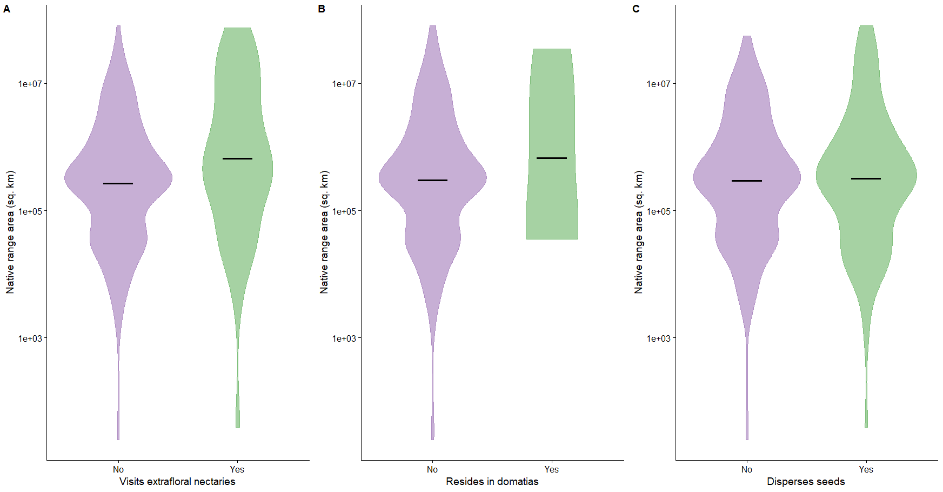

Slide 15
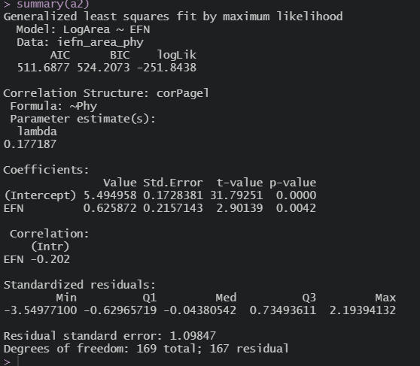
Introduced range – EFNs – positive effect

Slide 16
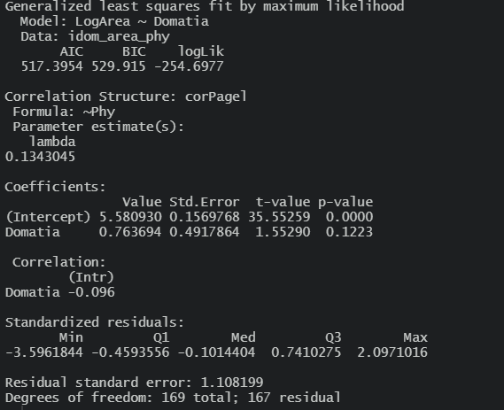
Introduced range – domatia – no effect

Slide 17
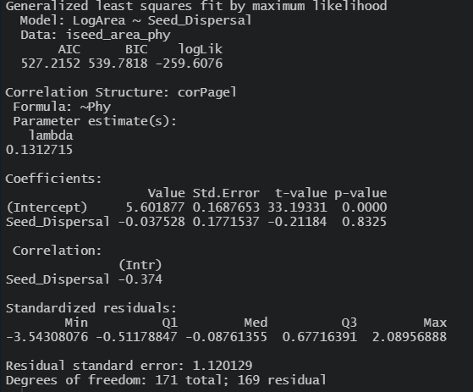
Introduced range – seed dispersal – no effect

Slide 18
Paper outline
Introduction: range size, generalization specialization and their costs and benefits
Discussion: Native vs. invaded range size differences, phylogenetic signal in plant and ant mutualisms, reciprocal effects in ant and plant partners, the role of specialization, human uses (legumes)

