Slide 1
PFPI 2026
WELCOME
Welcome to PFPI —
Pro Football Predictions, Incorporated
This is a quick walkthrough of the new site: how you'll get your weekly picks link, how to make your picks, and where to check the standings once games are final. No football or tech knowledge required — just follow along.
Takes about 5 minutes. By the end you'll know exactly what to expect each week and exactly what to click.
1 / 8

Slide 2
STEP 1
How you'll get your picks link
Each week, once that week's games are set, you'll get an email with a personal link — it's tied to your team, so it's yours and yours alone.
The link is good all week. You don't have to make every pick the moment the email arrives — open it, make a few picks, close it, come back later and finish. Your picks save automatically as you go.
The only thing that changes is that each individual game locks at its own deadline — usually shortly before that game kicks off. Once a game locks, you can no longer change that pick, but every other still-open game on the page is unaffected.
Bookmark or save the email — that link is how you'll always get back to your picks page for the week.
2 / 8

Slide 3
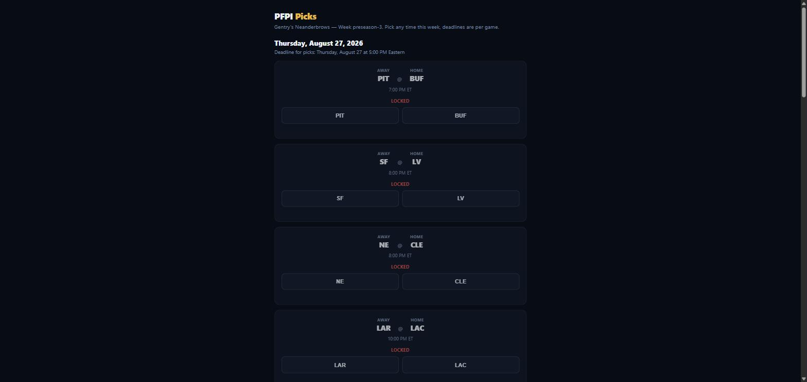
STEP 2
Making your picks
Your picks page lists the week's games grouped by day, with that day's deadline shown right above the games.
Each game shows two buttons — one for each team. Just tap the team you think will win. That's the whole action.
A game marked LOCKED has already passed its deadline and can no longer be changed — that's expected for older games, not an error.
The actual picks page — games grouped by date, deadline shown per day
3 / 8

Slide 4
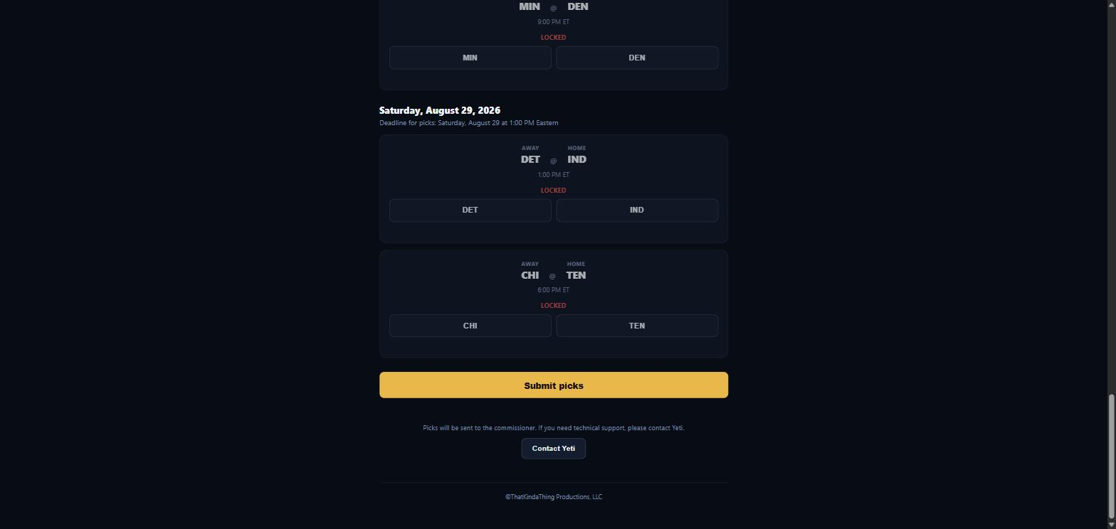
STEP 3 — DON'T SKIP THIS
Submitting your picks
Tapping a team button by itself does not finalize anything. It just saves that one pick. To actually send your picks in for the week, you need to press the Submit picks button at the bottom of the page.
Close-up
The Submit picks button, at the bottom of the page
Come back and press Submit again any time you change a pick — you can resubmit as many times as you like before each game locks.
4 / 8

Slide 5
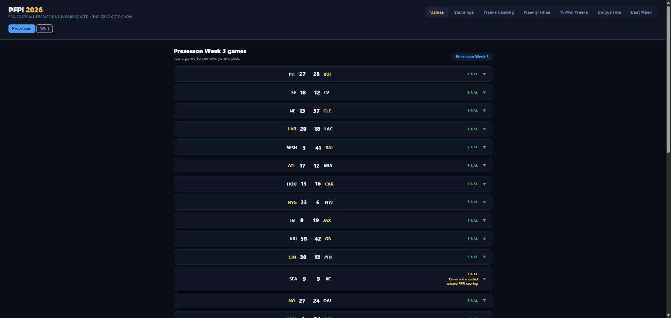
THE PUBLIC SITE
The Games tab
Anyone can visit the public PFPI site — no link or login needed. The Games tab shows that week's full schedule.
As games are played, scores fill in automatically. Once a game is FINAL, tapping it reveals what everyone in the family picked for that game.
The Games tab — schedule and scores for the week
5 / 8

Slide 6
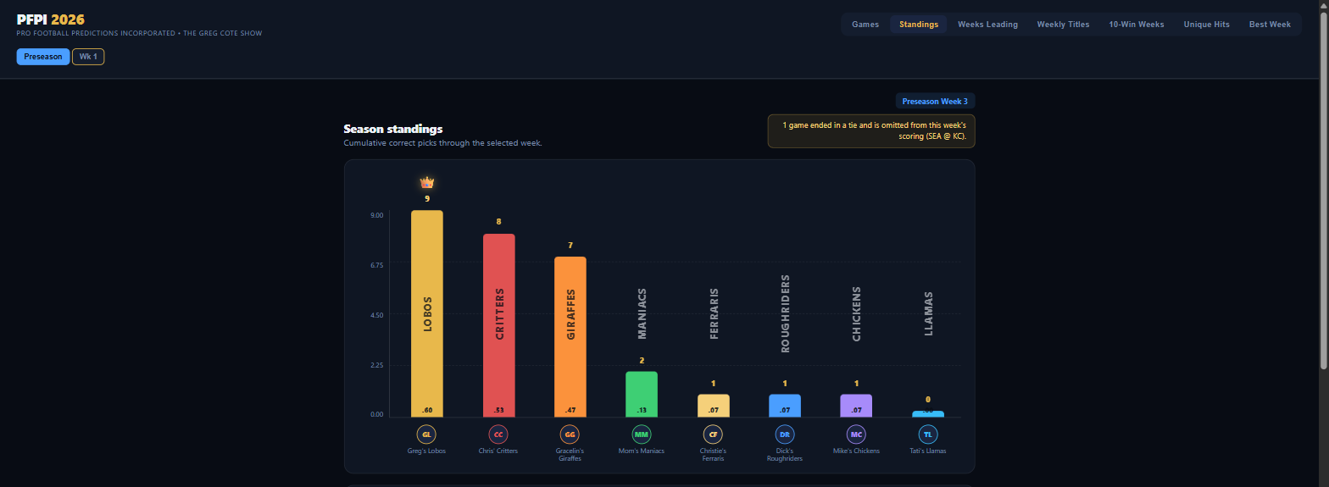
THE PUBLIC SITE
Standings & categories
The Standings tab shows a simple bar chart — one bar per team, tallest is in the lead. It's the fastest way to see where everyone stands.
There are a few other categories along the top too, in plain English:
The Standings tab — cumulative correct picks by team
Weeks Leading
How many weeks that team has been in first place.
Weekly Titles
How many individual weeks that team has actually won outright.
10-Win Weeks
How many weeks that team picked 10 or more games correctly.
Unique Hits
Correct picks nobody else in the family also got right.
Best Week
That team's single best-ever week, for bragging rights.
6 / 8

Slide 7
THE PUBLIC SITE
The Commissioner's Report
Each week, Greg writes up a short recap — his take on how the week went, who's rising, who's falling, and anything worth calling out.
You'll find it right on the main site, underneath the standings for that week. No separate link needed — it's just part of the page.
New report goes up most weeks once that week's games are final — check back after Sunday/Monday night football wraps up.
7 / 8

Slide 8
QUESTIONS?
Who to ask
TECHNICAL / SITE PROBLEMS
Yeti
yeti@yetiblanc.com
LEAGUE RULES / QUESTIONS
Greg
You've already got his contact info.
8 / 8

