Slide 1
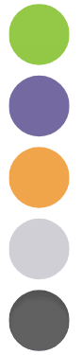
Orchestrations: Launch, Cancel, Kill
“Just Hire John Wick “ –B. Fahey
May 19 2026

Slide 2
Agenda
Templates
O4I
Insights
Orchestrate API

Slide 3
What Templates Are There?
What Can Run Away
Synch
O4I
Async
BP Triggered

Slide 4
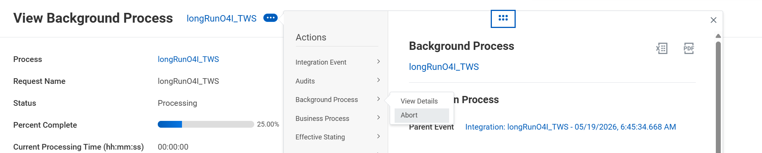
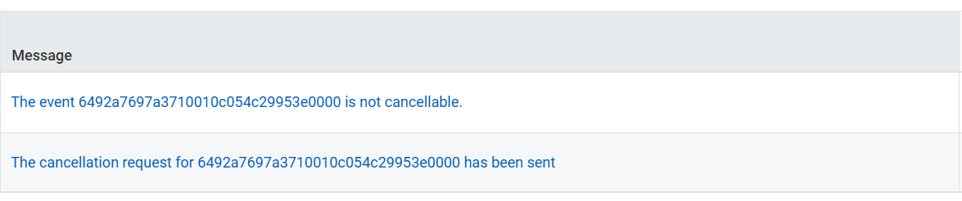
O4I Abort

Slide 5
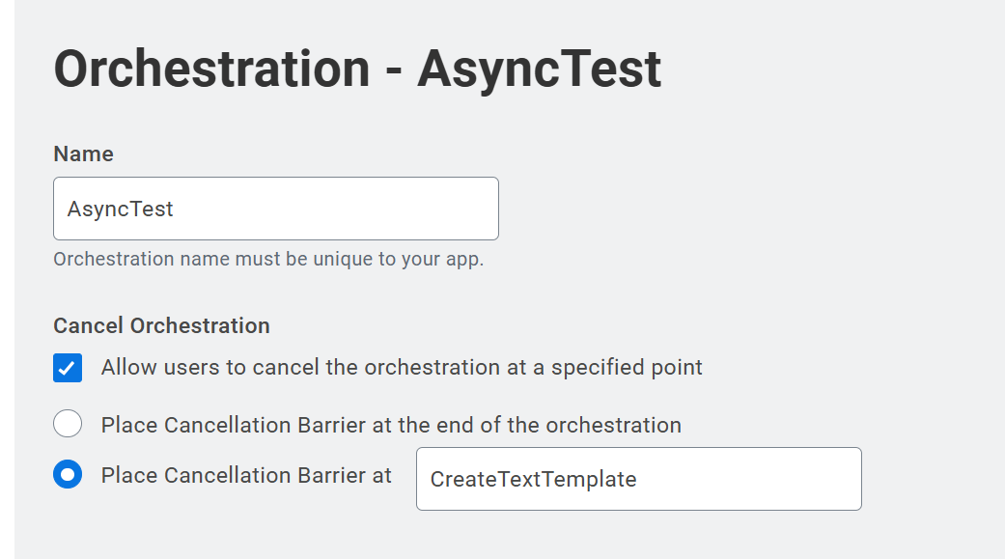
The Cancellation Barrier
Gives a Safe Stop for Cancel
How to decide where!

Slide 6
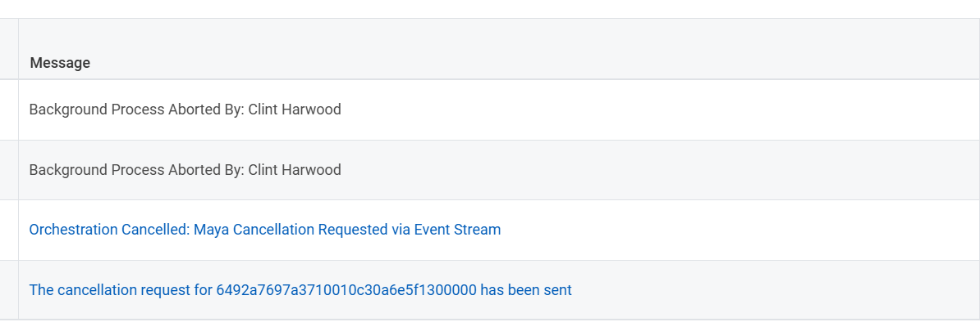
O4I Abort

Slide 7
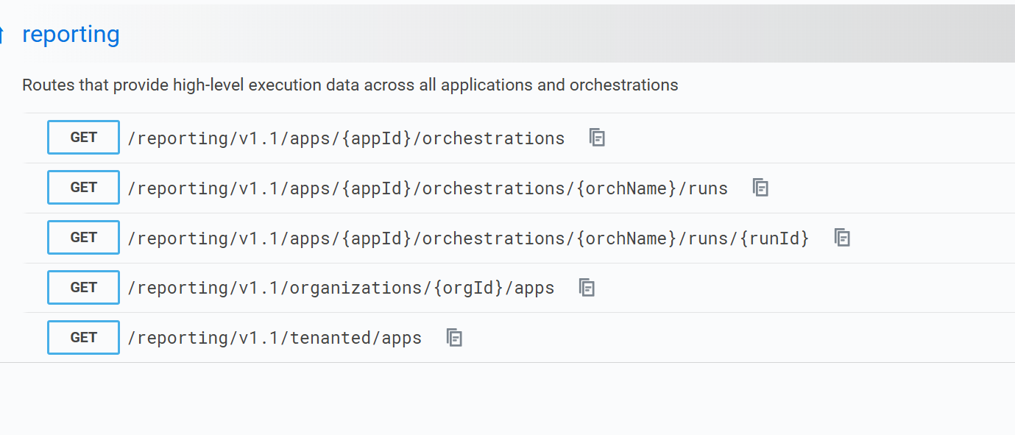
Orchestrate Insights API
Notes:
Recommended API Tester software
Postman
Bruno

Slide 8
Orchestrate Insights API
Recent Runs
Query the Logs
30 days
This Tenant
All Tenants
Notes:
Recommended API Tester software
Postman
Bruno

Slide 9
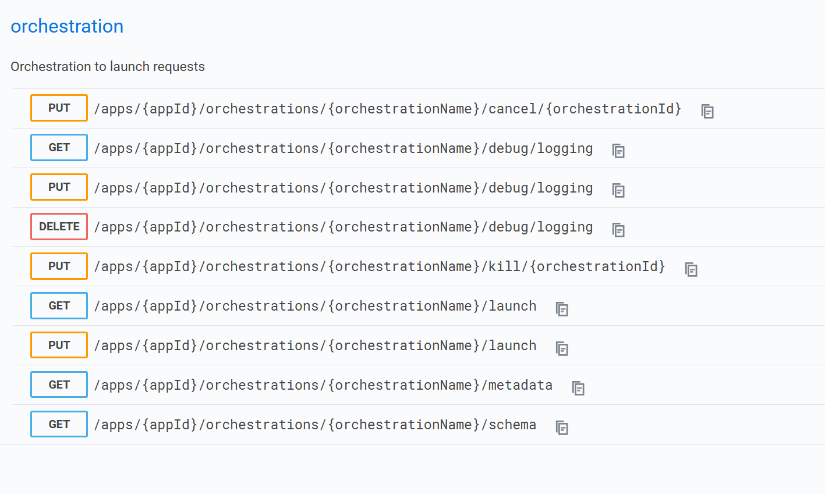
Orchestrate API

Slide 10
Security
Two types of Tokens
Tenanted
Developer Site (All Tenants)
Just need to be authenticated
Can Cancel an Orchestration you can’t launch
Lock down those Run IDs!
Notes:
Recommended API Tester software
Postman
Bruno

Slide 11
Cancel with a Put
/apps/{appID}/orchestrations/{orchestrationName}/cancel/{orchestrationId}
TENANTED Token
Use a Wrapper Orchestration

Slide 12
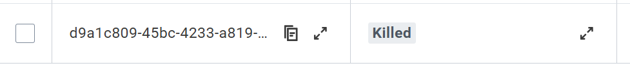
Kill with the UI
Ignores Cancellation Barrier
KILL_REQUESTED
Updates to KILLED

Slide 13
Kill with a PUT
Now Get out there and
Kill
Kill
Kill
(Read Dungeon Crawler Carl for the Reference)

Slide 14
Thank you.

