Slide 1
Wizard Session Document Generation
Talkin’ bout my (doc) generation

Slide 2
Agenda
What are the options?
BP Actions
Dude, where’s my document?

Slide 3
What are the options?

Slide 4
Document Generation Options
Create Document
✅ Fastest to build ❌ Very limited layout
Doc Templates
✅ Images + Grids
✅ Flexible for most use cases
BIRT
✅ Pixel-perfect layouts
❌ Most complex

Slide 5
BP Actions

Slide 6
BP Actions — Core Flow
Generate Document:
- Builds the document, allowing updates before review
Review Document:
- User preview, signing & download - Does not require Generate Document step

Slide 7
Dude, where’s my document?

Slide 8
Document Visibility Gotcha
Review Document are NOT stored in Worker Documents.
Fix:
Use an Orchestration + Document ID to attach it.

Slide 9
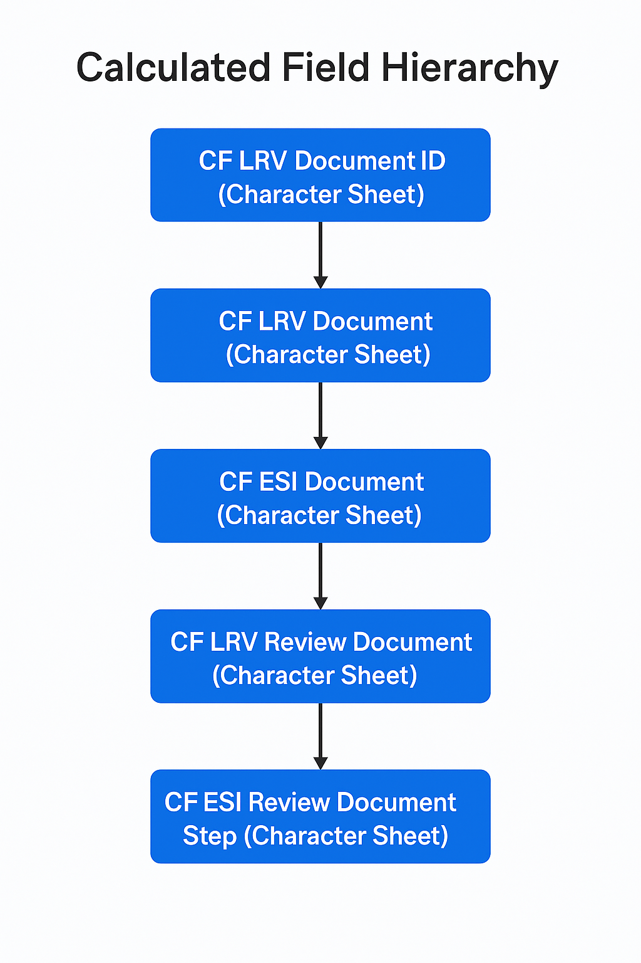
All the calc fields we need

Slide 10
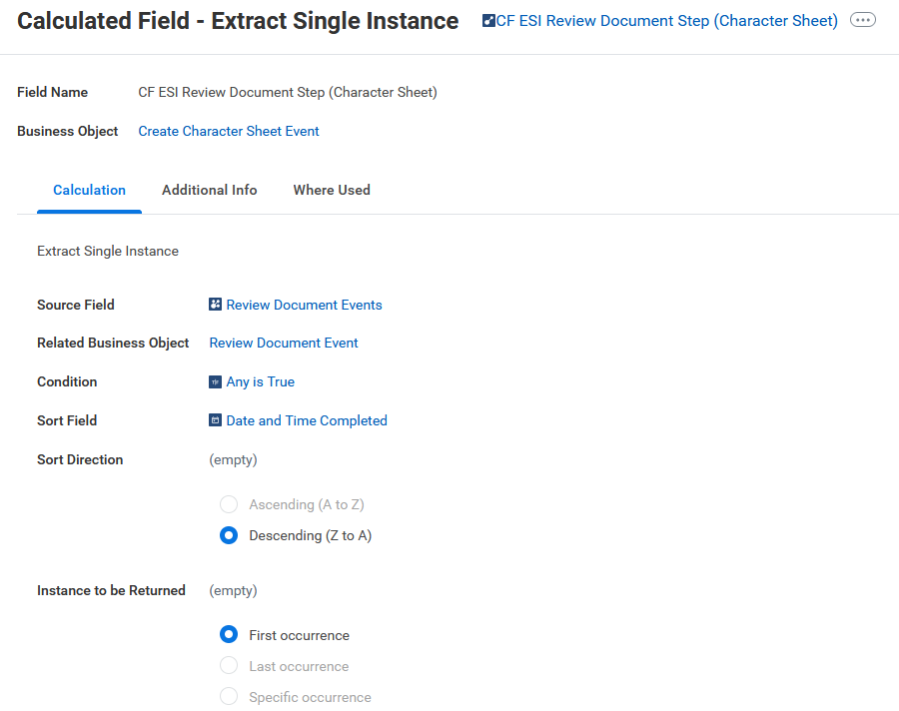
Extract the Review Document Event

Slide 11
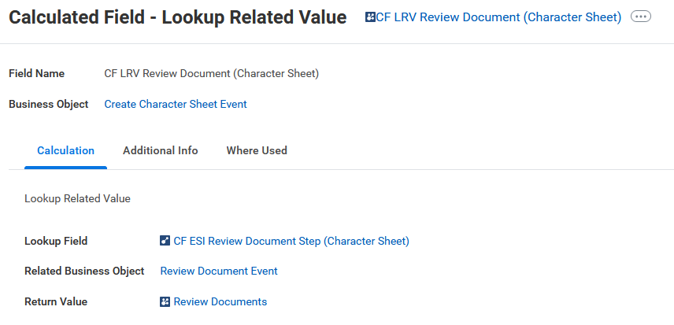
Extract the Review Documents

Slide 12
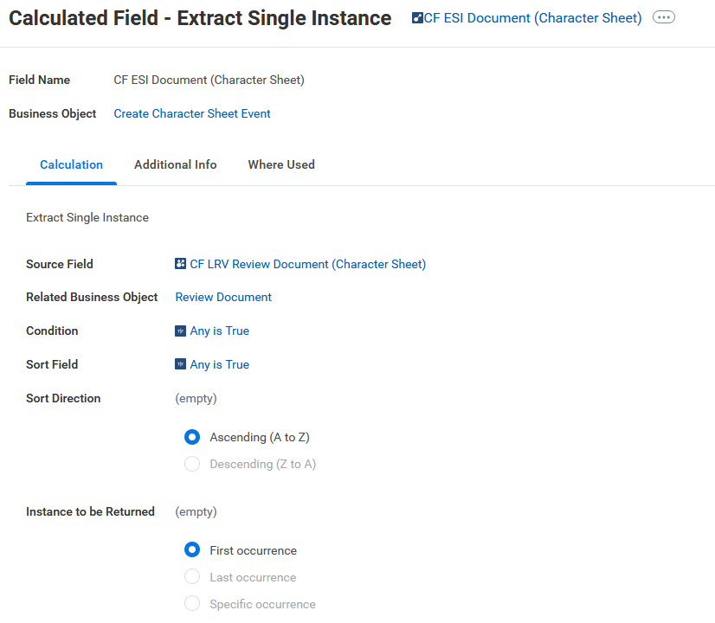
Extract the Most Recent Review Document

Slide 13
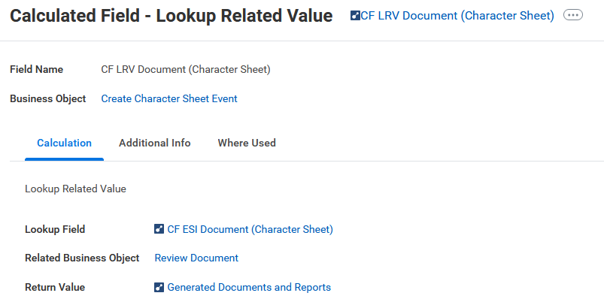
Extract the Generated Document

Slide 14
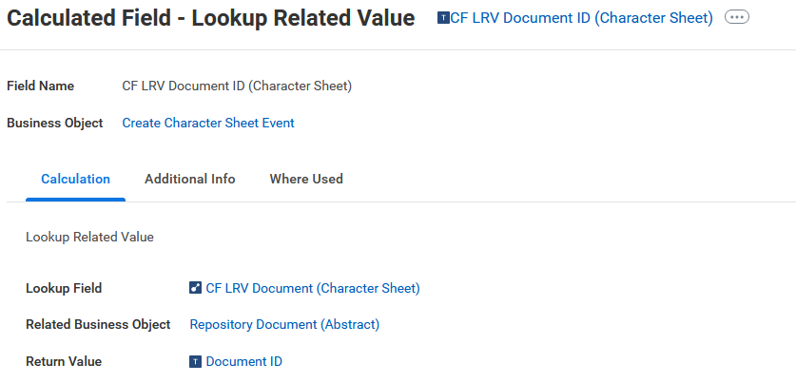
Extract the Document ID

Slide 15
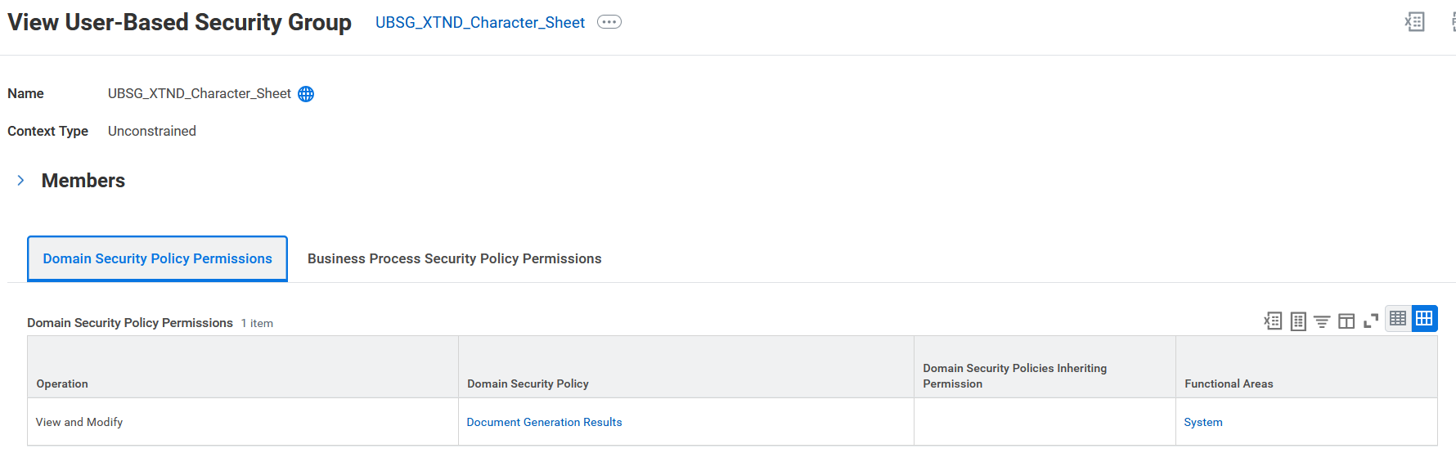
Security for ISSG (note the UBSG!)

Slide 16
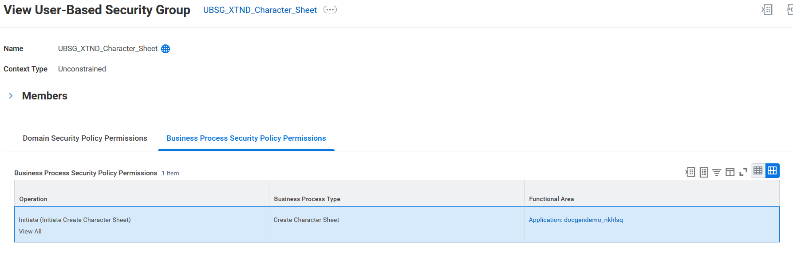
Security for ISSG (note the UBSG!)

