Slide 1
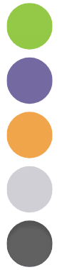
Page Performance Optimization
Beating the World Wide Wait
Jan 20 2026

Slide 2
Optimization Choices
Page Load Order
Inbound Data Performance
OnLoad and Scripting
Page Widget Performance

Slide 3
Page Load Order

Slide 4
Page Load Order
Endpoints
OnLoad
Widgets Load in Declaration Order
User Activities
OnSubmit
Outbound Endpoints

Slide 5
Inbound Data Performance

Slide 6
Data Is Usually The Problem
Too Much Data
"How can I show my user 1000 Rows?"
Push back on usability grounds

Slide 7
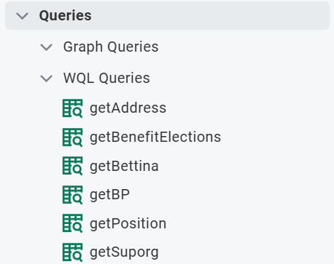
Parallel vs serial operations
Endpoints Assemble!
Endpoints will mostly go in parallel
Dependency can cause Sequential processing

Slide 8
Batch Protocol
Can batch up to 300+ calls
There is a KSS on this
Requires POST
Look for GET-POST Switcheroo in this KSS
Notes:
Recommended API Tester software
Postman
Bruno

Slide 9
OnLoad and Scripting

Slide 10
Nesting and Other Red Flags
Most common Memeroy Exceed is onload
Nested array functions
See this KSS

Slide 11
Page Widget Performance

Slide 12
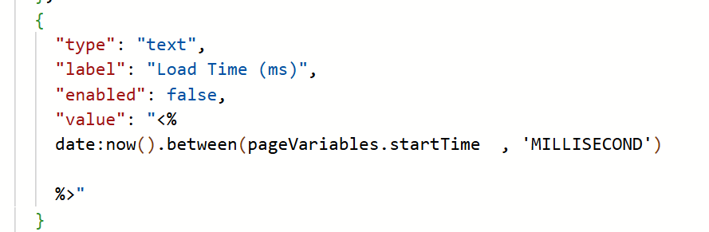
How To Time a Widget
Widgets load sequentially
Use a pageVariable to store a now()

Slide 13
Grids
Most likely widget to cause failure
"How can I show my user 1000 Rows?"
Pagination
Automated
Manual
View vs Edit

Slide 14
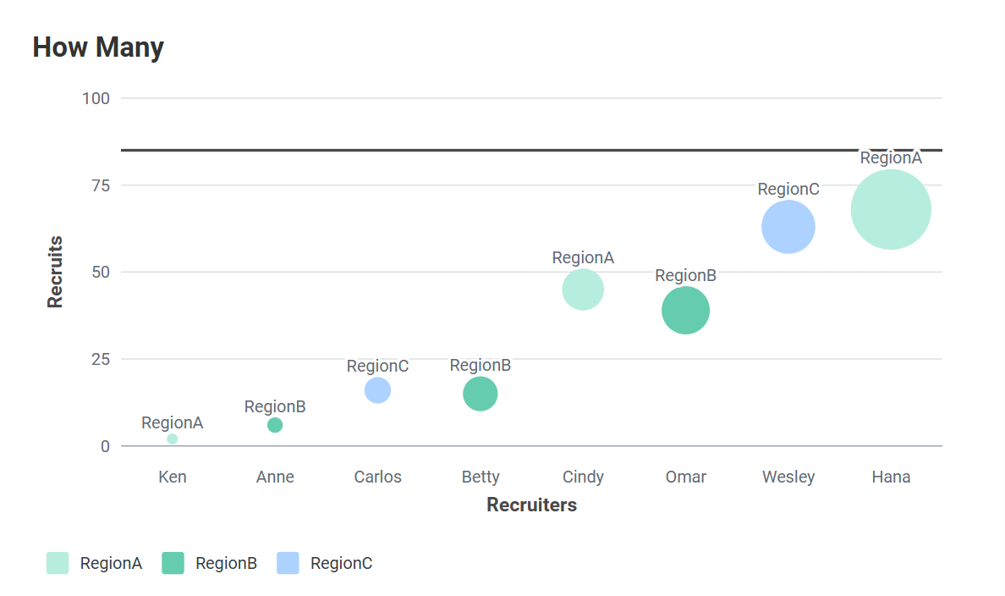
Images, Charts, and Other Myths
All slower than raw text, but not bad
Embedded Images render fast, but feel laggy
Chart Cards lazy load
Charts will mostly lazy load
Attachments will mostly lazy load

Slide 15
Thank you.

