Slide 1

2026R1 Feature Roundup
A Whole Herd of Cats!
Mar 17 2026

Slide 2
So. Many. Features.
New PMD Scripting Number Functions
OnFileAdd
Deep Linking Into Workday
New Join Loop UI
RichText Widget and AI

Slide 3
Number Functions
Min
Max
Format

Slide 4
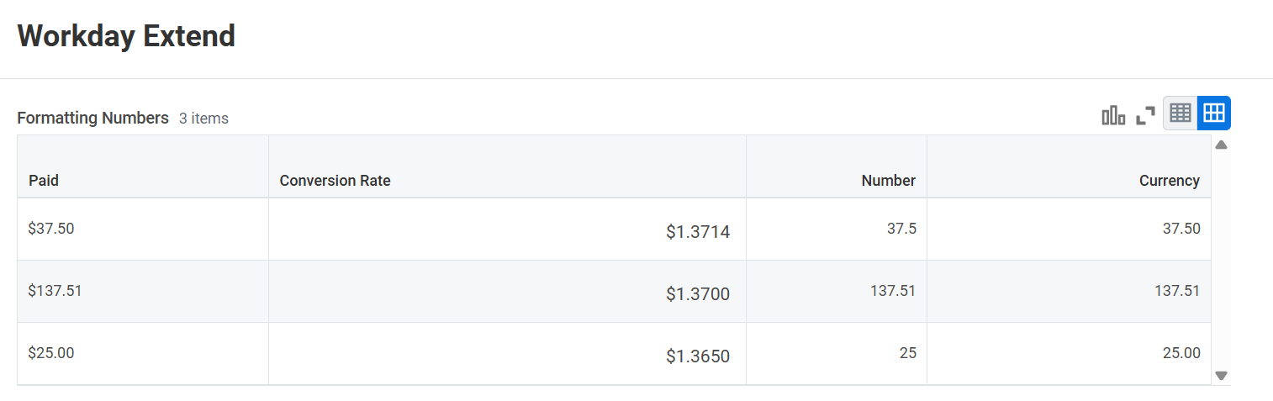

Slide 5
OnFileAdd

Slide 6
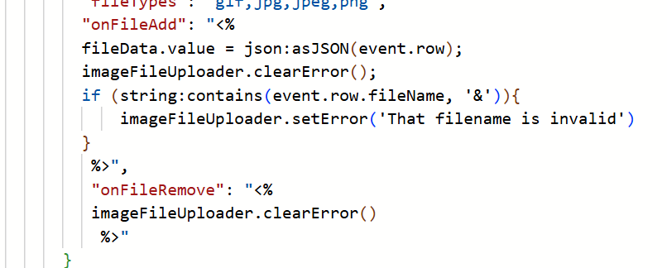
FileUploader
Anyone Else Remember Expression Language?
FileName and extension before Save
Huge improvement in User Experience
Notes:
Recommended API Tester software
Postman
Bruno

Slide 7
Deep Link

Slide 8
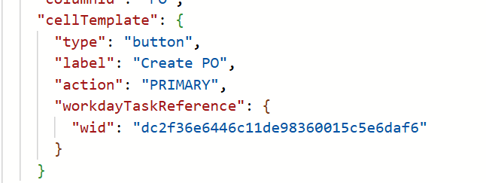
Link Into Core Workday
Buttons
Cards
No New Window

Slide 9
Join Loop

Slide 10
Join Loop UI
Original UI was a little confusing
Still a complicated tool
Primary
Streaming
Joining
In Memory Enriching
Notes:
All the developer tools are available within the Developer Console with the exception of the Workday Extend Plugin for IntelliJ
IntelliJ is a third-party software that is not commonly used anymore but does offer some utility for backing up code.

Slide 11
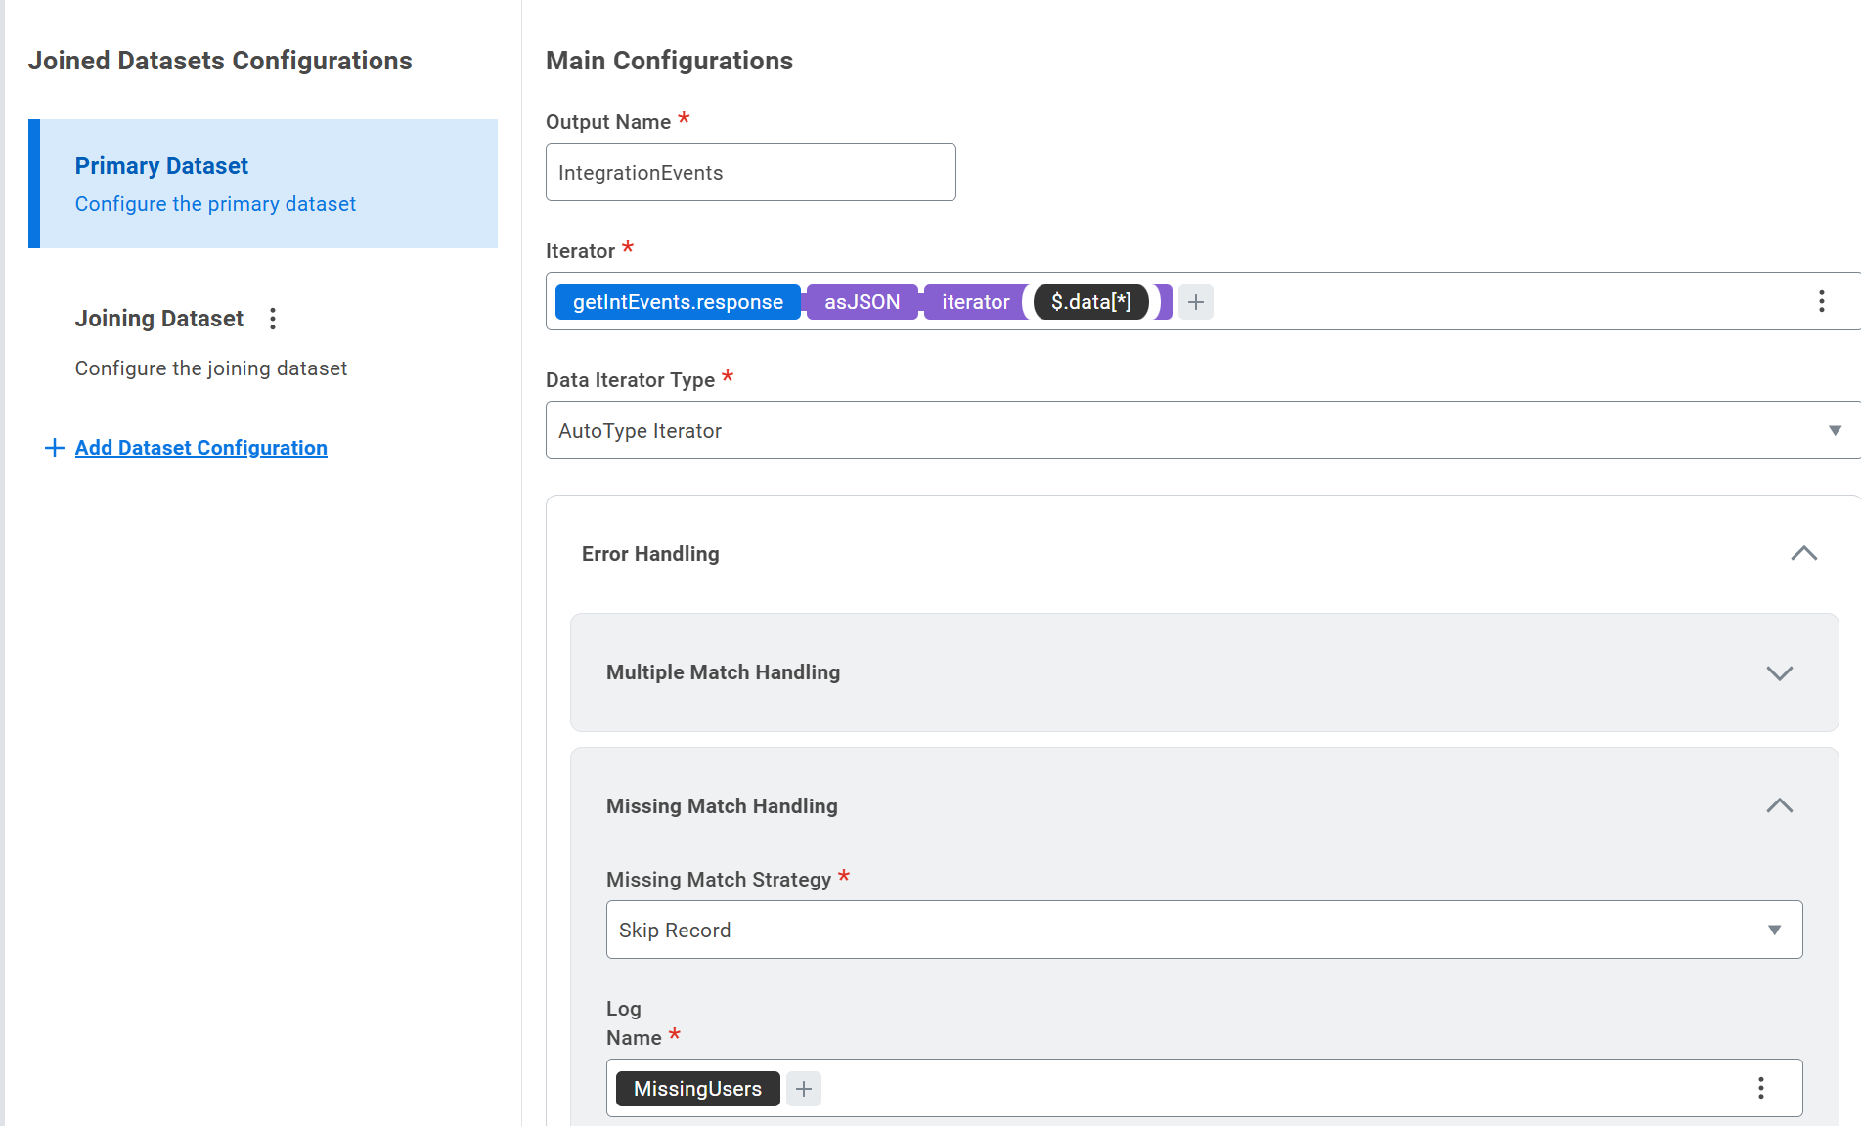
Join Loop

Slide 12
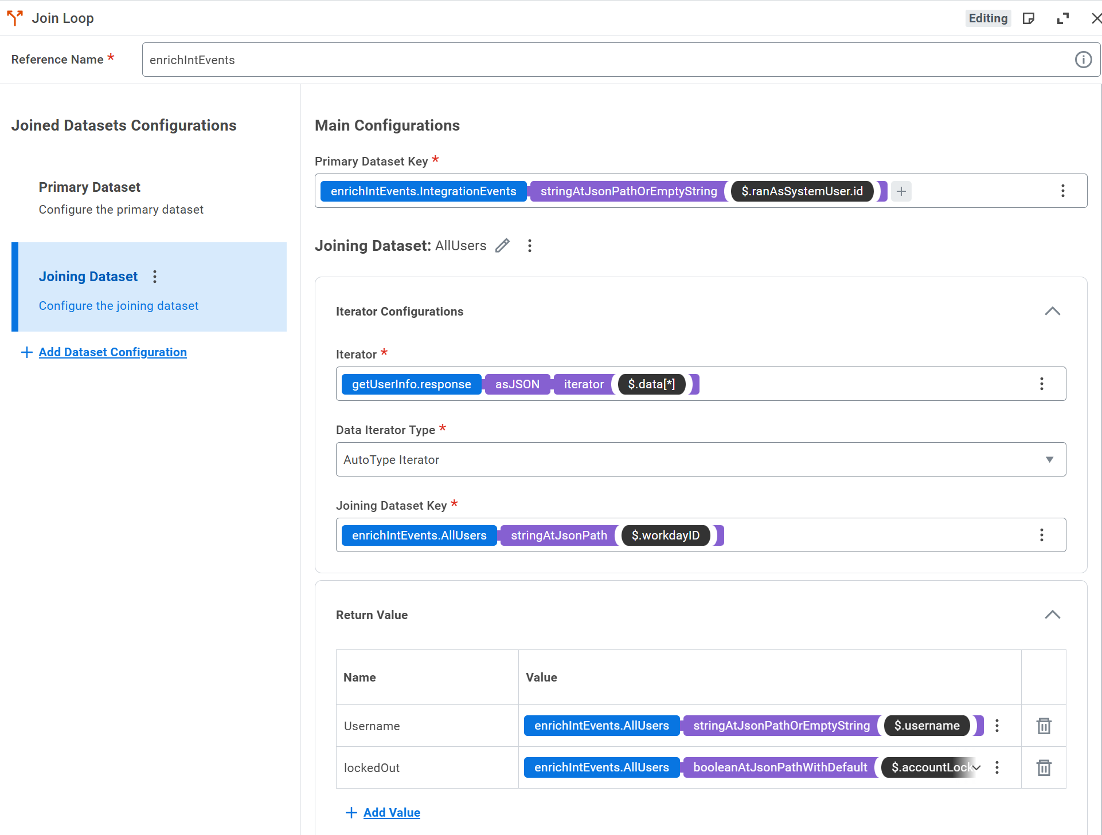
Join Loop

Slide 13
Rich Text and AI

Slide 14
Rich Text Widget
Nicely Formatted Text
Saw it in the number format

Slide 15
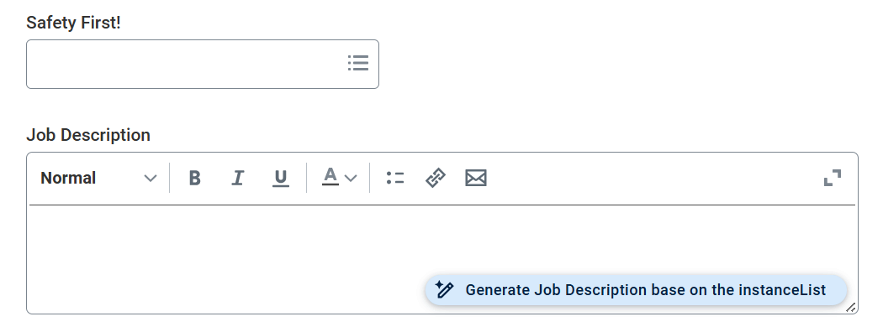
Generative AI
Add a Generative Prompt

Slide 16
Thank you.

