Slide 1
The Proposal
I sent a BP to Ryan Reynolds, he denied

Slide 2
BP Design Pattern Choices
Simple BP
Status Code Pattern
Current/Proposed

Slide 3
Keepin’ It Simple

Slide 4
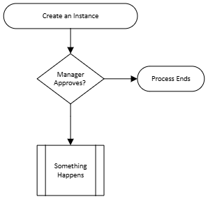
Easy To Set Up and Use
Create An Object
Create a BP against it
Often “Good Enough”

Slide 5
But There Are Some Troubles
Ongoing Changes
Update After Approve
Audit works

Slide 6
Status Codes

Slide 7
The Status Code Pattern
Build an object with a status code
Object has simple permissions
Status code has separate permissions
ISU to Update the Code only

Slide 8
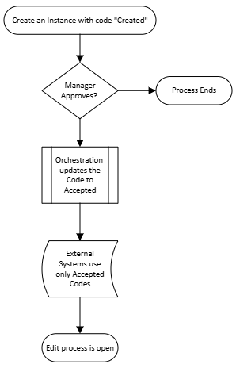
Already Covered in Depth
Look at the BP KSS from 2024
Fails are not as safe
More instances in the object

Slide 9
Current/Proposed

Slide 10
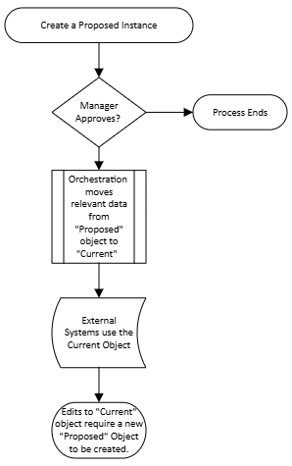
Current – Proposed Architecture
Build a Current Object
Build a Proposed Object
Proposed Object has simple permissions
Current Object is ISU driven
Modifications

Slide 11
Security Setup
Current Object
Everyone Gets View
ISU gets Modify
Proposed Object
Everyone gets Modify
Be careful of Context
Keep ISU access close

