Slide 1
THE HELIX PROPHETS
I'm Not Saying You're Obligated to Explore This Castle, But...

Slide 2

2-D Sidescroller with RPG Elements
Class system – mage, rogue, fighter
Mainly a platform challenge.
Concluding each level is a boss.

Slide 3

Player has lost identity and travels through a field and a castle to recover it. Player meets multiple enemies along the way and must navigate through the dangerous environment to complete the game.

Slide 4

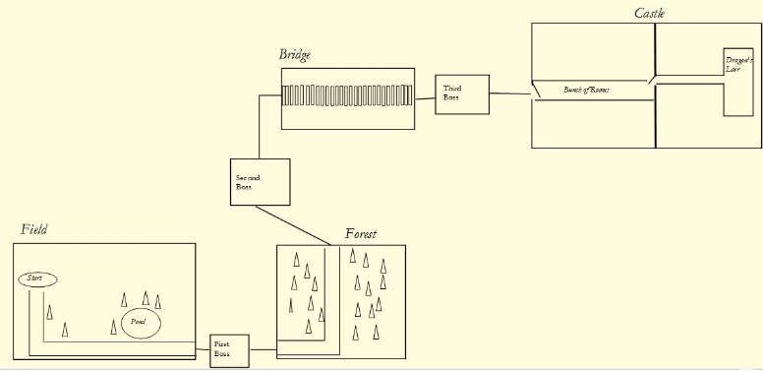

Slide 5


Slide 6

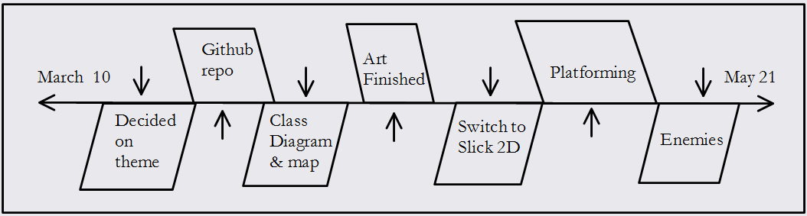

Slide 7

Slick 2D (Lwjgl with OpenGl)
Dyn4J
LOTS of threading

Slide 8

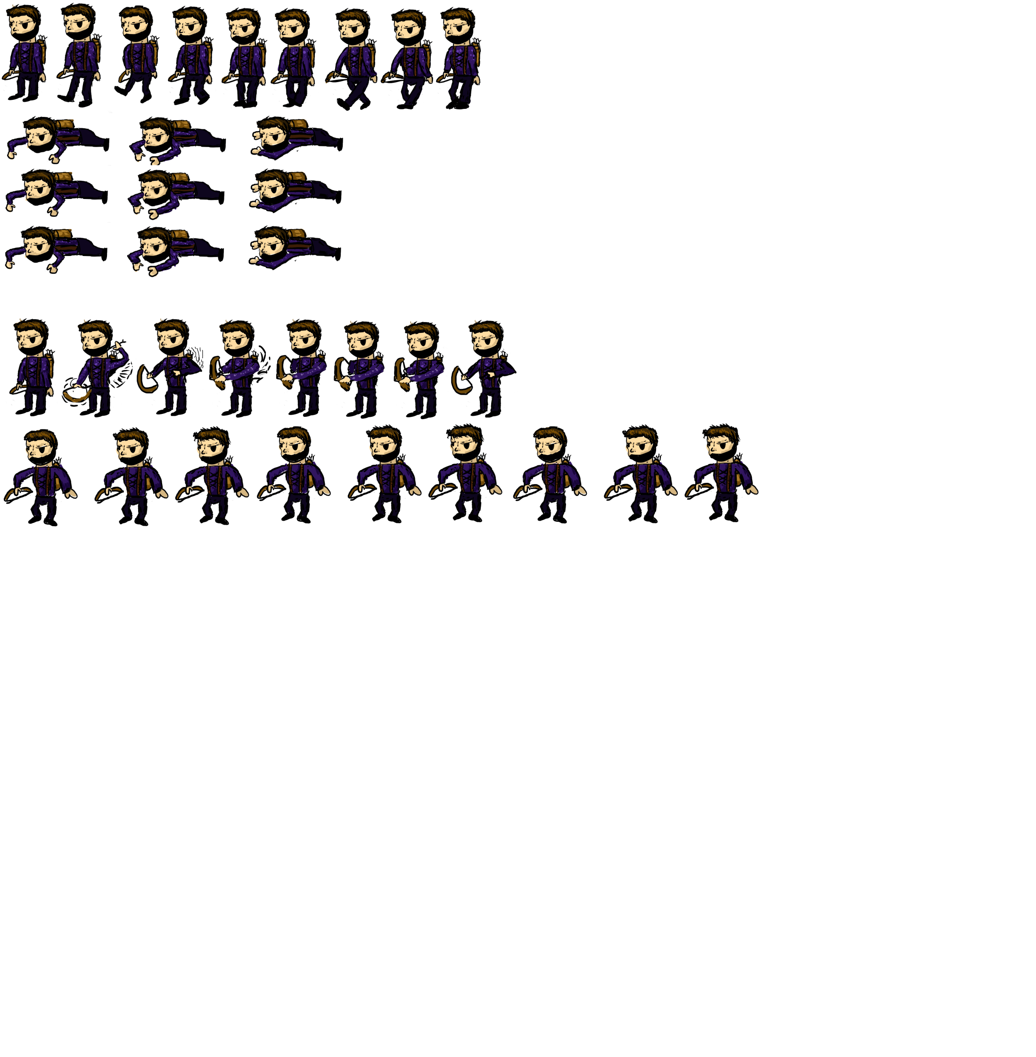

Slide 9


Slide 10

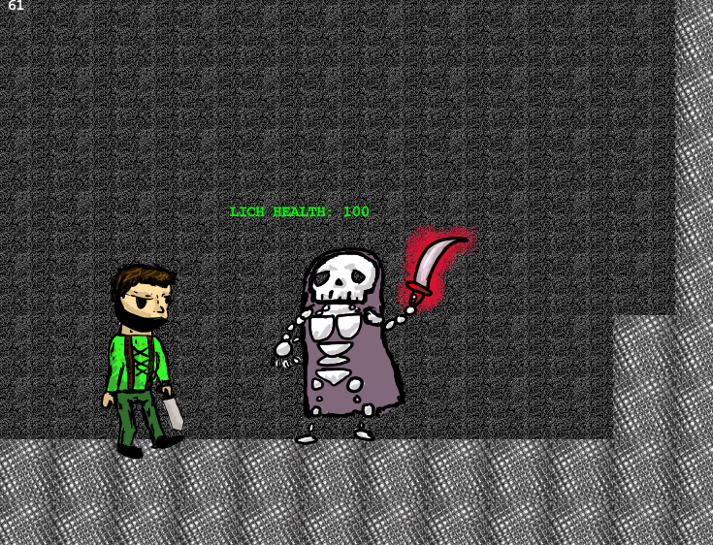

Slide 11

Rogue
Mage
Fighter
Lich
Cockatrice

Slide 12

Communication – Google Hangout and GitHub
Making a working product – iterative design
Working with the libraries – constant Googling and searching through documentation, trial and error. Made switch to slick 2D

Slide 13

Matt Brandy
Gustave Michelle
Logan Simpson
Travis Evans
Luke Hebert
Zachary Burke

