Slide 1
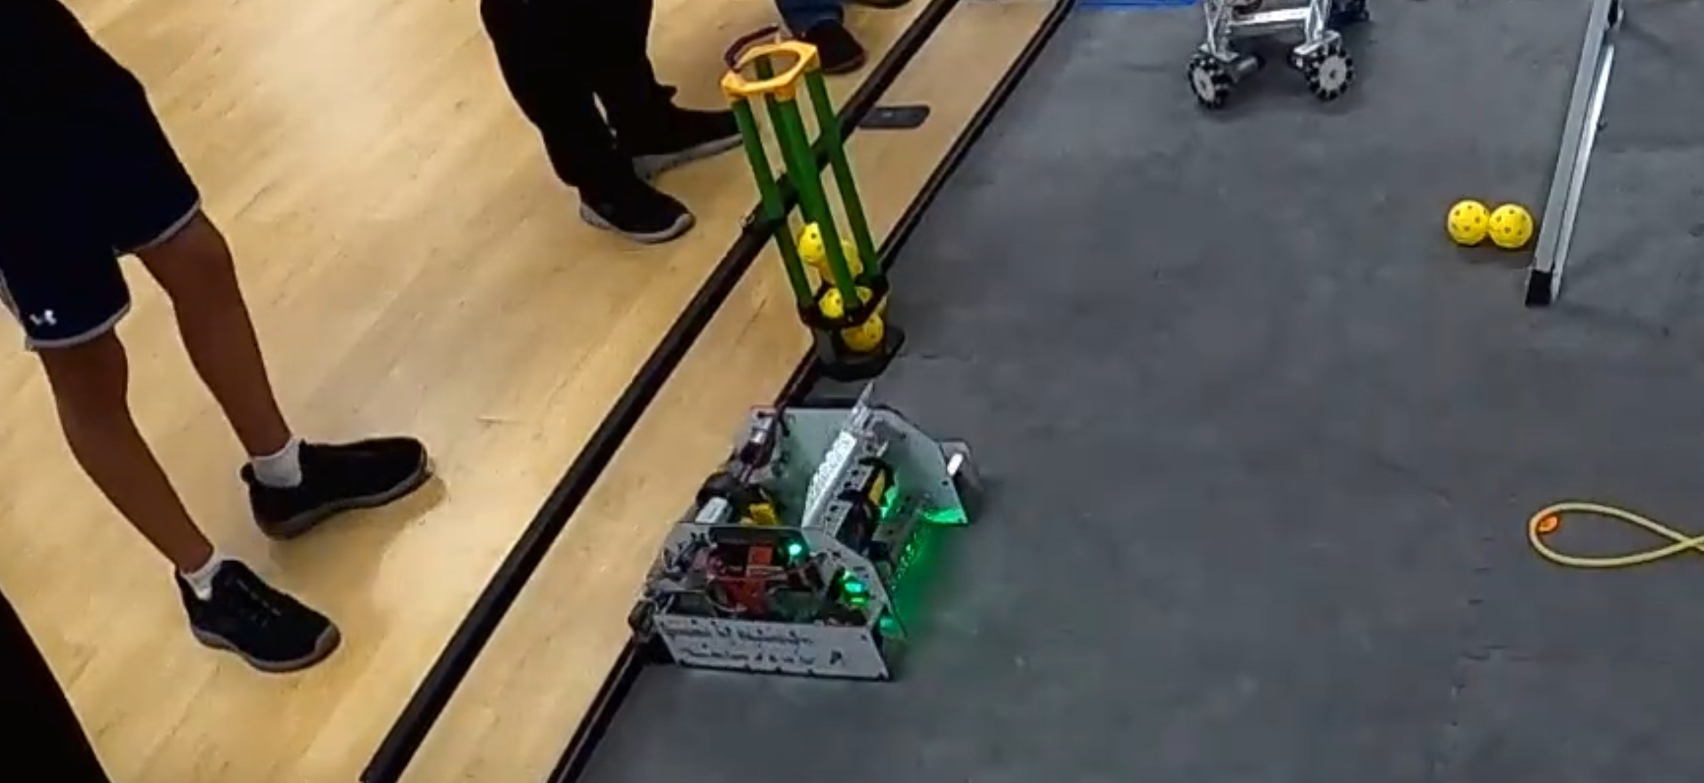

Describe your robot.
Let AI write the code.
Test. Repeat.
What The Hive learned watching our mentors code a robot in one week with Gemini in Android Studio — and how your team can do it too.
The Hive · FTC 3747 · Beehive Academy
Notes:
On screen while people sit down. No talking needed.

Slide 2
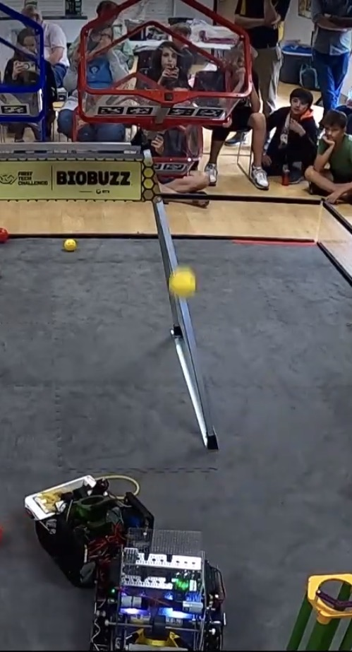
Who we are, and what this is
1
We're The Hive, FTC 3747. This year our students built and coded our robot by hand. No AI.
2
Our mentors entered the mentor competition with a separate robot, and ran an experiment on it: no hand-written Java. Everything described to Gemini.
3
We watched both. This is what the experiment showed, what we'd do with it, and how you can use it.
The mentor robot in a match
Notes:
Say every line plainly; this room suspects mentors do our work. Line 1: our students hand-coded our robot this year — no AI. Line 2: the AI experiment was the mentors', on a separate robot, for the mentor competition. Line 3: we're here to hand over what it showed. Don't argue the rumor; state the facts and move on.

Slide 3
The problem every team has
1
⏳
?
Most teams have 1 programmer.
Every mechanical change waits
The mechanical people know what the robot should do.
Sometimes 0.
on that one person.
They just can't type it in Java.
Notes:
Ask for a show of hands: "How many teams have exactly one person who can write Java?" Then: "How many of those people are also the coach?" Let it land. This is the pain the method solves. If you want, say which of us is the one programmer on The Hive.

Slide 4
The programmer doesn't go away. The job changes.
Before anyone else touches it
After every change
Describe the robot — every motor and servo, name, port, direction.
Architect it — subsystems, state machines, what the autonomous will need later.
Set the process — one change per prompt, test, commit.
That groundwork is what lets a mechanical teammate make a change in English and have it land in the right place.
Review what the AI did — and catch drift.
On the mentor robot: the autonomous that drove the intake through a fake gamepad. The D-pad that ended up doing two things — slow mode and flywheel tuning — instead of one.
Both worked. Both were wrong. Only a programmer reading the code saw it.
The programmer gets the big picture back: “What do I want vision to do?” instead of “How do I parse the Limelight result?”
Notes:
This is the answer to 'AI replaces the programmer' — it doesn't; it moves them up. The programmer does the prep that makes the mechanical teammate's English land: the description, the architecture, the process. Then they review every change for drift — the two real examples are on the slide, both from the mentor robot, both verbatim in the transcript: the autonomous that drove the intake through a simulated gamepad because nobody said an autonomous was coming, and the D-pad that was doing slow mode and flywheel tuning at once ('I thought gamepad 1 dpad was slow mode, not tuning the flywheel'). What the programmer gets back is the big picture: on our robot, adding one autonomous state was 10–20 minutes of copying boilerplate. That time becomes 'what do I want vision to do,' not 'how do I parse the Limelight result.'

Slide 5
AI can shrink your skills. Or multiply them.
−17%
+19%
50 vs 67
on the exam
longer, not shorter
comprehension score
PNAS 2025 · about 1,000 high-school students (math), randomized. Plain ChatGPT: practice +48%, unassisted exam −17%. A hints-only tutor “largely mitigated” the harm.
METR 2025 · 16 expert maintainers on their own code, 246 tasks. With AI they took 19% longer — and believed they'd been 20% faster.
Anthropic, Jan 2026 · their own tool, their own study (not peer-reviewed). 52 mostly-junior engineers: AI group understood less, finished ~2 min faster. Delegating hurt; asking questions didn't.
The difference is how you use it. Delegate and auto-accept: you lose understanding. Ask, read the diff, explain it: you don't. That's our rule — next slide.
Notes:
Say this before they do. These are three of the strongest negative results, including the vendor's own, and all three fit our position. PNAS 2025: about 1,000 high-school students, math, randomized; plain ChatGPT made practice 48% better and the unassisted exam 17% worse; a hints-only tutor 'largely mitigated' the harm. METR 2025: 16 expert open-source maintainers on their own repos, 246 real tasks; with AI they were 19% slower and believed they'd been 20% faster — the group that gains least couldn't even perceive it. Anthropic Jan 2026: their own tool, their own study, vendor-authored and not peer-reviewed, found harm against their own interest — 52 mostly-junior engineers learning a new library, AI group 50% vs 67% on comprehension, only about 2 minutes faster; 'delegation' hurt, asking conceptual questions didn't. What separates the harm studies from the no-harm studies is HOW the tool was used — delegate and auto-accept vs ask, read the diff, explain it. That is our rule on the next slide. If someone brings up MIT 'Your Brain on ChatGPT': essays, 18 people, criticized stats — don't lean on it either way.

Slide 6
Our rule: no AI until you can debug without it
14
chapters of Learn Java for FTC, by hand — read, type, do the exercise
“Do not use AI to help you on these assignments. We will probably use AI during the season. However, if you do not understand the basics of programming taught here, you will not be able to debug the code during the season. And, it becomes painfully obvious if you use AI because you cannot answer how your program works.”
40
FTCSIM exercises — Intro, Movement, Sensors, Puzzles, Grabby
0
AI until the mentor has checked every box, in order
then
AI as a season tool — and you still explain the code
— The Hive, 2026 Programming Training Checklist
Same rule as AP Computer Science Principles: “students must be prepared to explain their code in detail.” (College Board) Same rule as FTC judging: students answer; adults may only observe.
Fundamentals first, then AI. We think that's how you get the speed without losing the understanding.
Notes:
This is our onboarding checklist, verbatim. Read the whole quote out loud; it is the skeptics' own position, already in our program. Before a Hive programmer is cleared, the mentor checks off, in order, 14 of the first 15 chapters of Learn Java for FTC — the book has 25; section 9, analog sensors, is skipped, and 16–25 are extra credit, each read-and-code plus the exercise, typed into our own simulator with a real test harness — then 40 FTCSIM exercises. Then, and only then, AI as a season tool. Say 'we think' on the link between this and the studies: nobody has tested the sequence; it is our reading of them. College Board already requires the same thing for AP CS: students must be prepared to explain their code in detail. And at FTC judging the students answer — an adult may attend but may not interact or coach — so a team that can't explain its code loses the Control Award whether or not AI wrote it.

Slide 7
Seventy years of “that's not real programming”
1954
FORTRAN
“the strength of the skepticism about ‘automatic programming’… as it existed in 1954” — John Backus, who led the FORTRAN team, writing in 1978
1983
Pascal
“Real Programmers use FORTRAN. Quiche Eaters use PASCAL.” — Ed Post
2005
IDE autocomplete
“And I think it's making us dumber.” — Charles Petzold, on IntelliSense
2017
Stack Overflow
15.4% of 1.3 M Android apps contained security-related code copied from Stack Overflow; 97.9% of those had an insecure snippet — Fischer et al., IEEE S&P
2026
AI coding
Gemini drove our mentors' autonomous through a fake gamepad. It worked. A human reading the code caught it.
Every layer took the typing. None took the architecture, the testing, or the reading. — “the hard part of building software [is] the specification, design, and testing of this conceptual construct, not the labor of representing it.” Fred Brooks, 1987
Notes:
Most new layers of programming tools were called a crutch by the generation before — in the sources we found there's no named 1954 skeptic, only Backus remembering them, so say 'most', not 'every'. Each layer took over the typing; none took over deciding what to build, testing it, or reading what came out. Brooks said it in 1987. Fowler's honest limit (2025): this layer is non-deterministic — the same prompt doesn't give the same code twice — so reading and testing matter MORE than before, not less. Then tell the fake-gamepad story: Gemini drove our mentors' autonomous through a simulated gamepad because nobody said an autonomous was coming. It worked. A human reading the code caught it. That's the whole slide in one bug. Sources are in docs/research-ai-skills-case.md, slide 1 table.

Slide 8
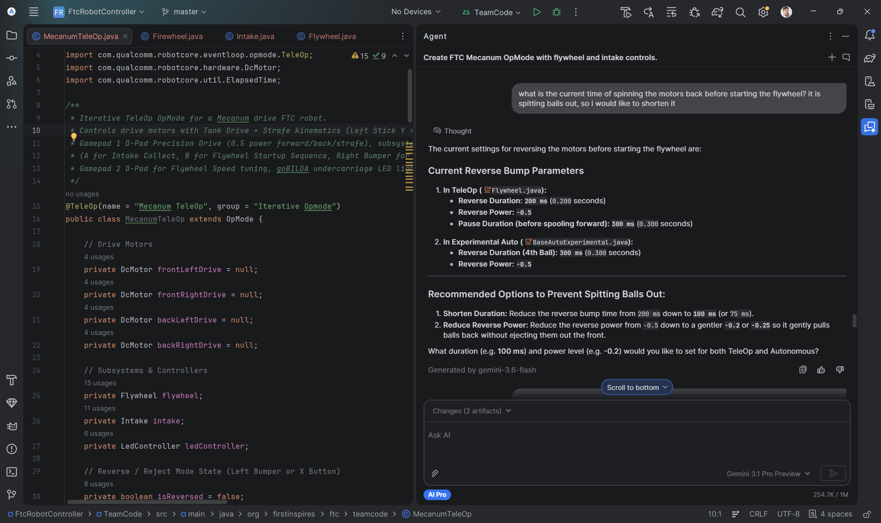
What the mentors did — the week
Sep 17, 10:26 PM
Ben (coordinator) describes the whole robot → working TeleOp that night, subsystem classes (25 minutes, 5 prompts)
Sep 18, ~9:50 PM
First autonomous state machines, Shoot First / Shoot Delayed — Asim's design, called out at the robot, typed by Ben
Sep 19, 8:29 AM
Asim (mechanical), at the keyboard: “holding both joysticks left made the robot strafe right, and vice versa. please fix”
8:36 AM
“it is spitting balls out, so i would like to shorten it” — reverse bump 200 → 100 ms
8:40 AM
“we get points for not touching the wall. Can we add a backup after the turn and drive forward?”
11:35 AM
“I thought gamepad 1 dpad was slow mode, not tuning the flywheel.”
Sep 19, 8:36 AM, as typed — and Gemini's reply: it reports the numbers (200 ms at −0.5, 300 ms pause), offers two options, then changes both at once. The next prompt put the power back.
11:37 AM
“I don't want the intake to resume. I want the intake to stop (whether it was stopped or running).”
2:57 PM
“Let's set the default speed to 0.95” — default changed from 1.0
67 prompts, two days and an evening. 0 lines of Java typed.
Scrimmage
Autonomous scored; TeleOp drove.
Notes:
Tell this as a story, not a list. Be precise about who did what, because coaches will ask: Ben described the architecture on night one and built the TeleOp out over the first two days — the shooter startup sequence, the pulsed feed, the LEDs. The first autonomous was Asim's design, called out at the robot while Ben typed, and from there it was a pair — Asim deciding what to change, Ben typing — plus eight prompts Asim typed himself: tank drive, the strafe fix, the spitting-balls pair, a whole experimental autonomous with three rounds of tuning. The point for the room: the person who understands the robot drives the prompt, whoever's hands are on the keys. Two things make the experiment honest, and say both: Ben CAN write Java, so choosing to describe instead of type was a choice; Asim can't, and made most of the changes anyway. The quotes are verbatim, typos and all. The screenshot is the 'spitting balls out' prompt exactly as typed, with Gemini's answer. If there's time, play docs/video/scrimmage-match3-auto.mp4 from the laptop here.

Slide 9
“I've written Java for twenty-five years. I didn't type a line of it. After the first build, the changes came from the mechanical mentors — sometimes typed by them, sometimes called out from over the robot while I typed. They don't write Java.”
— Ben, our coordinator
Notes:
Put it up and let it sit for a few seconds. Then: the person who understands the robot drives the prompt, whoever's hands are on the keys.

Slide 10
Hand-coding vs. architecting with AI
Our robot — hand-coded by us
Mentor robot — described to Gemini
3 of us could code it: Tom, Sophi, Sadiqah. Siloed — Tom wrote TeleOp, Sophi wrote autonomous
2 people wrote prompts — one writes Java, one doesn't
4 days of coding
67 prompts over two days and an evening; working TeleOp the first night
A borrowed sample autonomous only powered two wheels — the other two were braking. Tom saw the robot crawl in morning testing, then had to read Sophi's code cold to find why
Mechanical mentor fixed strafe, flywheel bump and controls — in English, no Java
Programmer codes while the mechanical teammate waits; often one programmer does it all and kludges around mechanical problems. One new autonomous state: 10–20 minutes of boilerplate
Firewheel transfer servos came out Sep 18 (reported 7:50 PM); code reworked that night by describing the new design
Each of us understood our own file. Nobody could summarize the other's
Someone still has to read what Gemini wrote — the Reader role
The bottleneck moved: from “who can type Java” to “who can describe the robot precisely.”
Notes:
This is the slide that's ours, and the left column is our real week. Four days of coding, three of us who could code the robot, and we were siloed: Tom wrote TeleOp, Sophi wrote autonomous. The bug: an autonomous borrowed from the FtcRobotController samples only powered two wheels, and the other two were set to brake at zero power — so the robot crawled. Tom saw it in testing the morning of the competition, then had to read Sophi's code cold, without knowing what she had done, to find why. Say the thing we'd do differently: AI could have given Tom a summary of the autonomous and he could have questioned it to find the bug. The grunt work: adding one state to the autonomous meant copying the same surrounding code again — 10 to 20 minutes for a new programmer, every time. Our process: the programmer works while a mechanical teammate waits, then sets up the robot and both watch the test; mechanical problems get fixed if quick or go on the to-do list; often it's one programmer doing all of it and kludging around mechanical problems in code. The honest comparison is not 'AI was faster': it's where the bottleneck was. On our robot every change went through whoever could type Java. On the mentor robot the bottleneck moved to describing precisely — and that's a skill the mechanical people already had. The right column is from the mentor transcript: the Sep 17 session was 25 minutes and 5 prompts, then the 18th and the 19th.

Slide 11
The method: describe → generate → test → refine
DESCRIBE
GENERATE
TEST
REFINE
“The intake is a motor named ‘intake’ plus two CR servos. A toggles collect at 0.5 power…”
Gemini writes or edits the OpMode
Deploy to the robot. Try it.
“it is spitting balls out, so i would like to shorten it”
…and back to GENERATE
The skill you build is DESCRIBE and REFINE: names, directions, timing, order.
Notes:
The loop is the whole workshop. Every checkpoint in the guide is one trip around it. The skill you build is DESCRIBE and REFINE: being specific about names, directions, timing and order.

Slide 12
The checkpoints — one trip around the loop each
0
Install Android Studio + FtcRobotController, sign in to Gemini
5
Refine: the mechanical mentor's four real prompts
1
Describe the robot: names, ports, purposes, directions
6
Auto v1: back off the wall and shoot → test
2
Mecanum drive → test
7
Auto v2: Shoot First / Shoot Delayed, which parks → test
3
Intake → test
8
Auto v3: under 30 seconds, keep the LEAVE points → test
4
Shooter: flywheel startup sequence + pulsed feed → test
9
Extras: LEDs, endgame rumble, the 4-ball experiment
github.com/The-Hive-3747/Teaching-AI-Coding — a guide page and a video per checkpoint
Notes:
Point out that 'test' comes after every step. The single biggest mistake is asking for everything at once. Small steps mean when something breaks, you know which description caused it. There's a guide page and a video per checkpoint — show the repo URL.

Slide 13
What a good description has
1
Names
exactly as in the Robot Controller config: front_left_drive, not “the front left motor”
2
Purpose
what the part does for the robot
3
Direction
which way is “forward”; which motors are mounted mirrored
4
Control
which button or stick; toggle or hold; what happens on release
5
Timing and order
what has to happen before what, and for how long
Anything you leave out, Gemini guesses.
Notes:
Read these out. Names: exactly as in the Robot Controller config — 'front_left_drive', not 'the front left motor'. If Gemini has to guess any of the five, it will, and the guess is where the bug comes from.

Slide 14
Vague vs. specific
Vague
Specific
“One motor named flywheel, reversed. Pressing B runs the flywheel and intake backward at −0.5 for 200 ms to clear a jammed ball, stops everything for 300 ms, then runs the flywheel forward at full power and keeps it there. Pressing B again stops it. While it's running and right bumper is held, pulse the intake 100 ms on at 0.5, 200 ms off, so balls feed one at a time.”
“Add a shooter.”
Which motor? Which way? Which button? Toggle or hold? What happens first?
Real — Sep 19 session, verbatim
“When I start up the flywheel, I want the process to continue to do the reverse function. But then I don't want the intake to resume. I want the intake to stop (whether it was stopped or running). Does that make sense?”
No code words. A sequence. A few lines changed in Intake.java.
Notes:
Read the vague one and ask the room what Gemini would have to guess. Then the specific one: everything it would have guessed is now stated. The third one is verbatim from the Sep 19 session — no code words at all, it describes a sequence — and that's why the fix was a few lines in Intake.java. This is the slide for the mechanical kids in the room.

Slide 15
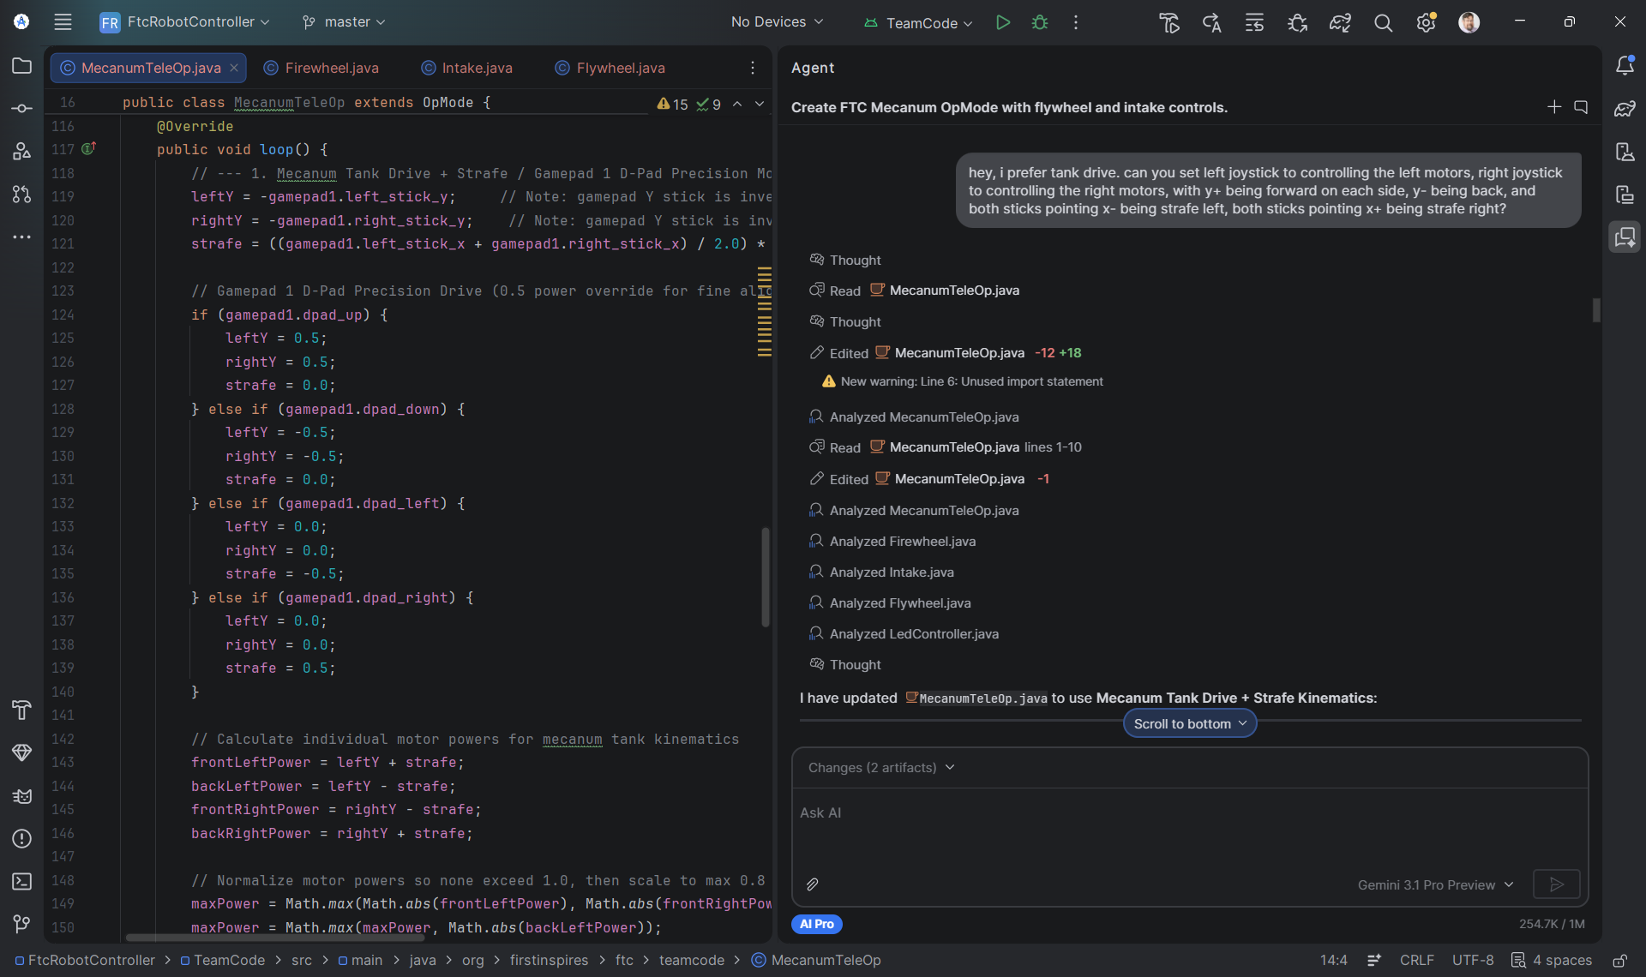
Now watch it happen
The mentors' tank-drive prompt, as typed, and the code it produced. You're about to see the same thing live.
Description already sent
Drive prompt, live
Read the code: names match
Build, deploy, drive
Refine: the real strafe fix
Deploy, drive again
Notes:
Switch to Android Studio. One of you drives the laptop, one narrates, one handles the robot. 1) Show the Gemini panel with the robot description already there. 2) Type the mecanum drive prompt live and send it; narrate what you asked for while it generates. 3) Show the generated OpMode — point at the hardware names, they match the config. 4) Build, deploy, drive. 5) Type the real refinement: "hey, in the latest push, holding both joysticks left made the robot strafe right, and vice versa. please fix" — deploy, drive again. 6) Stop there: "That's the whole method. Everything else is more trips around the loop." If it breaks, that's the method too: say what you see, paste the error into the panel, let the room watch the refine step. Don't apologize — a live fix is a better demo than a clean run.

Slide 16
Where it goes wrong — and the fix
Symptom | Cause | Fix
Won't compile: “cannot find symbol” | Gemini invented a name | Paste the error back: “Fix this compile error”
Strafe is mirrored | Mecanum mixing signs | “holding both joysticks left made the robot strafe right, and vice versa. please fix”
Flywheel startup spits balls out | Reverse bump too long | “what is the current time of spinning the motors back…? it is spitting balls out, so i would like to shorten it”
Two controls on one button | Control scheme drifted | “I thought gamepad 1 dpad was slow mode, not tuning the flywheel.”
Auto drives the intake through a fake gamepad | Nobody told Gemini an autonomous was coming | Say it up front: “An autonomous will use this class later — put the behavior in plain methods.” Gemini takes the expedient route unless you say what's coming.
Auto runs over 30 s | Gemini was told the limit; nobody saw the sum | “Add up every state's duration and tell me the worst-case run time.” Then cut one number.
Gemini rewrote everything, broke what worked | Didn't say “only change X” | “Only change the intake section. Leave the drive code as is.”
When it's wrong, the description was missing something. Say the missing thing.
Notes:
The italic rows and the fake-gamepad row happened on the mentor robot. The compile-error and over-30-seconds rows are the ones you'll hit first that the mentors got lucky on — their delayed auto adds up to 30.7 s on paper and the field timer let it finish. The pattern: when it's wrong, the description was missing something. Say the missing thing. The fake-gamepad row is the one Ben cares most about: the auto worked, but it was tied to the TeleOp button map because nobody said an auto was coming.

Slide 17
Lehi, 2026: it's in the job posting
Podium · Lehi, Utah · Software Engineering Intern
2.5%
“Familiarity with AI-assisted development tools such as Cursor, Claude Code, Codex, GitHub Copilot, or similar.” — alongside “Strong programming fundamentals…”
of all US job postings asked for AI skills in 2025 — up 55% in one year (Stanford AI Index 2026 / Lightcast)
Podium · Lehi, Utah · Senior Software Engineer
use AI tooling “as a genuine force multiplier, not a novelty” · “A hands-on, daily relationship with AI coding tools”
10%
Affirm · US fintech (remote role, Poland)
of 4,820 software-engineering postings required AI coding tools in one Sep 2026 scan; 20% mentioned them; interns highest at 27% (match.dev)
“every Affirm engineer builds with tools like Claude Code and most PRs are co-authored with AI… excelling in the reviewer's seat… is a core expectation”
“baseline”
1Password · Rust Developer
“Effective at using AI tooling to accelerate development, testing, debugging…” — and the interview is run without AI
“Reflexive AI usage is now a baseline expectation at Shopify.” — Tobi Lütke, CEO, Apr 2025 (as quoted in press)
Job ads that ask for AI skills advertise higher pay — PwC 62% within occupation (global, 2025), Lightcast 28% (US, 2024). Vendor data; correlation, not a promise.
Notes:
Lead with Podium — it's twenty minutes from here, it's an INTERN posting, and it names the tools. All four postings were verified live on Oct 3, 2026; re-open the links the morning of the talk, postings expire. Podium's senior posting uses our exact phrase: a 'genuine force multiplier, not a novelty.' Affirm's line is the sharpest — the job is now 'the reviewer's seat' (note: that posting is for a remote role based in Poland; Affirm is a US company). 1Password is the whole talk in one employer: use it daily, and interview without it. The pay numbers are vendor data and uncontrolled correlation — say 'job ads advertise', never 'you will earn' — and NEVER say 'Lightcast 56%'; that number has no source. Shopify is quoted via press, not the memo itself. Don't use Microsoft's '66% won't hire without AI skills' — 2024, self-reported, by the company selling Copilot.

Slide 18
The door is narrower. The tool is expected.
−20%
16.5%
50.5%
Software developers aged 22–25: employment down nearly 20%, late 2022 → Sep 2025 (payroll data). For young workers in AI-exposed jobs the gap widened to 19% by Aug 2026. — Stanford “Canaries in the Coal Mine”
of entry-level job descriptions now emphasize AI skills, up from 10.5% in fall 2025; employers say over a third of entry-level jobs require them. — NACE, spring 2026 (185 employers)
of graduating seniors aren't building AI skills at all. — NACE student survey, 2026
“The value of 90% of my skills just dropped to $0. The leverage for the remaining 10% went up 1000x.”
— Kent Beck, creator of Extreme Programming, April 2023
We think: the jobs disappearing are the ones AI does instead of a person. The ones being posted are the reviewer's seat. The checklist teaches the 10%.
Notes:
Concede the first number completely — it's payroll data, the best in the room: software developers aged 22–25 are down nearly 20% since late 2022 (Stanford 'Canaries', Nov 2025; the gap widened to 19% by Aug 2026), and the decline is where AI AUTOMATES work rather than augments it. Be precise about what it does NOT show: it does not show that having AI skills protects any individual kid. That half is our argument, so say 'we think'. The NACE numbers are a small self-reported employer survey (185 employers, sponsored by Jobscan) — lead with 16.5%, the harder number. The Kent Beck tweet is April 18, 2023, verbatim. This-season loss is an argument from one adult mentor experiment plus studies of professional developers, not evidence on students — say that too if asked.

Slide 19
Running this with your team
Describer
Tester
Reader
Coach
Whoever knows the robot best says what to change. They can type it or someone else can — what matters is whose words they are.
Deploys and drives. Says exactly what happened.
Reads the generated code aloud and explains it. This is where the learning happens.
Asks “what did you tell it?” when something breaks. Doesn't type.
Ground rules
One change per prompt. Test after every change.
Commit (or copy the file) after every working test.
If Gemini rewrites something that worked, say “only change X.”
The Reader has to be able to explain the code before the team moves on.
Notes:
The Reader role is the answer to 'aren't they just cheating.' If a student can explain what the state machine does and why the timings are what they are, they learned it. Tell the room which of these roles each of you would take on The Hive. The Describer on the mentor robot was Asim, the mechanical mentor — he can't write Java, and he made most of the changes.

Slide 20
What you need to start
A laptop that runs Android Studio (Windows, Mac or Linux)
First Gradle sync — three pop-ups
A Google account signed in to Gemini in Android Studio
Accept the Daemon JVM toolchain migration
Decline the Gradle / AGP upgrade — it breaks the FTC project
Accept the Windows Defender exclusion, or builds crawl
The FtcRobotController project cloned
Your robot's hardware config done on the Driver Hub — names and ports
A written list of every motor and servo: name, port, purpose, direction
The guide and videos: github.com/The-Hive-3747/Teaching-AI-Coding
Checkpoint 0 has all three.
Or bring your robot to a Hive training session. We'll teach your students to prompt. You leave with a driving robot — maybe more.
Notes:
The hardware list is the one thing to do BEFORE opening Gemini. For anyone installing tonight: during the first Gradle sync, Android Studio pops up three things. Accept the Daemon JVM toolchain migration. DECLINE the Gradle/AGP upgrade — it breaks the FTC project. On Windows, accept the Defender exclusion or builds crawl. Checkpoint 0 in the guide has all three.

Slide 21
Who made this
Tom, Sophi and Sadiqah — The Hive's programmers
Royd — coach and mechanical engineer
Hand-coded the team's own robot this season. Present this workshop and narrate the videos.
Second coach on The Hive.
Ben — coordinator
Claude (Anthropic)
Described the mentor robot's architecture to Gemini on night one. Typed no Java.
Compiled the transcript, guide and slides from the team's material.
Annie — head coach
Gemini in Android Studio (Google)
Wrote every line of the mentor robot's code from the mentors' descriptions.
Asim — mechanical mentor
Built the mentor robot; authored most of the later changes in plain English, eight of them at the keyboard.
Made the way it teaches: described by the team, generated, tested, refined.
Notes:
Read the names. The point of the slide is that the people are named and the AI is named — the same way we're asking every team to credit its code. Royd is the team's second coach and a mechanical engineer.

Slide 22
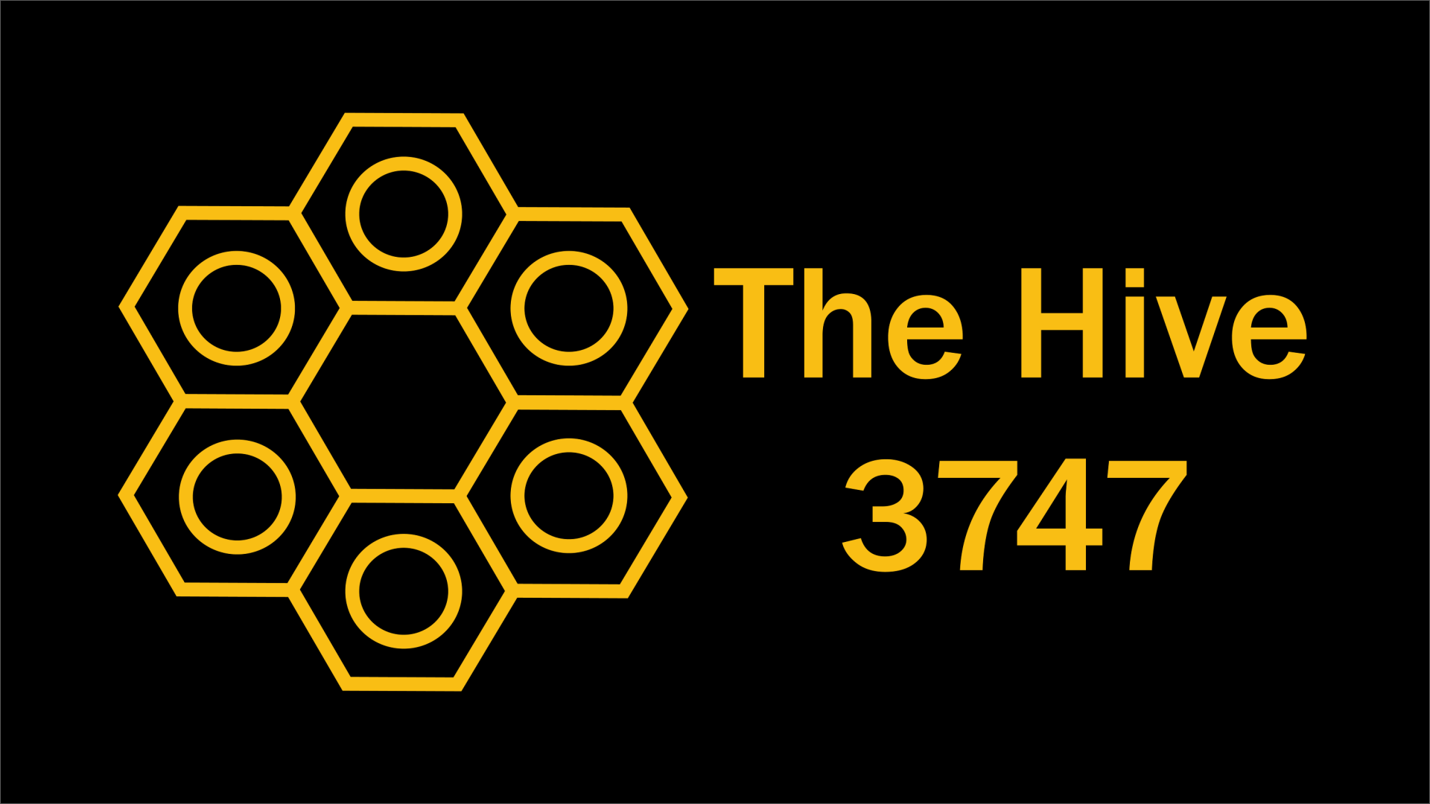
Start small.
Test every step.
When it's wrong, describe what was missing.
github.com/The-Hive-3747/Teaching-AI-Coding
Guide, videos, every real prompt, and the code — all of it.
Training sessions: bring your robot, leave with it driving. Find us at the pits: The Hive, FTC 3747.
Notes:
No Q&A slot, so say where people can find you afterward.

Slide 23
Sources — studies, rules, history
Bastani et al., PNAS 2025
Generative AI can harm learning — ~1,000 HS students · scale.stanford.edu/publications/generative-ai-can-harm-learning
Backus, 1978
The History of FORTRAN I, II, and III (HOPL) · softwarepreservation.computerhistory.org/FORTRAN/paper/p165-backus.pdf
Becker et al., METR, Jul 2025
16 expert developers 19% slower with AI · arxiv.org/abs/2507.09089
Post, 1983
Real Programmers Don't Use Pascal · ee.torontomu.ca/~elf/hack/realmen.html
Anthropic, Jan 2026
AI assistance and coding skill formation (vendor study) · anthropic.com/news/AI-assistance-coding-skills
Petzold, 2005
Does Visual Studio Rot the Mind? · charlespetzold.com/etc/DoesVisualStudioRotTheMind.html
College Board, AP CS Principles
Create task directions — AI use and attribution · apcentral.collegeboard.org/media/pdf/ap-csp-student-task-directions.pd
Fischer et al., IEEE S&P 2017
Stack Overflow Considered Harmful? · arxiv.org/abs/1710.03135
FTC Competition Manual 2026–27
Awards section: A201, A204, A208 · ftc-resources.firstinspires.org/ftc/game/manual-06
Brooks, 1987
No Silver Bullet · worrydream.com/refs/Brooks-NoSilverBullet.pdf
FIRST blog: Expanding the toolbox with AI
“The answer is yes!” — credit convention · community.firstinspires.org/expanding-the-first-toolbox-with-artificia
Fowler, 2025
LLMs bring new nature of abstraction · martinfowler.com/articles/2025-nature-abstraction.html
Learn Java for FTC (Alan Smith)
The textbook in The Hive's checklist · raw.githubusercontent.com/alan412/LearnJavaForFTC/master/LearnJavaForF
Notes:
Slides 5–7. Every title is a live link in the PDF and the .pptx. The caveats on each item are in docs/research-ai-skills-case.md; the 'must not repeat' table there is the one to read before you present.

Slide 24
Sources — employers and the market
Podium — Software Engineering Intern (Lehi)
verified Oct 3, 2026 · job-boards.greenhouse.io/podium81/jobs/7939921
Lightcast, Jul 2025
28% premium; 51% of AI postings outside IT (2024 data) · lightcast.io/resources/blog/beyond-the-buzz-press-release-2025-07-23
Podium — Senior Software Engineer (Lehi)
verified Oct 3, 2026 · job-boards.greenhouse.io/podium81/jobs/6637207
Brynjolfsson, Chandar & Chen, Nov 2025
Canaries in the Coal Mine (payroll data) · digitaleconomy.stanford.edu/app/uploads/2025/11/CanariesintheCoalMine_
Affirm — Senior Software Engineer
remote, Poland; verified Oct 3, 2026 · job-boards.greenhouse.io/affirm/jobs/7806681003
Canaries dashboard
gap widened to 19%, Aug 2026 · digitaleconomy.stanford.edu/project/indicators/canaries-dashboard/
1Password — Rust Developer
verified Oct 3, 2026 · jobs.ashbyhq.com/1password/c247ea98-bf31-45f0-a38b-1fe255909538
NACE, spring 2026
AI skills in entry-level jobs (185 employers) · naceweb.org/job-market/trends-and-predictions/demand-for-ai-skills-in-
Shopify memo, as quoted in Business Today
Apr 2025 (secondary) · businesstoday.in/technology/news/story/ai-use-is-no-longer-optional-at
NACE student survey, 2026
50.5% not building AI skills · naceweb.org/about-us/press/2026/ready-or-reluctant-employer-expectatio
Stanford AI Index 2026 / Lightcast
2.5% of US postings, +55% · lightcast.io/resources/research/stanford-ai-index-2026
Kent Beck, Apr 2023
90% of my skills are now worth $0 · tidyfirst.substack.com/p/90-of-my-skills-are-now-worth-0
match.dev, Sep 2026
AI coding tools in 4,820 SWE postings (one scan) · match.dev/post/ai-coding-tools-in-job-postings/data/
The Hive — verbatim transcript and research report
every prompt, every number, with its caveats · github.com/The-Hive-3747/Teaching-AI-Coding
PwC Global AI Jobs Barometer 2026
62% wage premium (vendor, uncontrolled) · pwc.com/gx/en/issues/artificial-intelligence/job-barometer/2026/2026-g
Notes:
Slides 15–16 and the team's own records. Job postings expire: re-open the Podium links the morning of the talk. PwC and Lightcast sell AI-related services; their wage figures are advertised-pay correlations, not controlled comparisons.

