Slide 1
PRECEDENCE AND ASSOCIATIVITY

Slide 2

PRECEDENCE
When there is more than one operator in an expression, the relative priorities of the operators with respect to each other that will determine the order
In which the expression will be evaluated . This priority is known as Precedence.
Operators of higher precedence are applied before operators of lower precedence.
Consider the example, 4 + 3 * 2
The operator ‘ * ‘ has higher precedence than ‘ + ‘ , causing the multiplication to be executed first, then the addition .
Hence the value of the expression is 10.
4 + (3 * 2 ) = 10

Slide 3
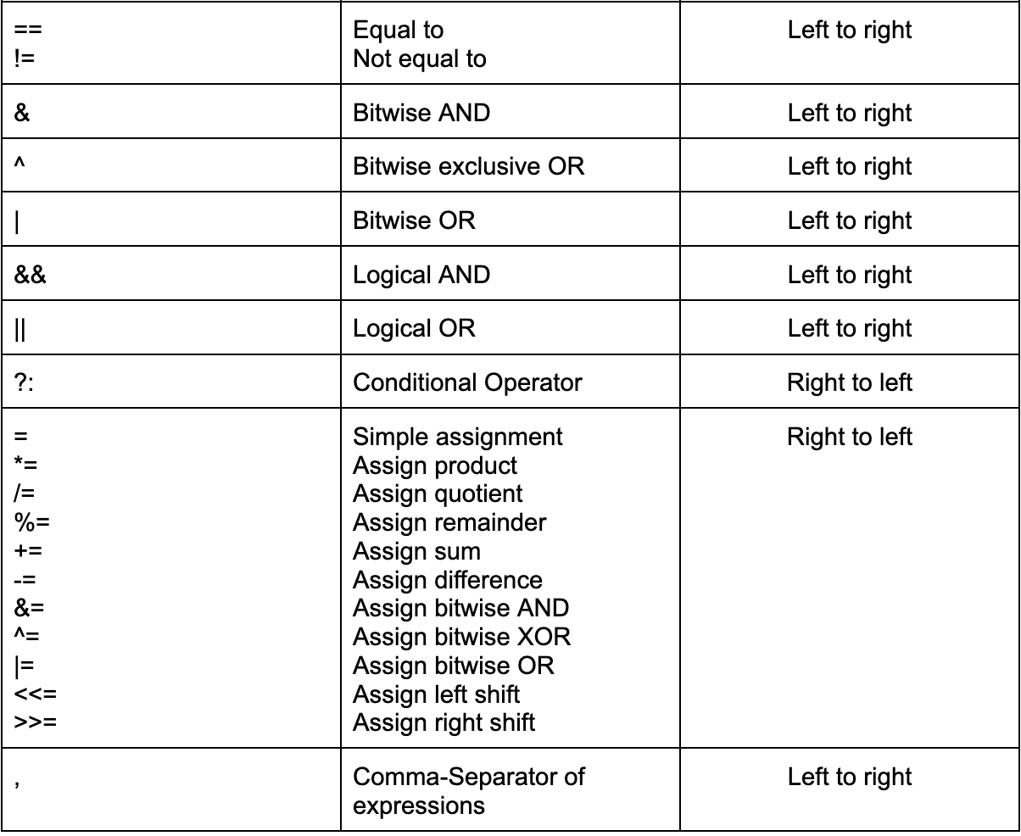

Slide 4
ASSOCIATIVITY
Consider an expression with operators of same precedence.
4 / 2 * 3
Here, both * and / have same precedence.
The ASSOCIATIVITY of operators determines the order in which operators of
equal precedence are evaluated when they occur in the same
Expression .
The ASSOCIATIVITY determines the direction, left-to-right or right-to-left, in which
the operator acts upon its operands.
In the above example, division operator will be executed first followed by multiplication.
The value of the expression is 6.

Slide 5
Example: n = 5 – 2 * 7 – 9 ;
The ‘*’ has a higher precedence than ‘ – ‘ so it is evaluated first, and the statement is equivalent to:
n = 5 – 14 – 9 ;
The minus has left-to-right associativity, so the statement is equivalent to :
n = -18 ;
EXAMPLES:
x = 2 * 3 + 4 * 5; x=26
x = 2 * ( 3 + 4) * 5; x=70
x = 7 * 6 % 15/9; x=1
x = 7 * ((6%15)/9); x=0

Slide 6
TYPE CONVERSION IN C
Type conversion in C is the process of converting one data type to another. It is performed by a compiler.
In type conversion, the destination data type can’t be smaller than the source data type.
It is also called as widening conversion.
For example, if x and y are both of int type, the expression x+y is of int type as well.
If the variables of an expression are of different type, the expression has the same data type as that of the variable with the largest size data type present in it.
Type conversion is of two types:
1. IMPLICIT TYPE CONVERSION
2. EXPLICIT TYPE CONVERSION

Slide 7
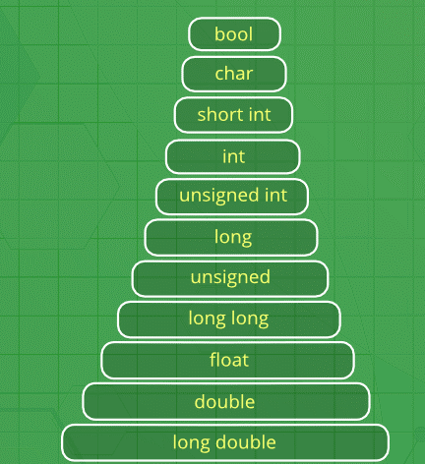
IMPLICIT TYPE CONVERSION:
It is done by the Compiler.
Type conversion takes place when more than one data type is present in an expression. Type conversion occurs to avoid loss of data.
As said , all the data types of the variables are upgraded to the data type of the variable with the largest data type.
Implicit conversions lose information such as
1. signs can be lost ( signed implicitly converted to unsigned)
2. overflow can occur ( long implicitly converted to float)

Slide 8
IMPLICIT TYPE CONVERSIONS OCCUR IN THE FOLLOWING WAYS:
CONVERSION BY ASSIGNMENT:
EXAMPLE : If f is a float type and i is an int type, i is promoted to float type in this assignment statement:
f = i;
In case of vice-versa,
i=f;
f is demoted to type int.
It’s fractional part is lost on assignment to i .
Eg: float f = 1.23;
int i;
i = f;
Here i has the value 1 and f still has the value 1.23.
The fractional part is lost when a floating point number is converted to an integer type.

Slide 9
CONVERSIONS OF CHARACTERS AND INTEGERS
ZERO EXTENSION:
Eg: 4-bits to 8-bits
Consider a number 4 → 0100 ( 4-Bit representation)
4 → 0000 0100 ( 8-Bit representation, extra bits are extended by 0).
2. SIGN EXTENSION:
For negative numbers,
Consider a number -4,
4 → 0100 ( 4-Bit representation)
1011 ( 1’s complement of 4)
1 ( Take 2’s complement)
-4 → 1100 ( 4-Bit representation)
In 8-Bit we represent -4 by 1111 1100 . So for negative numbers, extra bits are extended by 1.

Slide 10
3. TRUNCATION :
It is the process of reducing the number of bits of an integer .
Eg : Truncating a 16-bit integer to an 8-bit Integer ( Larger integer type to a smaller integer type)
Consider a 16-bit unsigned integer -→ 0x1234
Binary representation(16-Bit) -→ 0001 0010 0011 0100
Binary representation(8-Bit) -→ 0011 0100
When truncated to an 8-bit unsigned integer, only the lower 8 bits are kept.
Consider a 16-Bit signed integer with a negative value -12345
Binary representation (16-Bit) -→ 1100 1100 1100 0111.
When truncated to 8 bits, only the lower 8 bits are retained-→ 1100 0111
To find the magnitude, invert the bits and add1 : 1100 0111 -→ 0011 1000 → 0011 1001. Since the sign bit was 1, the value is -57.

Slide 11
TRUNCATE AT DECIMAL POINT:
Removes the fractional point of a floating-point number, resulting in an integer value. This can be done in two ways:
Using Type Casting : Simple and direct method to truncate a floating-point value by casting it to an integer type.
Example: ‘(int)123.456’ yields ‘123’.
Using ‘trunc’ function: Part of the ‘math.h’ library, provides explicit truncation of floating point values.
Returns the truncated value as a floating-point number with zero fractional part.
Example: ‘trunc(123.456)’ yields ‘123.0’.
OVEFLOW AND UNDERFLOW IN C
OVERFLOW and UNDERFLOW in C refer to situations where arithmetic operations exceed the storage capacity of the data type being used, leading to incorrect results.
These phenomena occur because data types in C have fixed sizes.

Slide 12
OVERFLOW: Overflow happens when a calculation produces a result that is larger than the maximum value the data type can represent.
EXAMPLE: 1. For an 8-bit unsigned integer, the range is from ‘0’ to ‘255’. If an operation exceeds this range, overflow occurs.
2. For a 16-bit integer, the range is from ‘-32768’ to ‘32767’. If an operation exceeds this range, overflow occurs.
UNDERFLOW: Underflow occurs when a calculation produces a result that is smaller than the minimum value the data type can represent.
EXAMPLE :1. For an 8-bit unsigned integer, the range is from ‘0’ to ‘255’. If an operation results in a value below ‘0’, underflow occurs.
2. For floating-point mnumbers, underflow occurs when a value becomes too small to be represented within the precision limits of the data type, often leading to a value of ‘0’.

Slide 13
Avoiding Overflow and Underflow
To avoid overflow and underflow, you can:
Check bounds before performing arithmetic operations.
Use larger data types if larger ranges are needed.
Utilize safe arithmetic functions provided by some libraries or implement custom checks in your code.
Compiler warnings and flags can sometimes help detect potential overflow and underflow issues during compilation.

Slide 14
SIGN-EXTENSION
#include <stdio.h>
int main() {
int8_t small_number = -30; // 8-bit signed integer
int16_t larger_number = small_number; // 16-bit signed integer
printf("Original 8-bit value: %d\n", small_number);
printf("Extended 16-bit value: %d\n", larger_number);
return 0;
}
OUTPUT:
Original 8-bit value: -30
Extended 16-bit value: -30

Slide 15
ZERO EXTENSION
#include <stdio.h>
#include <stdint.h>
int main() {
uint8_t small_number = 250; // 8-bit unsigned integer
uint16_t larger_number = small_number; // 16-bit unsigned integer
printf("Original 8-bit value: %u\n", small_number);
printf("Extended 16-bit value: %u\n", larger_number);
return 0;
}
OUTPUT:
Original 8-bit value: 250
Extended 16-bit value: 250

Slide 16
TRUNCATING A 16-BIT INTEGER TO AN 8-BIT INTEGER
#include <stdio.h>
#include <stdint.h>
int main() {
uint16_t large_value = 0x1234; // 16-bit unsigned integer
uint8_t small_value = (uint8_t)large_value; // Truncate to 8-bit unsigned integer
printf("Original 16-bit value: 0x%X\n", large_value);
printf("Truncated 8-bit value: 0x%X\n", small_value);
return 0;
}
OUTPUT:
Original 16-bit value: 0x1234
Truncated 8-bit value: 0x34

Slide 17
TRUNCATING A SIGNED INTEGER
#include <stdio.h>
#include <stdint.h>
int main() {
int16_t large_value = -12345; // 16-bit signed integer
int8_t small_value = (int8_t)large_value; // Truncate to 8-bit signed integer
printf("Original 16-bit value: %d\n", large_value);
printf("Truncated 8-bit value: %d\n", small_value);
return 0;
}
OUTPUT:
Original 16-bit value: -12345
Truncated 8-bit value: -57

Slide 18
TRUNCATING DECIMAL VALUES BY USING TYPE CASTING
#include <stdio.h>
int main() {
double floating_value = 123.456;
int truncated_value = (int)floating_value; // Cast to int, truncating the fractional part
printf("Original floating-point value: %.3f\n", floating_value);
printf("Truncated integer value: %d\n", truncated_value);
return 0;
}
OUTPUT:
Original floating-point value: 123.456
Truncated integer value: 123

Slide 19
USING TRUNC FUNCTION
#include <stdio.h>
#include <math.h>
int main() {
double floating_value = 123.456;
double truncated_value = trunc(floating_value); // Use trunc to remove the fractional part
printf("Original floating-point value: %.3f\n", floating_value);
printf("Truncated value using trunc: %.0f\n", truncated_value);
return 0;
}
OUTPUT:
Original floating-point value: 123.456
Truncated value using trunc: 123

Slide 20
OVERFLOW
UNSIGNED INTEGER OVERFLOW
#include <stdio.h>
#include <stdint.h>
int main() {
uint8_t max_value = 255; // Maximum value for uint8_t
uint8_t result = max_value + 1; // Overflow
printf("Result after overflow: %u\n", result); // Output will be 0
return 0;
}
OUTPUT:
“Result after overflow: 0

Slide 21
SIGNED INTEGER OVERFLOW
#include <stdio.h>
#include <stdint.h>
int main() {
int16_t max_value = 32767; // Maximum value for int16_t
int16_t result = max_value + 1; // Overflow
printf("Result after overflow: %d\n", result); // Output will be -32768
return 0;
}
OUTPUT:
Result after overflow : -32768

Slide 22
UNSIGNED INTEGER UNDERFLOW
#include <stdio.h>
#include <stdint.h>
int main() {
uint8_t min_value = 0; // Minimum value for uint8_t
uint8_t result = min_value - 1; // Underflow
printf("Result after underflow: %u\n", result); // Output will be 255
return 0;
}
OUTPUT:
Result after underflow : 255

Slide 23
FLOATING POINT UNDERFLOW
#include <stdio.h>
int main() {
float small_value = 1.0e-38; // Very small value for float
float result = small_value / 10.0f; // Underflow
printf("Result after underflow: %e\n", result); // Output may be 0
return 0;
}
OUTPUT:
Result after underflow : 0

Slide 24
EXPLICIT TYPE CONVERSION
Explicit type conversion, also known as type casting, is a way to manually convert a value from one data type to another in C.
This is often necessary when you want to perform operations that involve different data types or need to ensure a specific type for a variable.
The syntax for explicit type casting in C is:
(target_type) value

Slide 25
EXAMPLES:
INTEGER TO FLOATING POINT
#include <stdio.h>
int main() {
int int_val = 10;
float float_val;
float_val = (float)int_val; // Explicitly cast int to float
printf("Integer value: %d\n", int_val);
printf("Converted to float: %.2f\n", float_val);
return 0;
}
OUTPUT:
Integer value: 10
Converted to float: 10.00

Slide 26
FLOATING POINT TO INTEGER
#include <stdio.h>
int main() {
float float_val = 10.75;
int int_val;
int_val = (int)float_val; // Explicitly cast float to int
printf("Floating point value: %.2f\n", float_val);
printf("Converted to integer: %d\n", int_val);
return 0;
}
OUTPUT:
Floating point value: 10.75
Converted to integer: 10

Slide 27
LARGE INTEGER TO SMALLER INTEGER
#include <stdio.h>
#include <stdint.h>
int main() {
int32_t large_val = 123456789;
int16_t small_val;
small_val = (int16_t)large_val; // Explicitly cast int32_t to int16_t
printf("32-bit integer value: %d\n", large_val);
printf("Converted to 16-bit integer: %d\n", small_val);
return 0;
}
OUTPUT:
32-bit integer value: 123456789
Converted to 16-bit integer: -13035

Slide 28
CHARACTER TO INTEGER
#include <stdio.h>
int main() {
char char_val = 'A';
int int_val;
int_val = (int)char_val; // Explicitly cast char to int
printf("Character value: %c\n", char_val);
printf("Converted to integer (ASCII code): %d\n", int_val);
return 0;
}
OUTPUT:
Character value: A
Converted to integer (ASCII code): 65

