Slide 1
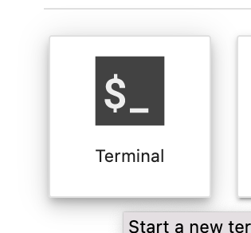
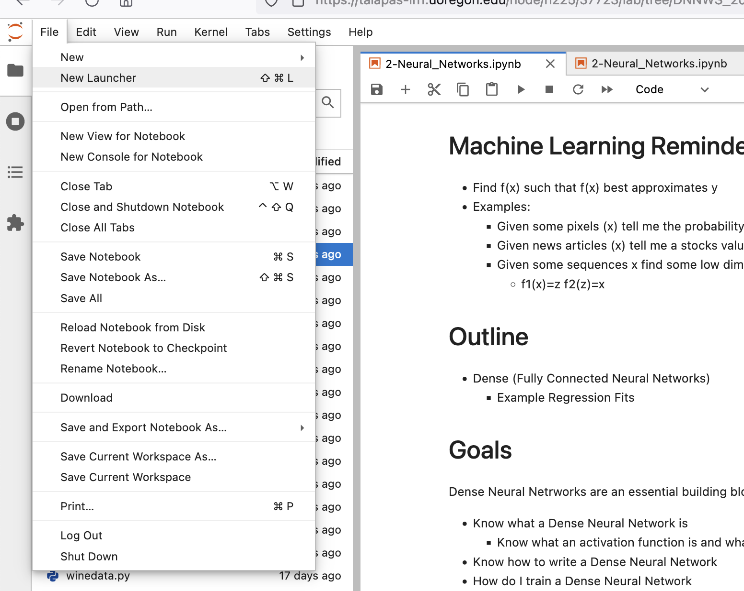

Grab The Latest from Github!
2. Click Terminal
1. In Jupyter Click New Launcher
3. In Terminal type
cd DNNWS_2022/ git pull
If this command fails. you may have already modified today’s notebook. Save your work by moving it to a new file (mv file.ipynb new_file.ipynb) and try git pull again.

