Slide 1
Open On Demand Setup
Number of CPU Cores 1 → 2
Total Memory 4 → 8
Like before use the interactive app:
Jupyter Notebook (python3/Tensorflow/PyTorch) [2021-10-21]
Update git like before

Slide 2
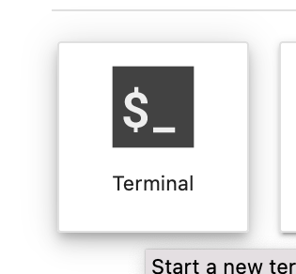
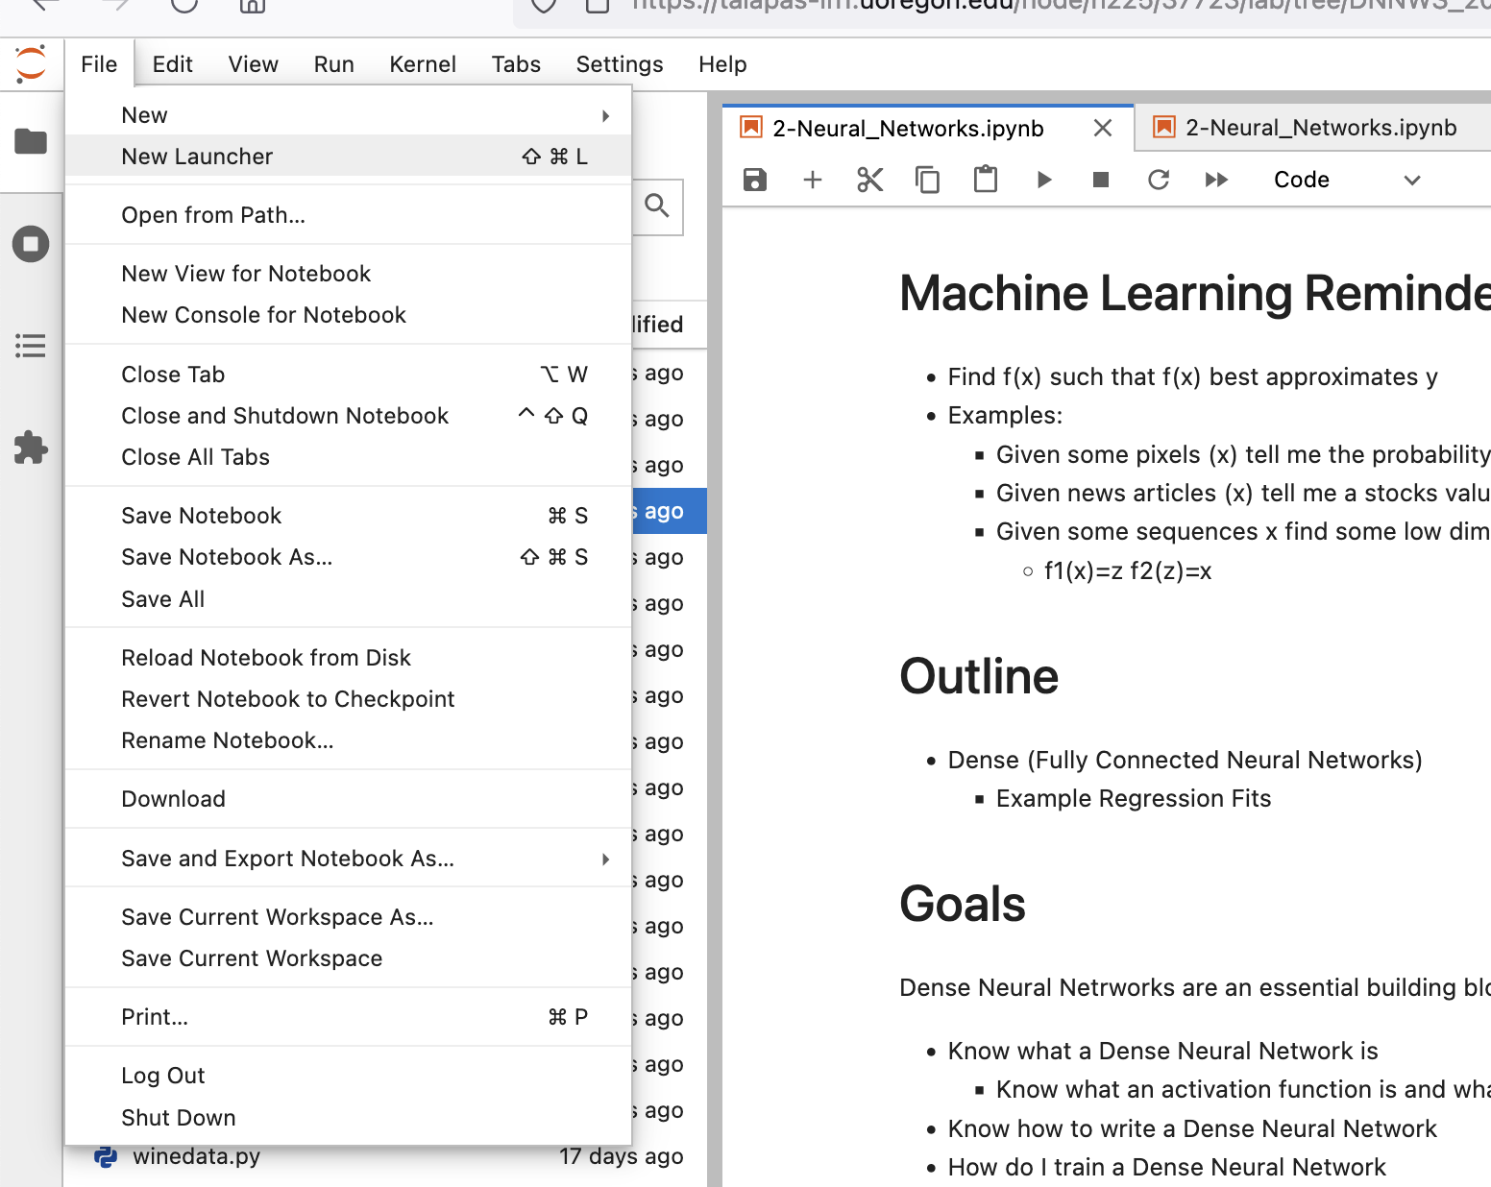

Grab The Latest from Github!
2. Click Terminal
1. In Jupyter Click New Launcher
3. In Terminal type
cd DNNWS_2022/ git pull
If this command fails. you may have already modified today’s notebook. Save your work by moving it to a new file (mv file.ipynb new_file.ipynb) and try git pull again.

