Slide 1
Machine Learning
Jake Searcy
Associate Director of AI

Slide 2
Getting Started
https://github.com/jsearcy1/BI608-2020

Slide 3
Motivations
Johns Hopkins study suggests medical errors are third-leading cause of death in U.S.
https://hub.jhu.edu/2016/05/03/medical-errors-third-leading-cause-of-death/
Error=any action “that does not achieve its intended outcome” or any planned action that, for whatever reason, is not done “that may or may not cause harm to the patient.”

Slide 4
What is Machine Learning
Machine learning (ML) is a lot like programing
It’s a series of technique for telling a computer how to do something
Instead of writing an algorithm with code you create a system that can learn an algorithm from data
Often is not the right choice
Training an ML model to add numbers
Would take a comparatively lot of work
And isn’t would be as accurate a
Perfect when you have data but no algorithm
Besides quick coding fingers, look for a personality that can cope with failure. You almost never know what you’re doing, even if you think you do.
--Cassie Kozyrkov Chief Decision Intelligence Engineer at Google

Slide 5
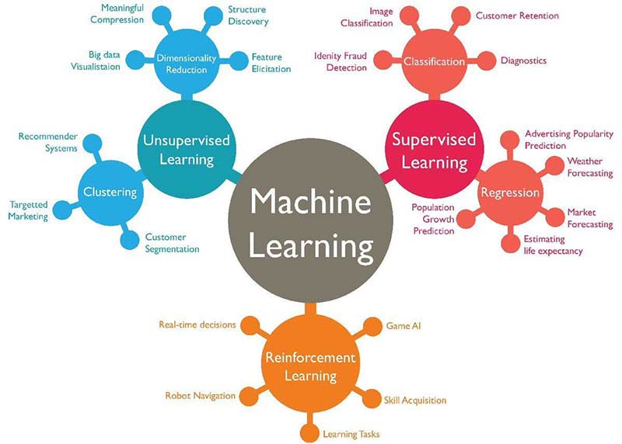
What technique depends on the problem
Image Source

Slide 6
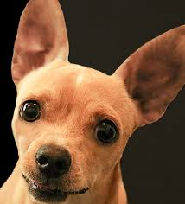

Thought Experiment
How would you write an algorithm to tell the difference between cats and dogs

Slide 7
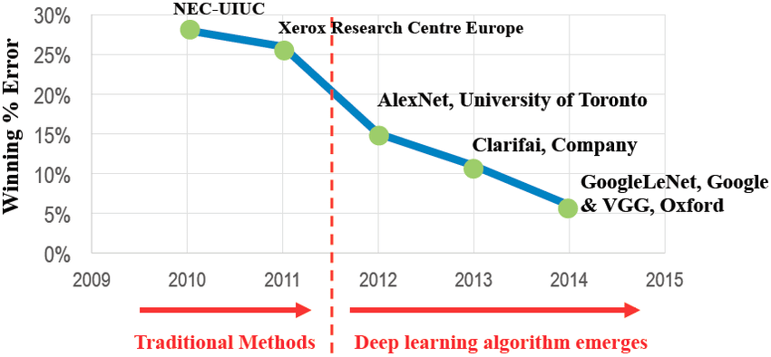
Images
Rule based algorithms are difficult to design images, deep learning wins
Image-net Challenge: Identify the subject of an image out of 1000 classes
Human Error

Slide 8
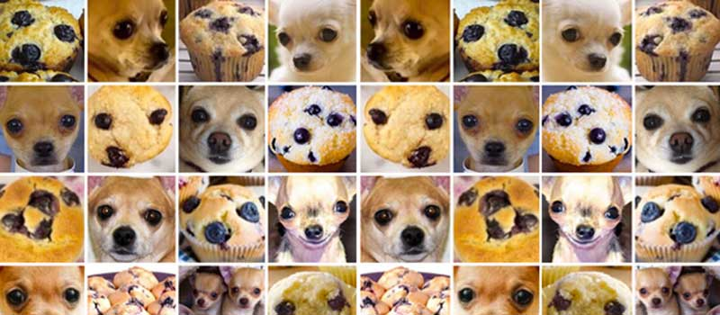
Still an Algorithm
Algorithms can have bugs
Bugs in ML often occur in data

Slide 9
Vocab
Artificial Intelligence
An all encompassing term for a broad field the most promising of which is currently machine learning
Machine Learning
Deep Learning - Deep Neural Networks of all forms
‘Traditional’ Machine Learning - Pretty much everything else
Trees, SVMs, Linear Regression, Naive Bayes...
X’s = Input variables
Y’s = Target Variables
Loss function - Numerical Goal of the Model

Slide 10
Machine Learning
In different works ML models try to
Find f(x) such that f(x) best approximates y
Examples:
Given some pixels (x) tell me the probability it’s a cat (y)
Given news articles (x) tell me a stocks value (y)
Important Note: No prediction of causality
Function outputs can be stochastic

Slide 11
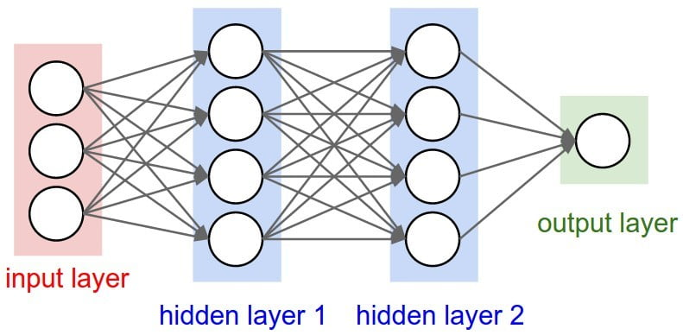

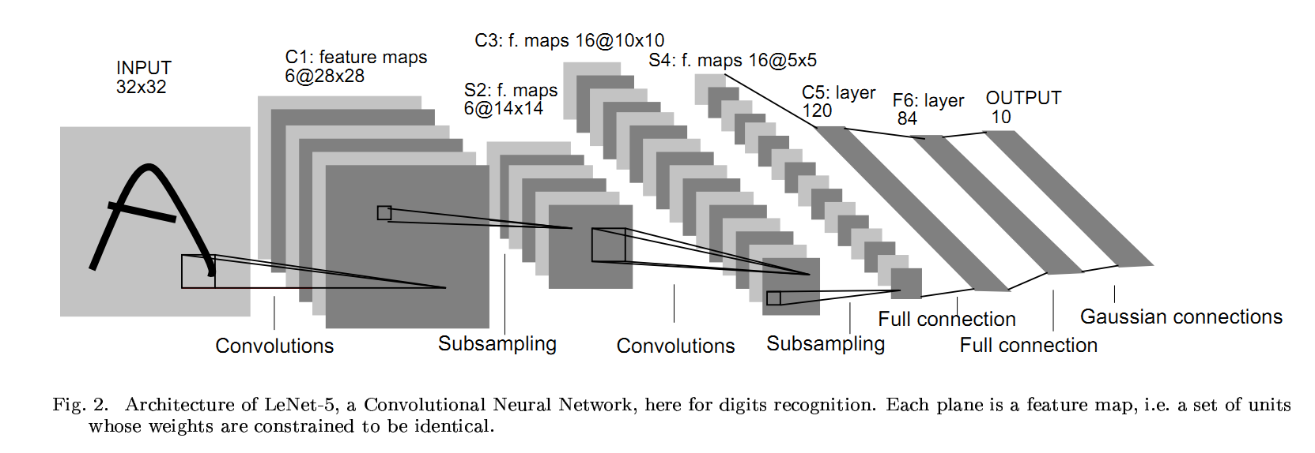
Deep Learning
Very powerful method used for a host image analysis problems
Many layers often of different types
Dense, Convolutional, Dropout

Slide 12
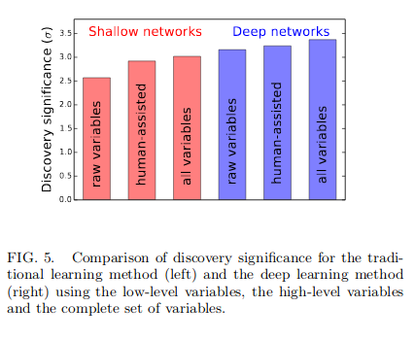
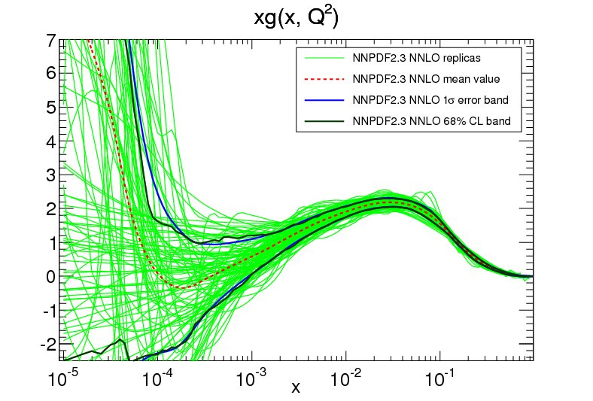
DNN Advantages
Often can lead to better results than human crafted algorithms
Provided the data is sufficient
Can ingested huge varieties of raw data with limited or no preprocessing
Text
Images
Sounds
etc.
Can estimate uncertainties on fits without assumptions on functional forms
Rare due to CPU expense
10.1103/PhysRevLett.114.111801

Slide 13
Building a Network
Deep Neural Networks are usually a stack of layers that learn how to transform input data into something useful

Slide 14
The big two
The two most important blocks we’ll introduce throughout the workshop
Dense Neural Networks
Simplest layers and an introduction
Convolutional neural Networks
Layers designed for images

Slide 15
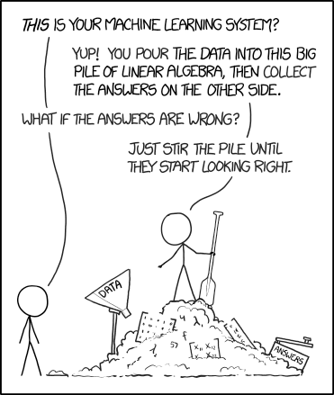
How Does it Work

Slide 16



Software Tools
Tons of implementations of basic ML tools
Matlab
R
STAT
SAS
All ML research and development is happening in python
Tensorflow
PyTorch
Deploying ML models in production a bit more diverse
Tensorflow

Slide 17
Hardware Tools
GPUS
Nvidia GPUs are the primary tools for machine learning
Primarily due to CUDA
CPUS
Fine for smaller models, can’t compete with GPUS for larger models
Tensor Cores
Next generation of core highly optimized for tensor operations used in Deep Learning
Google’s TPUs
Nvidia’s RTX/Volta lines
FP16 only
Others
FPGAs
Graph Cores and other custom chips
As a user CPUS are a good place to start, and GPUs will be the main workhorse

Slide 18
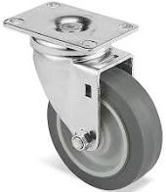
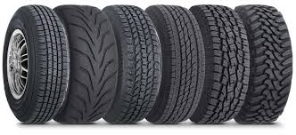
Engineering
Not a Good a Car Tire
What is ‘right’
Some things don’t work
Lots of things work fine
What works best depends on the dataset
When getting started focus on what works
Plenty of Good Car Tries

Slide 19
Machine Learning Cycle
Create/Get a dataset
Build a model
Train your dataset
Evaluate
Repeat
-------------
Use

Slide 20
Let’s Get Started!

