Slide 1


Mukhota
Detailed Guide
Part A How to use it, screen by screen
Part B How it works inside: engines, security, AI
Open contents
Mask it. Check it. Answer it. · AICA Level 2 Capstone
Notes:
This deck is the detailed companion to the project presentation. Part A walks through every screen in the order you use them. Part B explains the engines inside.

Slide 2


Contents
Click any line to jump there. Every slide has Contents and Next buttons.
Contents
Next
Part A · Using Mukhota
Part B · Technicalities
3
Install and start
18
Architecture
4
Screen tour
19
Reading the PDF and OCR
5
Step 1 · Open the notice
20
Detection engine
6
Step 2 · Detect and review
21
Redaction engine
7
Step 2 · Fix by hand
22
Verification engine
8
Step 3 · Apply redaction
23
Tokens and the vault
9
Step 4 · Verify
24
AI layer
10
Side by side check
25
Security and privacy model
11
Step 5 · Draft Reply: set up
26
Tech stack and project files
12
Optional · Six-box framing
27
Limits and good practice
13
Preview, cost and send
14
Review, fill and save
15
No API? Make a prompt
16
Settings and AI providers
17
Case Register and reminders

Slide 3
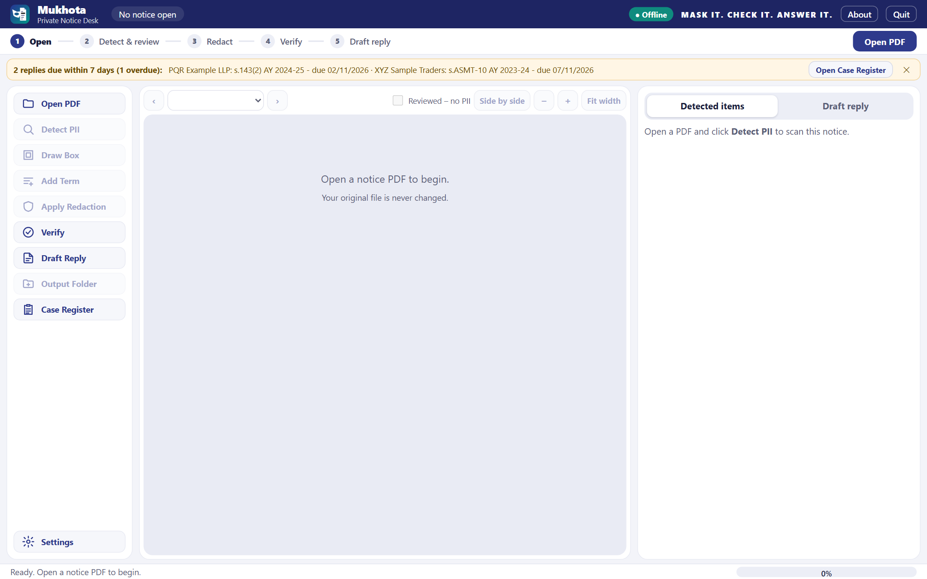
Install and start
PART A · USING MUKHOTA · Once per computer
Contents
Next
1
Python 3.12
2
install.bat
3
run.bat
Install 64-bit Python 3.12 from python.org; tick 'Add python.exe to PATH'
Double-click once: builds venv, installs libraries, makes the icon (needs internet)
Opens Mukhota in your browser at 127.0.0.1 (this computer only)
Desktop window: run_desktop.bat; same files, lists and register
File pickers are Windows windows; they may open behind the browser
Quit when done; a closed tab stops Mukhota after about 5 minutes
Practise safely with samples\Specimen_Notice_271B_FICTITIOUS.pdf
Start screen: reminder bar, five-step bar, toolbar
Notes:
Install once with install.bat; it is the only step that needs the internet besides Draft Reply. Start with run.bat for the browser version or run_desktop.bat for the desktop window.

Slide 4
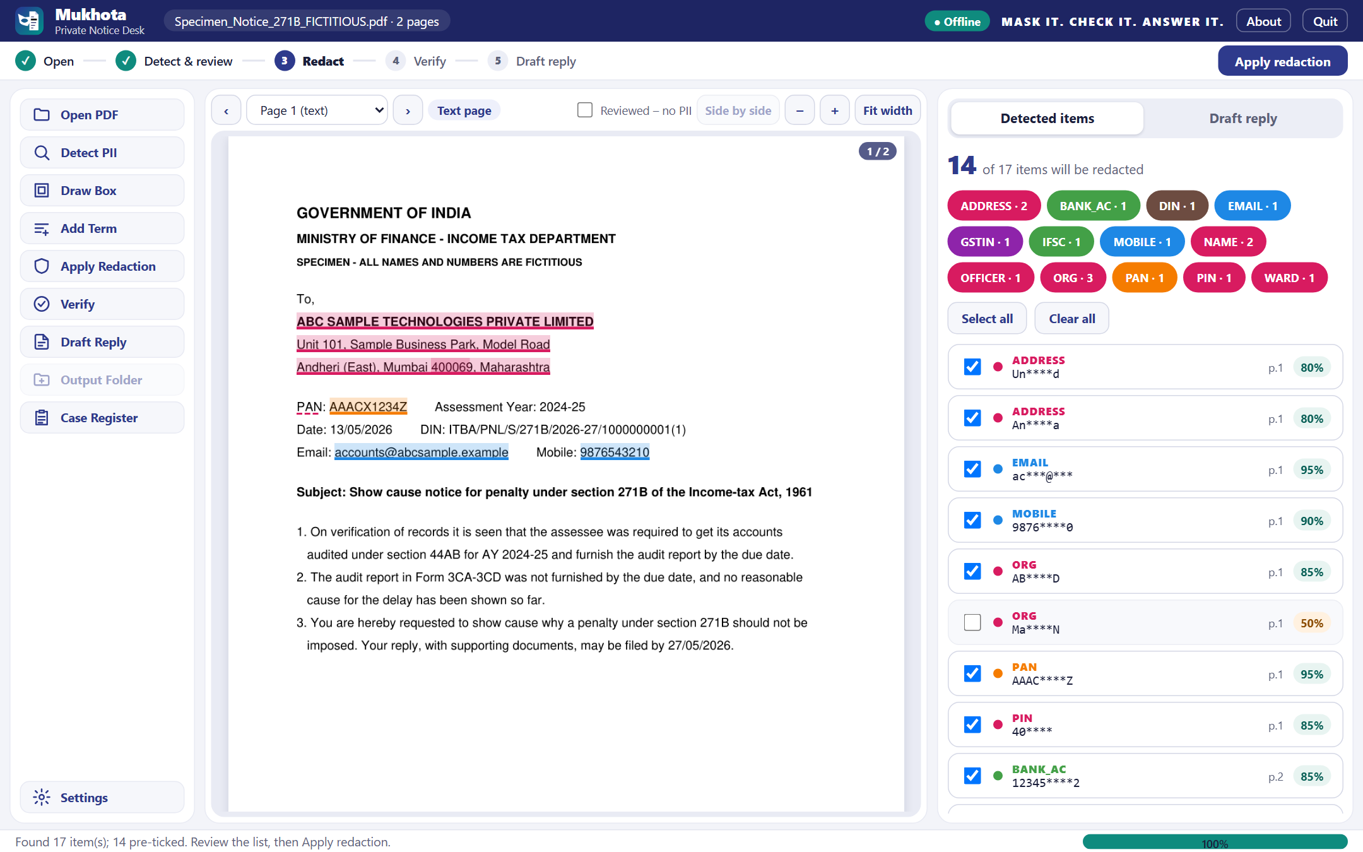
Screen tour
PART A · USING MUKHOTA · Where everything is
Contents
Next
1
1
Header
2
file name, Offline badge, About, Quit
2
Step bar
where you are; main button for the next step
3
3
Toolbar
every action, top to bottom
4
5
4
Page view
notice with coloured highlights; scroll through pages
5
Detected items
tick to redact; chips filter by type
6
Status bar
what is happening, with progress
6
Notes:
The screen has six areas. The step bar always shows the next action as a big button, so a new user can just follow it.

Slide 5
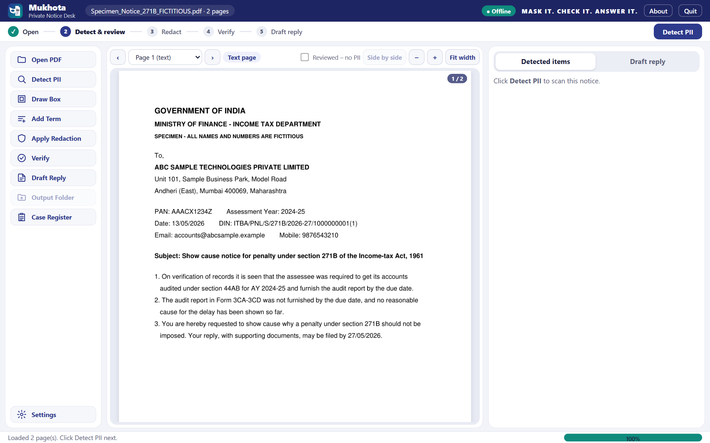
Step 1 · Open the notice
PART A · USING MUKHOTA · Open PDF
Contents
Next
Click Open PDF and pick the notice; the original file is only read, never changed
Each page is classed as a text page or a scanned page; scanned pages are read with OCR
Low OCR confidence puts a red Manual review required badge on that page
The notice joins the Case Register with section, AY and dates read from its text
Password-protected PDFs must be unlocked first
After opening: page shown, step bar moves to Detect & review
Notes:
Opening reads the PDF into memory. Text pages use their text layer; image pages are OCR'd with RapidOCR.

Slide 6
Step 2 · Detect and review
PART A · USING MUKHOTA · Detect PII
Contents
Next
Click Detect PII: every hit is highlighted and listed with type, page and confidence
Ticked items are redacted; untick anything that is not personal
Below 60% confidence items start unticked for you to judge
Colour chips filter by type; Select all / Clear all act on what is shown
Values are masked in the list (e.g. AAAC****Z)
Pages with no PII: tick Reviewed – no PII above the page
17 items found on the 2-page specimen; 14 pre-ticked
Notes:
Detection covers IDs, contact details, names and addresses, officers, codes and signatures. Review is the human safety step: untick false hits, keep the real ones.

Slide 7
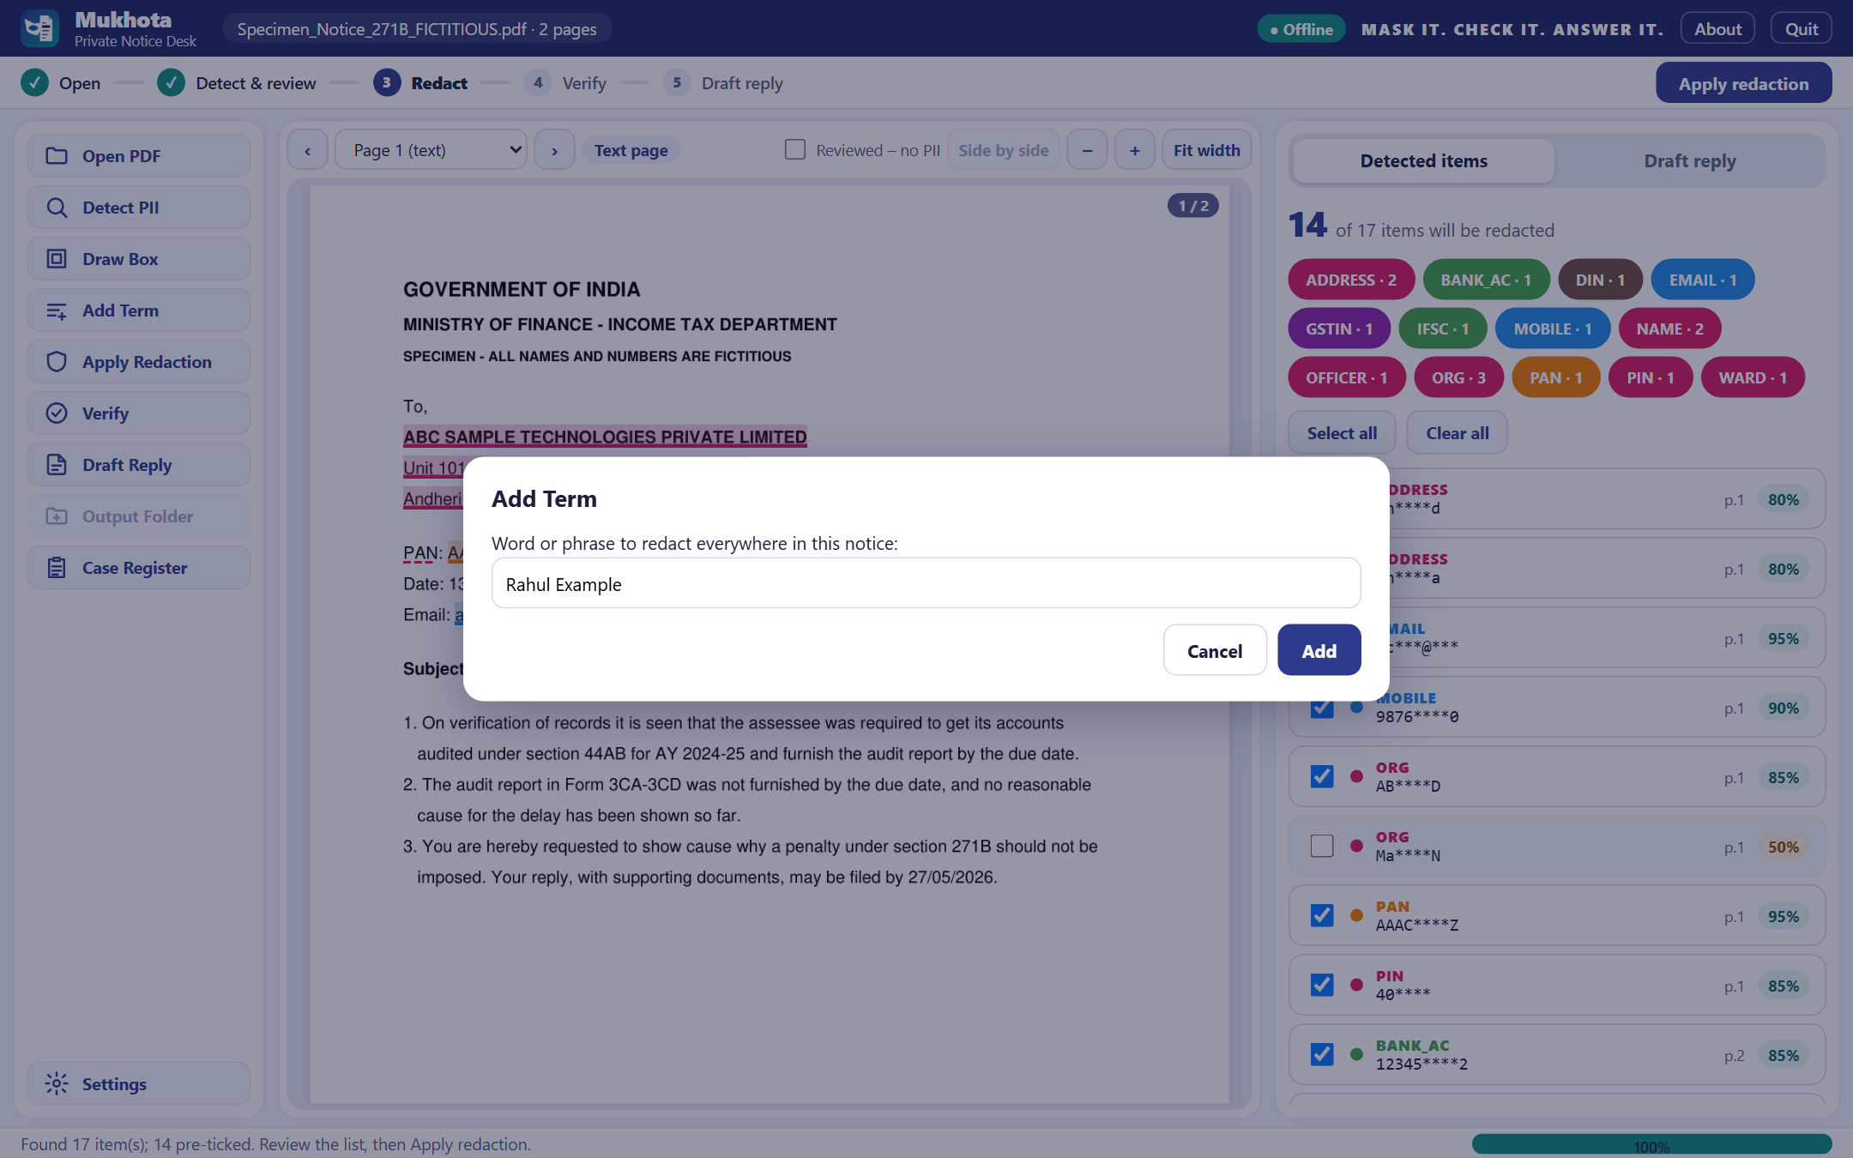
Step 2 · Fix by hand
PART A · USING MUKHOTA · Draw Box · Add Term
Contents
Next
1
Draw Box
2
Add Term
Toggle on, drag a rectangle over anything missed: a logo, a stamp, a handwritten note
Type a word or phrase; every occurrence in the notice is added and ticked
Untick false hits such as a department name
Teach it for next time: Settings → Do-not-redact list, Client master list
Verification is strict: a value redacted once but visible elsewhere fails; use Add Term
Add Term: 'Rahul Example' is added on every page it appears
Notes:
Anything the detectors miss can be added by drawing a box or typing a term. Regular names belong in the client master list so they are found automatically.

Slide 8
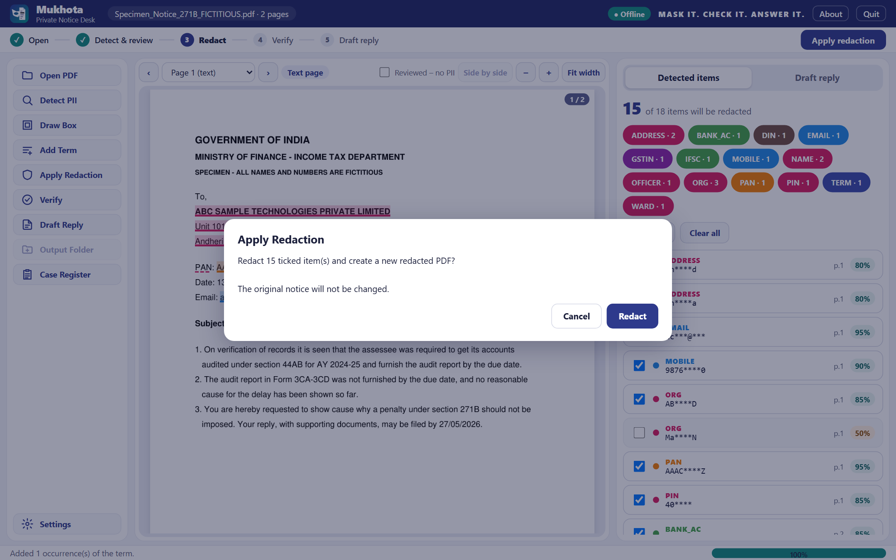
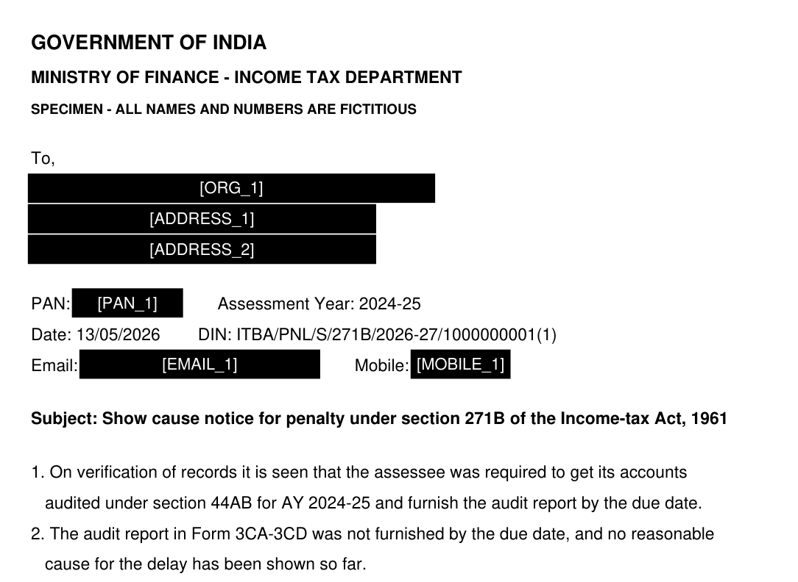
Step 3 · Apply redaction
PART A · USING MUKHOTA · Apply Redaction
Contents
Next
Files created in <notice>_mukhota\
File | What it is
<notice>_REDACTED.pdf | The file to share
<notice>.vault | Encrypted token ↔ value map; never share
verify_report.txt / .json | Audit report, no values, with SHA-256
candidates.json | Types, pages, tokens only
Scanned pages are rebuilt as flat images with no hidden text
Metadata, XMP, links, attachments, JavaScript and form fields are stripped
Verification starts automatically when redaction finishes
Text under each box is removed, and a token such as [PAN_1] is written in
Notes:
Apply Redaction asks for confirmation, then writes a new PDF in a folder next to the notice. The original stays untouched.

Slide 9
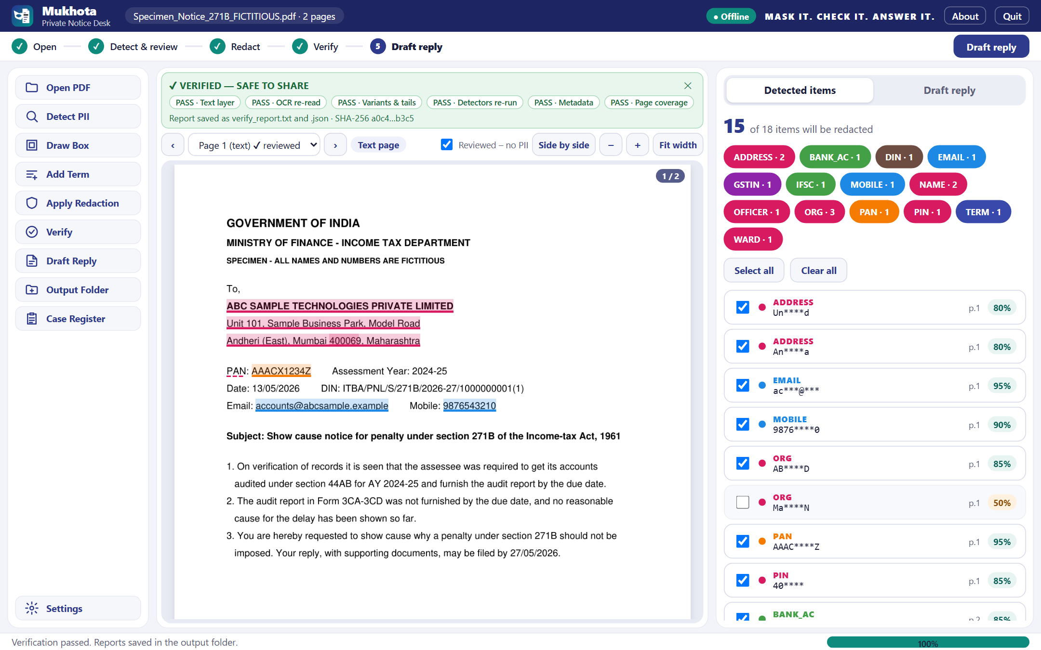
Step 4 · Verify
PART A · USING MUKHOTA · Verify
Contents
Next
Six checks, all must pass
1 Text layer · no original value left
2 OCR re-read · fresh OCR of every page
3 Variants & tails · no spaced / lower-case forms or ID tails
4 Detectors re-run · nothing new is found
5 Metadata · annotations, links, files, JS empty
Green VERIFIED – SAFE TO SHARE; a red banner lists each failure and jumps to its page
6 Page coverage · every page redacted or marked reviewed
Notes:
Verification re-opens the output and tries six different ways to find anything left. Draft Reply refuses any PDF without a matching PASS report.

Slide 10
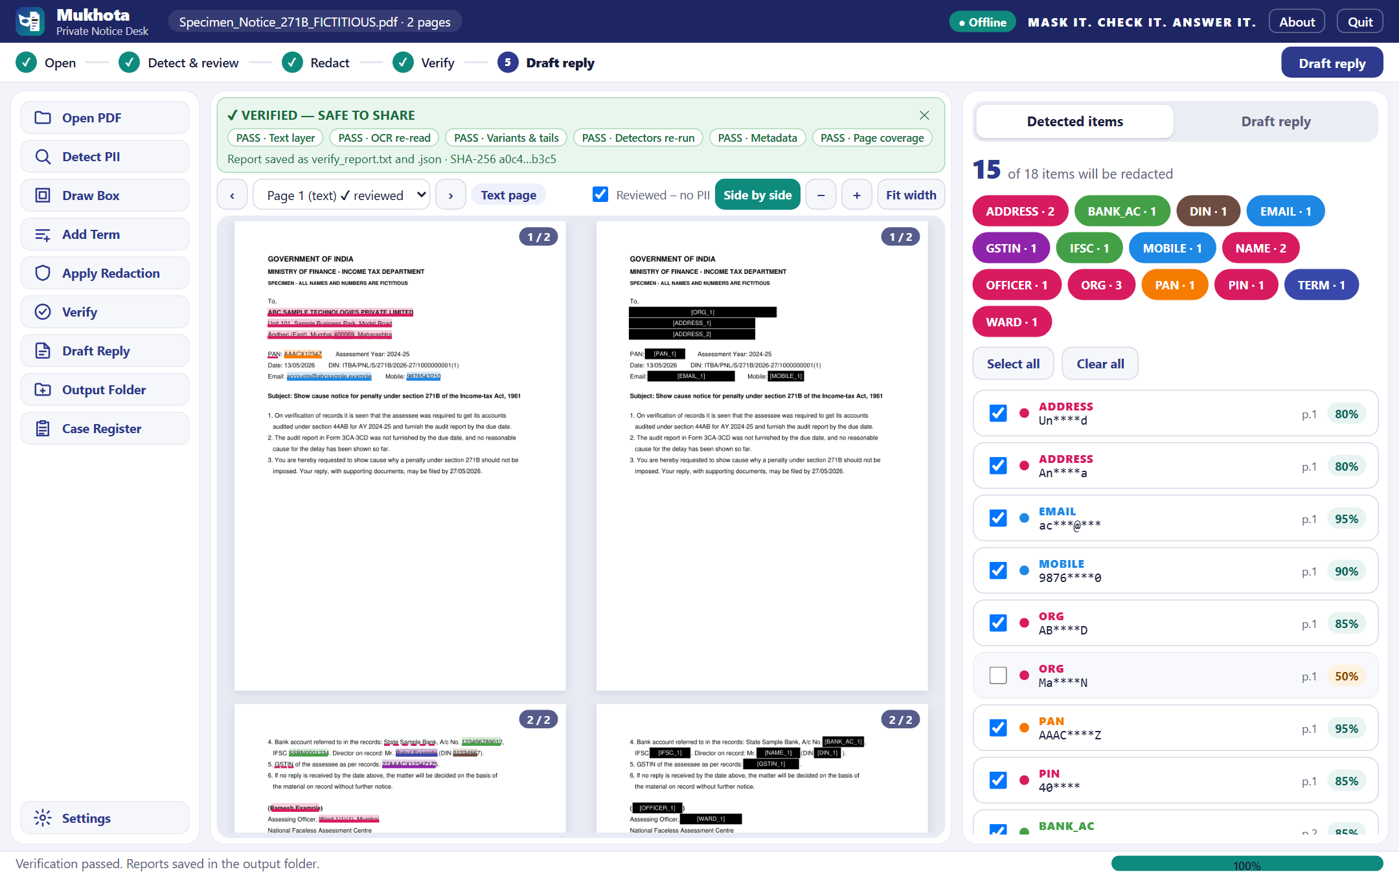
Side by side check
PART A · USING MUKHOTA · Compare before sharing
Contents
Next
Click Side by side above the page after redaction
Original left, redacted right, scrolling together
Zoom and Fit width apply to both
Check every page visually, especially stamps and signatures
Then Output Folder opens the results
Notes:
A quick visual comparison catches anything a machine check cannot judge, such as a stamp image.

Slide 11
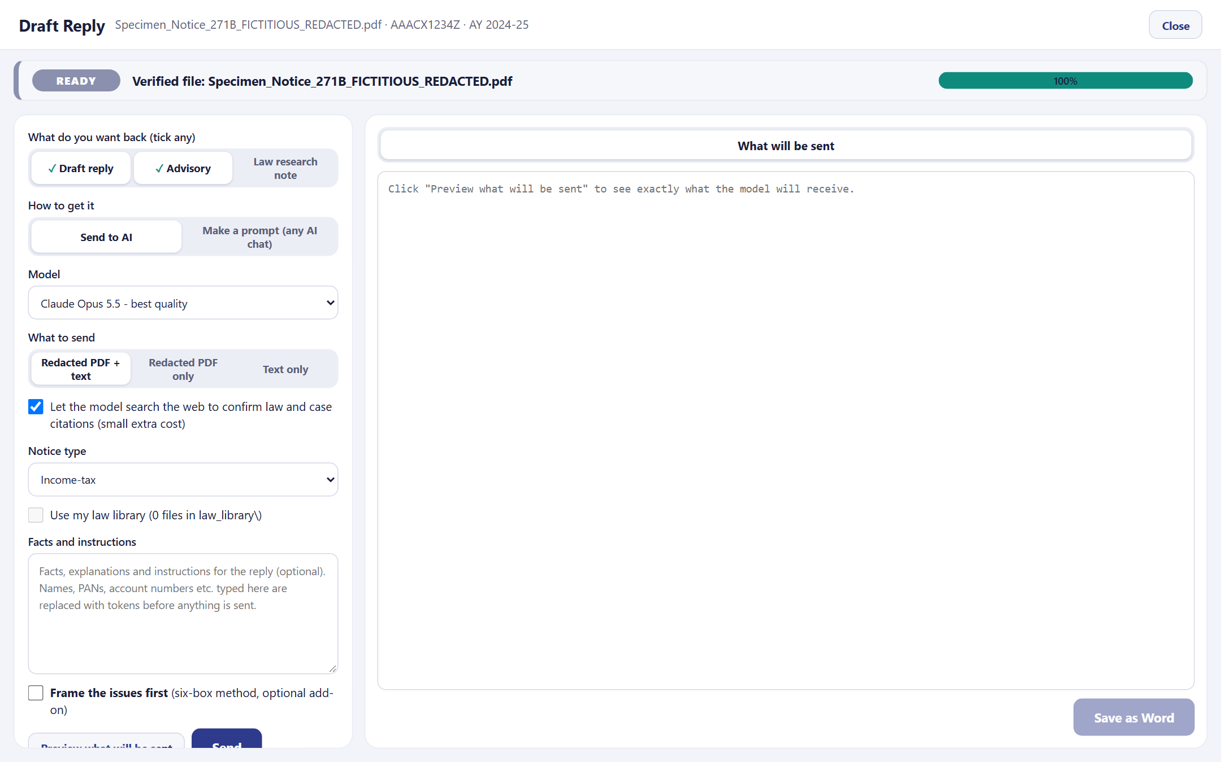
Step 5 · Draft Reply: set up
PART A · USING MUKHOTA · Draft Reply
Contents
Next
What you want back: Draft reply, Advisory, Law research note (tick any)
How to get it: Send to AI, or Make a prompt for any AI chat
Model: Claude (default) or another provider from Settings
What to send: redacted PDF + text, PDF only, or text only
Web search: lets the model confirm sections and case law
Facts and instructions: IDs and labelled names become tokens before sending
Only a verified redacted PDF can be opened here
Notes:
Draft Reply works only on a verified file. Choose what you want back and how; only the ticked sections are requested and saved.

Slide 12
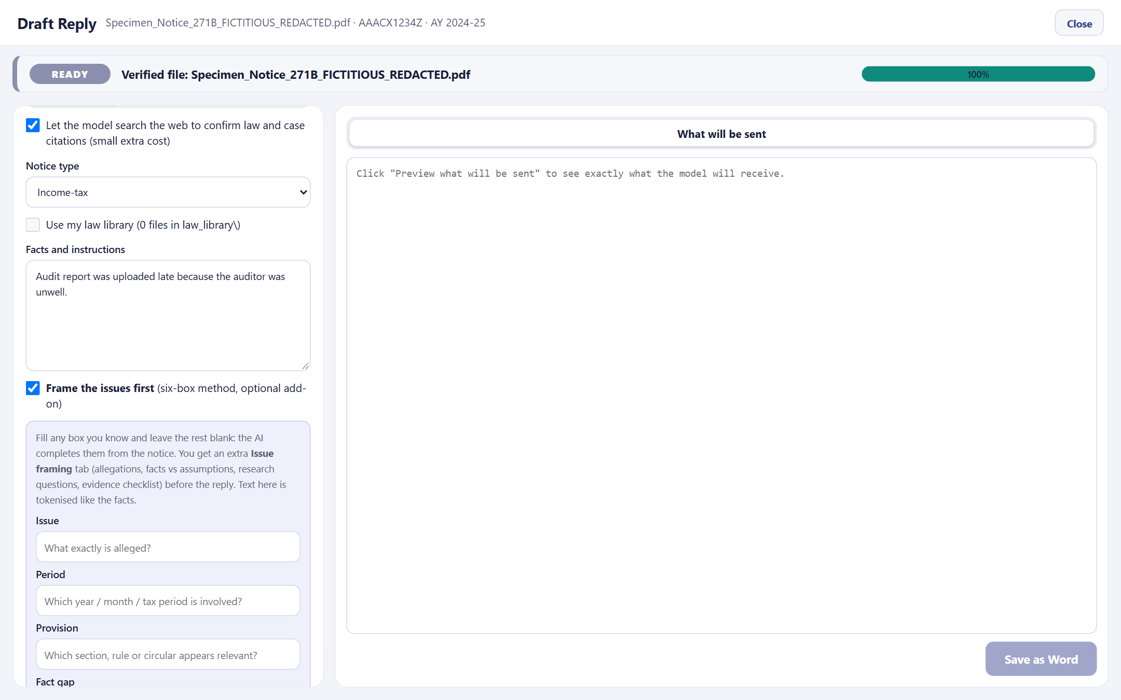
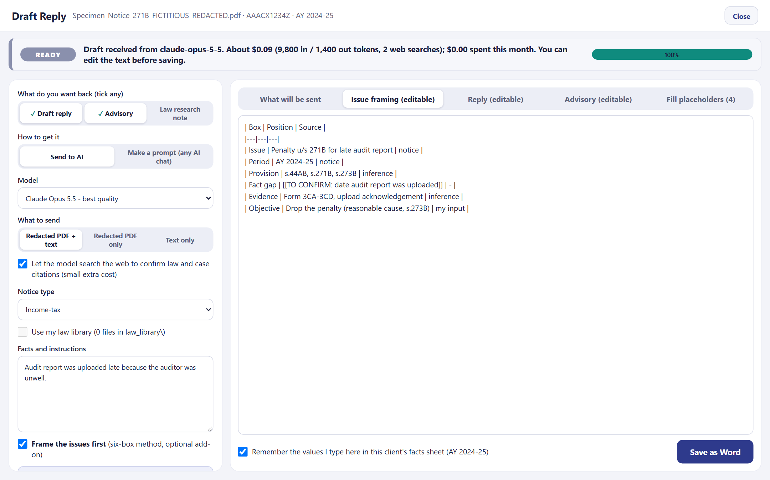
Optional · Six-box framing
PART A · USING MUKHOTA · Frame the issues first
Contents
Next
Tick the add-on and fill any box you know
The answer opens with an Issue framing tab
Issue
Period
Provision
Fact gap
Evidence
Objective
Leave boxes blank and the AI completes them · gaps become [[TO CONFIRM]], never assumptions · works for Send and Make a prompt
Notes:
The six-box method frames the problem before drafting: issue, period, provision, fact gap, evidence and objective. It is off unless ticked.

Slide 13
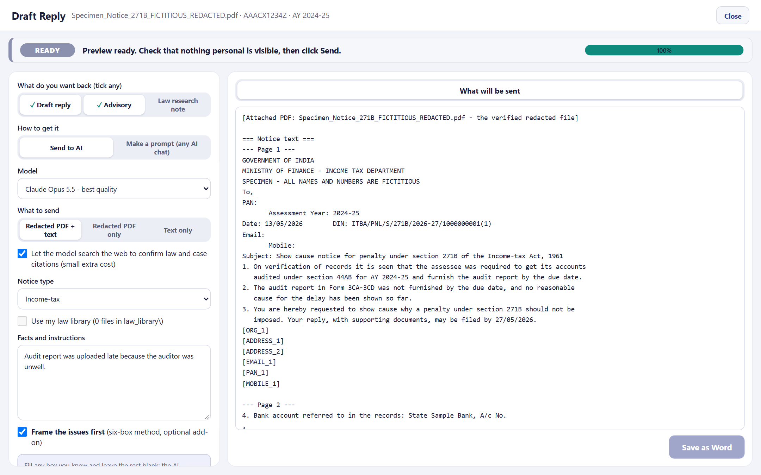
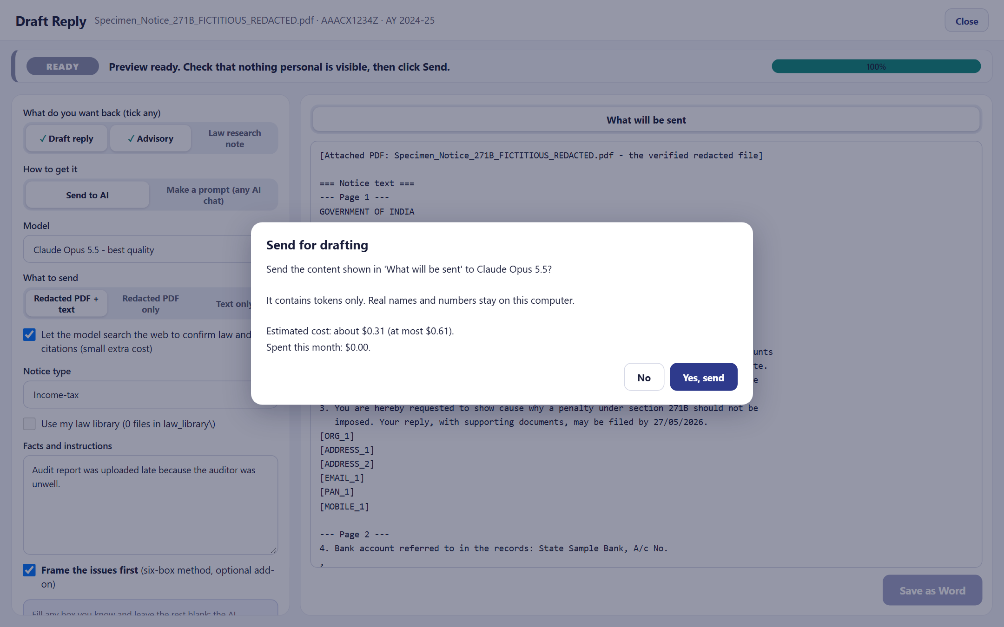
Preview, cost and send
PART A · USING MUKHOTA · Preview · Send
Contents
Next
Preview: exactly what leaves the computer, tokens only
Send: estimated cost and this month's spend, then confirm
Status bar: READY → WORKING (live message, timer) → DONE or FAILED
Monthly limit in Settings; a draft over it asks again with No as default
Notes:
Always read the preview. The cost question shows a typical and a maximum estimate before anything is sent.

Slide 14
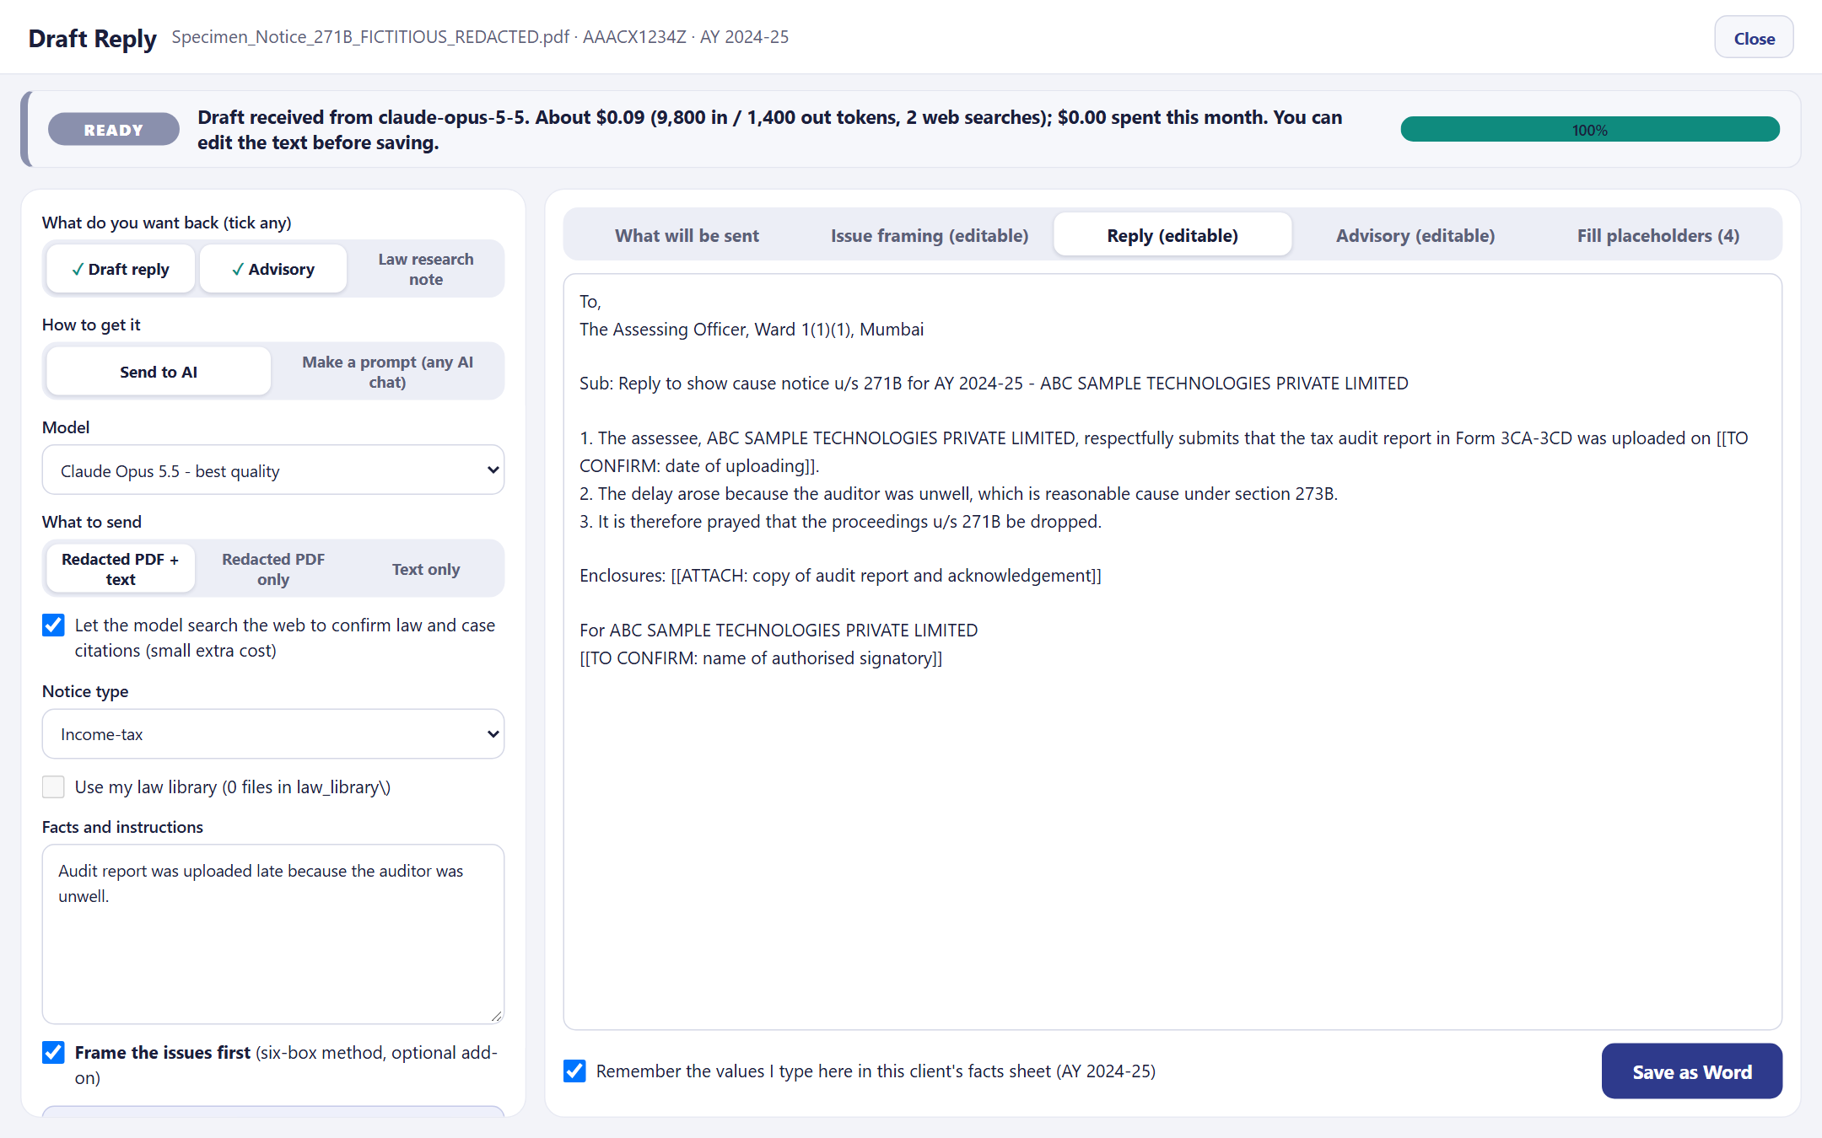
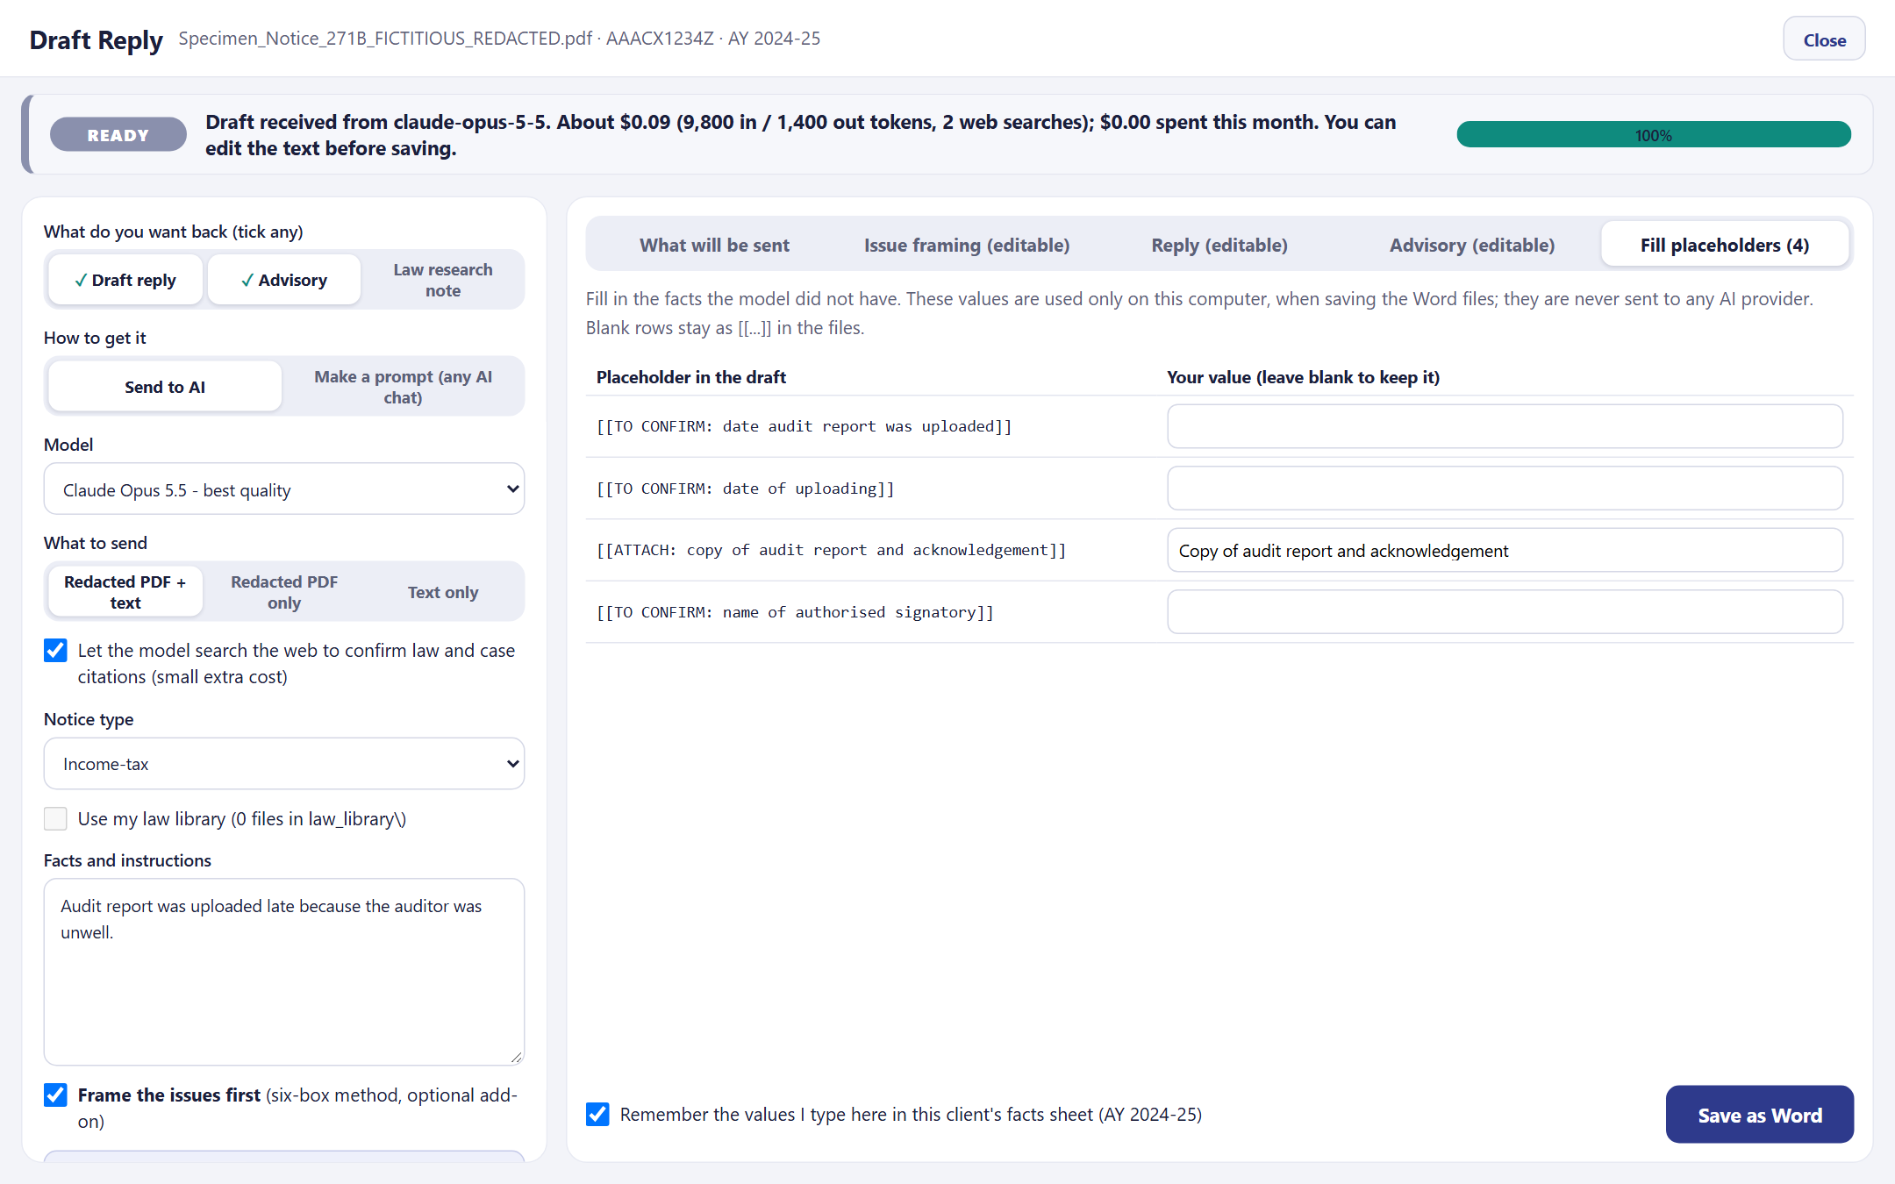
Review, fill and save
PART A · USING MUKHOTA · Save as Word
Contents
Next
Reply restored with real names, editable
Fill placeholders: values stay on this computer
Client facts… keeps status, auditor, turnover and dates per client (encrypted) and pre-fills placeholders
Save as Word: Reply, Advisory, Framing .docx + CHANGES.txt of your edits; never share the Advisory
Notes:
Gaps come back as [[TO CONFIRM]] or [[ATTACH]] placeholders. Fill them locally, edit the text, then save as Word in Bookman Old Style.

Slide 15
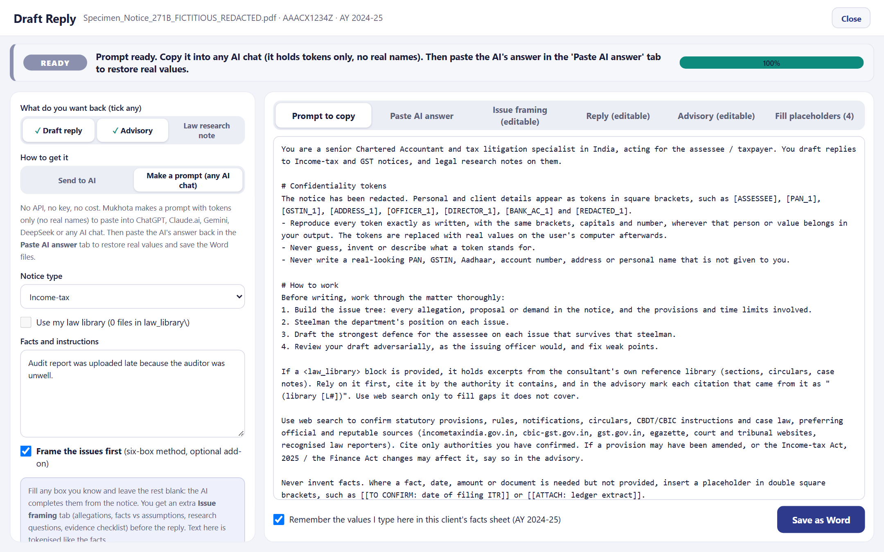
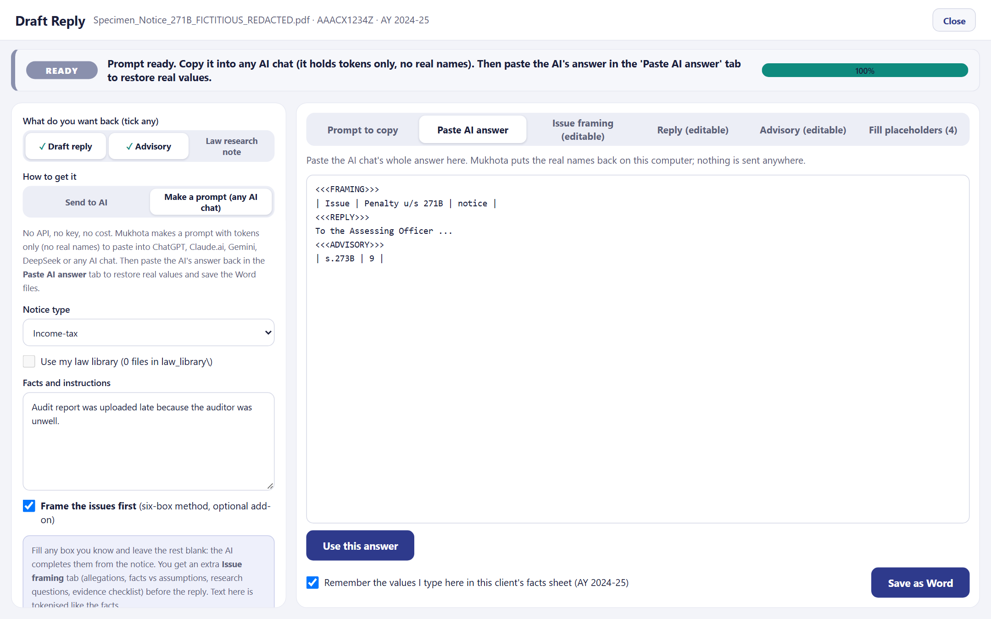
No API? Make a prompt
PART A · USING MUKHOTA · Any AI chat, no key, no cost
Contents
Next
1
Make prompt
2
Copy
3
Paste in any AI chat
4
Paste answer back
Choose Make a prompt, click Make prompt
Copy prompt or Save as .txt
ChatGPT, Claude.ai, Gemini, DeepSeek…
Use this answer: real names restored
Notes:
Prompt mode needs no API key. The prompt holds tokens only. Paste the chat's answer back and Mukhota restores the real values on this computer.

Slide 16
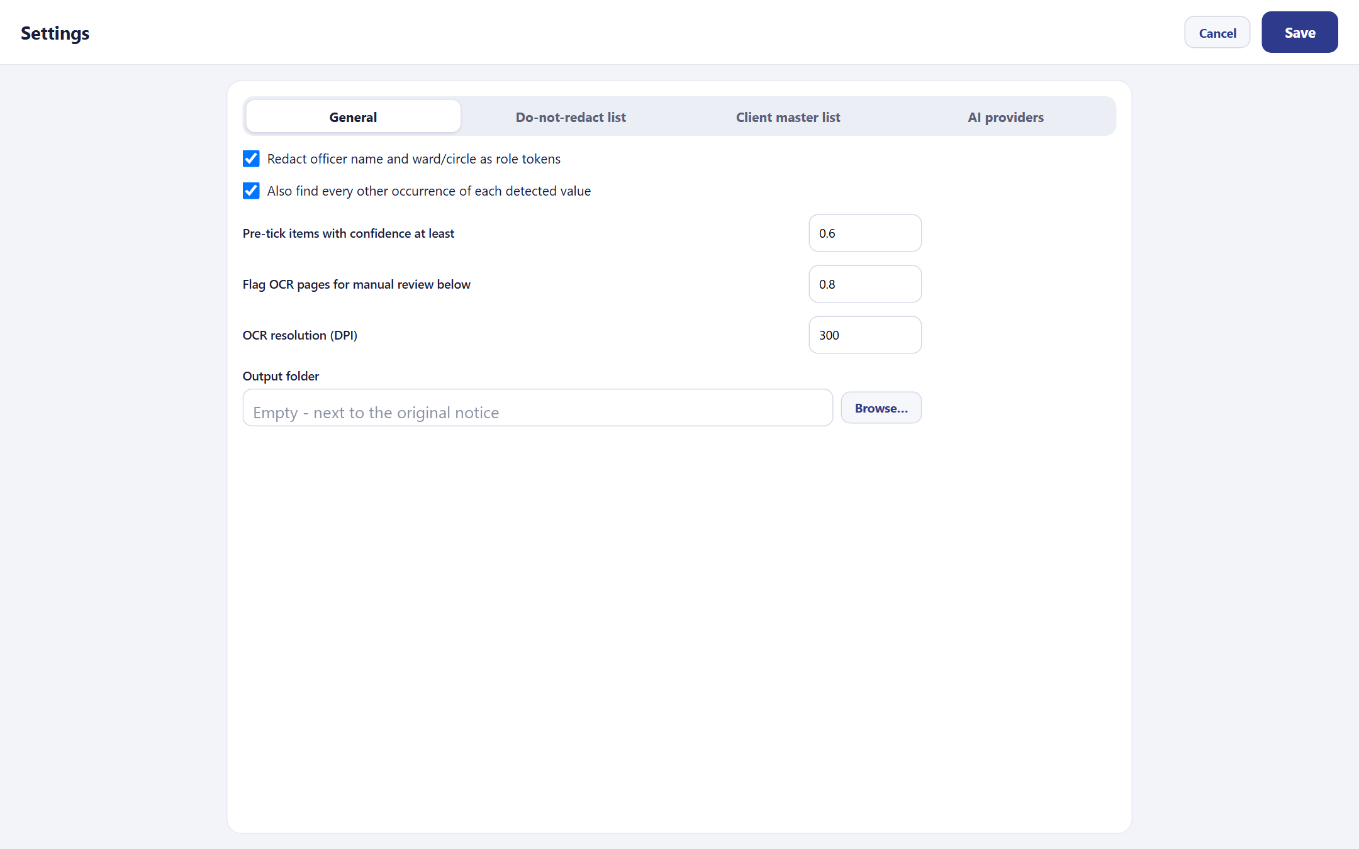
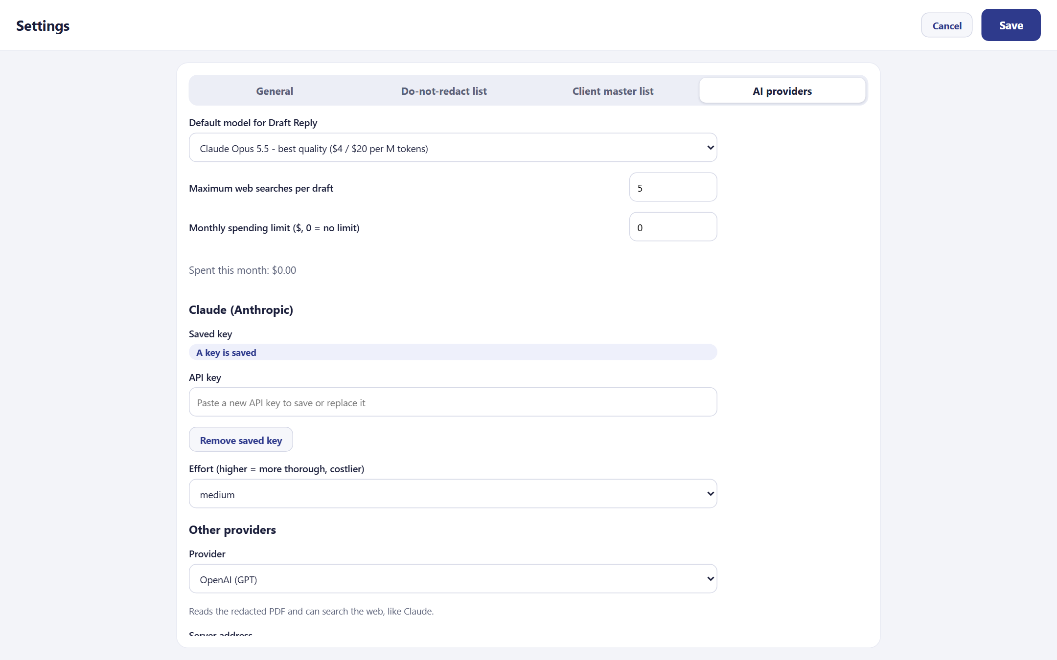
Settings and AI providers
PART A · USING MUKHOTA · Settings
Contents
Next
General: pre-tick confidence, OCR review level, DPI, output folder
AI providers: default model, web searches, monthly limit, keys
Do-not-redact list (allowlist.yaml) and Client master list (client_master.csv) are edited here too
API keys go to Windows Credential Manager, one per provider; never into a file
Notes:
Settings has four tabs. Other providers appear in Draft Reply once they have a model name; enter prices so the cost guard works.

Slide 17
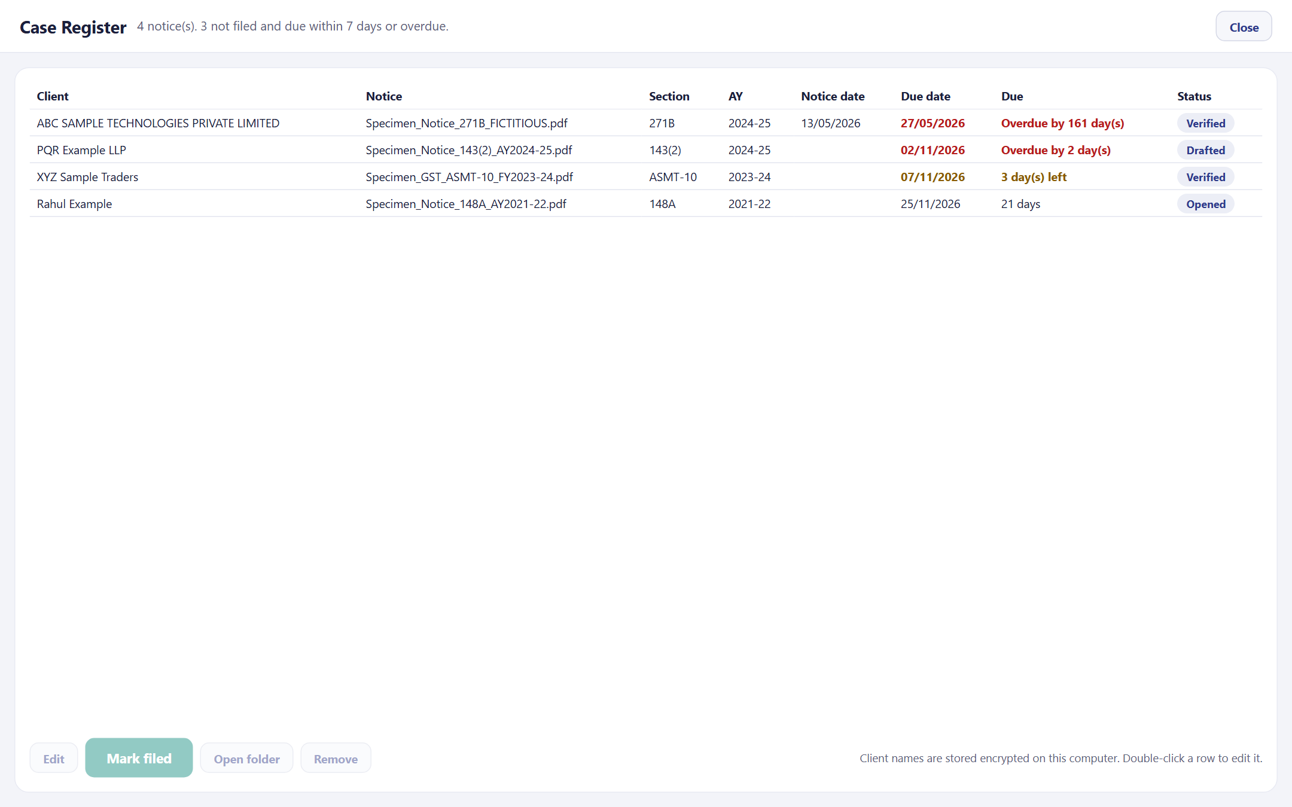
Case Register and reminders
PART A · USING MUKHOTA · Case Register
Contents
Next
Every notice opened is listed: client, section, AY, dates, status
Status moves Opened → Redacted → Verified → Drafted → Filed
Red = overdue, amber = due within 7 days
Double-click a row to correct it; Mark filed closes it
Start-up reminder bar and Windows notification
Client names are stored encrypted
Fictitious cases shown
Notes:
The register tracks every notice and its reply due date, with reminders when Mukhota starts.

Slide 18
Architecture
PART B · TECHNICALITIES · How the pieces fit
Contents
Next
Browser front end
Desktop front end
On this computer
index.html · app.js · style.css
stdlib HTTP server on 127.0.0.1 (mukhota/web)
PyQt6 window (mukhota/gui)
same engine, same files
config.yaml · allowlist.yaml
client_master.csv · register.db
clients\*.facts · usage.json · logs\
<notice>_mukhota\ outputs
Keys: Windows Credential Manager
Core engine · mukhota/core (no user interface)
ingest (PDF + OCR) · detectors · redact · verify · tokens (vault)
drafting · ai / ai_client / ai_openai / ai_gemini · netguard
register · client_facts · law_library · usage · docx_writer · config
Libraries
Internet
PyMuPDF · RapidOCR + ONNX Runtime · OpenCV · spaCy · cryptography · keyring · python-docx · AI SDKs
Only the chosen AI host, only during Draft Reply
Notes:
Two thin front ends share one engine. Everything is stored locally; the only outside connection is the AI host during drafting.

Slide 19
Reading the PDF and OCR
PART B · TECHNICALITIES · ingest.py
Contents
Next
1
Read
2
Classify
3
OCR
4
Flag
PyMuPDF opens the bytes in memory; the file on disk is never written
Text page if it has 30+ characters; scanned if images cover 80%+
RapidOCR (ONNX) at 300 DPI; line boxes split into word boxes
OCR confidence below 0.8 → Manual review required
Every word keeps its box, so a hit maps back to an exact rectangle on the page
Images inside text pages are not OCR'd; their pixels are still removed under a box
Rotated pages are supported through the page rotation flag
All thresholds are in config.yaml and Settings
Notes:
Ingest decides per page whether to trust the text layer or OCR the image, and keeps a box for every word.

Slide 20
Detection engine
PART B · TECHNICALITIES · detectors.py
Contents
Next
Layer | What it finds | How
Validated IDs | PAN, GSTIN, TAN, Aadhaar, CIN, LLPIN, DIN, Udyam, IEC, passport, vehicle | Patterns + GSTIN checksum + Aadhaar Verhoeff
Contact & bank | Mobile, landline, e-mail, IFSC, bank account | Account numbers only near A/c, Bank labels
Names & addresses | Addressee, M/s, Shri, Smt, Name:, Address:, PIN in addresses | To-block and salutation rules
Officers | Officer name, ward / circle | Lines near designations
Your lists | Client master entries; do-not-redact words and patterns | Exact + fuzzy (0.88) match
Language model | Other person / organisation names | spaCy en_core_web_sm, low confidence
Visual | QR codes, barcodes, signatures, stamps | OpenCV + ink / seal heuristics
Propagation: each confident value is searched everywhere else in the notice
Pre-tick at 60%: lower-confidence hits wait for your decision
Notes:
Detection is layered: validated identifiers first, then context rules, your own lists, the language model and visual detectors.

Slide 21
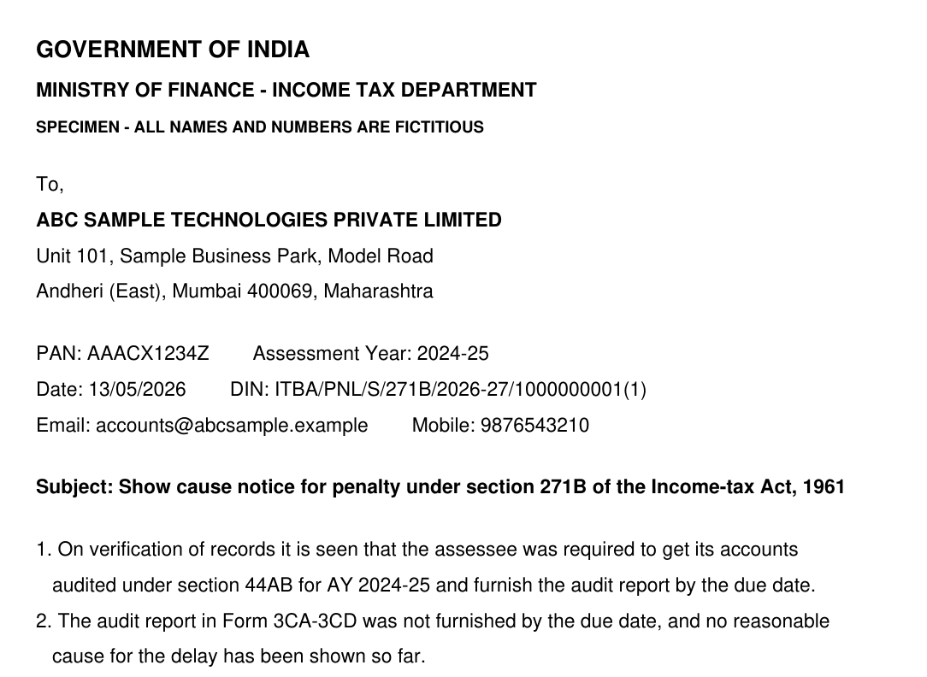

Redaction engine
PART B · TECHNICALITIES · redact.py
Contents
Next
Text pages: PyMuPDF redaction removes the text and image pixels under each box
Token label such as [PAN_1] written into the black box
Scanned pages: rendered at 300 DPI, boxes painted, rebuilt as a flat JPEG (quality 85)
Scrubbed: metadata, XMP, annotations, links, form fields, attachments, JavaScript
Producer set to 'Mukhota'
Why not just black boxes?
A drawn box leaves the text underneath: copy-paste reveals it
A scanned page can carry a hidden OCR text layer
Document properties often hold names and file paths
Notes:
Redaction removes data rather than hiding it, rebuilds image pages and scrubs every place PDFs hide information.

Slide 22
Verification engine
PART B · TECHNICALITIES · verify.py
Contents
Next
# | Check | How it works | Fails when
1 | Text layer | Search the output's text for every vault value | Any value found
2 | OCR re-read | Fresh OCR of every page, then search | Any value found
3 | Variants & tails | No spaces / lower case; last 4 digits of IDs | Variant found; tail next to a label
4 | Detectors re-run | Run all detectors on the output | New PII (your rejections are notes)
5 | Metadata | Inspect properties, XMP, annots, files, JS, forms | Anything non-empty
6 | Page coverage | Each page redacted or marked reviewed | A page with neither
Bound to the file: the report stores the SHA-256 of the original and the redacted PDF. Draft Reply calls is_verified(pdf), which is true only when a PASS report matches the file's current hash: change one byte and drafting is refused.
Notes:
Six independent checks, and a hash that ties the PASS result to the exact file.

Slide 23
Tokens and the vault
PART B · TECHNICALITIES · tokens.py
Contents
Next
ABC SAMPLE TECHNOLOGIES PVT LTD
[ORG_1]
AI answer with [ORG_1]
Restored on this PC
One value, one token: [ASSESSEE], [PAN_1], [ADDRESS_2]…; case, spacing, M/s, Pvt/Private, Ltd/Limited ignored
Roles from the client master (assessee, director, partner); else the first addressee is [ASSESSEE]
Vault: token ↔ value map encrypted with Fernet (AES-128 + HMAC-SHA256)
Key: Windows Credential Manager, service 'Mukhota'; opens only on the same Windows login
Typed facts get tokens too, kept in <notice>_draft.vault for later paste-back
Restore: exact tokens swapped back; any altered token is listed as a warning
Notes:
Tokens let the AI reason about who is who without knowing the real values. The vault that maps them back never leaves the computer.

Slide 24
AI layer
PART B · TECHNICALITIES · ai.py · drafting.py
Contents
Next
Provider | Redacted PDF | Web search | Connection
Claude (default) | Yes | Yes | Anthropic SDK
OpenAI (GPT) | Yes | Yes | Responses API
Google Gemini | Yes | Yes (Google Search) | google-genai
DeepSeek, Mistral, Groq, OpenRouter, Custom | No (text) | No | OpenAI-compatible
Ollama, LM Studio | No (text) | No | Local; nothing leaves the PC
Prompt = shared rules (reply_system.md) + one section file per output + notice + tokenised facts
Markers <<<FRAMING>>> <<<REPLY>>> <<<ADVISORY>>> <<<LAW_NOTE>>> split the answer into tabs
Cost guard: token count before sending, typical / max estimate, monthly limit, usage.json
Streaming progress feeds the status bar
Prompts are editable in prompts\
Notes:
One dispatcher talks to every provider. The prompt files are plain Markdown, so drafting style can be tuned without code.

Slide 25
Security and privacy model
PART B · TECHNICALITIES · netguard.py · server.py
Contents
Next
Network guard
Local web server
socket and DNS calls patched: only loopback and the chosen AI host are allowed; everything else raises an error
127.0.0.1 on a random port; one-time key (secrets, constant-time compare); Host header checked
Browser hardening
Secrets
Content-Security-Policy and nosniff headers; stops after 5 idle minutes
API keys and the vault key only in Windows Credential Manager
Logs
No telemetry
types and counts only; IDs, numbers, e-mails and paths masked
no auto-update; the original notice is never modified
Notes:
Privacy is enforced in code, not left to habit: the app itself cannot reach any server except the AI provider you chose.

Slide 26
Tech stack and project files
PART B · TECHNICALITIES · requirements.txt
Contents
Next
Library | Version | Used for
PyMuPDF | 1.26.7 | Read, redact, rebuild PDFs
RapidOCR + ONNX Runtime | 1.4.4 / 1.22.1 | OCR of scanned pages
OpenCV · NumPy | 4.11 · 2.5 | QR / barcode, image work
spaCy + en_core_web_sm | 3.8 | Name recognition
cryptography · keyring | 50.0 · 25.7 | Fernet vault, Credential Manager
PyQt6 | 6.9.1 | Desktop window
anthropic · openai · google-genai | 2.3 · 3.42 · 2.34 | AI providers
python-docx · PyYAML · Pillow | 1.2 · 6.0 · 13.0 | Word, config, images
Mukhota-Private-Notice-Desk\
├─ mukhota\core\ engine
├─ mukhota\web\ browser version
├─ mukhota\gui\ desktop version
├─ prompts\ AI instructions
├─ samples\ fictitious notice
├─ docs\ decks, screenshots
├─ law_library\ your references
└─ install.bat · run.bat · README.md
Python 3.12 (64-bit): the OCR engine does not support newer Python yet. Everything installs through pip.
Notes:
All dependencies are pinned and pure pip; install.bat rebuilds the environment on any Windows PC with Python 3.12.

Slide 27
Limits and good practice
PART B · TECHNICALITIES · Read before real use
Contents
Next
Known limits
Good practice
Indian names: the language model is weak on them; keep the client master list current
Signatures and stamps: detection is heuristic; check every page
OCR word boxes are estimated from line boxes
Free-text names in Facts are not always caught; read the preview
Drafts are a starting point; check every citation marked VERIFY
Practise on the fictitious specimen first
Share only files that show the green VERIFIED banner
Never share the .vault, the Advisory or the client facts
Use Side by side before sending anything out
Prefer a local model (Ollama / LM Studio) for the most sensitive matters
Notes:
Mukhota reduces risk; it does not remove the need for a professional's final look.

Slide 28
Mask it. Check it. Answer it.
Mukhota · Private Notice Desk · AICA-Level-2-Projects / Mukhota-Private-Notice-Desk
Back to contents
Notes:
End of the detailed guide.

