Slide 1
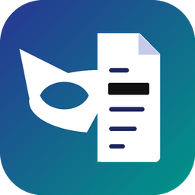

Mukhota
Private Notice Desk
Mask it. Check it. Answer it.
Redact personal data from tax notices, prove it is gone, then draft the reply with AI
Start the tour
AICA Level 2 · Capstone Project
Notes:
Mukhota means 'mask'. It is a private desk for tax notices: it masks personal data, checks the masking is complete, and only then lets AI help draft the reply. Click Start the tour to open the menu.

Slide 2





Explore the project
Click any tile. The Menu button on every slide brings you back here.
1
2
3
4
5
Problem statement
Solution
Usability
How it works
Technicalities
Why sharing tax notices is risky
Mask · Check · Answer
Five guided steps, any AI
From PDF to restored reply
Stack, security, AI layer
Notes:
The menu: five topics, one slide each. Click a tile's icon or heading to jump to it.

Slide 3


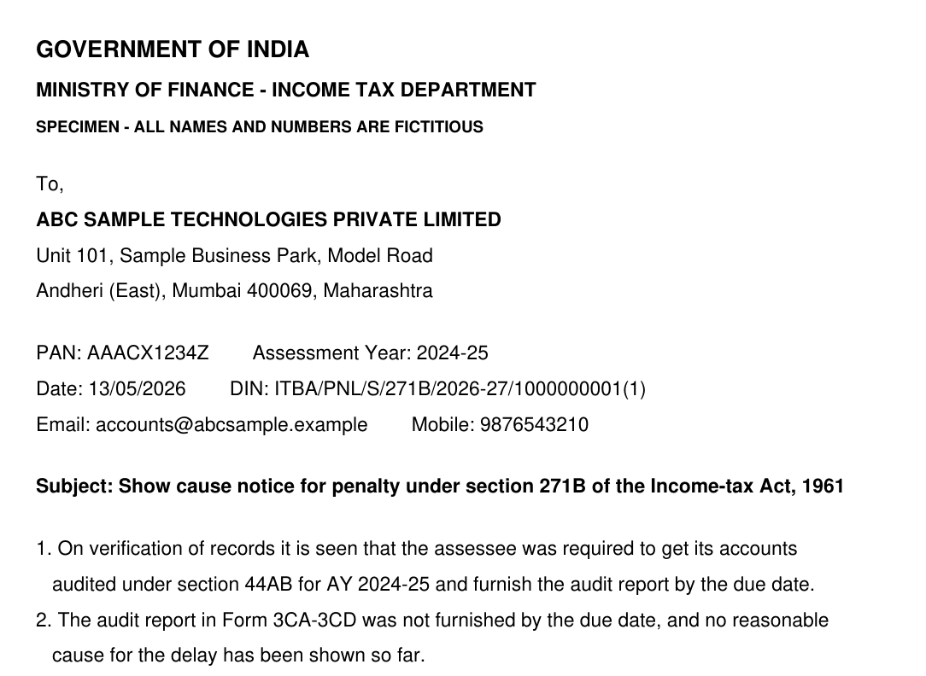




Problem statement
Menu
Next
Every notice is full of client PII
PAN, GSTIN, bank account, mobile, address, director DIN
Using AI means pasting it into a chatbot
Client data leaves the office on every prompt
Manual black boxes still leak
Hidden text layer, OCR of scans and metadata survive
Law and trust are at stake
17
personal details found on one 2-page specimen notice
DPDP Act, 2023 · ICAI confidentiality · client trust
Notes:
Tax professionals want AI help with notices, but each notice carries a client's identity and finances. Pasting it into a chatbot shares all of it. Drawing black boxes in a PDF editor often leaves the text underneath, scanned images and document metadata intact. Data-protection law and professional confidentiality both demand better.

Slide 4
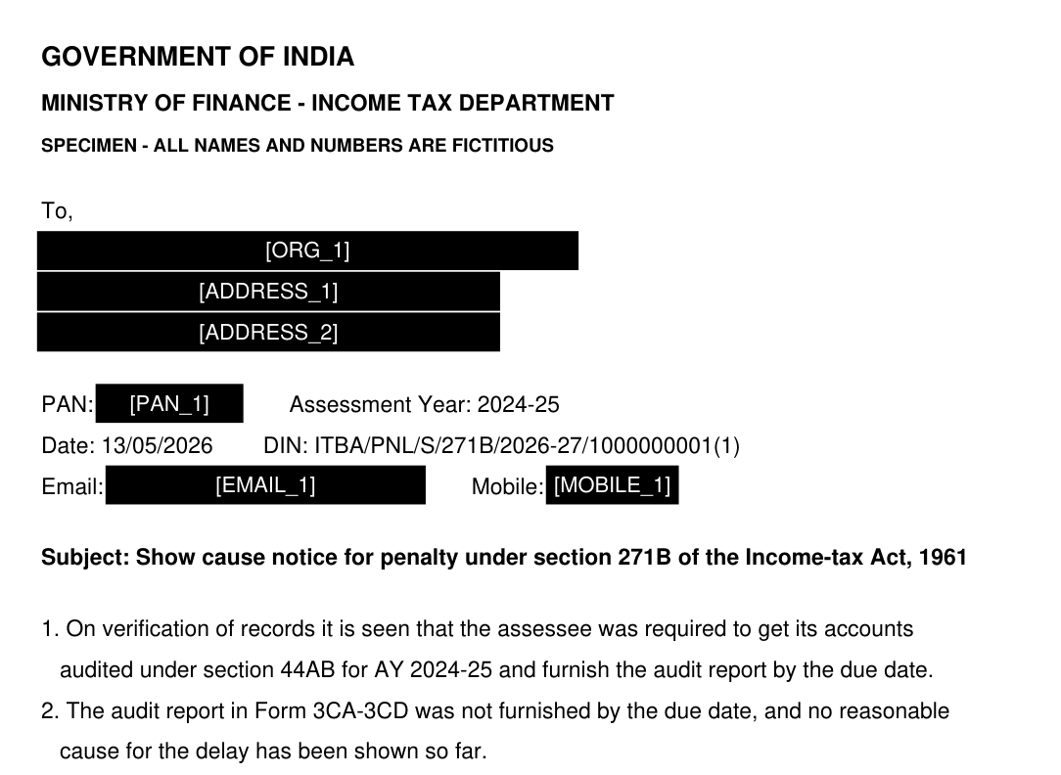



Solution
Menu
Next
Mask it
Finds PII and burns it out: text removed, not covered; scans flattened
Check it
6 independent checks prove nothing is left before you share
Original notice
Redacted + verified
Answer it
Original PDF is never changed
Redaction and verification run 100% offline
AI is optional, and sees [ORG_1], never the name
AI drafts the reply from tokens only; real names come back on your PC
Notes:
Mukhota does three things in order. Mask: it detects personal data and removes it from the PDF, not just covers it. Check: six separate tests confirm nothing is left. Answer: only then can AI draft a reply, and it only ever sees tokens like ORG_1 and PAN_1.

Slide 5

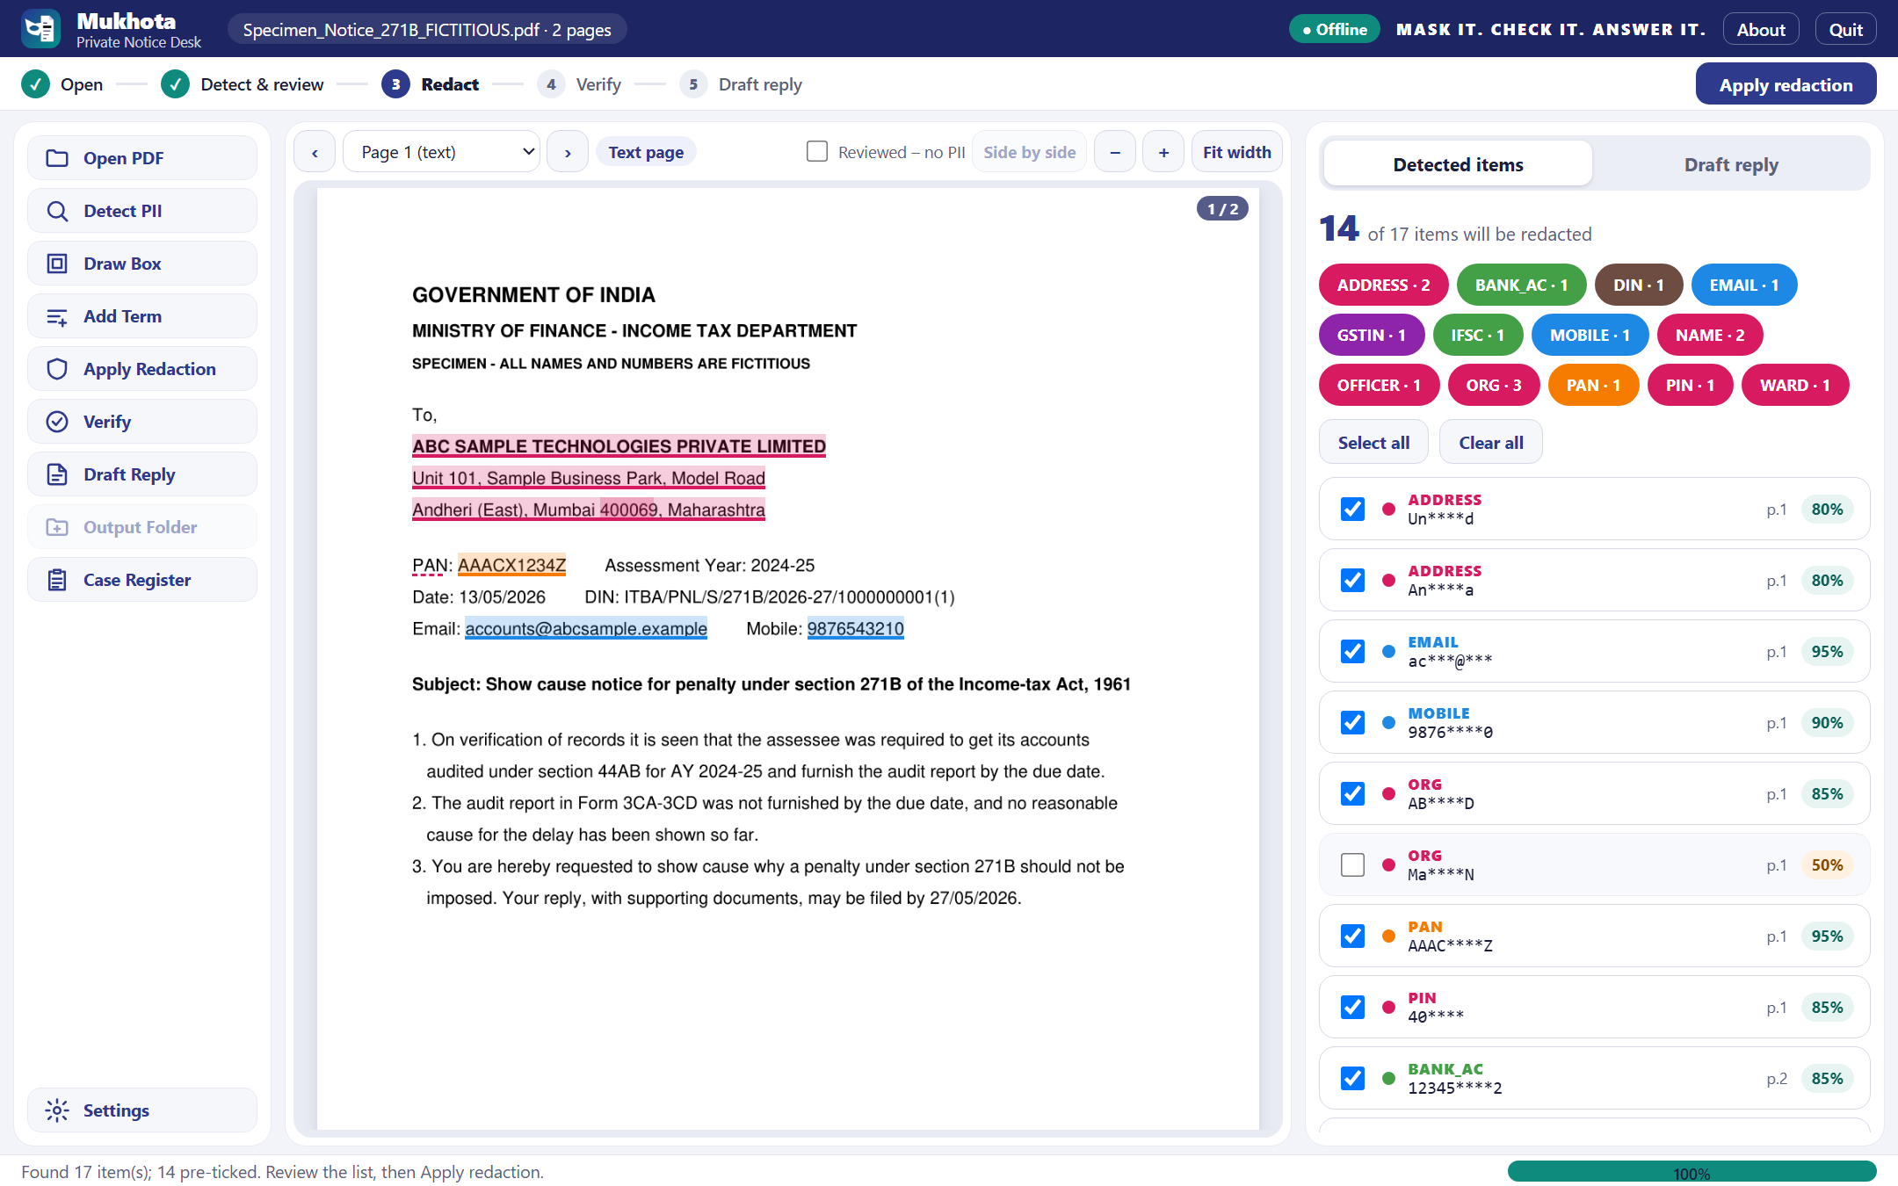




Usability
Menu
Next
Five guided steps
Open → Detect → Redact → Verify → Draft
Browser or desktop
Runs locally, no cloud account
Review in seconds
Chips, tick / untick, draw a box
Any AI, or none
Claude, OpenAI, Gemini… or a prompt
Ready-to-file output
Word reply, advisory, due-date register
Detect & review: every hit is highlighted on the page and listed with its type and confidence
Notes:
The workflow is a five-step bar, so a junior knows what to do next. It runs in the browser or as a desktop window, entirely on the user's computer. Review is quick: coloured chips by type, tick or untick, draw a box or type a term. For drafting, any major AI provider works, or Mukhota makes a prompt to paste into any chat with no API key.

Slide 6




How it works
Menu
Next
Open
Detect
Redact
Verify
Draft
PDF read, never changed; scans OCR'd
Patterns + NER find 13+ PII types
Text removed, token labels burnt in
6 checks + SHA-256 report
AI on tokens, restored locally
The token round trip
ABC SAMPLE TECHNOLOGIES PVT LTD
[ORG_1]
AI drafts with [ORG_1]
ABC SAMPLE TECHNOLOGIES PVT LTD
On your PC
Sent to AI
Answer comes back
Restored locally
Notes:
A notice goes through five steps. Detection combines patterns for PAN, GSTIN, IFSC, accounts and so on with spaCy named-entity recognition. Redaction removes the text itself and burns in labels like PAN_1. Verification re-reads the output six ways. For drafting, the AI receives only tokens; the encrypted vault on the user's computer swaps the real values back in.

Slide 7






Technicalities
Menu
Next
Python 3.12 core
Two front ends
Network guard
PyMuPDF · RapidOCR (ONNX) · OpenCV · spaCy
Browser on 127.0.0.1 with a one-time key · PyQt6 desktop
Sockets blocked except the chosen AI host
Encrypted vault
AI layer
Proof and output
Fernet token map; key in Windows Credential Manager
Anthropic · OpenAI · Gemini · OpenAI-compatible; PDF + web search
6-check report (txt + json, SHA-256) · Word via python-docx
Notes:
Everything is Python 3.12 and installs through pip. PyMuPDF reads and redacts PDFs, RapidOCR on ONNX reads scans, spaCy adds name detection. A socket-level guard blocks every connection except the AI provider chosen for drafting. Token maps are encrypted with Fernet, with the key in Windows Credential Manager. The AI layer speaks to Claude, OpenAI, Gemini and OpenAI-compatible providers, with cost estimates and a monthly cap.

Slide 8
Mask it. Check it. Answer it.
6
10
13+
verification checks before sharing
AI providers, or a no-API prompt
kinds of personal data detected
Repository folder: Mukhota-Private-Notice-Desk · AICA-Level-2-Projects
Back to menu
Notes:
To close: six checks before anything is shared, ten AI providers or none at all, and more than thirteen kinds of personal data detected and replaced with tokens. Thank you.

