Slide 1

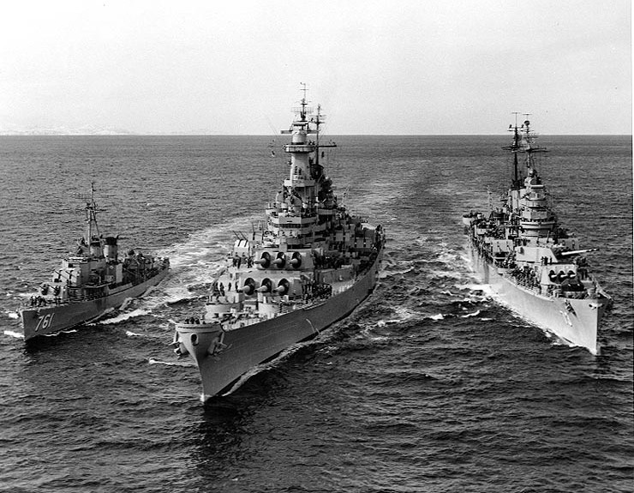
LET’S ALL PLAY
REACTIVE BATTLESHIPS!
Notes:
Before we start, there are few things you need to know:
Ben and I have worked together a few times.
We have spent a few long train rides together.
We get bored easily
We have been known to play battleships to pass the time
We decided to make an electronic version – we are geeks after all.
You also need to know I’m lazy..
But most importantly you need to know…. Ben is impatient.

Slide 2
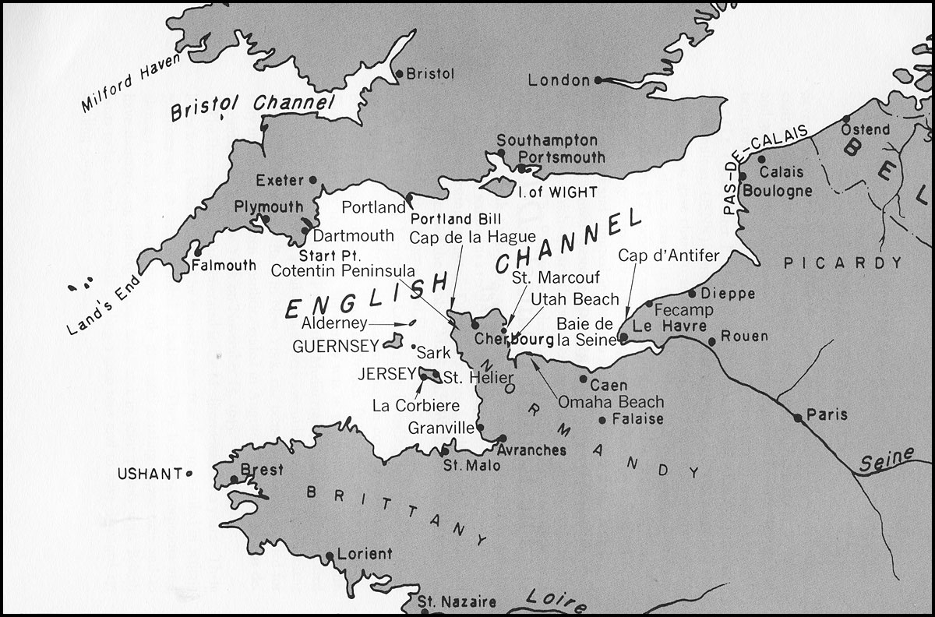
QUICK! HIDE!!
X
“X” MARKS THE SPOT
Notes:
As you might expect, I would hide my ‘battleship’ somewhere on a map, in the play area, and he would try to hit it.

Slide 3
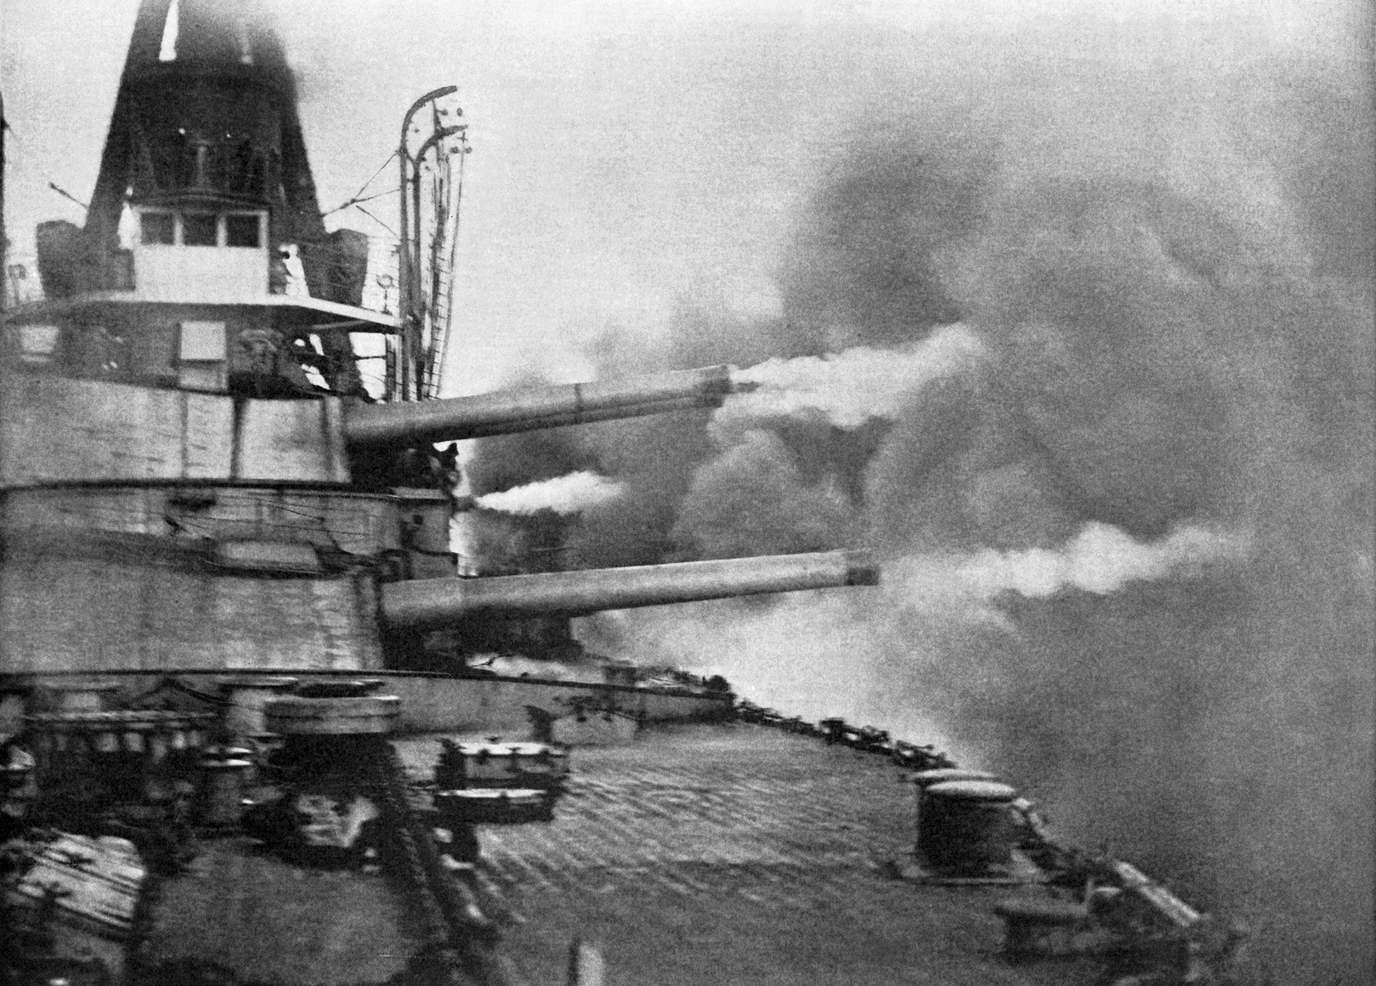
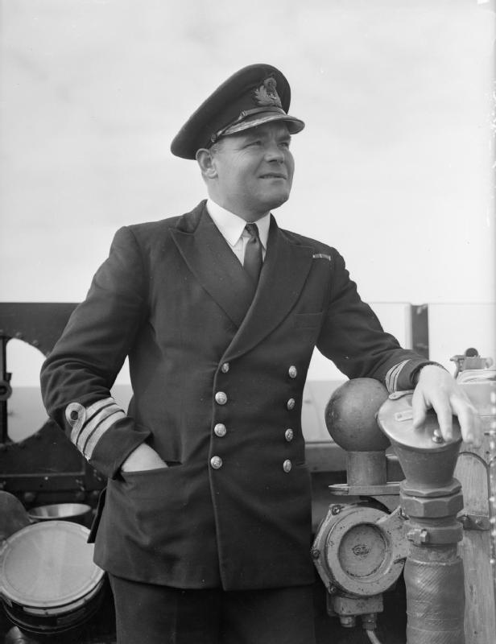
GUNNERY FOR GENTLEMEN
FIRE! HIT?
‘FRAID NOT OLD CHAP
Notes:
He would take a shot and I’d tell him if he’d hit my battleship and then he’d take another shot.
I got a bit bored of this, so we automated the hit detection.
He’d take a shot, the application would tell him it he’d hit.. And so we’d continue.

Slide 4
GUNNERY FOR IMPATIENT CADS!
FIRE! HIT?
SADLY NOT.
FIRE! HIT?
HARD LINES OLD BOY.
FIRE! HIT?
SORRY CHUM…
FIRE! HIT?
FIRE! HIT?
FIRE! HIT?
FIRE! HIT?
FIRE! HIT?
FIRE! HIT?
FIRE! HIT?
FIRE! HIT?
FIRE! HIT?
ERRR.. I SAY!
Notes:
He would take a shot and I’d tell him if he’d hit my battleship and then he’d take another shot.
I got a bit bored of this, so we automated the hit detection.
He’d take a shot, the application would tell him it he’d hit.. And so we’d continue.
However… Ben soon lost patience and decided to try some saturation gunnery…
This spoiled the game…. I had to find a way to keep up, and he wanted a way to go faster..

Slide 5
ENGINEERING SCHEMATICS
Co-ordinate Generator
(Gunnery!)
Geofence Detection
(Damage Control!)
User Interface
(Plotting Room!)
Kafka
Kafka
Notes:
So we automated…

Slide 6
ENGINEERING SCHEMATICS
Geofence Detection
(Damage Control!)
Co-ordinate Generator
(Gunnery!)
Geofence Detection
(Damage Control!)
User Interface
(Plotting Room!)
Kafka
Kafka
Geofence Detection
(Damage Control!)
Notes:
…and it wasn’t fast enough. Detecting whether a shot lands inside our outside a geofence is quite computationally expensive.

Slide 7
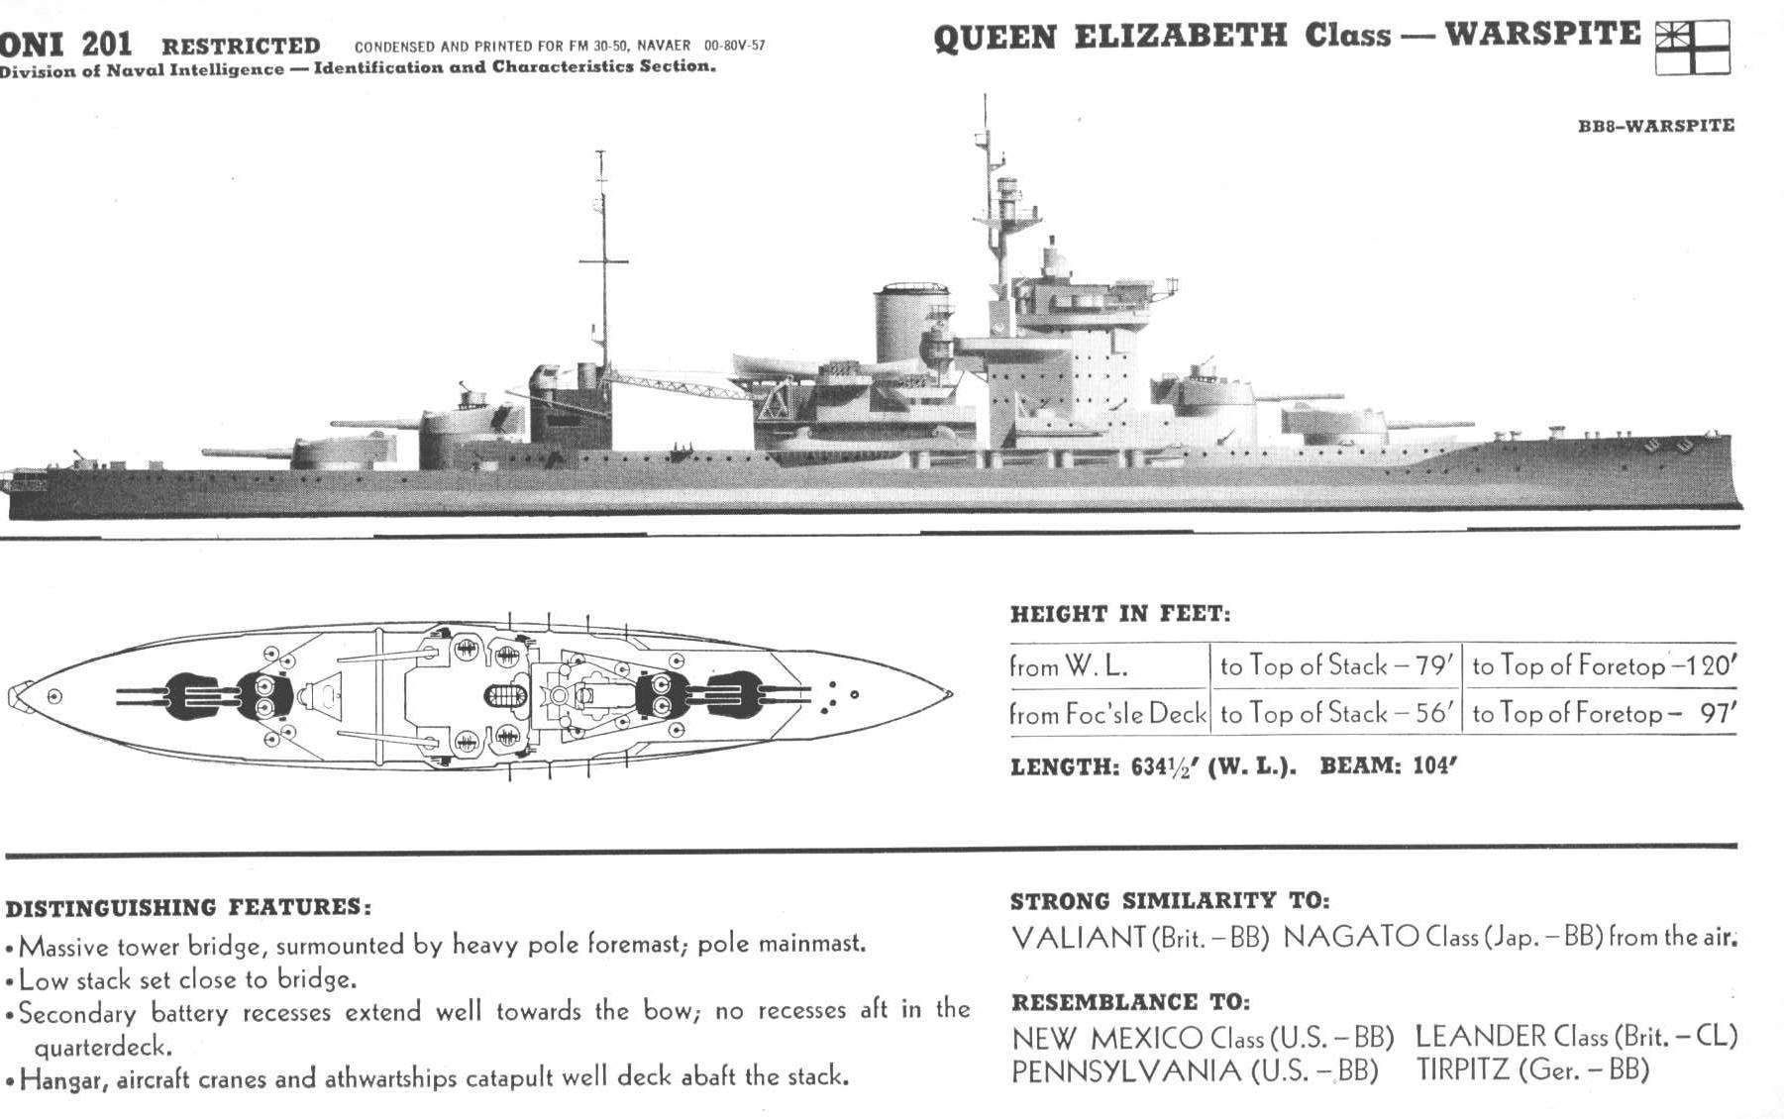
I SAY!
QUITE THE CHEAT OLD BOY
Notes:
As you might expect, I would hide my ‘battleship’ somewhere on a map, in the play area, and he would try to hit it.
He would take a shot and I’d tell him if he’d hit my battleship and then he’d take another shot.
I got a bit bored of this, so we automated the hit detection.
He’d take a shot, the application would tell him it he’d hit.. And so we’d continue.

