Slide 1


Natural Language Processing to identify substances related to overdose deaths: An R-tidymodels workshop
David Goodman-Meza

Slide 2
References
R for data science: https://r4ds.had.co.nz/
Text Mining with R: https://www.tidytextmining.com/
Statistical Machine Learning: https://bcheggeseth.github.io/253_fall_2021/index.html
Supervised Machine Learning for Text Analysis: https://smltar.com/

Slide 3







NLP Workflow
Exploratory Data Analysis
Pre-Process Data
Linear regression - lm
Logistic regression - glm
KNN - kknn
Naive Bayes - naivebayes
Random forest - randomForest, ranger
Boosted trees - xgboost
SVM – Kernlab, liquidSVM
Neural networs – Keras, nnet
Model
Evaluate

Slide 4
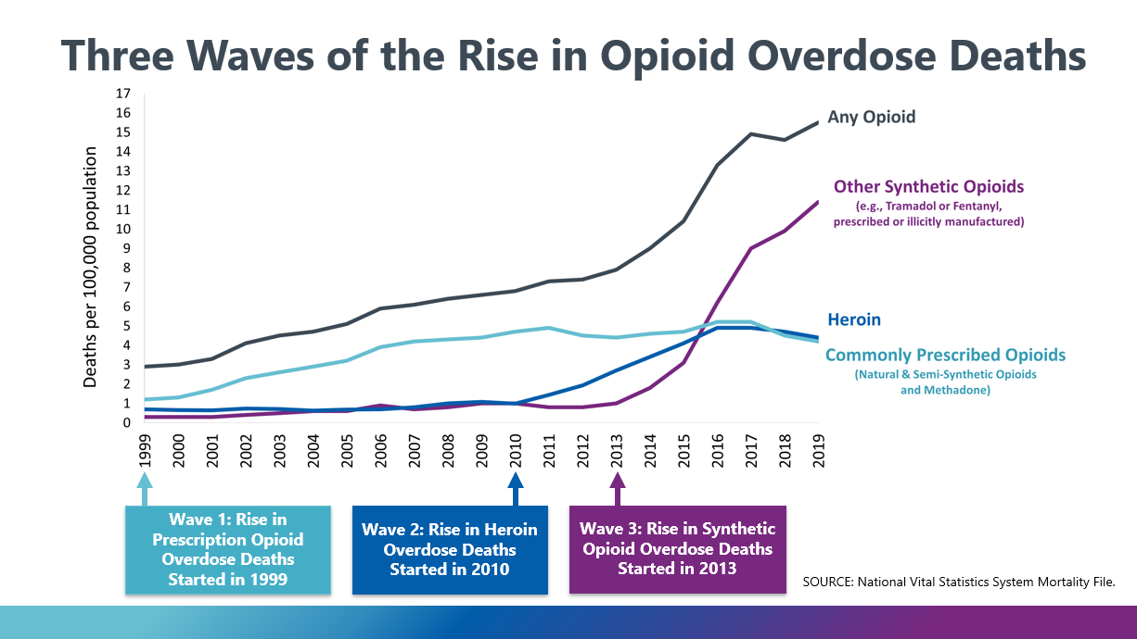
Drug Overdoses U.S.

Slide 5
Premise
According to the CDC there were over 93,000 deaths in 2020
We know this 7 months after the fact
We only know these trends at the national- and state-levels
We only know this over a 12-month period
Overall objective is to create an automated approach to rapidly and accurately identify substances that led to death in coroners’ report to provide much more rapid surveillance data around overdoses.
Aims:
To evaluate a natural language processing (NLP) based approach on their diagnostic accuracy to identify substances related to overdose in coroners/medical examiner data
Ahmad F, Rossen, LM, Sutton, P. Provisional drug overdose death counts: National Center for Health Statistics; 2021 [8/3/2021]. Available from: https://www.cdc.gov/nchs/nvss/vsrr/drug-overdose-data.htm.

Slide 6
Train-test split
data_split <- initial_split(df,
prop = 0.8,
strata = .y)
train <- training(data_split) #Save training as object
test <- test(data_split) #Save testing as object
#Other tools in rsample
cv_folds <- vfold_cv(training, v = 5, strata = .y) #Cross validation
boot_test <- bootstraps(testing, times = 1000, strata = .y) #Bootstrapping

Slide 7

Recipe
rec( y ~ x1 + x2 + x3, data = df) #Initial set-up
rec <- rec( y ~ x1 + x2 + x3, data = df) %>% #Initial set-up
update_role(new_role = “outcome”) %>% #Update roles (if needed)
update_role(all_continous( ), new_role = “predictor”) %>%
step_( ) %>% #Add steps
step_( )
prepped.rec <- Prep(rec)
baked.rec <- bake(prepped.rec, new_data = )

Slide 8
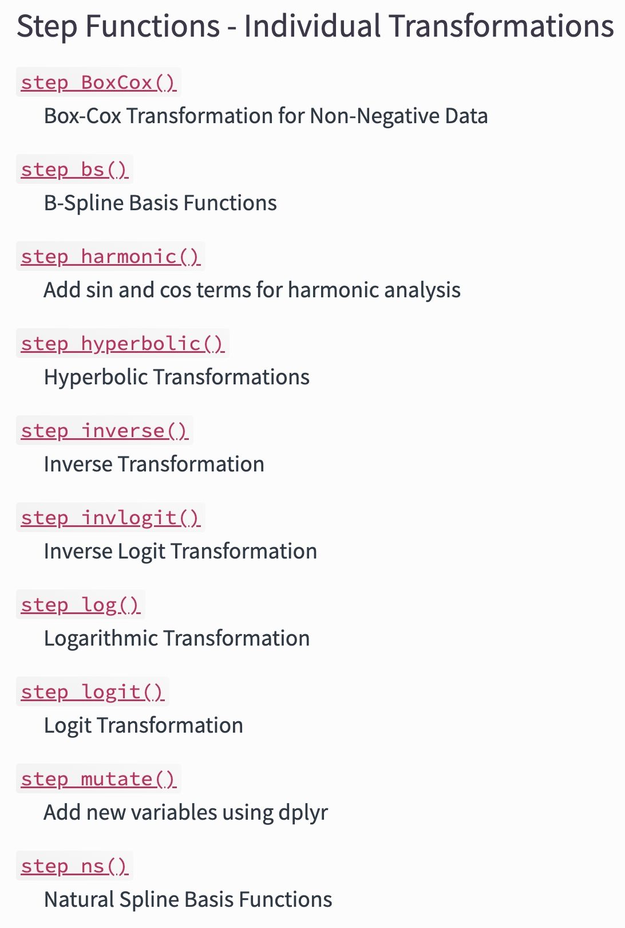
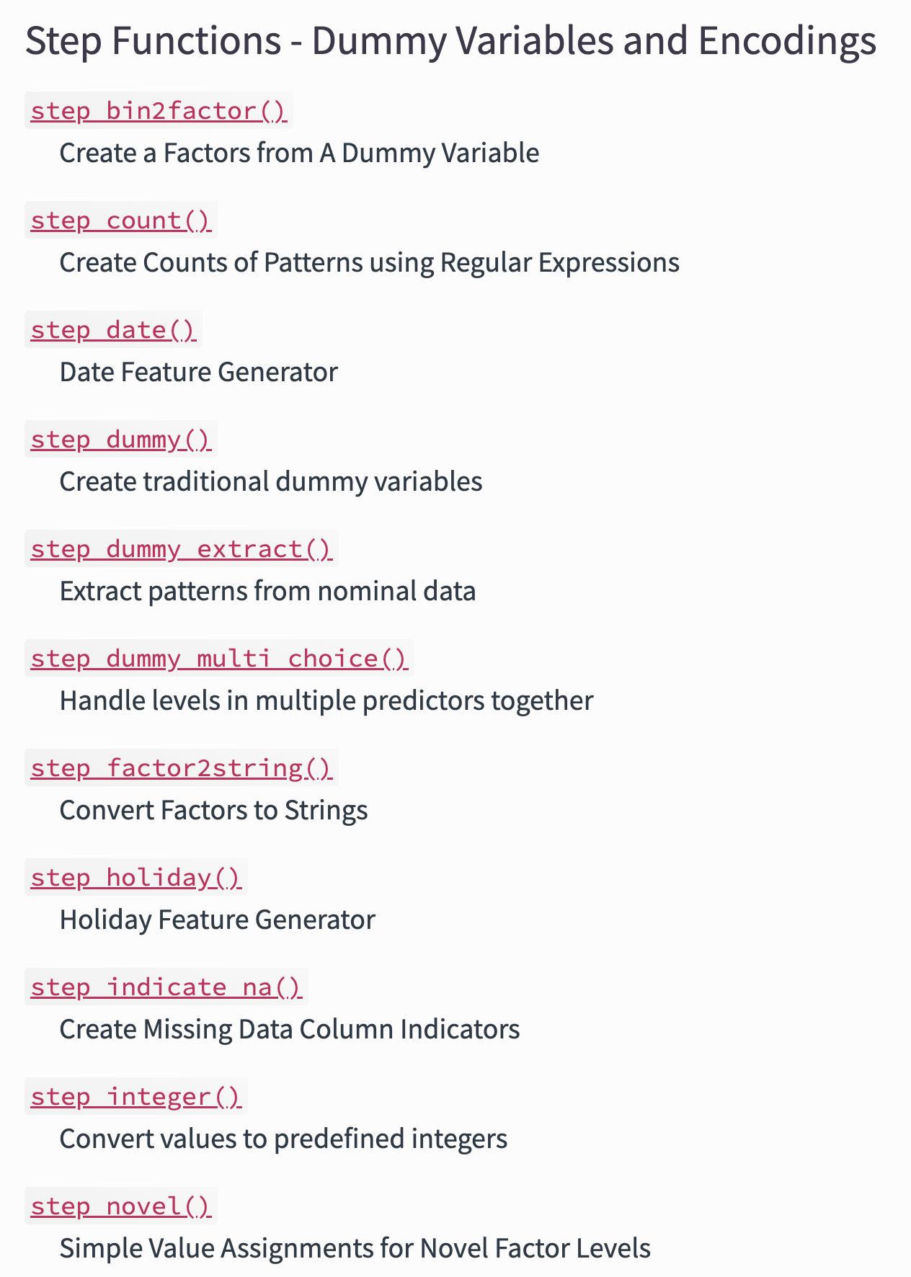
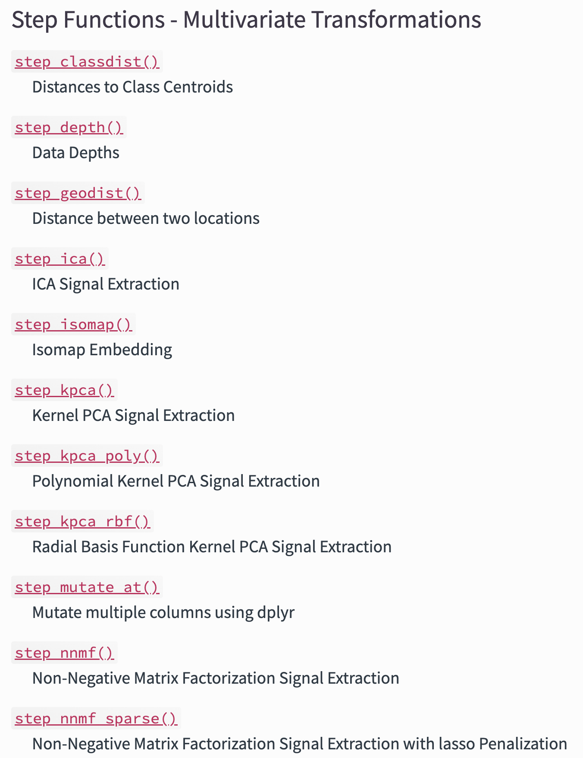
Recipes: Steps https://www.tidymodels.org/find/recipes/

Slide 9
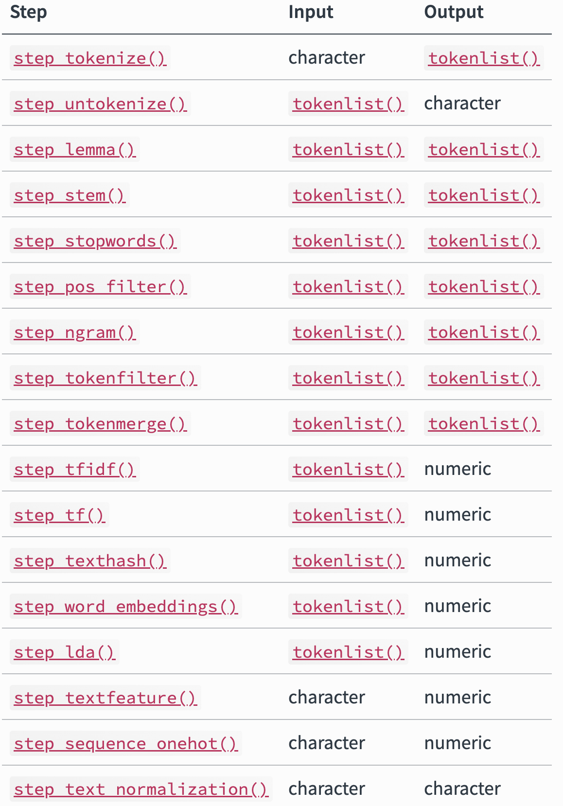
Textrecipes

Slide 10
Recipe: Example
rec <- rec(fentanyl ~ text, data = training) %>% #Initial set-up
step_tokenize(text, #Tokenize, default word
options = list(lowercase = F,
strip_punct = TRUE)) %>%
step_tokenfilter(text,
min_times = 5,
max_times = Inf) %>% #Filter
step_tfidf(text) #Weight words based on TF-IDF
#Others
step_tf(text)
step_sequence_onehot(text)
step_word_embeddings(text, embeddings = glove_embed, prefix ="emb_")

Slide 11



NLP Workflow
Exploratory Data Analysis
Pre-Process Data
Linear regression - lm
Logistic regression - glm
KNN - kknn
Naive Bayes - naivebayes
Random forest - randomForest, ranger
Boosted trees - xgboost
SVM – Kernlab, liquidSVM
Neural networs – Keras, nnet
Model
Evaluate

Slide 12
Set up Models
rf_spec <- rand_forest() %>% #Pick a model
set_mode(“classification”) %>% #Set the mode
set_enginge(“randomForest”) #Set the engine
Search models:
https://www.tidymodels.org/find/parsnip/

Slide 13
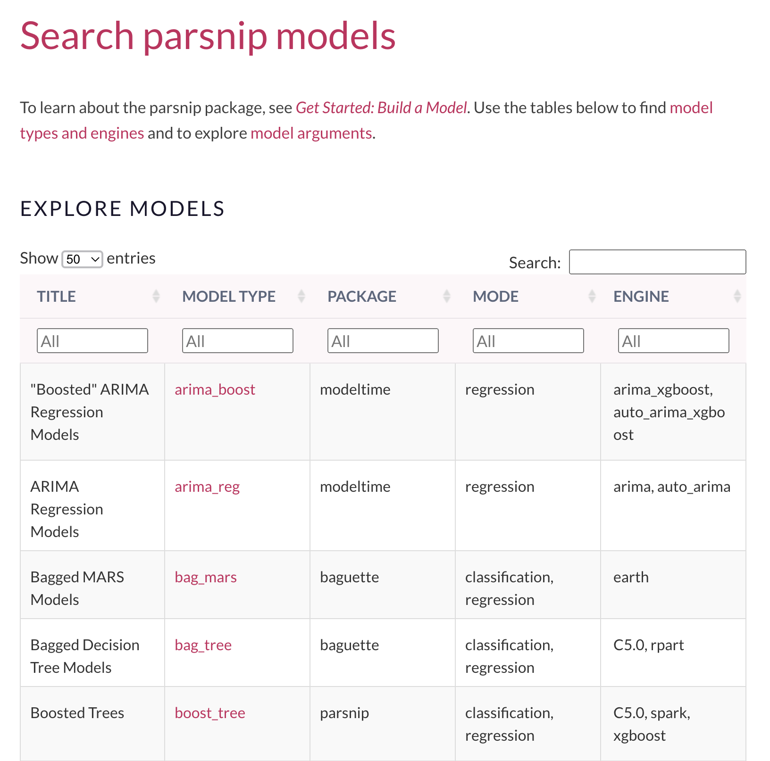
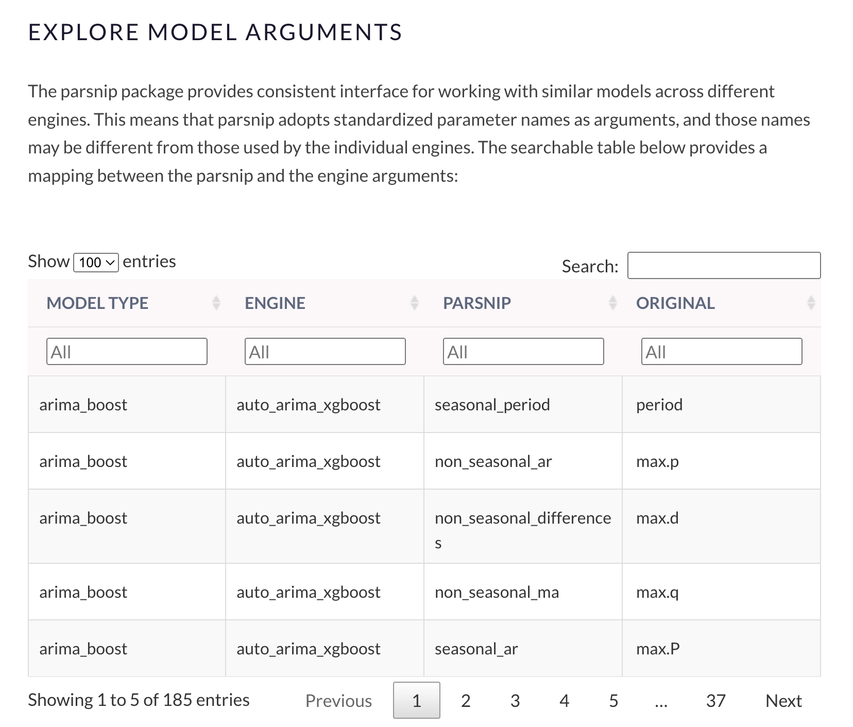

Slide 14
Set up Models
rf_spec <- rand_forest() %>% #Pick a model
set_mode(“classification”) %>% #Set the mode
set_enginge(“randomForest”) #Set the engine
#Set hyperparameters manually or for automatic tunning
rand_forest(min_n = tune( ), trees = tune( ), mtry = tune( )) %>% set_mode(“classification”) %>% set_enginge(“randomForest”)

Slide 15
Set up hyperparameter grid
grid_ctrl <- control_grid(
save_pred = TRUE,
parallel_over = "everything",
save_workflow = FALSE,
event_level = "first"
)
#Set cores for parrallelization
doMC::registerDoMC(cores = parallel::detectCores(logical = FALSE))
doMC::registerDoMC(cores = 4)

Slide 16
Putting it together: Workflow vs workflowsets
rf_wflow <- workflow() %>%
add_recipe(rec) %>%
add_model(rf_spec)
rf_fit <- rf_wflow %>%
fit(data = mtcars)
#We would have to write individual code for each model

Slide 17
Putting it together: workflow vs Workflowsets
wflw_set <- workflow_set(
preproc = list(recipe_1 = rec1, recipe_2 = rec2, ...),
models = list(model_1 = model_spec, model_2 = model_spec2,..),
cross = TRUE)
grid_resutls <- wflw_set %>%
workflow_map( )

Slide 18
Putting it together: workflow vs Workflowsets
cv_folds_train <- vfold_cv(training, v = 5, strata = .y) #Cross validation
grid_results <- wflw_set %>%
workflow_map(
seed = 100, #For reproducibility
resamples = cv_folds, #Cross validation
grid = 10, #Number of tunning runs
control = grid_ctrl, #Grid set-up
metrics = metric_set( #Metrics to calculate
recall, precision, f_meas, accuracy, kap, roc_auc, sens, spec, ppv, npv),
verbose = T #View progress
)

Slide 19
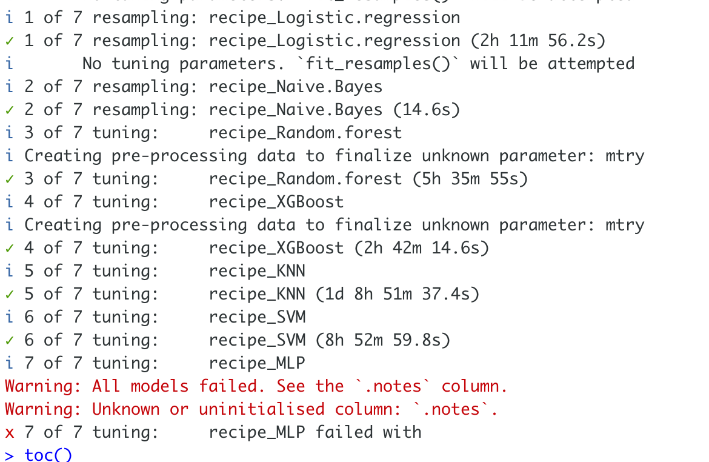
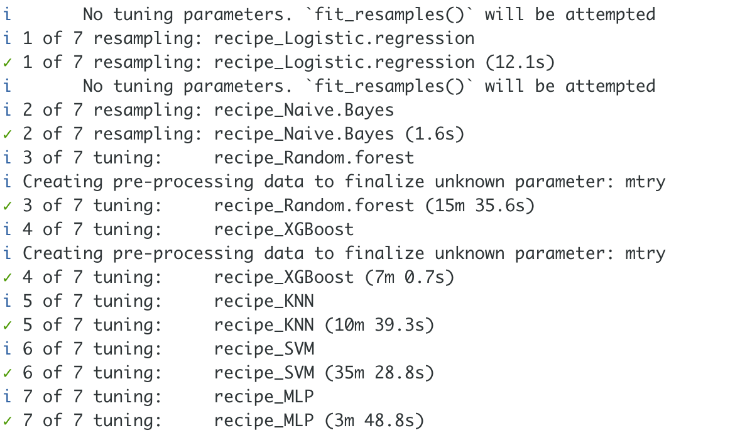
Training output
Inf tokens
100 tokens

Slide 20
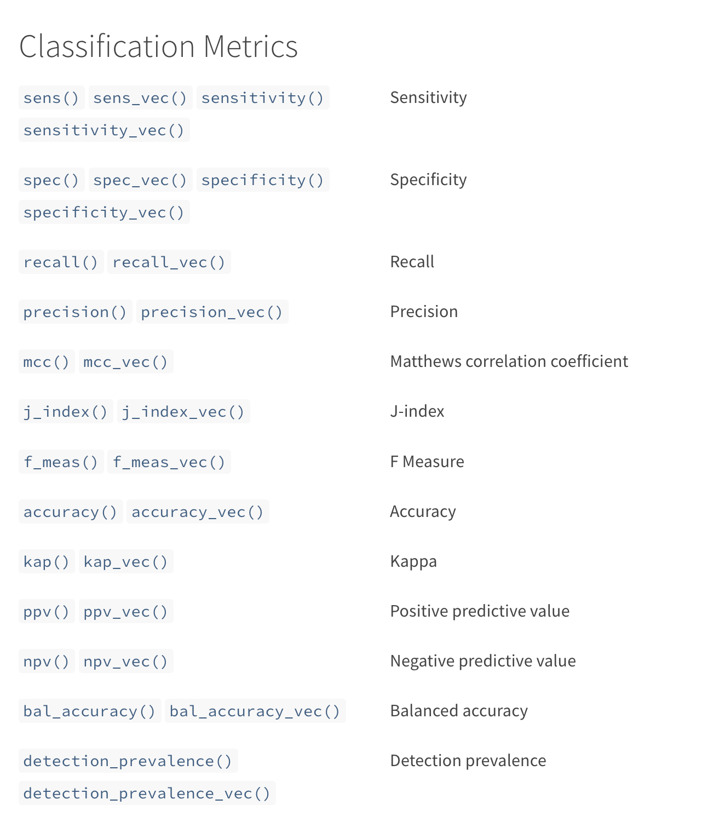
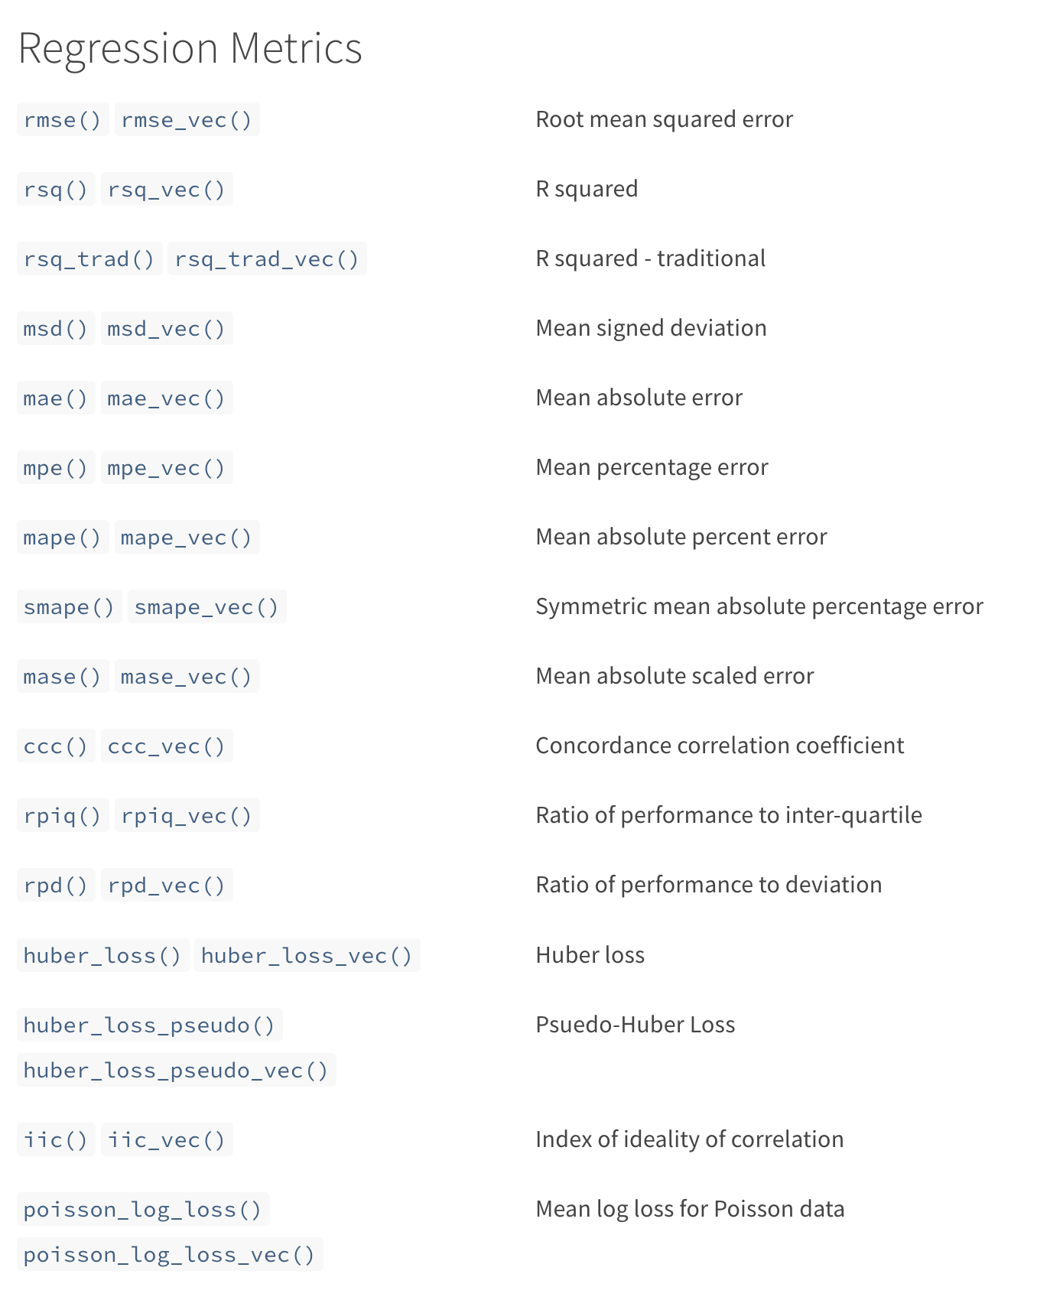

Slide 21
Plot Training Results
grid_results %>% autoplot() #Plot all results
grid_results %>% autoplot(select_best = T) #Plot best results
grid_results %>% collect_predictions() %>% #ROC curve
roc_curve(truth = var, estimate = .pred_1) %>%
autoplot()
grid_results %>% collect_predictions() %>% #PR curve
pr_curve(truth = var, estimate = .pred_1) %>%
autoplot()

Slide 22
Table Training Results
grid_results %>% #Get all metrics
collect_metrics( )
grid_results %>% #Get only best metrics
rank_results(
rank_metric = "f_meas",
select_best = TRUE
)

Slide 23
Evaluate on Test dataset alone
best.workflow <- tbl.train.results.best$wflow_id[1]
best.paramaters <- grid_results %>%
extract_workflow_set_result(tbl.train.results.best$wflow_id[1]) %>%
select_best(metric = "f_meas")
test_results <- grid_results %>%
extract_workflow(best.workflow) %>%
finalize_workflow(best.paramaters) %>%
last_fit(split = data_split,
metrics = metric_set(f_meas, accuracy, kap, roc_auc, sens, spec, ppv, npv))

Slide 24
Get final results
test_results %>% collect_metrics() #Results long
test_results %>% #Results wide
collect_metrics() %>%
pivot_wider(
id_cols = .config,
names_from = .metric,
values_from = .estimate
)

Slide 25
Confusion Matrix
test_results %>%
collect_predictions( ) %>%
conf_mat(truth, .pred_class) %>%
autoplot(type = "heatmap") #Can also be “mosaic”

Slide 26
Feature importance
test_results %>%
pluck(".workflow", 1) %>%
extract_fit_parsnip() %>%
vip(num_features = 20)

Slide 27
Questions?
dgoodman@mednet.ucla.edu

