Slide 2
References
R for data science: https://r4ds.had.co.nz/
Text Mining with R: https://www.tidytextmining.com/
Statistical Machine Learning: https://bcheggeseth.github.io/253_fall_2021/index.html
Supervised Machine Learning for Text Analysis: https://smltar.com/

Slide 3







NLP Workflow
Exploratory Data Analysis
Pre-Process Data
Linear regression - lm
Logistic regression - glm
KNN - kknn
Naive Bayes - naivebayes
Random forest - randomForest, ranger
Boosted trees - xgboost
SVM – Kernlab, liquidSVM
Neural networs – Keras, nnet
Model
Evaluate

Slide 4
Train-test split
data_split <- initial_split(df,
prop = 0.8,
strata = .y)
train <- training(data_split) #Save training as object
test <- test(data_split) #Save testing as object
#Other tools in rsample
cv_folds <- vfold_cv(training, v = 5, strata = .y) #Cross validation
boot_test <- bootstraps(testing, times = 1000, strata = .y) #Bootstrapping

Slide 5

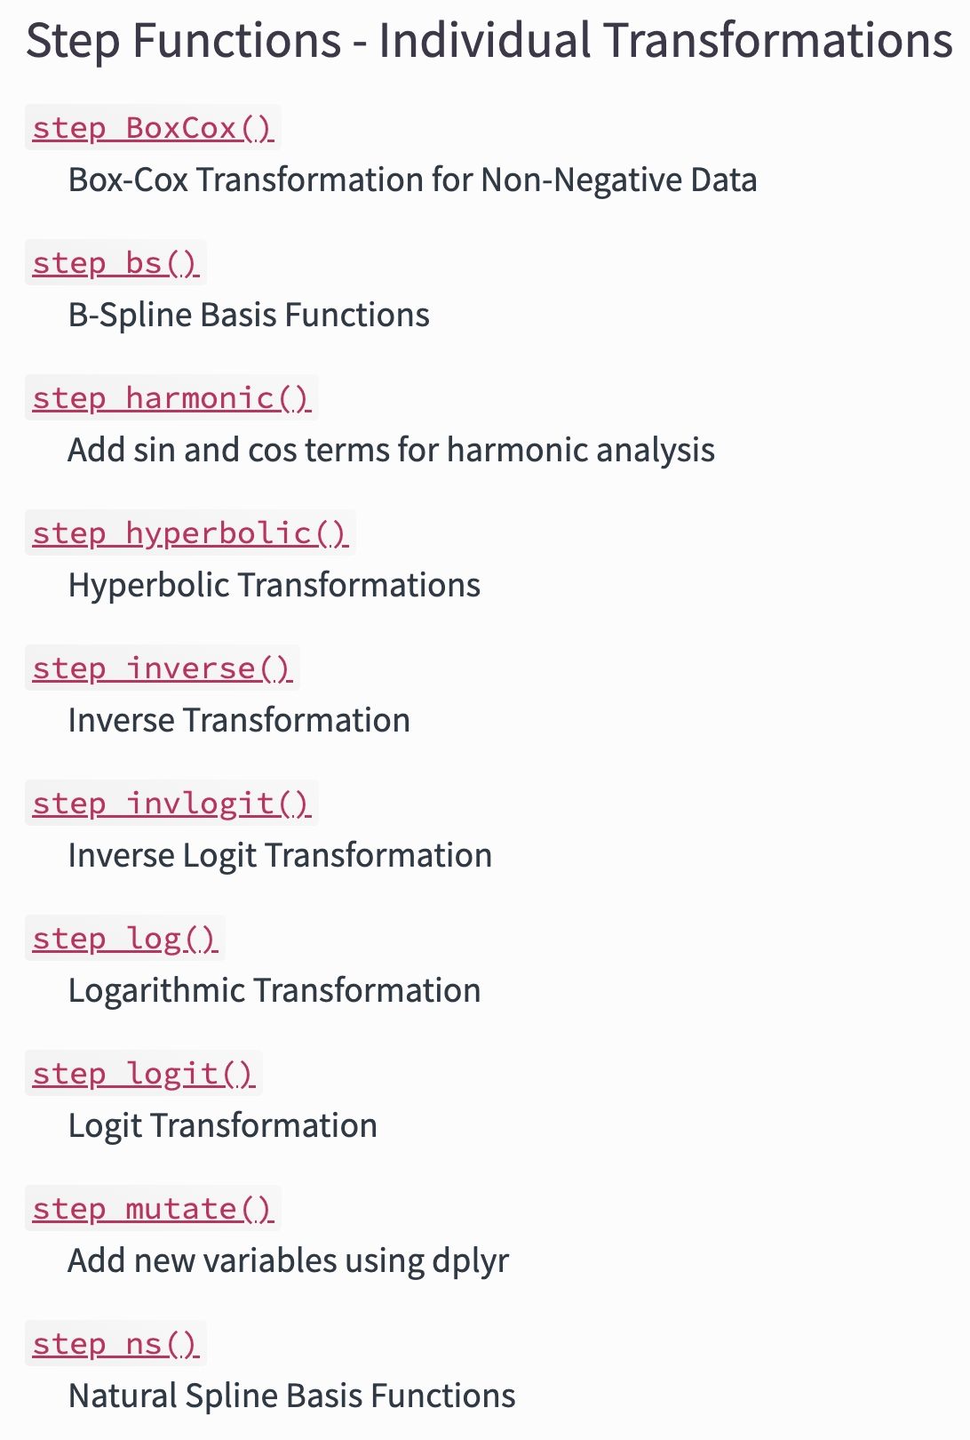
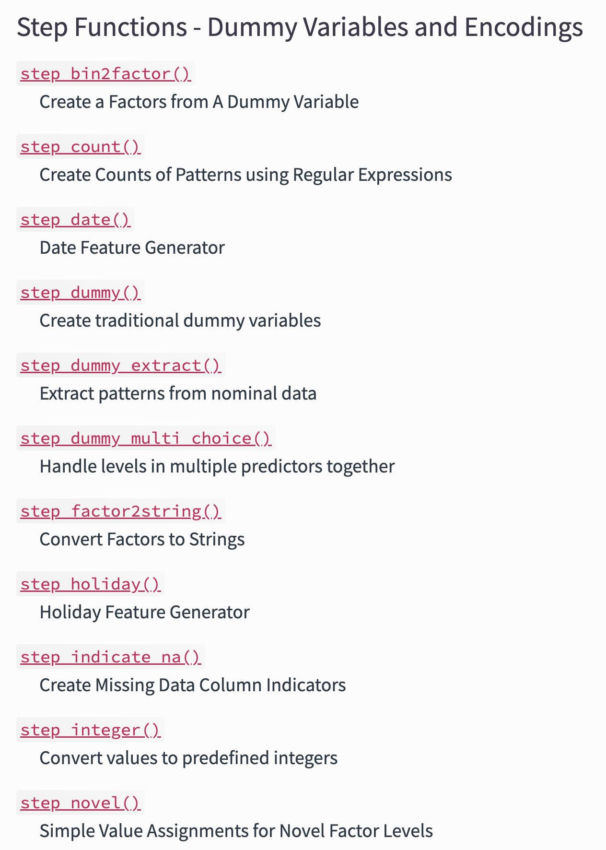
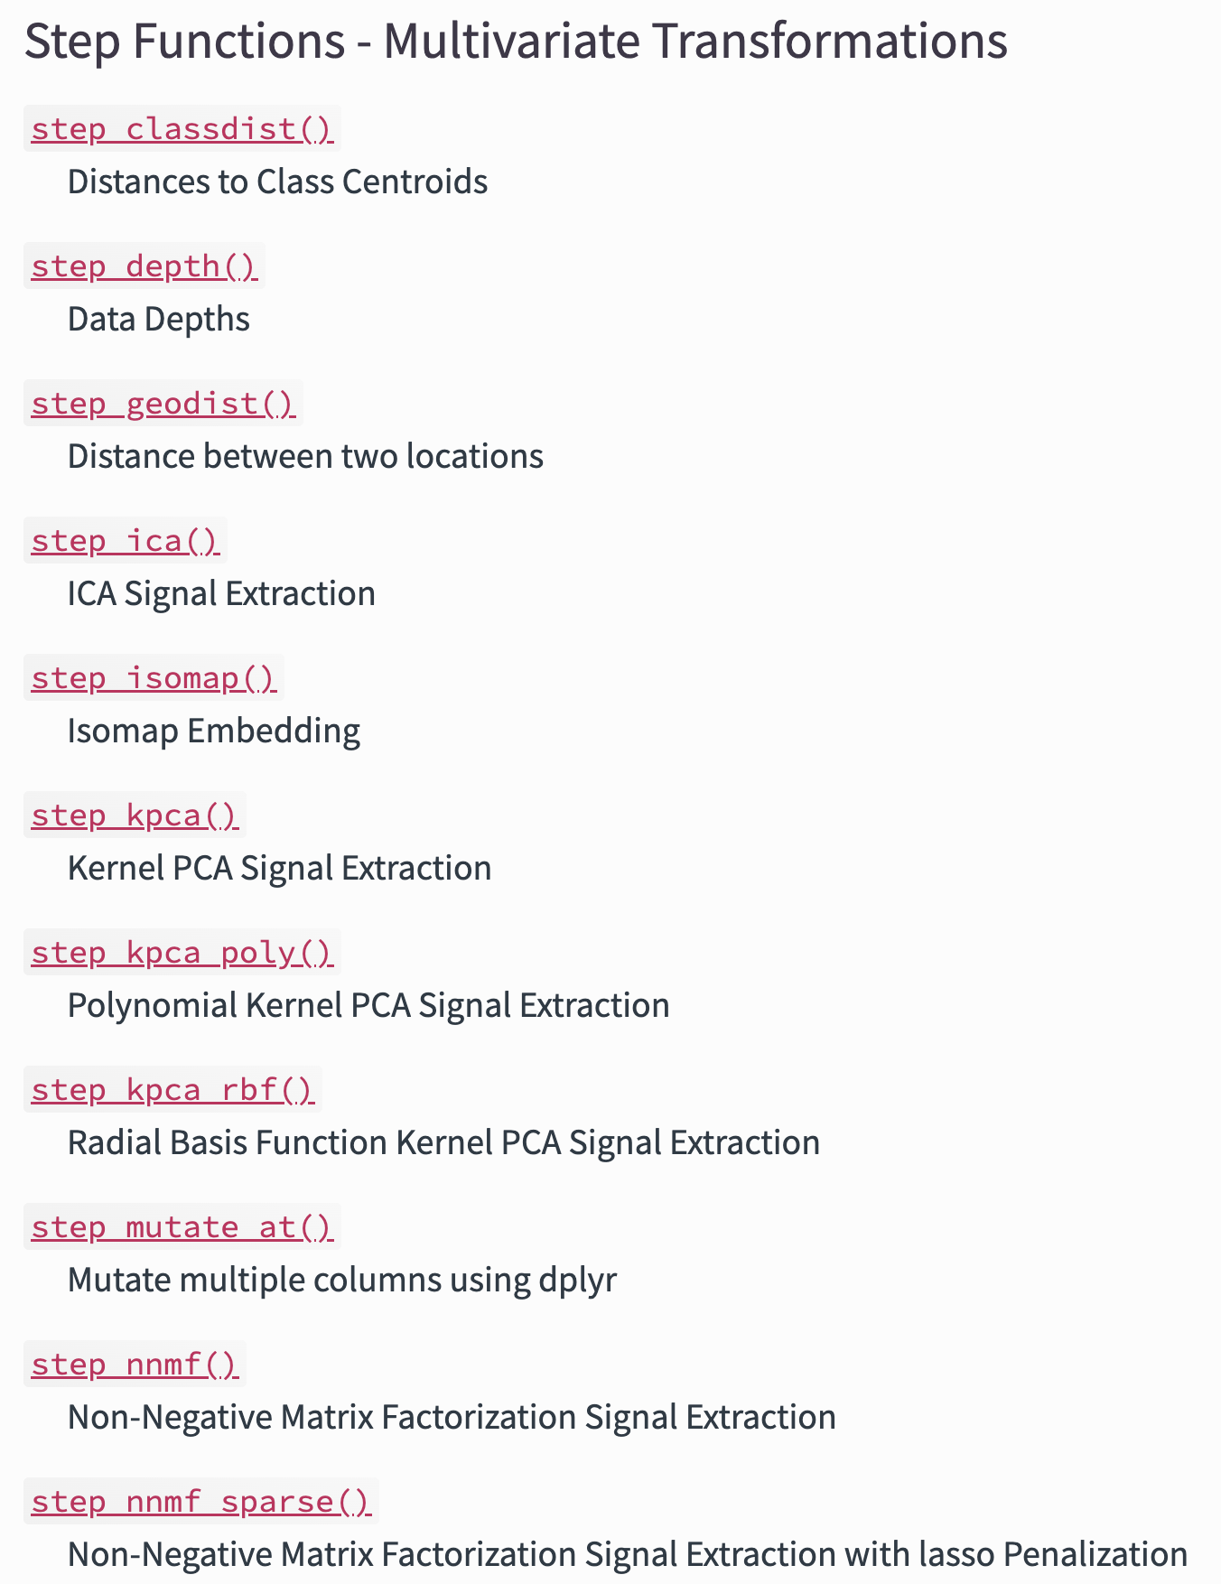
Recipes: Steps https://www.tidymodels.org/find/recipes/

Slide 6
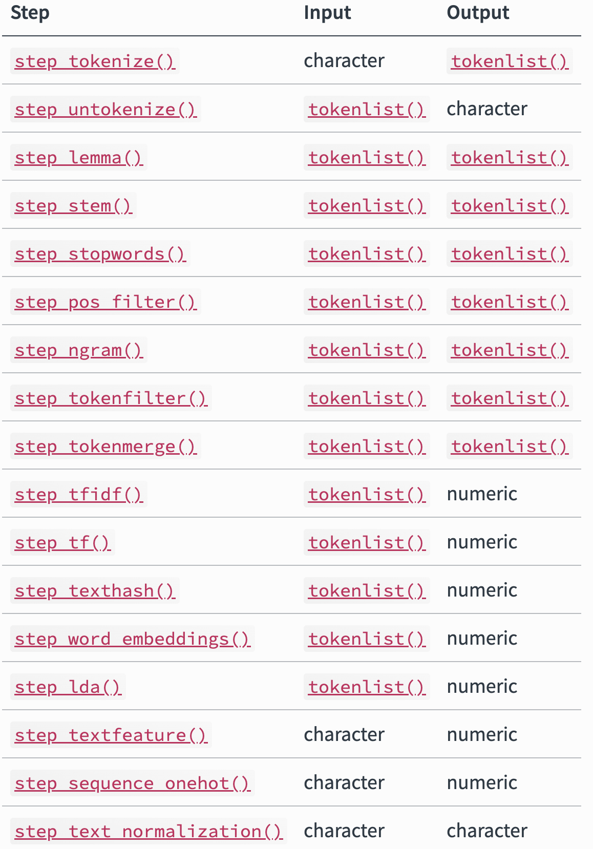
Textrecipes

Slide 7
Recipe
rec( y ~ x, data = df) #Initial set-up
rec <- rec( y ~ x, data = df) %>% #Initial set-up
update_role(new_role = “outcome”) #Update roles (if needed)
update_role(all_continous( ), new_role = “predictor”)
step_( ) %>% #Add steps
step_( )
prepped.rec <- Prep(rec)
baked.rec <- bake(prepped.rec, new_data = )

Slide 8
Recipe: Example
rec <- rec(fentanyl ~ text, data = training) %>% #Initial set-up
step_tokenize(text, #Tokenize, default word
options = list(lowercase = F,
strip_punct = TRUE)) %>%
step_tokenfilter(text,
min_times = 5,
max_times = Inf) %>% #Filter
step_tfidf(text) #Weight words based on TF-IDF
#Others
step_tf(text)
step_sequence_onehot(text)
step_word_embeddings(text, embeddings = glove_embed, prefix ="emb_")

Slide 9



NLP Workflow
Exploratory Data Analysis
Pre-Process Data
Linear regression - lm
Logistic regression - glm
KNN - kknn
Naive Bayes - naivebayes
Random forest - randomForest, ranger
Boosted trees - xgboost
SVM – Kernlab, liquidSVM
Neural networs – Keras, nnet
Model
Evaluate

Slide 10
Set up Models
rf_spec <- rand_forest() %>% #Pick a model
set_mode(“classification”) %>% #Set the mode
set_enginge(“randomForest”) #Set the engine

Slide 11
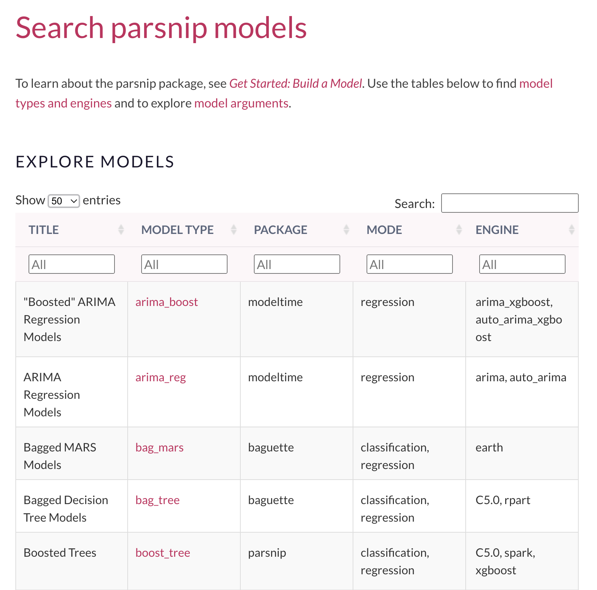
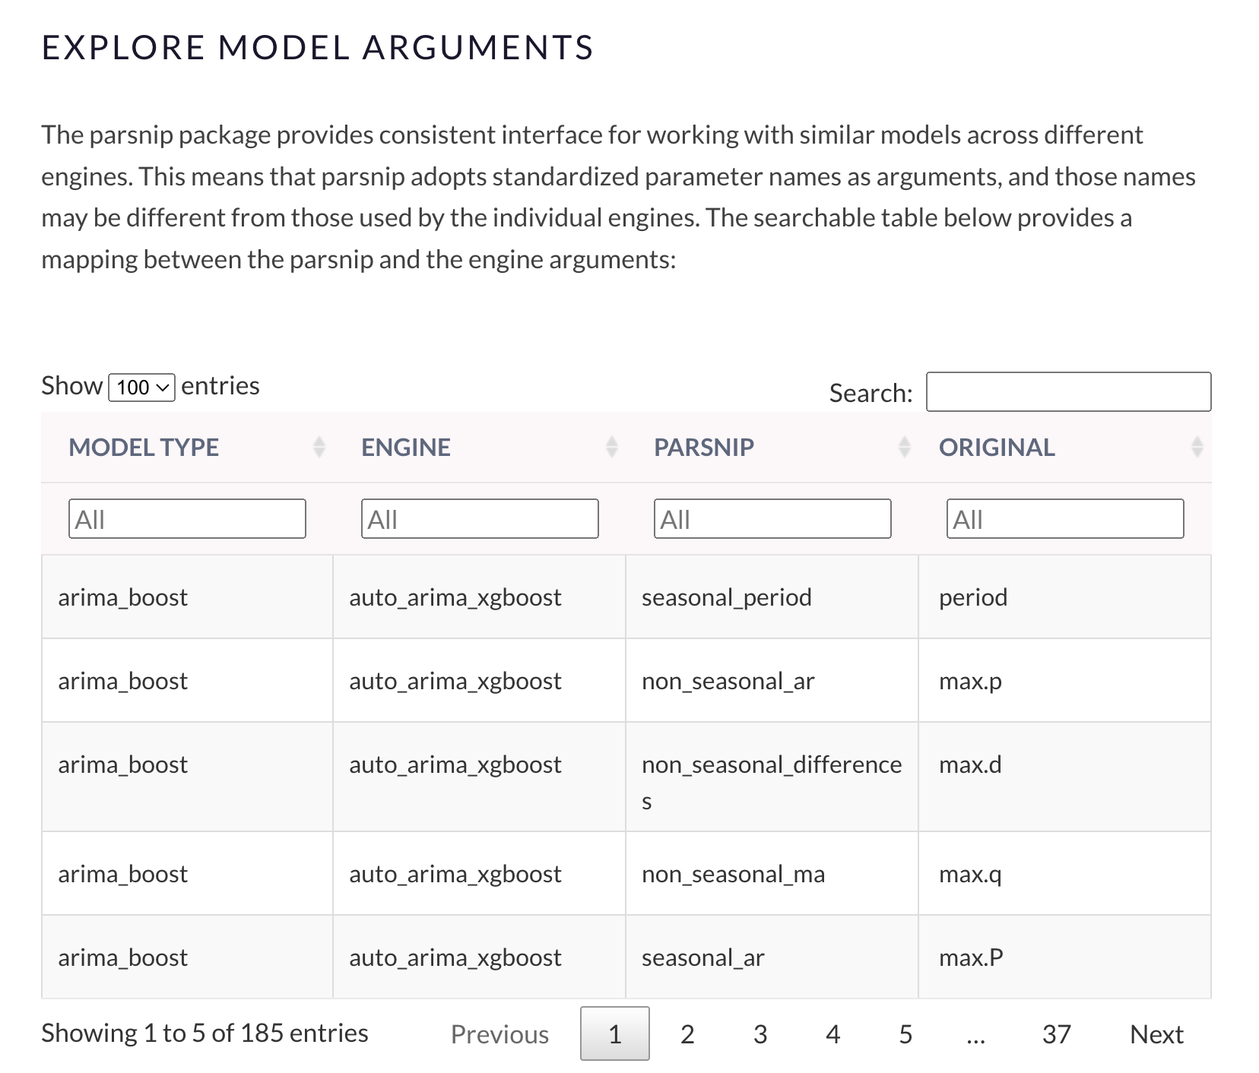

Slide 12
Set up Models
rf_spec <- rand_forest() %>% #Pick a model
set_mode(“classification”) %>% #Set the mode
set_enginge(“randomForest”) #Set the engine
#Set hyperparameters manually or for automatic tunning
rand_forest(min_n = tune( ), trees = tune( ), mtry = tune( )) %>% set_mode(“classification”) %>% set_enginge(“randomForest”)

Slide 13
Set up hyperparameter grid
grid_ctrl <-
control_grid(
save_pred = TRUE,
parallel_over = "everything",
save_workflow = FALSE,
event_level = "first"
)
#Set cores for parrallelization
doMC::registerDoMC(cores = parallel::detectCores(logical = FALSE))
doMC::registerDoMC(cores = 4)

Slide 14
Putting it together: Workflow vs workflowsets
rf_wflow <- workflow() %>%
add_recipe(rec) %>%
add_model(rf_spec)
rf_fit <- rf_wflow %>%
fit(data = mtcars)
#We would have to write individual code for each model

Slide 15
Putting it together: workflow vs Workflowsets
wflw_set <- workflow_set(
preproc = list(recipe_1 = rec1, recipe_2 = rec2, ...),
models = list(model_1 = model_spec, model_2 = model_spec2,..),
cross = TRUE)
grid_resutls <- wflw_set %>%
workflow_map( )

Slide 16
Putting it together: workflow vs Workflowsets
cv_folds_train <- vfold_cv(training, v = 5, strata = .y) #Cross validation
grid_results <- wflw_set %>%
workflow_map(
seed = 100, #For reproducibility
resamples = cv_folds, #Cross validation
grid = 10, #Number of tunning runs
control = grid_ctrl, #Grid set-up
metrics = metric_set( #Metrics to calculate
recall, precision, f_meas, accuracy, kap, roc_auc, sens, spec, ppv, npv),
verbose = T #View progress
)

Slide 17
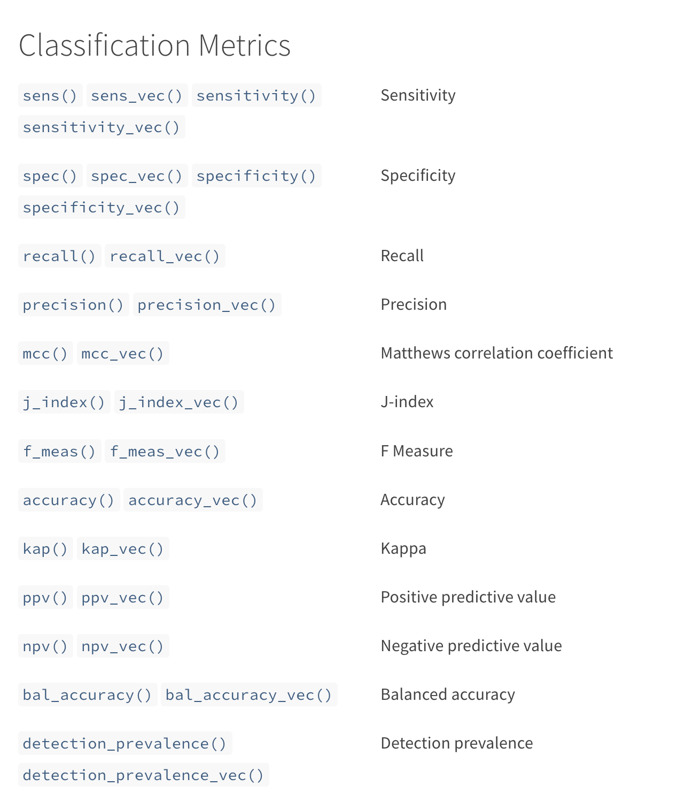
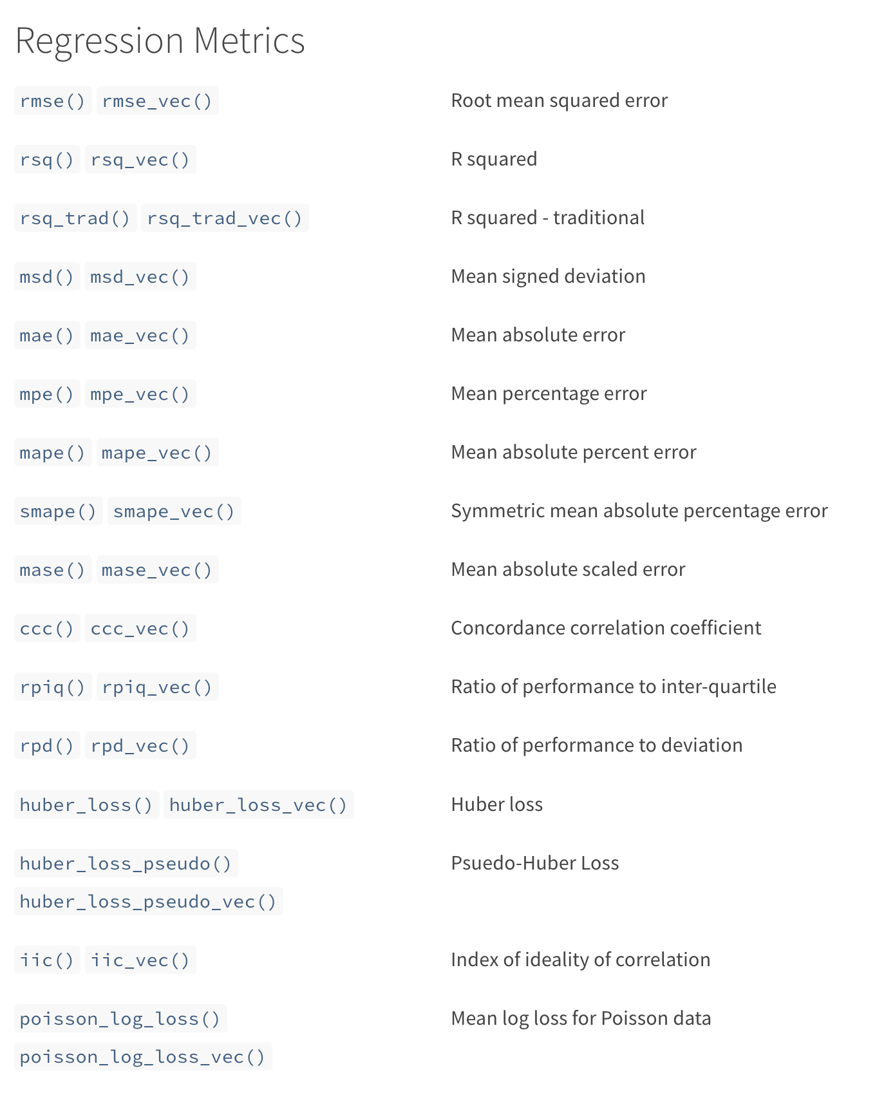

Slide 18
Plot Training Results
grid_results %>% autoplot() #Plot all results
grid_results %>% autoplot(select_best = T) #Plot best results
grid_results %>% collect_predictions() %>% #ROC curve
roc_curve(truth = var, estimate = .pred_1) %>%
autoplot()
grid_results %>% collect_predictions() %>% #PR curve
pr_curve(truth = var, estimate = .pred_1) %>%
autoplot()

Slide 19
Table Training Results
grid_results %>% #Get all metrics
collect_metrics( )
grid_results %>% #Get only best metrics
rank_results(
rank_metric = "f_meas",
select_best = TRUE
)

Slide 20
Evaluate on Test dataset alone
best.workflow <- tbl.train.results.best$wflow_id[1]
best.paramaters <- grid_results %>%
extract_workflow_set_result(tbl.train.results.best$wflow_id[1]) %>%
select_best(metric = "f_meas")
test_results <- grid_results %>%
extract_workflow(best.workflow) %>%
finalize_workflow(best.paramaters) %>%
last_fit(split = data_split,
metrics = metric_set(f_meas, accuracy, kap, roc_auc, sens, spec, ppv, npv))

Slide 21
Get final results
test_results %>% collect_metrics() #Results long
test_results %>% #Results wide
collect_metrics() %>%
pivot_wider(
id_cols = .config,
names_from = .metric,
values_from = .estimate
)

Slide 22
Confusion Matrix
test_results %>%
collect_predictions( ) %>%
conf_mat(truth, .pred_class) %>%
autoplot(type = "heatmap") #Can also be “mosaic”

Slide 23
Feature importance
test_results %>%
pluck(".workflow", 1) %>%
extract_fit_parsnip() %>%
vip(num_features = 20)

