Slide 1
WWW What went wrong
Linux tool that helps you get online assistance right from the terminal

Slide 2
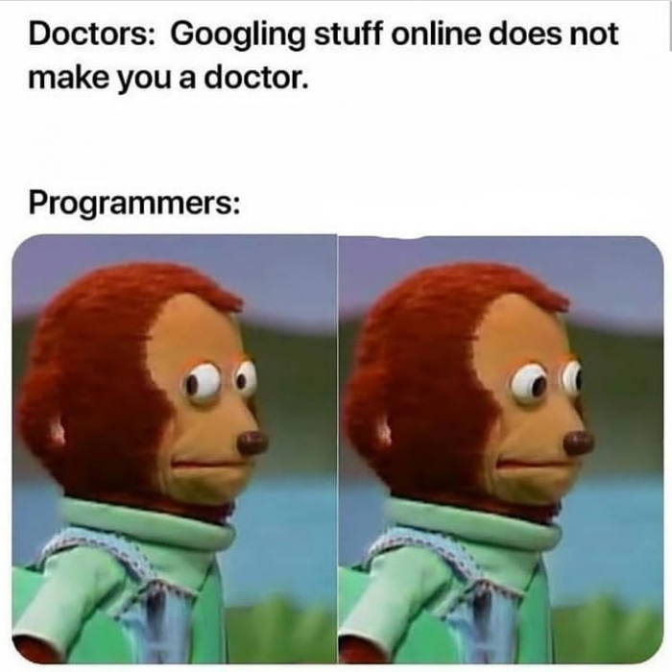
Background & BUSINESS NEED
Each month ~50 Million people visit StackOverFlow which became the second homepage of the average programmer.
As errors and code exceptions are part of every programmers day, our tool aims to help programmers save time and get fast solutions to their problems right in the terminal.
Saving time to programmers is VERY valuable.

Slide 3
Our solution
WWW is a Linux tool that can build a query from the executed command and error, or get a custom query as argument. The query is searched online seeking for solutions in supported websites using Google.
The results are parsed and printed to the user’s terminal in a simple and focused way.
The user can navigate between solutions from the same source, ask for more solutions or edit the query to get better results.

Slide 4
Technical view
The project is built in Python
We are using BeautifulSoup4 to parse SOF threads
More sites can be added conveniently by parsing their specific HTML structure
Error filtering and capturing

Slide 5
Future plans
Graphical GUI – Develop a graphical GUI that shows focused solutions with easy options to edit the queries.
Report the queries and the found solutions to a server which can output statistics
Add support to new sites

Slide 6
Security
In the current status of the project we are not storing any information and thus no security or information protection is needed.
Future plans might change the security needs

Slide 7
Licenses
All of our used python libraries (BeautifulSoup4, googlesearch, tabulate, termcolor) have MIT license.
Our license - MIT

Slide 8
demo

Slide 9

Business Model
“Data Is The Most Important Currency..” Forbes 2018
There is a lot to learn from error messages, developers can gain a lot from knowing where their program fails or what errors does it output.
WWW is a “middle man” between the user and Google and by capturing the user’s queries and found solutions we can output import insights about programs and their unexpected outputs.

