Slide 1


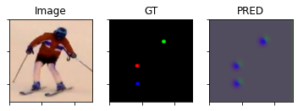
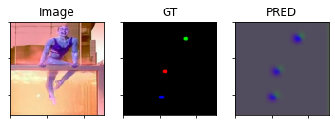
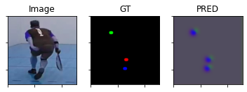
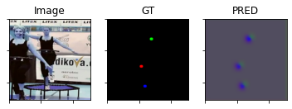
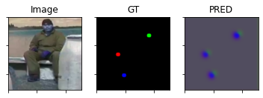
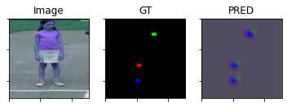
G33: Single Person 2-D Pose Estimation from RGB images using Convolutional Neural Networks
Akhil Bommadevara (abommad) | Ishan Bhatt (ivbhatt) | Aishwarya Seth (aseth)
Motivation:
Human Pose-Estimation(HPE) has a wide range of applications:
Activity recognition, Person tracking, Robust Person Detection
VR gaming, Animation (Style Transfer based approaches)
Physical Therapy/Rehabilitation, Posture improvement, Assisted Living
Problem Definition:
We are trying to build a HPE system that:
Takes RGB images as input.
Assumes images to have a subject person without
significant occlusions.
Detects the visible key points of the subject person.
Data[6]:
MPII Human Pose dataset (25K images) of over 40K people with annotated body joints (left/right) (ankle, knee, hip, shoulder, elbow, wrist) + head + thorax(upper-neck) + pelvis.
About 4K people with all 13 key-points visible.
Network input size = 256 x 256 x 3 (tentative)
Results:
Used about 20 images (10 epochs) to train; right-ankle, right-knee, right-shoulder on single hourglass module .
SotA PCK-h@0.5 = 92.5 [7]
Model[4][5]:
L1
L2
L3
(WIDTH/1) x (HEIGHT/1) x 3
(WIDTH/2) x (HEIGHT/2) x (S*1)
(WIDTH/4) x (HEIGHT/4) x (S*2)
(WIDTH/4) x (HEIGHT/4) x (S*4)
(WIDTH/2) x (HEIGHT/2) x (S*2)
(WIDTH/1) x (HEIGHT/1) x F
(WIDTH/1) x (HEIGHT/1) x C
References:
A. Yao, et. al., ‘‘Coupled action recognition and pose estimation from multiple views,’’ Int. J. Comput. Vis., Oct 2012
M. B. Holte, et. al., ‘‘HPE and activity recognition from multi-view videos: Comparative explorations of recent developments,’’ IEEE J. Sel. Topics Signal Process., Sep 2012
Spagnolo & Paolo, ‘‘Proceedings IEEE conference on advanced video & signal based surveillance. AVSS 2003,’’ in Proc. IEEE Conf. Adv. Video Signal Based Surveill.
S.-E. Wei, et. al.. “Convolutional pose machines” in CVPR, 2016
A. Newell, ‘Stacked Hourglass Networks for Human Pose Estimation”, arxiv, July 2016
M. Andriluka, et. al., “2D Human Pose Estimation: New Benchmark and State of the Art Analysis”, CVPR, 2014
Zhang, Hong, et al. "HPE with spatial contextual information." arxiv, 2019
TRAIN IMAGES
UNSEEN IMAGES

Slide 2
MPII dataset reference
12 keypoints - names
3868 images
Resize 256x256

Slide 3
L1
L2
L3

