Slide 1

SEMANTIC WEB SEARCH
Natural Language Processing
(CSC 791)
Aishwarya Seth (aseth@ncsu.edu)
Jayaty (jjayaty@ncsu.edu)

Slide 2
Search
Finding data based on what users want
Code, document, image, definition, recipe, article or news
Broad categories:
Keyword based
Semantic

Slide 3
What is Semantic Search??
Figuring out what users actually mean to ask
Determine intent and contextual meaning of search query to find results
Different from keyword matching

Slide 4
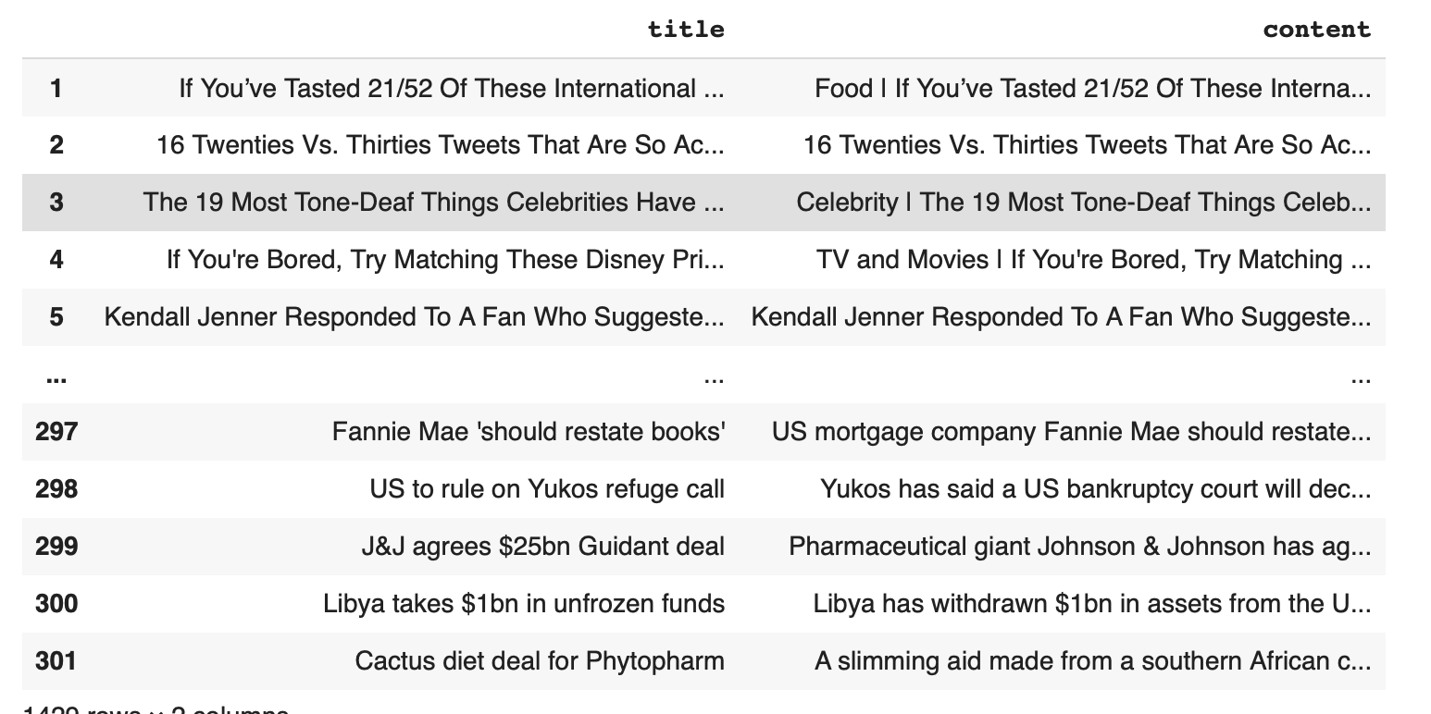
Dataset
Data collected from different resources such as GeeksforGeeks, NY Times news, and Pubmed
Pre-processed all to consist of only 2 columns i.e. 'title' and 'content'
Equal number of rows taken from all data sources
Duplicates and null values removed
Sample dataset is as follows:

Slide 5
Sentence BERT
'
Modification of BERT network
Siamese and triplet network used to derive semantically meaningful sentence embedding
Used for large scale semantic similarity comparison, clustering, information retrieval
Claims to perform better than all the SotA sentence embedding techniques for STS

Slide 6
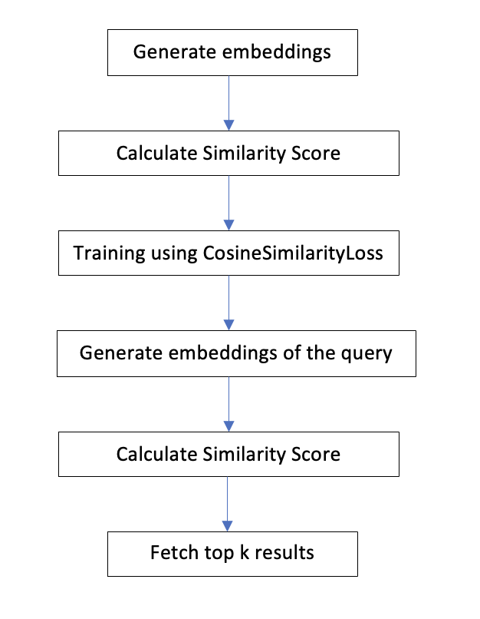
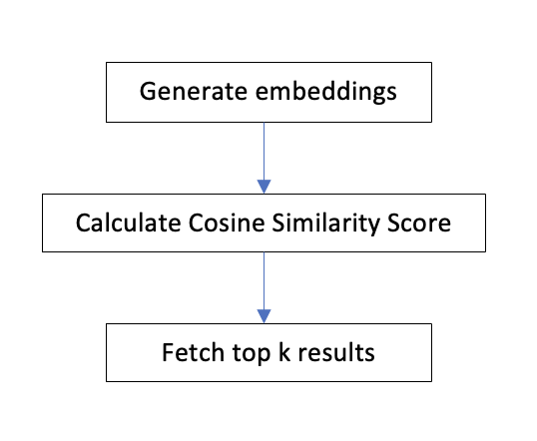
Implementation
Two approaches:
Pre-trained Model
2. Trained Model

Slide 7
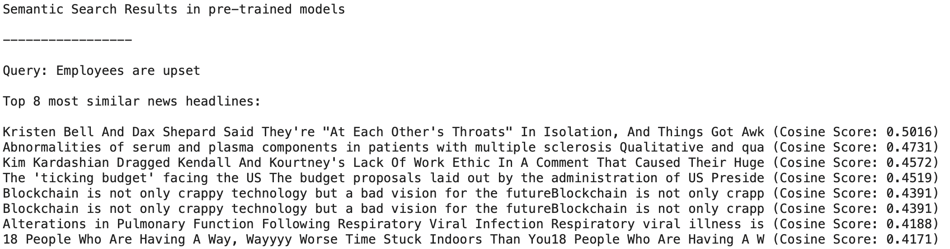
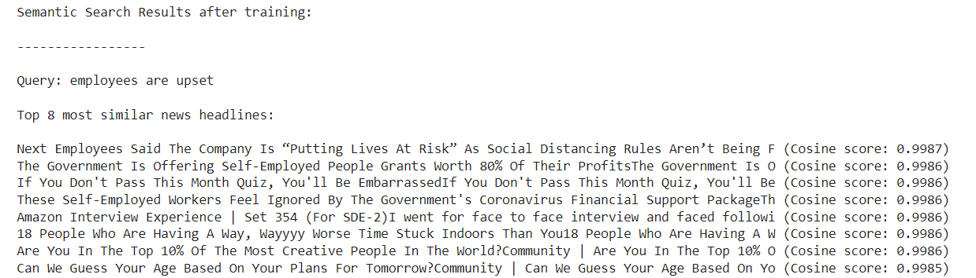
Result
Pre-trained Model vs Trained Model
Less similar articles
Low cosine score
More similar articles
High cosine score
Trained model performs better than the pre trained model.

Slide 8
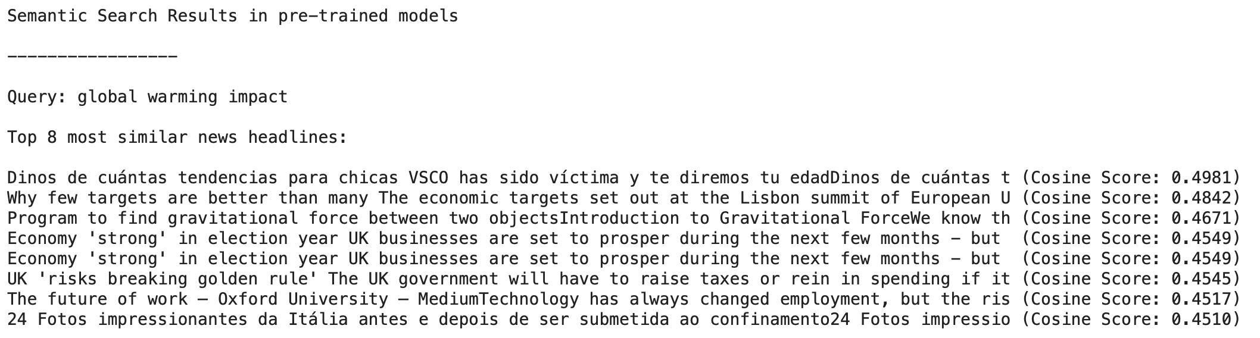
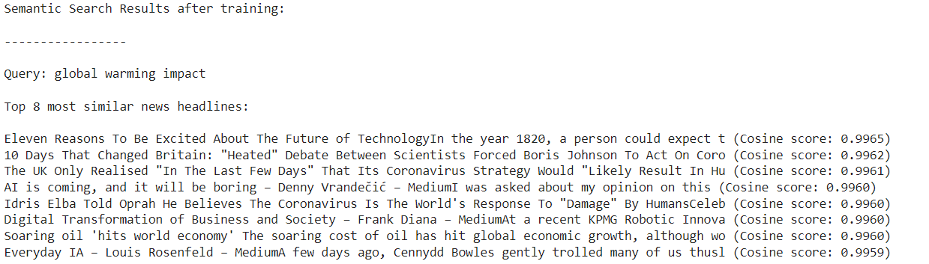
Result
Pre-trained Model vs Trained Model
Trained model performs comparable to the pre trained model.

Slide 9
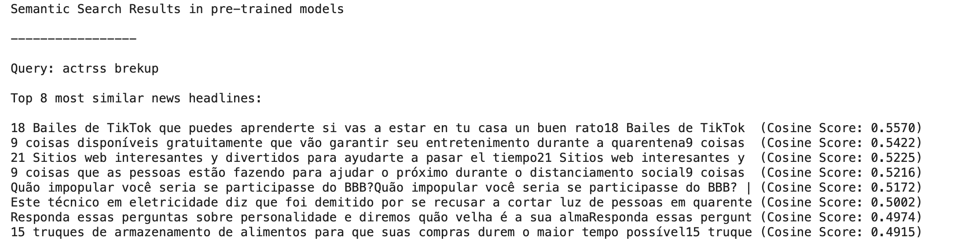
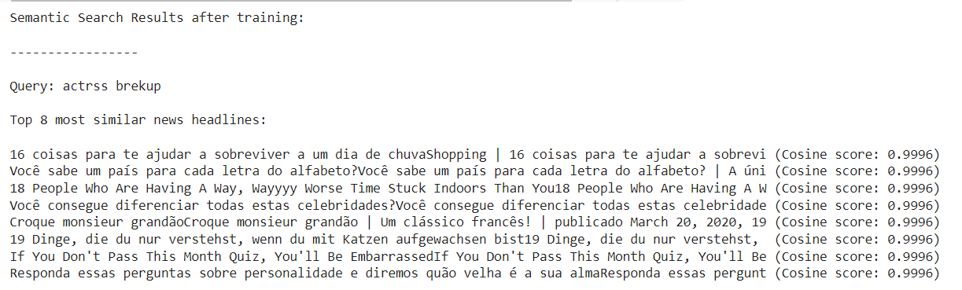
Result
Pre-trained Model vs Trained Model
With input query : “actrss brekup”
When the input query is spelled wrong both the models are giving output of different language.

Slide 10
Future Work
Handle different data types such as images, URLs, documents
Use knowledge graphs for unstructured data
Perform image processing and generate image as results
Use other parameters like publishing date and author to train the model

