Slide 1
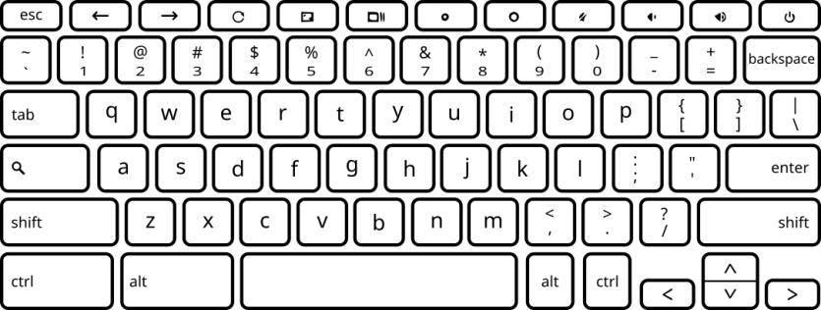
Listen to the noisy sounds.
A tinnitus sound will be hidden in the noise about half of the time.
When you hear a tinnitus sound hidden inside, answer “yes”. Otherwise, answer “no”.
Press the “F” key to begin.

