Slide 1
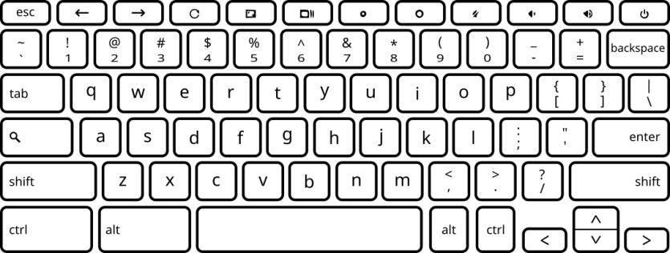
You have successfully completed another 100 trials!
Please take a moment to rest.
When you’re ready to continue, press the “F” key.

