Slide 1
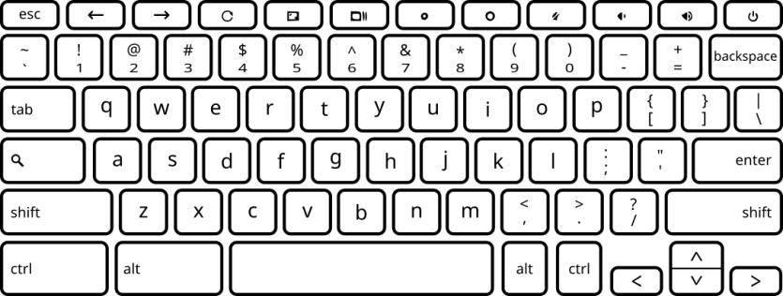
Choose the tone that sounded closest in pitch to your tinnitus.
Press the “F” key for Tone A or the “J” key for Tone B.

