Slide 1
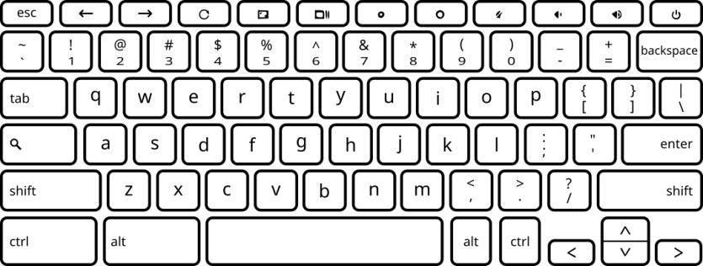
Listen to both sounds, then indicate your answer to the following question:
Which tone sounded closer to your tinnitus?
Press the F key to begin.

