Slide 1
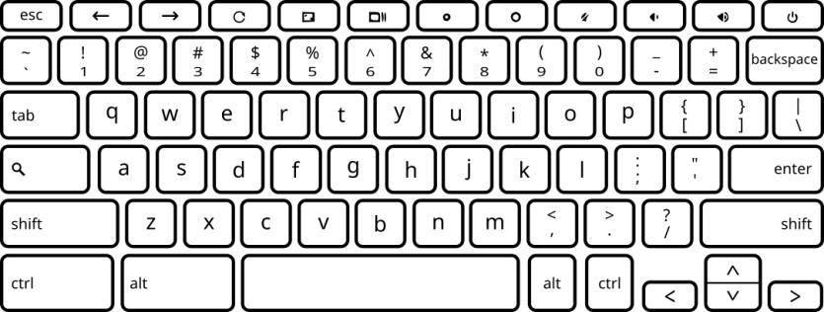
Did you hear a tinnitus sound?
Press the “F” key for “no” and the “J” key for “yes”

