Slide 2



O Nas
Mateusz Boś – Software Developer
Michał Górski – Software Developer
O firmie
Future Processing
Company, which provides offshore
software development services
for Western European companies seeking reliable
long-term partnerships.
Notes:
Hello everyone.
We are from Future Processing polish company.
Each of us is working in Central Mobile Team. Yes we all are developing the mobile platform: such as Android, BlackBerry, iPhones etc.

Slide 3
Program
O Androidzie słów kilka
Struktura projektu, IDE
Co będziemy dziś robić?
Project structure and AndroidManifest.xml file
Podstawowe layouty
Activity i Intent
Interaction between activity and views
Buttons and TextWatchers
Odczyt i zapis danych do SharedPreferences
Splash, Intenty i Handlery
Wielowątkowość z użyciem Async Tasków
Dialog (okno dialogowe)
Ciekawostki Androida
Notes:
TODO

Slide 4
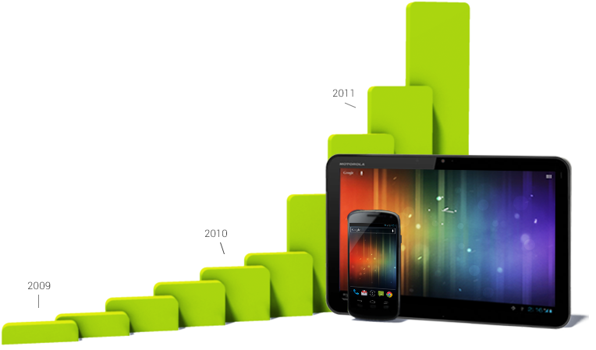
Android - overview
The world’s most popular mobile platform
Provided by Google
Android powers hundreds of milions mobile devices
Available in more than 190 countries
Global partnerships
Contributions of open-source Linux community
Over 300 hardware, software and carrier partners
Powerful development framework
Single application model
Android Developer Tools
Marketplace for apps distribution
Notes:
As You probalby already know the Android is the most popular mobile platform.
It was invented in 2003 by Android Inc. the google both it in 2005 and all the history begin in 2007 when the first release was made.
During the years the android become more and more popiular. Right now there is about 500 milions active deices in 2012 with this platform.
Android is based on open-source linus operating system.
Android have very powerfull delepomnet frameworks, and HUGE google play (old market place), where users can find a lot of many interesting applications and games.

Slide 5
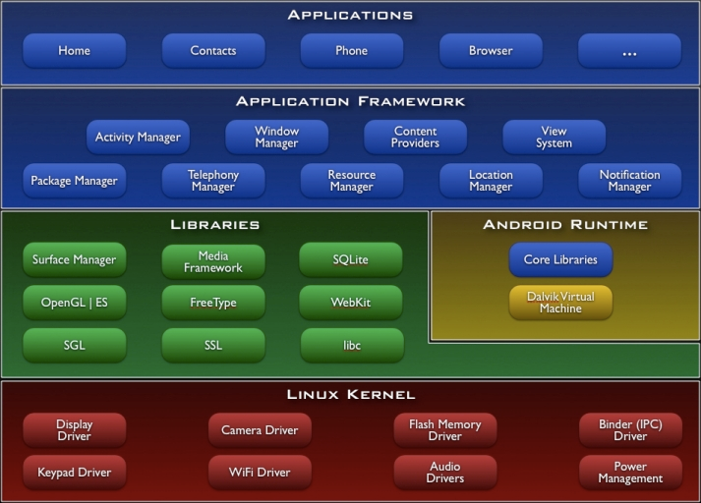
Android architecture
Notes:
Only FYI!

Slide 6
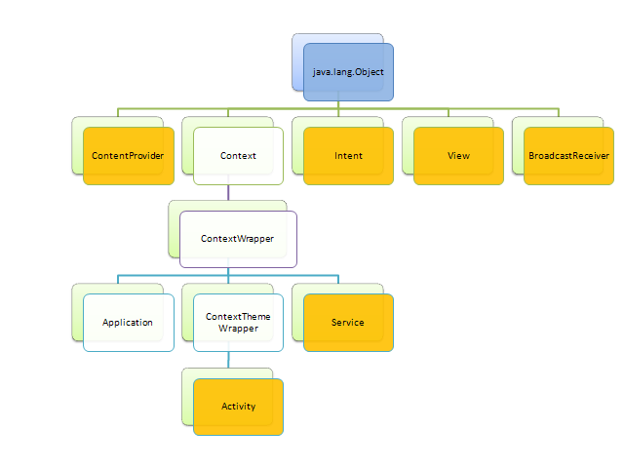
Simplified class diagram of Android framework

Slide 7
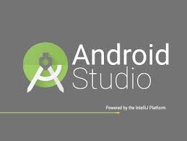


Środowisko – z czym będziemy dziś pracować
Java Development Kit 1.8
Android Studio (based on IntelliJ IDEA) - IDE
Android SDK

Slide 8
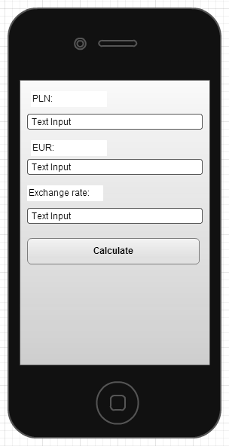
Opis dzisiejszego zadania
Napiszemy aplikację która konwertuje kwoty ze złotówek na euro i odwrotnie.
Aplikacja powinna umożliwiać ręczną zmianę kursu wymiany.
Aplikacja powinna pobierać obecny kurs z podanego serwisu.
Notes:
Say something about what we will be doing today.
Today we would like You to write the whole application from a struch! Yes it is a huge challeg to do this it that short time, but we think that we will be able to finish this and write the main functionality.
Our application will be the conventer from PLN to EURO and vice versa.
We will be movething throe the functionality step by step, and adding new items to this application.
So lets begin…. This view will be also availbe later.

Slide 9
Stworzenie nowego projektu
Notes:
Open eclipse and show how to create new project.
We have to start from begining. So each of You will have to create your own project. Now we will show You how to do this in eclipse IDE.
File->New Android Project-> Enter Application name: „Best Converter”
Enter project name: „BestConventer” (NO SPACES!)
Enter package name: „pl.best.conventer”
Please use this package convention:
{country short cut like uk, pl, de, it etc}. (dot). {your name and surname} (dot bettwen) and (dot) {application name}
This is the most important thing. Application in google play and in device will be see by this name!
Configure luncher icon
Create blank activity
Set activity name and layout name

Slide 10
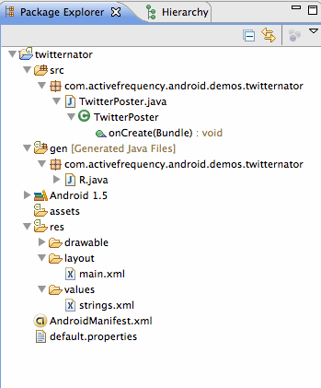
General project structure of Android application
/src
/bin
/gen
R.java
/assets
/res
/drawable
/layout
/values
/libs
AndroidManifest.xml
Notes:
Please look insite the project what each of You have created.
There are some important folder and file that You have to know a little more about them:
Src -> soruce folder – contains Java Places (Your Java classes / code )
Gen –> Containt generated by andorid sdk building tool R.java class – this is the list of all resources names
Bin -> Containt the compiled java classes into class files and also containt compiled manifest and dax format classes.
Assert -> contains some files like html do be dispalyed in applciation
Res -> contains all resources files - drawable, layouts, values and raw files (most in xml format)
Libs -> containt jar files that will be compiled into application
Manifest -> the main application configuration file.

Slide 11
The AndroidManifest.xml file
Every application must have an AndroidManifest.xml file (with precisely that name) in its root directory. The manifest presents essential information about the application.
Among other things, the manifest does the following:
Names Java package
Describes components of the application (activities, services, broadcast receivers, content providers, etc.)
Declares permission to access protected parts of Android API
Declares minimum level of Android API
etc.

Slide 12




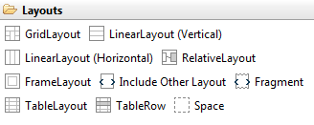
Basic Layouts
Linear Layout
Relative Layout
List View
Grid View
Notes:
The layout is the base design of items on device screen.
There are several main layouts: Group View (type)
Linear, Realive, Abstract, Frame, List, Grid, Scroll etc

Slide 13
Linear Layout
LinearLayout is a view group that aligns all children in a single direction, vertically or horizontally. You can specify the layout direction with the android:orientation attribute.

Slide 14
Relative Layout
RelativeLayout is a view group that displays child views in relative positions. The position of each view can be specified as relative to sibling elements (such as to the left-of or below another view) or in positions relative to the parent RelativeLayout area (such as aligned to the bottom, left of center).

Slide 15
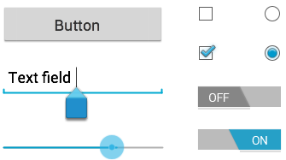
Basic Views
TextView
EditText
Button
ImageView
Views are stored in *.xml files
Inside /res/layouts directory.

Slide 16
Android Studio Time
Create the layout
Notes:
We will open an eclipse and show how to create the layout how to add items whayt differents are beetween the layuts time etc.

Slide 17
Description of the workshop task
and UI general mockup
Write an application, which converts currency from PLN (Polish Złoty) to EUR (Euro)
and backwards.
User should have to possibility to provide rate exchange manually.
In addition, application should be able to download current rate of exchange from the internet.
Notes:
Show one more time what we will be doing today – they have layout to make!

Slide 18
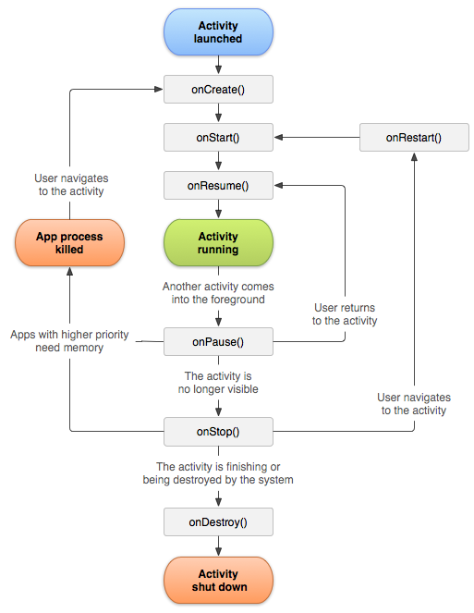
Activity
Single, focused thing, that user can do
Each activity is a „single screen”
Each activity has its own layout
Must be defined in AndroidManifest
Activity can be started by Intent
Activity has its lifecycle
onCreate() & onDestroy() events
onResume() & onPause() events
onStart() & onStop() events
Notes:
Now we will focus on activity. One applciation can have many activies class, Each activiti will be responsible for display layot and manage user interfaces.

Slide 19
Activity Lifecycle
Notes:
Each activiti has the lifecycle – it will be not importat here on this workshop but we deside that you should know more abote this.
Activity life cycle is manage by Android System. So we have to handle all important methods.

Slide 20
Interaction between activity and views - example
Source of /res/layout/activity_main.xml
...
<Button android:id="@+id/button1"/>
...
Source of src/MainActivity.java
...
protected Button button1;
protected void onCreate(Bundle savedInstanceState) {
super.onCreate(savedInstanceState);
setContentView(R.layout.activity_main);
button1 = (Button) findViewById(R.id.button1);
button1.setOnClickListener(new OnClickListener() {
public void onClick(View v) {}});
}
...

Slide 21
Android Studio Time
Get all views from layout in Activity
Notes:
We will open an eclipse and show how to create the layout how to add items whayt differents are beetween the layuts time etc.

Slide 22
Description of the workshop task
and UI general mockup
Write an application, which converts currency from PLN (Polish Złoty) to EUR (Euro)
and backwards.
User should have to possibility to provide rate exchange manually.
In addition, application should be able to download current rate of exchange from the internet.
Notes:
One more time

Slide 23
Button and EditText
Each button has onClickListener.
EditText has getText and setText metods
button.setOnClickListener(new OnClickListener() {
public void onClick(View v) {
editText.getText().toString();
}});

Slide 24
TextWatcher
TextWatcher is an interface that will notify us about change in edit text.
The most important method for us is: onTextChanged
void onTextChanged(CharSequence s, int start, int before, int count)
editText.addTextChangedListener(new MyTextWatcher());

Slide 25
Android Studio Time
Write the main fuctionality TextWatcher and/or Button Solution
Notes:
Show in eclipse how to get text from edit text and how to use TextWatchers

Slide 26
Reading, writing and storing data in Android - basics
SharedPreferences
Internal and External Storage
SQLite database
Notes:
Our project has some issue, each time You have to enter an exchange rate.
Now we will fix this. In android there are 3 say of saving data for application: -> Shared Prefferenced
-> Storages
-> SQL database

Slide 27
Shared Preferences - overview
Allows you to save and retrieve persistent key-value pairs of primitive data types. You can use SharedPreferences to save any primitive data: booleans, floats, ints, longs, and strings. This data will persist across user sessions (even if your application is killed).
Places, where SharedPreferences are stored:
/data/data/YOUR_PACKAGE_NAME/shared_prefs/YOUR_PREFS_NAME.xml
by default: /data/data/YOUR_PACKAGE_NAME/shared_prefs/YOUR_PACKAGE_NAME_preferences.xml

Slide 28
Shared Preferences - example
public class Calc extends Activity {
public static final String PREFS_NAME = "MyPrefsFile";
@Override
protected void onCreate(Bundle state){
super.onCreate(state);
// Restore preferences
SharedPreferences settings = getSharedPreferences(PREFS_NAME, 0);
boolean silent = settings.getBoolean("silentMode", false);
setSilent(silent);
}
@Override
protected void onStop(){
super.onStop();
// We need an Editor object to make preference changes.
// All objects are from android.context.Context
SharedPreferences settings = getSharedPreferences(PREFS_NAME, 0);
SharedPreferences.Editor editor = settings.edit();
editor.putBoolean("silentMode", mSilentMode);
// Commit the edits!
editor.commit();
}
}

Slide 29
Android Studio Time
Save exchange rate into Shared Preferences
Notes:
Show in eclipse how to get text from edit text and how to use TextWatchers

Slide 30
Intents
Intents are asynchronous messages which allow Android components to request functionality from other components of the Android system
Source of src/ExampleActivity.java
...
Intent intent = new Intent(this, ActivityTwo.class);
startActivity(intent);
...

Slide 31
Handlers
Sometimes we need to delegate some taks do be done later in in other thread (in backgound). We can use handlers here.
In onCreate method of SplashActivity:
...
handler = new Handler();
runnable = new Runnable() {
@Override
public void run() {
startActivity(new Intent(SplashActivity.this, MainActivity.class));
finish();
} };
...

Slide 32
Handlers
We have to remove hadler from handlers list in on pause
@Override
protected void onResume() {
super.onResume();
handler.postDelayed(runnable, minDisplayMs);
}
@Override
protected void onPause() {
super.onPause();
handler.removeCallbacks(runnable);
}

Slide 33
Eclipse Time
Add splash Screen and use intent to start main activity
Notes:
Show in eclipse how to get text from edit text and how to use TextWatchers

Slide 34
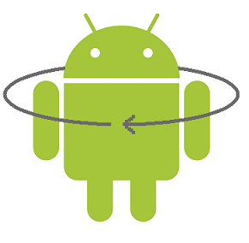
Multithreading in Android with AsyncTask
AsyncTask enables proper and easy use of the UI thread. This class allows to perform background operations and publish results on the UI thread without having to manipulate threads and/or handlers.

Slide 35
AsyncTask – example – class definition
private class DownloadFilesTask extends AsyncTask<URL, Integer, Long> {
protected Long doInBackground(URL... urls) {
performVeryLongOperation();
return (long) 0;
}
protected void onProgressUpdate(Integer... progress) {
setProgressPercent(progress[0]);
}
protected void onPostExecute(Long result) {
showDialog("Downloaded " + result + " bytes");
}
}

Slide 36
AsyncTask – example – thread execution
Once created, a task is executed very simply:
new DownloadFilesTask().execute(url1, url2, url3);
The three types used by an asynchronous task are the following:
Params, the type of the parameters sent to the task upon execution.
Progress, the type of the progress units published during the background computation.
Result, the type of the result of the background computation.
Not all types are always used by an asynchronous task. To mark a type as unused, simply use the type Void:
private class MyTask extends AsyncTask<Void, Void, Void> { ... }

Slide 37
Android Studio Time
Add AsyncTask do dowload and parse the exchange rate value
Notes:
Show in eclipse how to get text from edit text and how to use TextWatchers

Slide 38
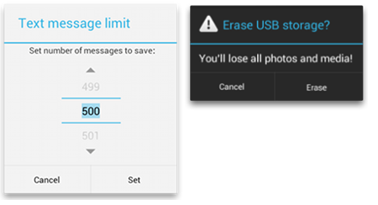
Dialogs – overview
A dialog is a small window that prompts the user to make a decision or enter additional information. A dialog does not fill the screen and is normally used for modal events that require users to take an action before they can proceed.

Slide 39
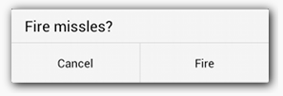
Creating Dialog – example
public class FireMissilesDialogFragment extends DialogFragment {
@Override
public Dialog onCreateDialog(Bundle savedInstanceState) {
// Use the Builder class for convenient dialog construction
AlertDialog.Builder builder = new AlertDialog.Builder(getActivity());
builder.setMessage(R.string.dialog_fire_missiles)
.setPositiveButton(R.string.fire, new DialogInterface.OnClickListener() {
public void onClick(DialogInterface dialog, int id) {
// FIRE ZE MISSILES!
}
})
.setNegativeButton(R.string.cancel, new DialogInterface.OnClickListener() {
public void onClick(DialogInterface dialog, int id) {
// User cancelled the dialog
}
});
// Create the AlertDialog object and return it
return builder.create();
}
}

Slide 40
Android Studio Time
Add dialog box to make manual change for exchange rate
Notes:
Show in eclipse how to get text from edit text and how to use TextWatchers

Slide 41
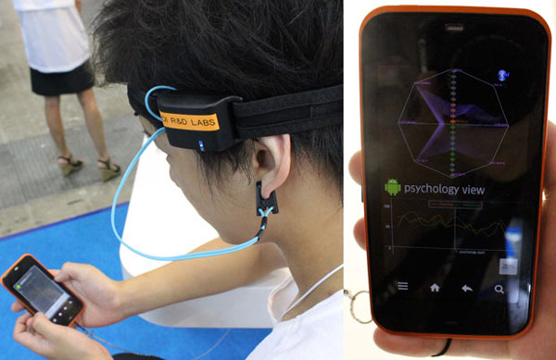

Interesting facts and possibilities
You can write native C++ apps for Android with NDK
You can write Android apps for Google Glass
You can read EEG signal from your brain with NeuroSky device and Android
You can interact with microcontrollers (e.g. Arduino) via BlueTooth and WiFi
And many more! Your imagination is the only limit.

Slide 42

Evaluate us!
Please take a 5 minut and answers some question about this workshop.

