Slide 1

C# Course Project Title – Employee Payroll System
Team – C1
USN | Name
01FE17BCS125 | Nitin Verma
01FE17BCS144 | Puneet Gupta
01FE17BCS148 | Rahetul Asquin
01FE17BCS158 | Ritbik Bharti

Slide 2
Introduction
A payroll management system is a tool that enables your business to handle all your employee’s financial records hassle-free
It helps to maintain the employee details elegantly and handles several time-consuming redundant tasks in an automated fashion.
The payroll system handles mainly employee’s salaries, bonuses, deductions, net pay, and generation of pay-slips for a specific period.

Slide 3
Problem Statement
To build an user friendly employee payroll system that can maintain the employee details easily for the end user.

Slide 4
Objectives
Quickly find out an employee details.
To build an user friendly app to save and display employee salary.
To provide easy and faster salary calculation.
To generate pay slip as pdf.

Slide 5
Functions
Employee Module:
Designation
Department
Employee details
Salary Module:
Allowance
Deduction
Pay Slip

Slide 6
Actors
Administrator [Employer] :
Have the master control over the system
Can create and delete records.
Can generate the pay slip.

Slide 7
Functional Requirements
The admin should be able to add the details of employee.
The admin should be able to edit the details of employee.
The admin should be able to search the details of the employee.
The admin should be able to generate the pay slip of the employee.

Slide 8
Non Functional Requirements
The system should be fast and error free.
The system should have built in error checking and correction facilities.
The system should be able to handle large amount of data comfortably.

Slide 9
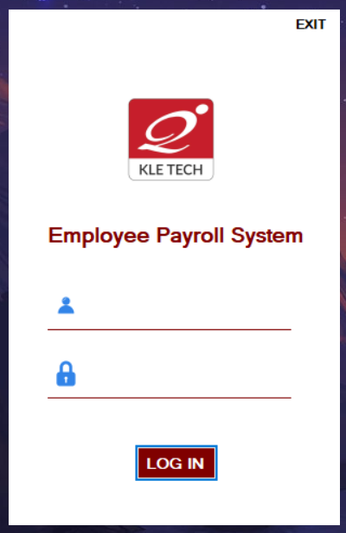
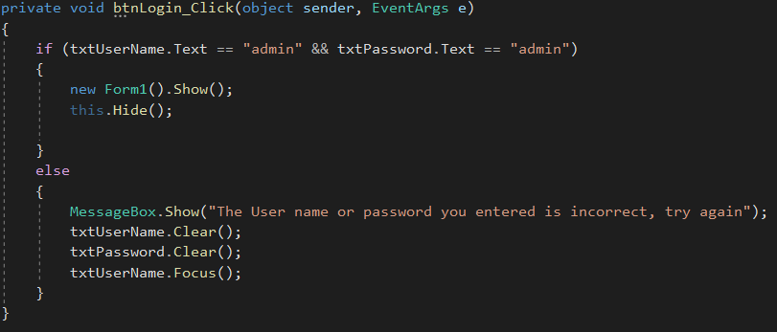
Implementation

Slide 10
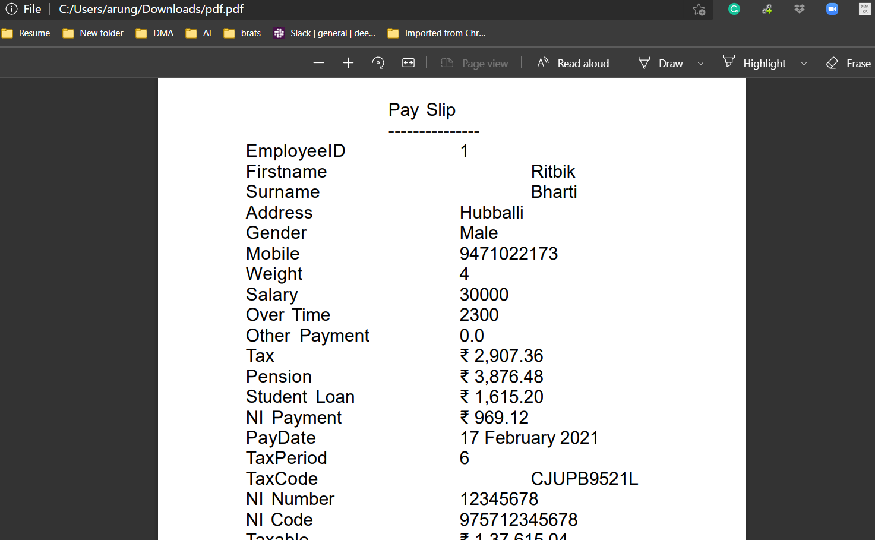
Implementation

Slide 11
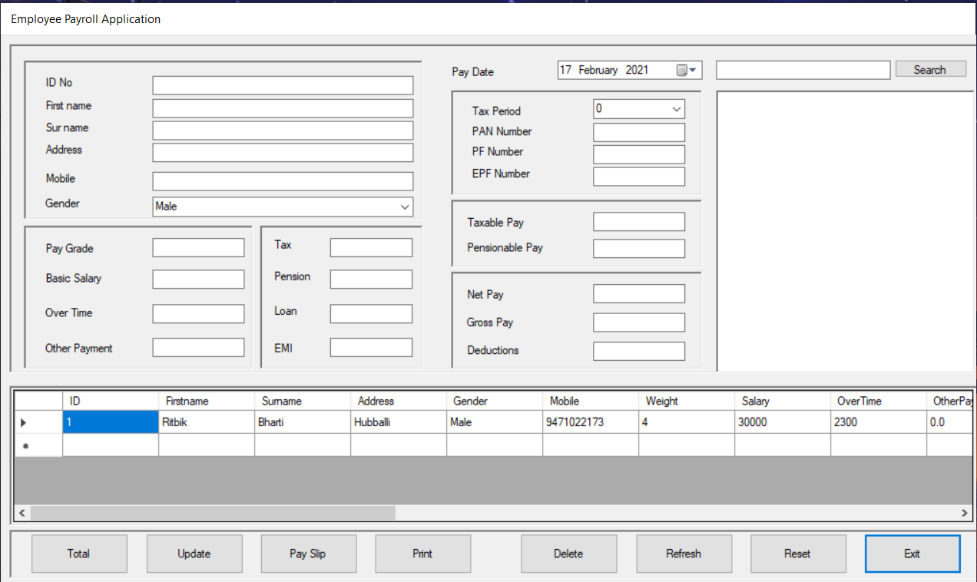
Implementation

Slide 12
Individual Contribution
Puneet Gupta - GUI
Nitin Verma – Login and Build
Rahetul Asquin - Database
Ritbik Bharti – Core logic and C#

Slide 13

Thank You

