Slide 1
JavaScript Promises

Slide 2
How JavaScript Works:
JavaScript is single threaded and each browser tab has one event-loop
two bits of script cannot run at the same time
they have to run one after another.
JavaScript shares a thread with other processes and is in the same queue as:
updating styles
handling user actions, etc.
Activity in one process delays the others

Slide 3
Callbacks Review
We have used callbacks order to work around JavaScript’s single-threaded event loop
Callbacks are the classical approach to asynchronous programming
A callback provides a function as an argument to another function, which executes an asynchronous task
Once the asynchronous task completes, the executing function calls your callback function.

Slide 4
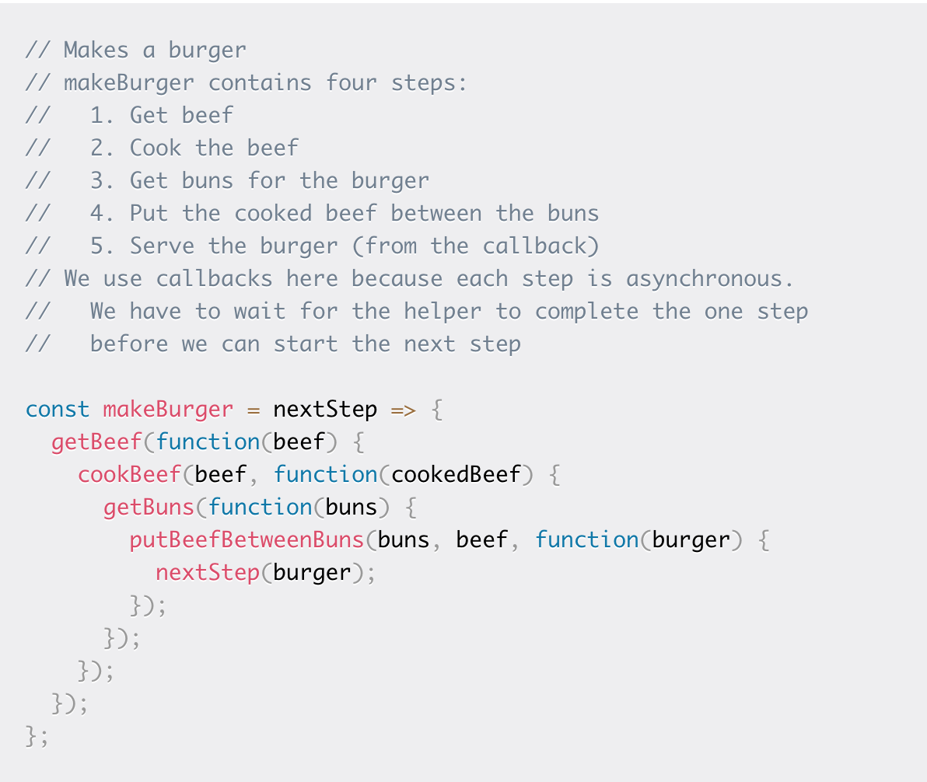
Callback “hell”
Nesting functions can make reading and understanding code more difficult

Slide 5
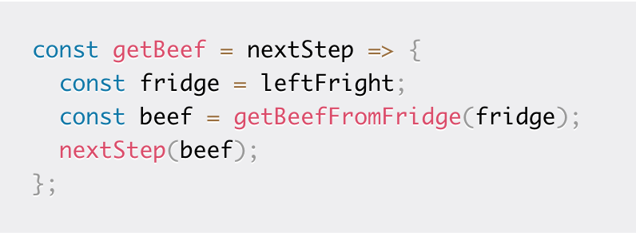
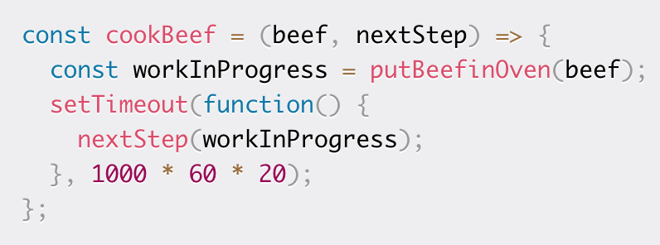
Some solutions to callback “hell”
Split up callbacks and place into them into different functions.
Using this within makeBurger() would result in a lot of code

Slide 6
A better solution to callback “hell”: Promises
Introduced in (2015) to allow for more readable asynchronous code
The Promise object represents the eventual completion (or failure) of an asynchronous operation, and its resulting value.
essentially, a promise is a returned object to which you attach callbacks, instead of passing callbacks into a function.

Slide 7
Promise Object
A promise can be:
pending - Hasn't fulfilled or rejected yet
fulfilled - The action relating to the promise succeeded
rejected - The action relating to the promise failed

Slide 8
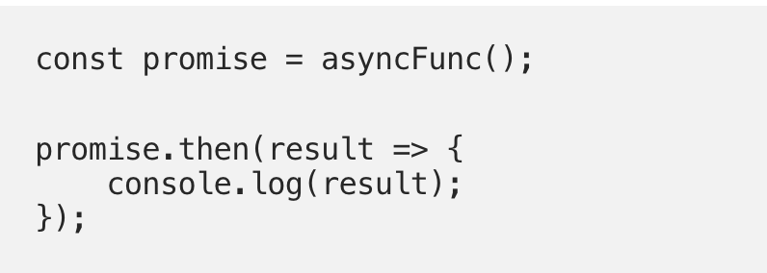
Usage in Practice
First, asyncFunc() immediately returns a promise
Then, the .then() method is used to provide an action to be taken when the asynchronous task completes

Slide 9
Callbacks Vs. Promises
Callbacks | Promises
A program tells the executing function what to do when the asynchronous task completes | The executing function returns a special object (the Promise). Then a program tells the promise what to do when the asynchronous task completes
Callback nesting can cause errors and is harder to read | Code is made to be more readable and understandable
 | Callbacks will never be called before the completion of the current run in a JavaScript loop
 | Callbacks added with .then(), will be called, even when there is a failure
 | Multiple callbacks may be added by calling .then(). Each callback is executed one after another, in the order in which they were inserted.

Slide 10
Async/Await
Async/await has been introduced in 2017.
This technique should really be listed under Promises
just syntactic sugar for working with promises.
but it can help make code even more readable!

Slide 11
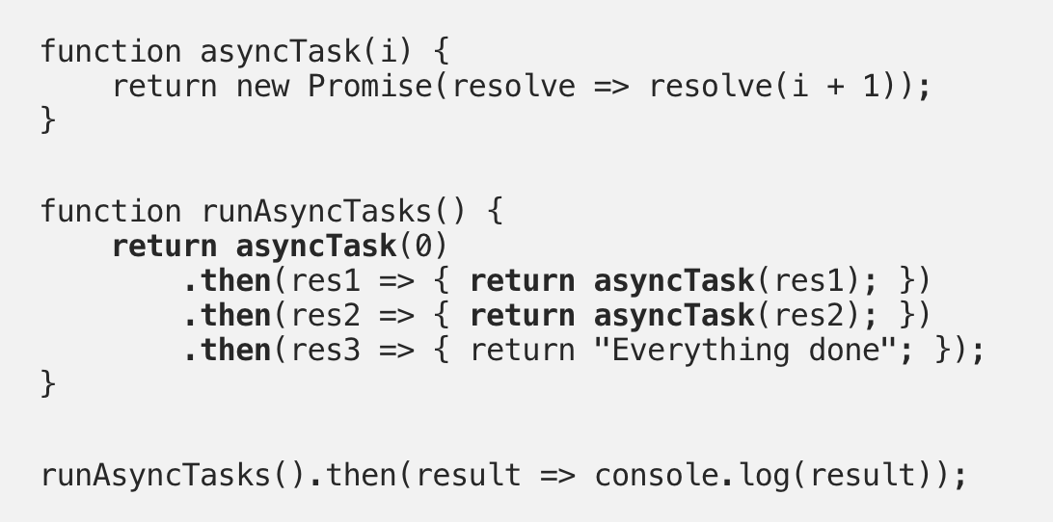
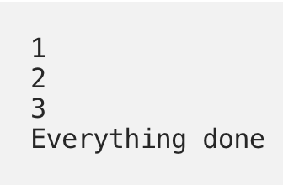
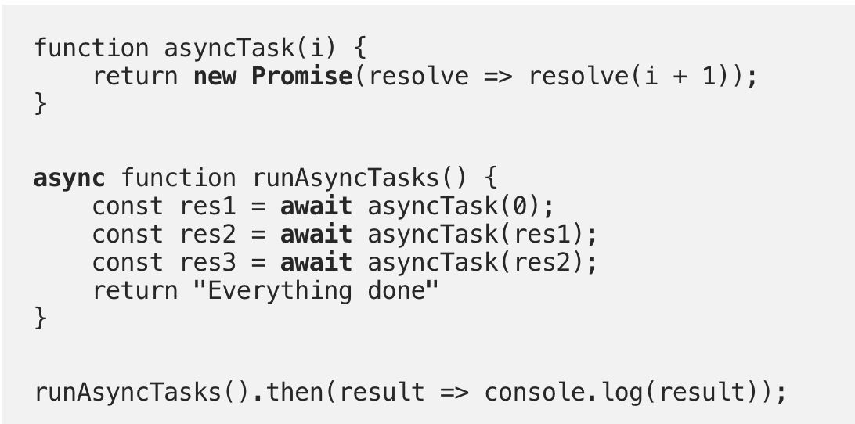
.then() vs. async/await same output

