Slide 1

M01 LUCY

Slide 2
Human-to-agent instruction compiler

Slide 3
Human-to-agent instruction compiler
Thought partner (FDC)
Facts
Dimensions
Chains

Slide 4
Human-to-agent instruction compiler
Thought partner (FDC)
Facts
Dimensions
Chains
Knowledge-as-Agent
deployable AI agent
operational continuity and employee continuity

Slide 5
Human-to-agent instruction compiler
Thought partner (FDC)
Facts
Dimensions
Chains
Knowledge-as-Agent
deployable AI agent
operational continuity and employee continuity
AI democratization
Don’t need prompt engineering skills
Don't need a premium license

Slide 6
Demo
A fictional company called
M01 Lucy Cinemas

Slide 7
AI Democratization
Accessibility First
M01 Lucy is designed for everyday employees, not AI engineers.
Most employees:
do not have access to premium AI licenses
do not have prompt engineering experience
do not know how to structure agent behavior

Slide 8
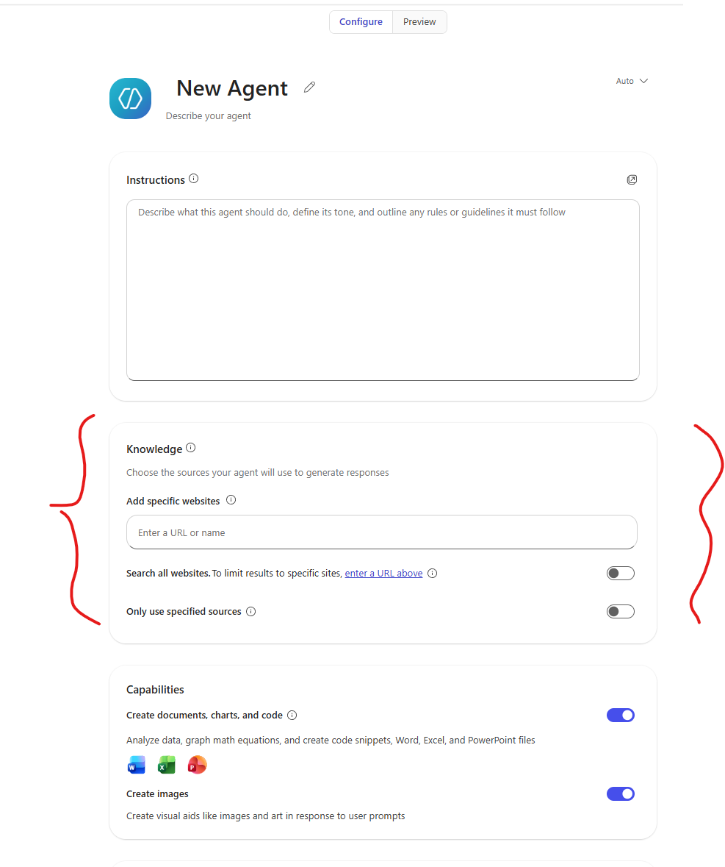
Without M365 Copilot license
M365 Copilot agent builder can only reference public URL

Slide 9
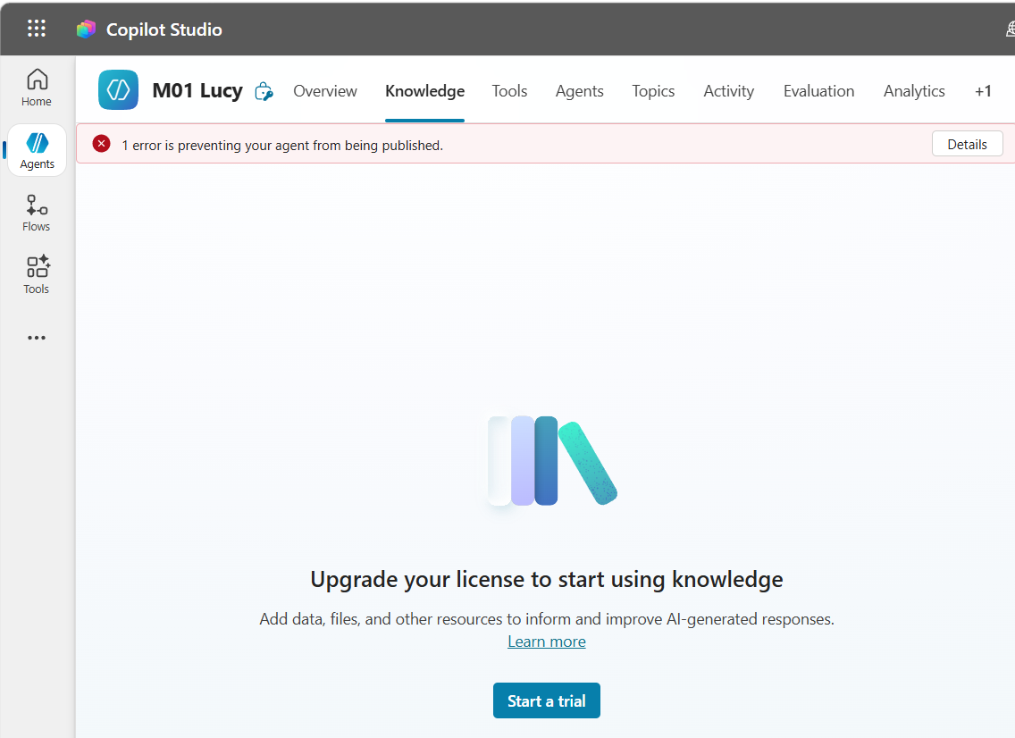
Without M365 Copilot license
M365 Copilot agent builder can only reference public URL
Limited access to Copilot Studio

Slide 10
AI Democratization
Diversity
As more people rely on the same AI tools, there is an increasing risk that thinking becomes standardized across the organization
The agents generated by Lucy are grounded in the owner's own knowledge and reasoning patterns allowing them to act as true extensions of an individual's thinking.

