Slide 1
SPOTIFY DATA ANALYSIS by Music Notes
Katherine
Carmen
Michelle
Veethika
01/11/2024

Slide 2





One good thing about music, when it hits you, you feel no pain ~ Bob Marley

Slide 3

Data Collection
Music Data was collected from the Spoitify API
Conducted data cleaning to perform exploratory data analysis (EDA) and data visualization of the Spotify dataset using Python (Pandas, NumPy, Matplotlib)
Data analysis - Exploring the relationship between the audio features of a song and how positive or negative its impact is on streaming, involving sentiment analysis and many more.
Use data to identify patterns and relationships between different characteristics. The activity will support in developing ability to review and interpret a dataset.
Explore if there was any impact to streaming before and after Covid

Slide 4
Data Collection
Data was retrieved from sites .
It was analyzed from Kaggle and Spotify API
The data retrieved from Spotify was very huge
It was saved to a CSV file for further analysis

Slide 5
Data Cleaning
Data was cleaned using excel comparison
Merging?
Duplicates?

Slide 6
Data Summary
Data was summarized per year -2017-2021
The summary data provided a statistical representation

Slide 7
Data Visualization
Matplotlib was used to display bar charts of the following
Streams by Genre per Year
Streams by Genre per artist and year
Streams by Genre

Slide 8
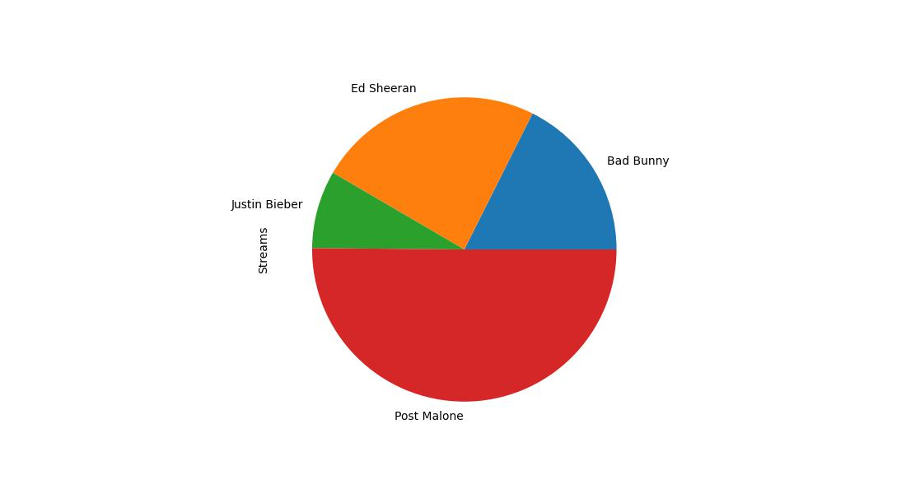
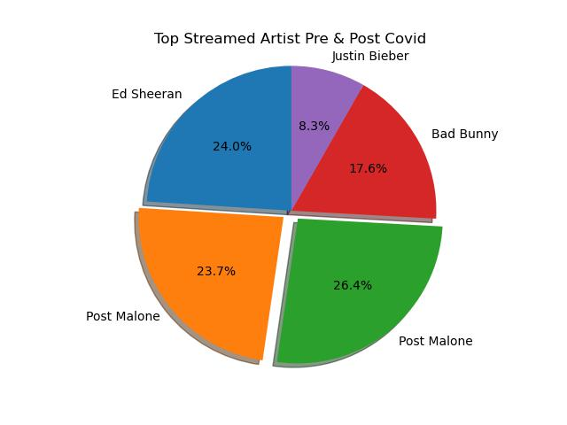
Data Visualization
Pie Chart of Most Streamed Artist Pre and post covid
Year | Artist | Streams
2017 | Ed Sheeran | 4,526,988,042
2018 | Post Malone | 4,474,074,823
2019 | Post Malone | 4,989,227,763
2020 | Bad Bunny | 3,322,524,063
2021 | Justin Bieber | 1,560,451,296
Post Malone hold first place between the years 2018 and 2019. then during covid Bad Bunny streams were the highest.

Slide 9
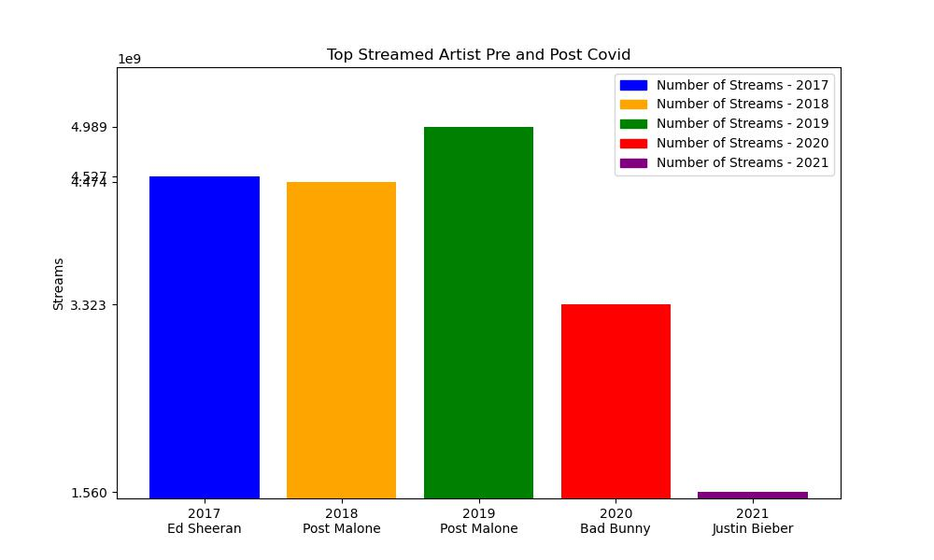
Data Visualization
Top Stream Artist Bar chart
Event though Bad bunny was not the highest Streamed Artist Through out the Years he was the most Streamed Artist in the heart of Covid Year 2020 with a 3.3 Million streamed

Slide 10
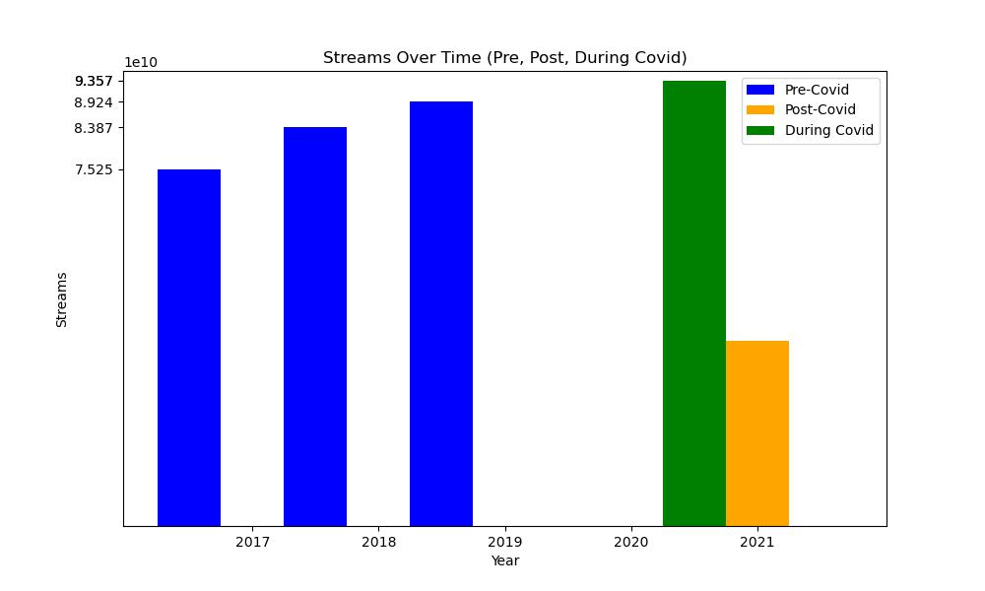
Data Visualization
Stream/Downloads per Year , Pre-During and Post Covid-19
Year | Streams
2017 | 75,248,867,959
2018 | 83,871,067,173
2019 | 89,244,533,337
2020 | 93,572,987,487
2021 | 39,775,784,728
The bar chart clearly show the music streaming increase approximately 4.0B from 2019- 2020. Also note that 2021 streaming data is for 6 month.
We estimate that the streaming for the year 2021 year end would reach 78.0 B streams.

Slide 11
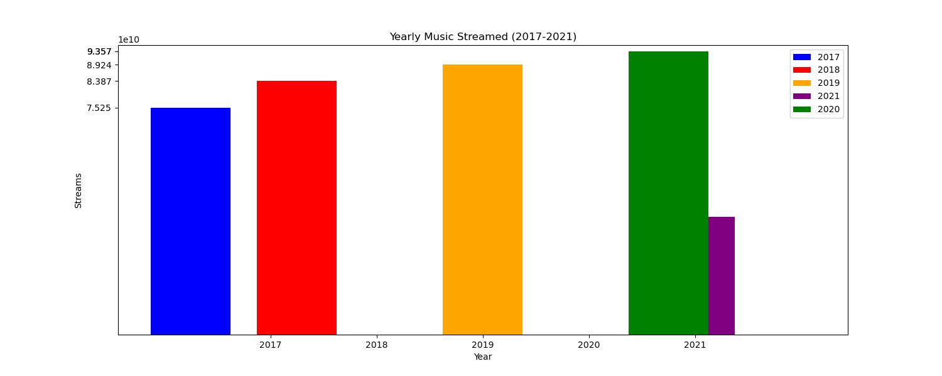
Data Visualization
Stream/Downloads per Year , Pre-During and Post Covid-19

Slide 12
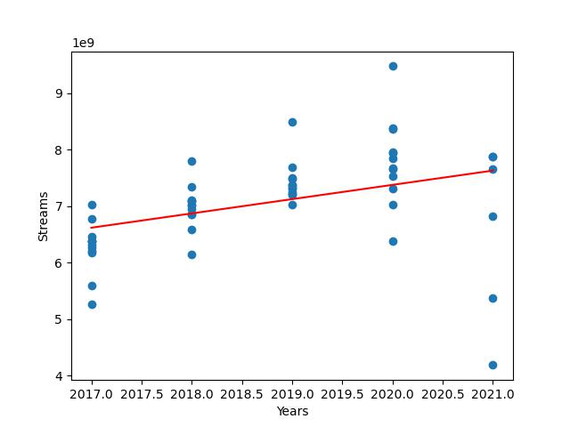
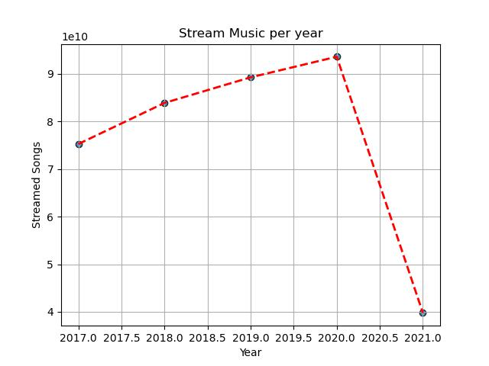
Data Visualization
Correlation between streaming Music and Covid-19
This graph shows the trend the music streaming took from 2017 – 2021
There is a positive correlation between music streamed and covid 19 era.

Slide 13


Thank you Q & A

