Slide 1
SPOTIFY DATA ANALYSIS by Music Notes
KathLeen SNIDER-BELINSKI
Carmen WIGGINS
Michelle PETRAS
Veethika SINGH
01/11/2024

Slide 2





One good thing about music, when it hits you, you feel no pain ~ Bob Marley

Slide 3
Hypothesis:
“When the world shut down on March 17, 2020, music consumption via the streaming platform Spotify experienced a statistically significant change.”

Slide 4

Data Collection
Music Data was collected from Kaggle.com (from Spotify) and the Spotify API
Conducted data cleaning to perform exploratory data analysis (EDA) and data visualization of the Spotify dataset using Python (Pandas, NumPy, Matplotlib)
Data analysis - exploring the relationship between the audio features of a song and how positive or negative its impact is on streaming, involving sentiment analysis and many more
Use data to identify patterns and relationships between different characteristics. The activity will support in developing ability to review and interpret a dataset
Explore if there was any impact to streaming before and after Covid

Slide 5
Data Cleaning
“Genre” was defined too broadly for comparisons
Master Genre key created
Column added and populated from the key
“Month” and “Year” columns added for cleaner data grouping
New csv output for analysis

Slide 6
Data Visualization
Matplotlib was used to display bar charts of the following
Total Streams
Streams by Genre
Streams by Artist
Analysis of Spotify Audio Features

Slide 7
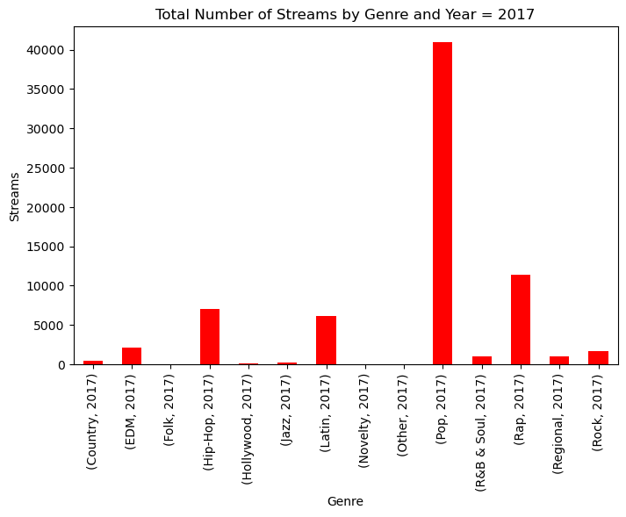
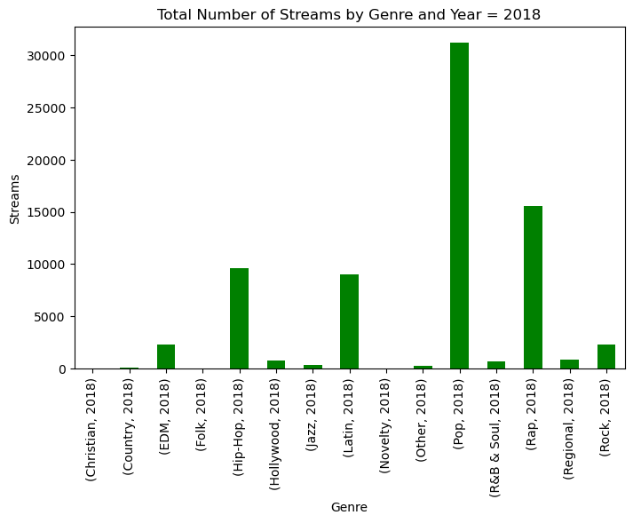
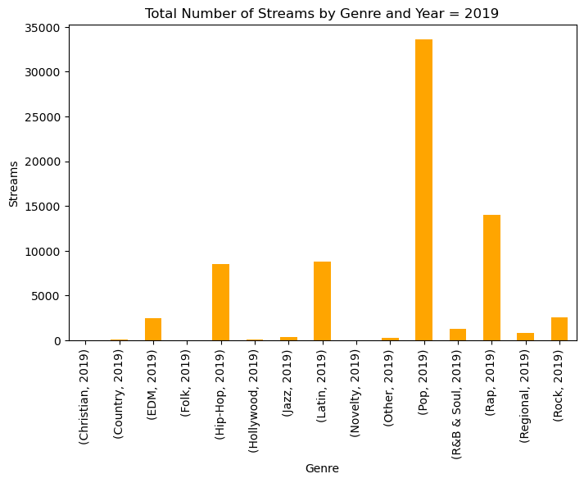
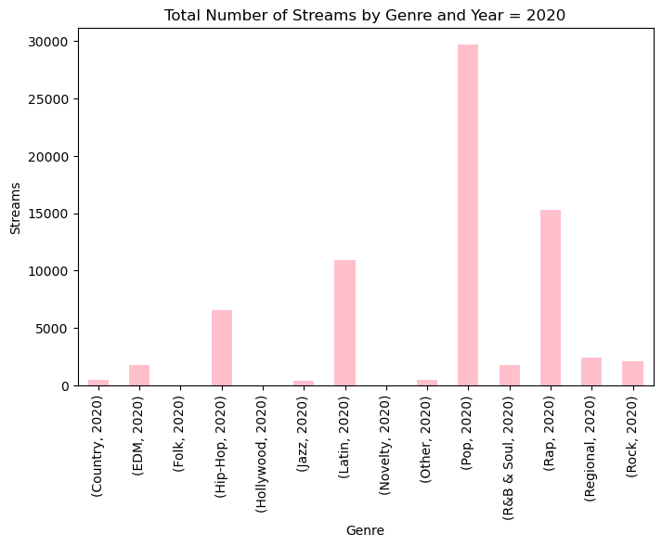
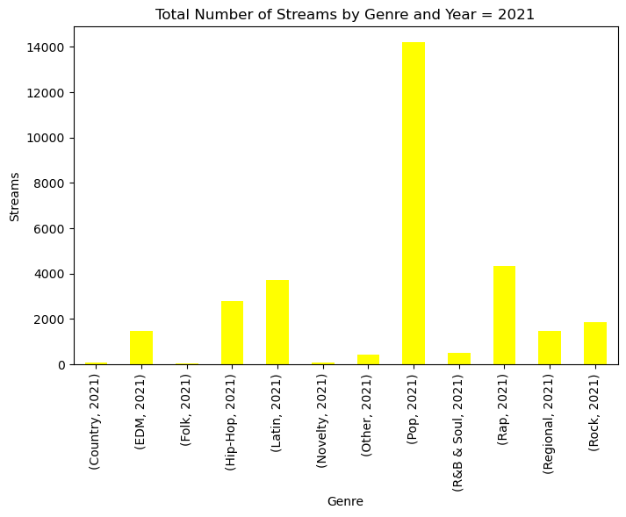
Data Visualization – Change in Genre by Year(2017-2021)
No Significant change was found in the years before , during and after covid. Pop remained the most popular Genre followed by Rap

Slide 8
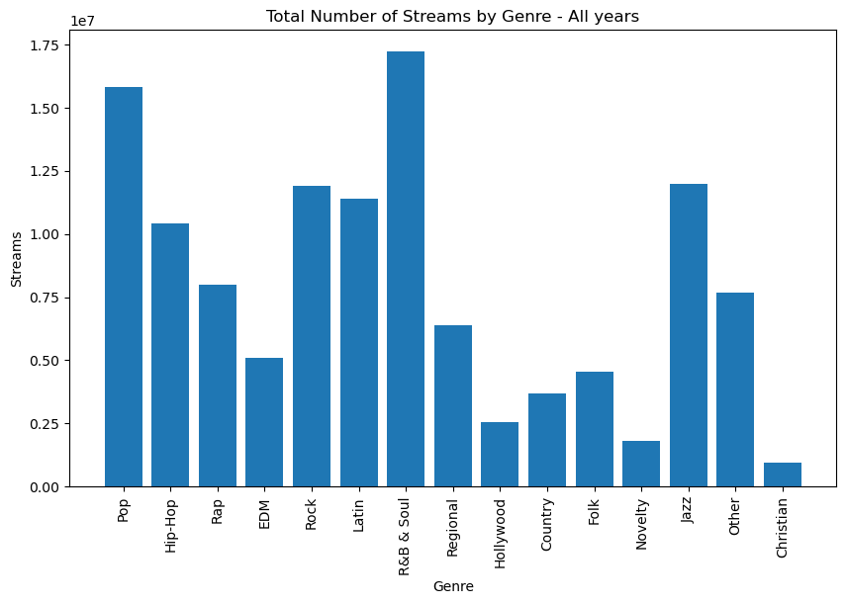
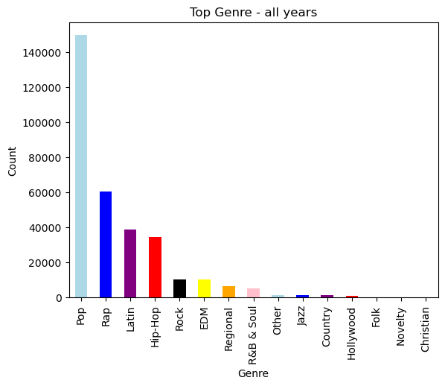
Data Visualization – Most Streamed / Top Genre
There was not much change in the type of music that was streamed
Overall, across all years Pop was the most popular.
There was a slight increase in Spotify streaming during Covid

Slide 9
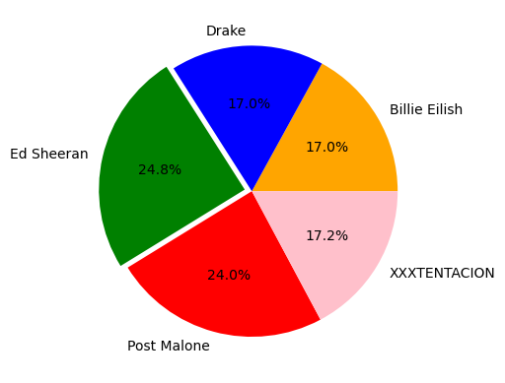
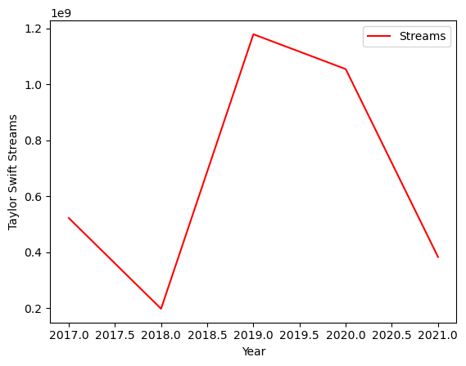
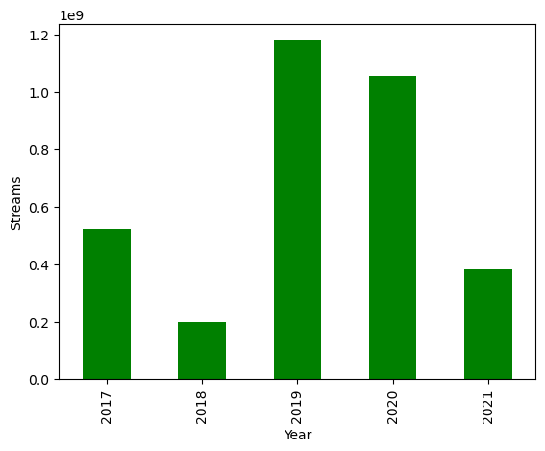
Data Visualization – Top Streamed Artists By Genre
Some artists’ popularity continued into covid
One artist Taylor Swift was sampled.
Ed Sheeran was the most popular artist across all years and genres

Slide 10
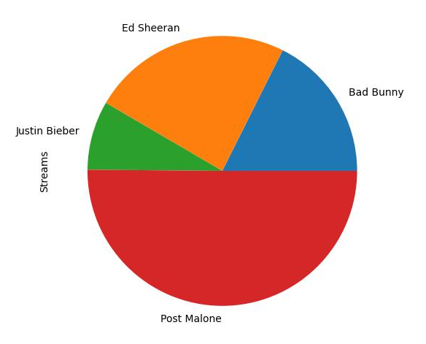
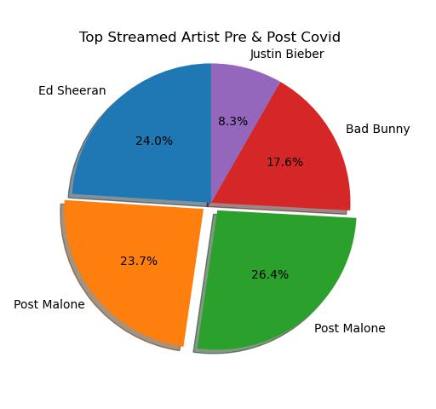
Data Visualization – Most Streamed Artists
Year | Artist | Streams
2017 | Ed Sheeran | 4,526,988,042
2018 | Post Malone | 4,474,074,823
2019 | Post Malone | 4,989,227,763
2020 | Bad Bunny | 3,322,524,063
2021 | Justin Bieber | 1,560,451,296
Pie charts of most streamed artists pre and post covid
Post Malone holds first place between the years 2018 and 2019
During Covid Bad Bunny streams were the highest

Slide 11
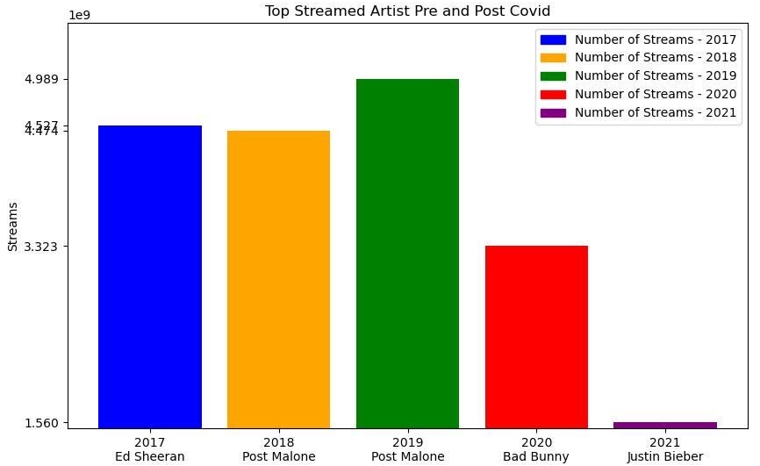
Data Visualization – Top Streamed Artists
Even though Bad Bunny was not the highest streamed artist through out the years, he was the most streamed artist in the heart of Covid (2020) with 3.3 million streams

Slide 12
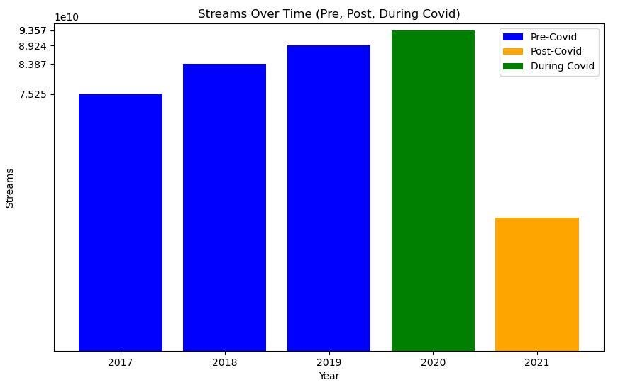
Data Visualization – Streams Per Year
Streams per year pre, during and post Covid
The bar chart clearly show the music streaming increased approximately 4.0 B from 2019- 2020
Note that 2021 streaming data is only through July 17, 2021
We estimate that the streaming for the 2021 year end would reach 78.0 B streams
Year | Streams
2017 | 75,248,867,959
2018 | 83,871,067,173
2019 | 89,244,533,337
2020 | 93,572,987,487
2021 | 39,775,784,728

Slide 13
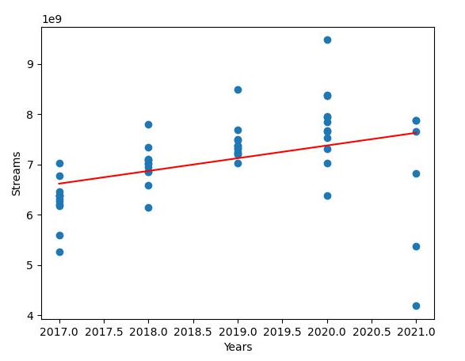
Data Visualization - Correlation
Correlation between streaming music and Covid
This graph shows the trend music streaming took from January 1^{st,} 2017 to July 17^{th,} 2021
There is a positive correlation between music streamed and covid 19 era.

Slide 14
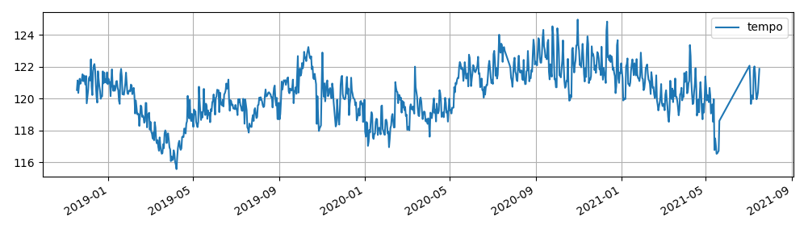
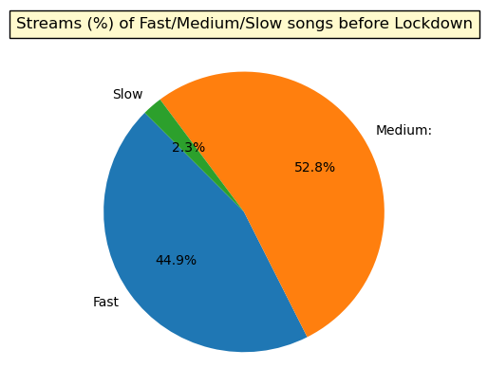
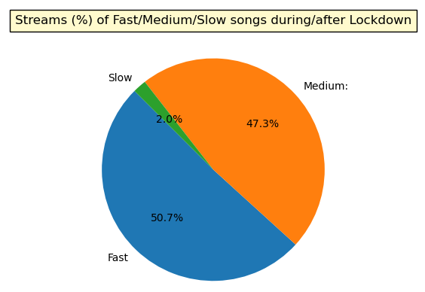
Data Visualization - Tempo
Tempo is the overall estimated tempo of a track in beats per minute (BPM)
In musical terminology, tempo is the speed or pace of a given piece and derived directly from the average beat duration
Tempo was split into three different speeds for analysis
Fast > 120 BPM
Medium 76-120 BPM
Slow < 75P BPM
During post COVID lockdown, the tempo of songs being streamed saw an increase of about 6% in comparison to pre COVID lockdown numbers

Slide 15
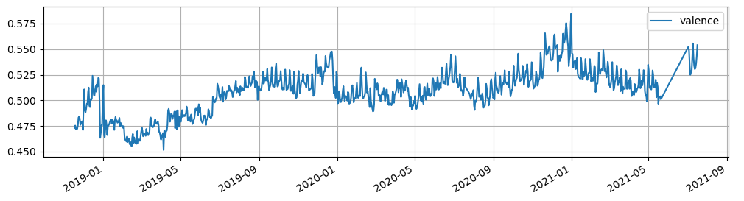
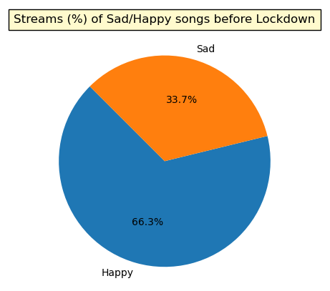
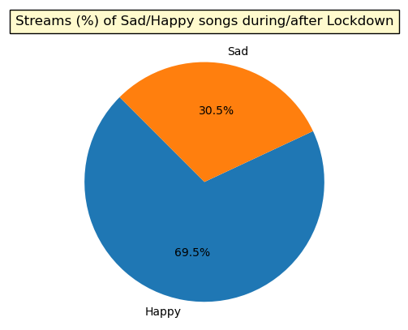
Data Visualization - Valence
Valence describes the musical positiveness or sentiment conveyed by a track
Tracks with high valence sound more positive (e.g., happy, cheerful, euphoric), which tracks with low valence sound more negative (e.g., sad, depressed, angry
Valence was split into sentiment (happy or sad) for analysis
Tracks with a valence greater or equal to 0.5 are considered “happy” songs, whereas tracks with a valence less than 0.5 are considered “sad” songs
During post COVID lockdown, the sentiment of songs being streamed saw an increase of about 3% in comparison to pre COVID lockdown numbers

Slide 16
Conclusion:
“After the review of the statistical data, we conclude that there was no significant change in music streaming via Spotify during and after the Covid lockdown.”

Slide 17


Thank you Q & A

