Slide 1
Where We Live Gets Under the Skin: NaNDA and Immune Aging
GSA Annual Scientific Meeting Online Workshop Series 2026
Grace Noppert, PhD
Research Associate Professor, Institute for Social Research

Slide 2
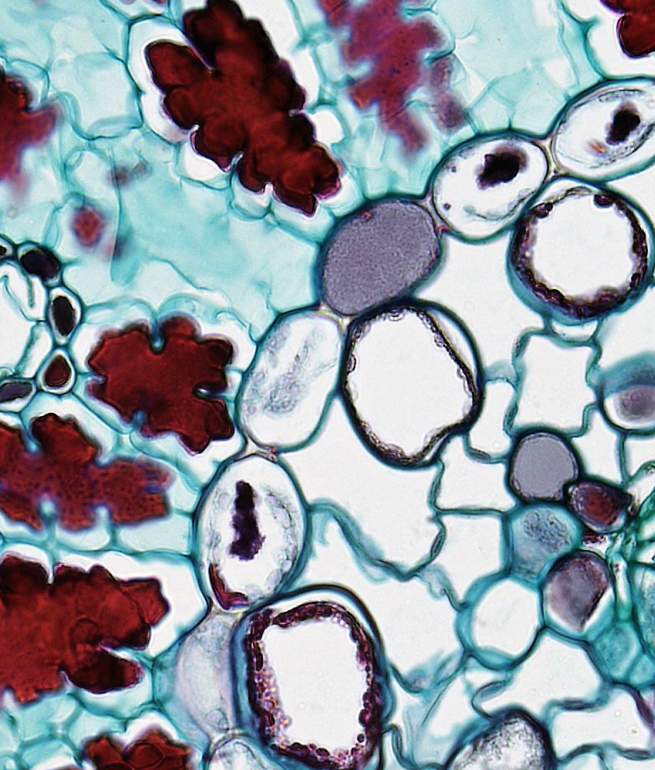

Where We Live Gets Under the Skin:
GSA ANNUAL SCIENTIFIC MEETING ONLINE WORKSHOP SERIES 2026
NaNDA and Immune Aging
Grace Noppert, PhD
Research Associate Professor

Slide 3
Can the neighborhood you live in change the way your immune system ages?
3

Slide 4
Why look at the immune system?
Our immune system ages
An “older” immune system is less able to fight off new infections and is associated with many chronic conditions
Chronic stress and repeated infections may speed that aging up
Neighborhoods may be a key source of stress and/or infectious diseases
4

Slide 5
Three signs of immune aging
1
2
3
CD4+ “helper” T cells
CD8+ “killer” T cells
CMV antibodies
CMV is a common virus that stays in the body for life. Higher antibody levels suggest the immune system is working harder to keep it in check.
The balance of worn, experienced cells to fresh, ready-for-anything (naïve) cells. Measured as a ratio of older: younger cells.
The same balance: more experienced cells relative to naïve cells means an older profile. Measured as a ratio of older: younger cells.
For all three, higher values point to an “older” immune profile.
5

Slide 6

The data: Health and Retirement Study
Nationally representative study of Americans over 50
Running since 1992, with follow-up every two years
More than 20,000 participants
In 2016, blood samples measured immune function
We also knew where people lived in 2016
6

Slide 7
9,000+
older adults in each analysis with both immune data and a neighborhood we could link to NaNDA
7

Slide 8
How the NaNDA link works
1
2
3
4
Start with people
Find the neighborhood
Match to NaNDA
Analyze together
HRS participants and their 2016 home address (kept confidential)
Each address falls in a census tract: a small area of a few thousand residents
Join on the tract ID to pull ready-made neighborhood measures
Each person’s blood data now sits next to their neighborhood data
The census tract ID is the bridge: one shared column links a health study to NaNDA.
8

Slide 9
What we pulled from NaNDA
Neighborhood disadvantage
% living below the poverty line
% unemployed
% receiving public assistance or food stamps
% female-headed households with children
Neighborhood affluence
% households earning over $75K
% in professional or managerial jobs
% with a bachelor’s degree or higher
Also: population density
How crowded the neighborhood is
9

Slide 10
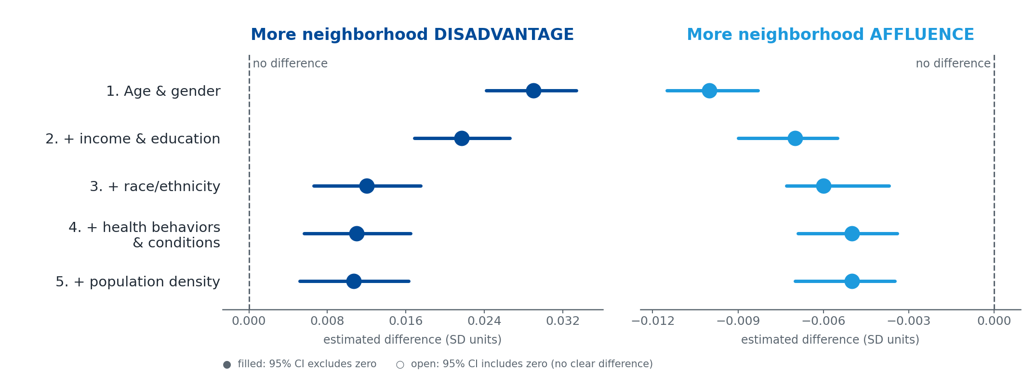
What we found: CMV antibodies
More disadvantage → higher CMV antibodies. More affluence → lower.
The link shrinks once we account for people’s own circumstances, but it never goes away.
10

Slide 11
Where the signal showed up
More disadvantage
More affluence
CD4+ T cells: experienced vs. naïve
▲ Higher: older profile*
No clear difference
CD8+ T cells: experienced vs. naïve
No clear difference
No clear difference
CMV antibodies
▲ Higher: older profile
▼ Lower: younger profile
Both CMV links held after accounting for personal income, education, race/ethnicity, health, and population density.
*Held after accounting for income and education; weakened once race/ethnicity was added.
11

Slide 12
Where we live becomes biologically embedded. It shows up in our immune systems.
12

Slide 13
Why NaNDA made this possible
Ready-made neighborhood measures for the whole U.S.
Links to any study with a geographic ID, like a census tract
Consistent definitions, so results can be compared across studies
Lets health researchers examine whether where you live shows up in how you age
13

Slide 14
Thank you! Questions?
Grace Noppert, PhD
gnoppert@umich.edu
14

Slide 15
Backup slides
Detailed results: CD4+ T cells
Detailed results: CD8+ T cells
Who was in the study
15

Slide 16
Choose your breakout
Back together at 1:45
BEGINNER
Choosing Your First NaNDA Dataset
Pick this if
You are new to neighborhood data, or want help finding the right dataset.
You'll leave with
A NaNDA dataset matched to your geography and years.
INTERMEDIATE
Linking NaNDA with Your Data
Pick this if
Your data have addresses, ZIP codes, or census tracts to merge with NaNDA.
You'll leave with
A merge you ran on practice data, plus code you can reuse.
How to join
Click Breakout Rooms in your Zoom toolbar. It may be under More.
Choose Beginner or Intermediate, then click Join.
Not sure? Start with Beginner. You can switch rooms any time.
1
2
16

Slide 17
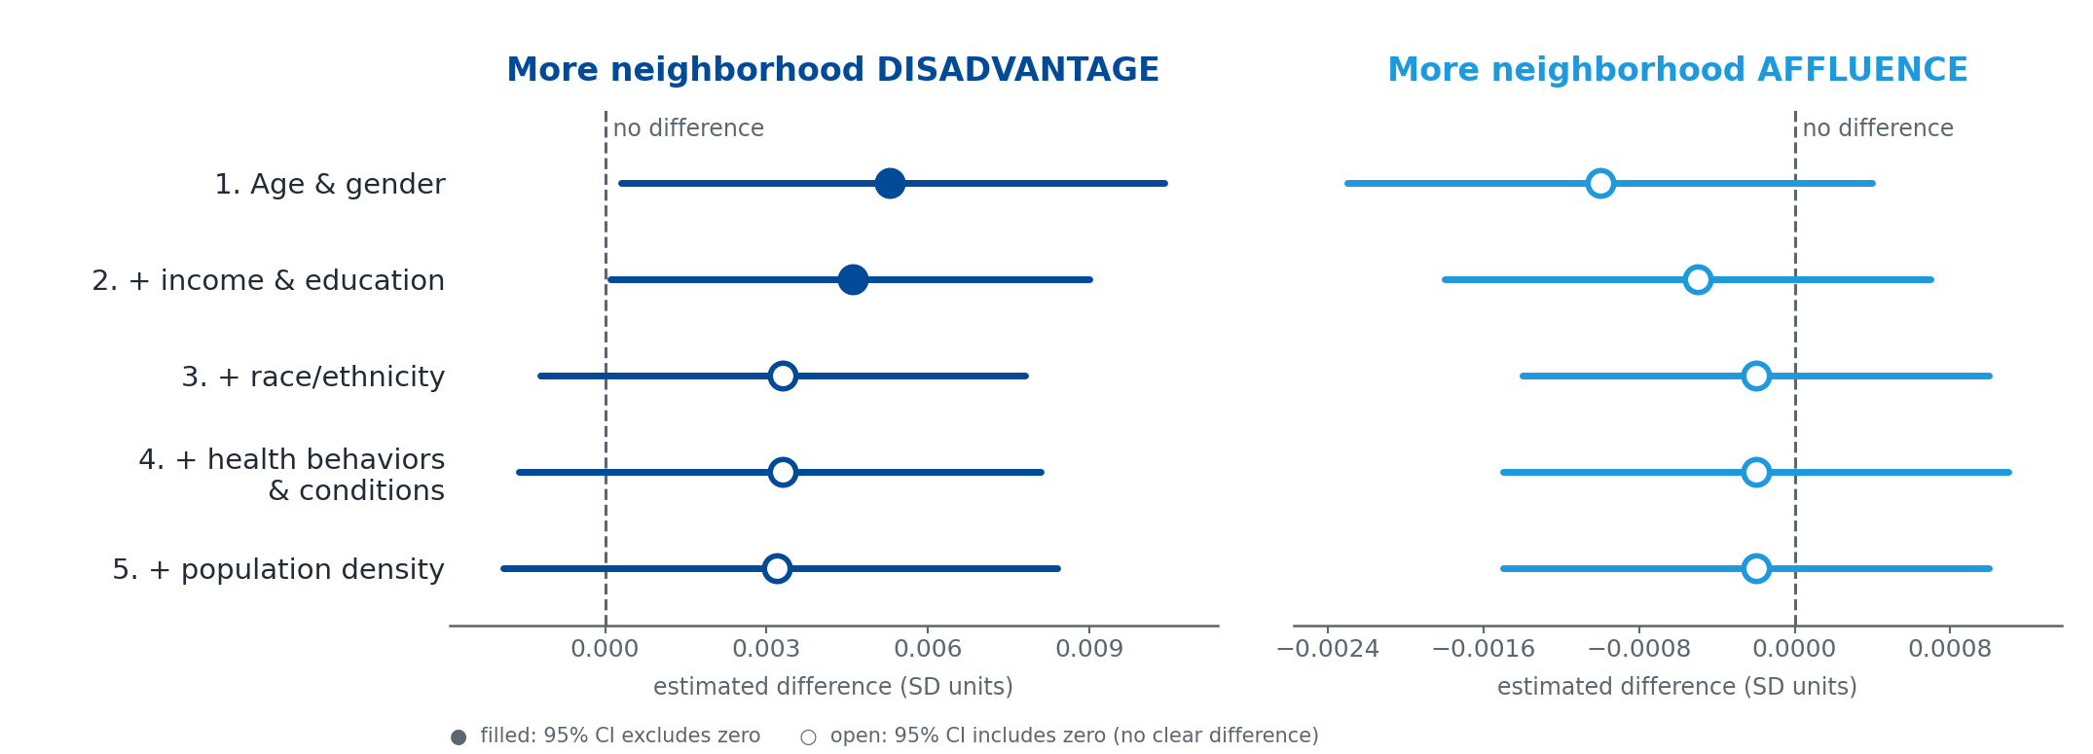
Backup: CD4+ T cells (EMRA:naïve ratio)
Linear regression estimates with 95% confidence intervals; outcomes standardized (SD units). Model 1: age + gender; Model 2: + income & education; Model 3: + race/ethnicity; Model 4: + health behaviors + chronic conditions; Model 5: + neighborhood population density.
17

Slide 18
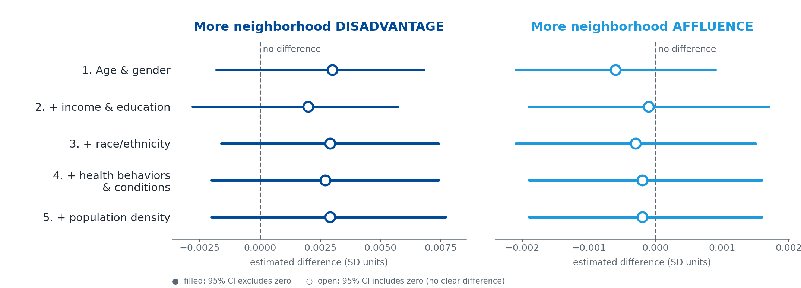
Backup: CD8+ T cells (EMRA:naïve ratio)
Linear regression estimates with 95% confidence intervals; outcomes standardized (SD units). Model 1: age + gender; Model 2: + income & education; Model 3: + race/ethnicity; Model 4: + health behaviors + chronic conditions; Model 5: + neighborhood population density.
18

Slide 19
Backup: Who was in the study (N = 9,933)
Demographics
Median age 67; 59% female
64% NH White, 18% NH Black, 15% Hispanic, 3% other
Education: 17% less than HS, 51% HS grad, 7% some college, 24% college grad
Neighborhood, median (IQR)
Disadvantage: 7.81 (7.5)
Affluence: 28.37 (20.89)
Immune measures, median (IQR)
CD8+:CD4+ ratio: 0.33 (0.31)
CD4+ EMRA:naïve: 0.04 (0.12)
CD8+ EMRA:naïve: 2.31 (4.88)
CMV: 72% seropositive; IgG 214.2 U/mL (578.25)
19

