Slide 1
Using Neighborhood Data in Aging Research
The National Neighborhood Data Archive (NaNDA)
GSA Annual Scientific Meeting Online Workshop Series 2026
Wednesday, October 7, 2026, 12:00 to 2:00 PM ET

Slide 2




Funding & support
National Institutes of Health
  National Institute on Aging, R01AG109115
  National Institute of Nursing Research, U01NR020556
  National Institute on Minority Health and Health Disparities, U01NR020556
2

Slide 3

Your presenters
Philippa Clarke she|her
  Research Professor, NaNDA Co-Principal Investigator
Grace Noppert she|her
  Research Associate Professor, NaNDA Co-Principal Investigator
Lindsay Gypin she|her
  Data Librarian and Senior Project Manager
Robert Melendez he|him
  Data Analyst
Will Clary he|him
  Research Data Analyst
3

Slide 4
Today's plan
Time (ET) | What we are doing | Who
12:00 | Welcome and logistics | Philippa & Lindsay
12:05 | What is NaNDA? Overview and repository tour | Lindsay & Philippa
12:30 | NaNDA in action: examples from aging research | Philippa & Grace
12:55 | Choose your breakout | Lindsay
1:00 | Breakouts: beginner and intermediate | All
1:45 | Reconvene and report back | Grace
1:55 | Wrap-up and resources | Lindsay
4

Slide 5
Housekeeping
Captions are available. Turn them on with Show Captions in your Zoom toolbar.
Stay muted in the full group. You are welcome to unmute in your breakout.
Chat is for comments and links. Q&A is for questions you want us to answer.
GSA Digital Programs is running the technical side. Message the host if something breaks.
You do not need to install anything. Everything today runs in a browser.
5

Slide 6
Workshop materials
EVERYONE
Presentation slides
Slides from all of today's presentations.
BEGINNER
Participant Handout
For Choosing Your First NaNDA Dataset: your worksheet, plus the breakout's slide content. Scavenger hunt answers are at the bottom.
INTERMEDIATE
Practice data and code
For Linking NaNDA with Your Data: practice data and sample merge code in Stata, R, and Python.
Available through the workshop DOI. The link is in the chat.
6

Slide 7

In the chat: what do you wish you could measure about the neighborhoods?
7

Slide 8
By 2:00 you will be able to
Identify which NaNDA datasets fit your research question, by geographic level, years covered, and topic
Link NaNDA to your own data using geographic identifiers, including when to use tract_fips10 or tract_fips20, and how ZIP codes differ from ZCTAs
Frame a research question that combines neighborhood measures with your individual-level aging outcomes
8

Slide 9
Two options. You pick one at 12:55.
Beginner: Choosing Your First NaNDA Dataset
  Census tracts, ZCTAs, and which matches your data
  Matching NaNDA years to your collection period
  Reading a codebook and finding the identifier
  Hands-on time in the repository
Intermediate: Linking NaNDA with Your Data
  Identifiers and the pitfalls that break a merge
  When you need a crosswalk, and which one
  A live merge you can follow along with
  Drafting a research question that uses both
9

Slide 10


NaNDA overview
An overview of the National Neighborhood Data Archive, and a tour of the repository
GSA Annual Scientific Meeting Online Workshop Series 2026, October 7, 2026
10

Slide 11
What we'll cover
01
Why neighborhood context matters for aging research
02
What NaNDA is, and what is in it
03
Which NaNDA datasets are already linked to the studies you use
04
Geography: the part that trips people up
05
A live tour of the repository
11

Slide 12

What is your neighborhood?
A few blocks.
A school catchment.
A census tract, because that is what the data came in.
Your choice changes your findings
12

Slide 13
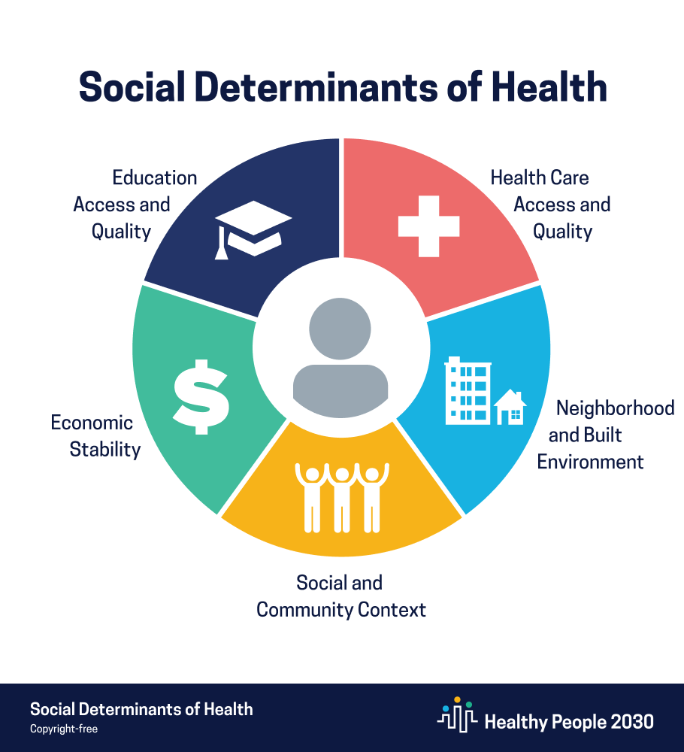
SOCIAL DETERMINANTS OF HEALTH
Neighborhood and built environment is one of the five domains.
It is also the one most researchers have the least data on.
Healthy People 2030, U.S. Department of Health and Human Services.
13

Slide 14
What we mean by neighborhood
Built and physical
Social and economic
•
Walkability, public transit, traffic
•
Disadvantage, affluence, gentrification
•
Food stores, parks and recreation
•
Mortgage lending, housing affordability
•
Healthcare, hospitals
•
School quality, employment, crime
•
Air pollution, climate, air conditioning
•
Voter registration, turnout, and partisanship
•
Broadband
14

Slide 15
Where data come from
1
2
3
Ask people
Go look
Use data that already exist
Survey items on safety, cohesion, park quality. Captures perception, but it is your own data collection.
Systematic social observation, in person or by street view. Rich, and expensive.
Census and ACS, business point data, parcel data, weather stations, administrative records. This is what NaNDA is built from.
15

Slide 16

Every research team was building the same neighborhood measures from scratch.
2019
In 2019, NaNDA was founded
16

Slide 17
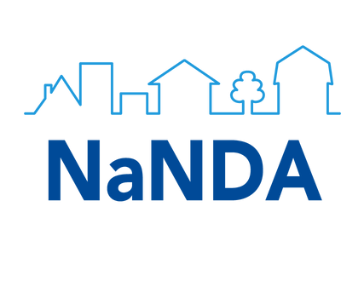

What is NaNDA?
The National Neighborhood Data Archive (NaNDA) is an open data repository. It provides FAIR datasets about physical and social environment that researchers can easily combine with their own data.
17

Slide 18
FAIR data principles
F
A
I
R
FINDABLE
ACCESSIBLE
INTEROPERABLE
REUSABLE
go-fair.org/fair-principles
18

Slide 19
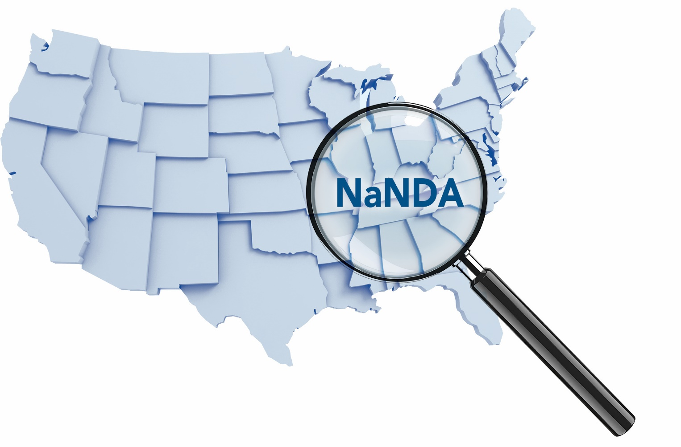
Examples of neighborhood topics include:
Health care services
Parks
Social Services
Transportation
(public parks, national and state parks)
(crisis centers, shelters, child day care services)
(street connectivity, public transit stops, traffic)
(health care providers, residential care facilities, hospitals)
Broadband
Liquor, tobacco and dispensaries
Crimes
Grocery stores
(internet availability, speed, adoption, and access)
(crime reported by the FBI)
(counts and density measures)
(counts and density measures)
19

Slide 20
Data updates
Updated Voter Registration, Turnout, Partisanship (2024, Census Tract)
Business Openings & Closings
Quality of Public Transit
National Housing Preservation Database
LGBTQ+ Health & Policy
Policing
20

Slide 21
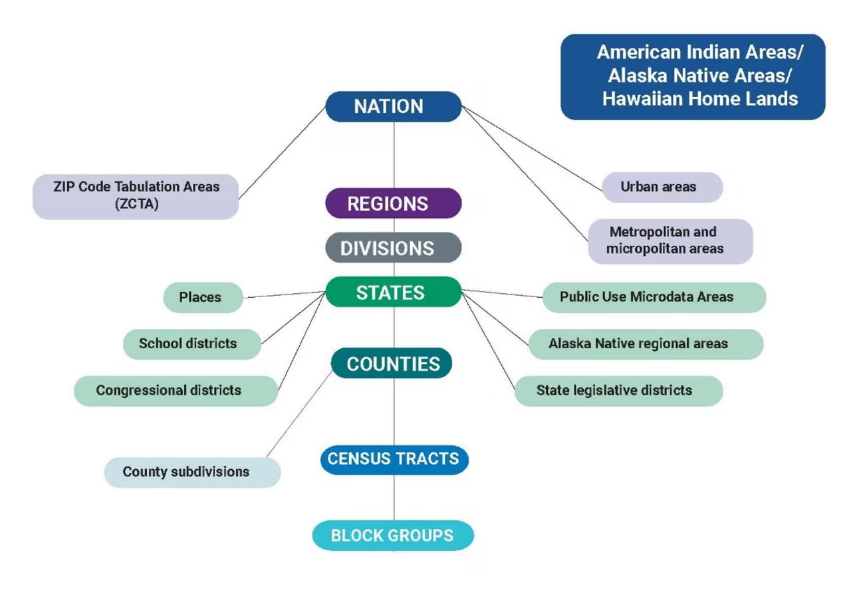
Hierarchy of select geographic entities
census.gov
21

Slide 22

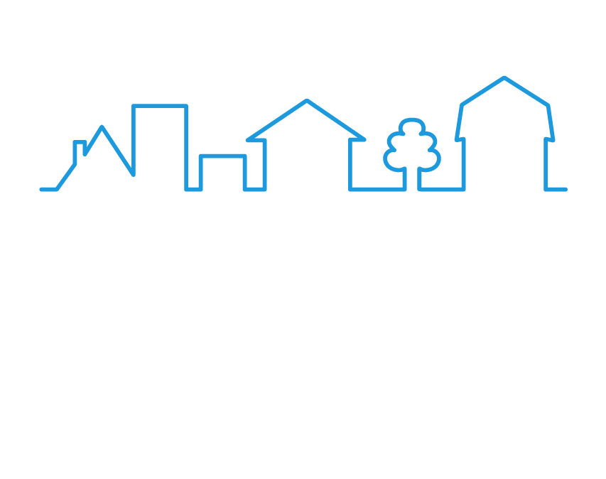
NaNDA geographies
census.gov
22

Slide 23
Which geography do I use?
IF YOUR DATA HAVE…
JOIN TO NANDA USING…
→
A census tract, FIPS code, or GEOID (11 digits)
The FIPS code directly. Check whether it uses 2010 or 2020 geographic boundaries: tract_fips10 and tract_fips20 are not interchangeable
→
A ZIP code
A ZIP-code-to-ZCTA crosswalk. Some ZIP codes have no ZCTA
→
Full street addresses (not PO boxes)
Geocode first, in ArcGIS or an online geocoder, then join on the resulting FIPS code
23

Slide 24
“Pre-linked” NaNDA
DATA SOURCE
POPULATION
GEOGRAPHY
PROTOCOL FOR ACCESS
Health and Retirement Study
US adults age 51+
Census tract
Accessed through virtual enclave with restricted data application
National Health and Aging Trends Study
US adults age 65+
Census tract
Accessed through virtual enclave with restricted data application
Panel Study of Income Dynamics
1968 US sample
Block group
Accessed through virtual enclave with restricted data application
Michigan Medicine Electronic Health Records
Michigan Medicine patients
Residential address
IRB approval and U-M affiliation, accessed through DataDirect
Federal Statistical Research Data Centers
Varies by dataset (Census, NCHS, AHRQ surveys)
Census block
Approved project proposal and background check, accessed in a secure research data center
24

Slide 25




Your data plus NaNDA data, joined on one geographic identifier.
Your Data
NaNDA Data
New Ideas
25

Slide 26
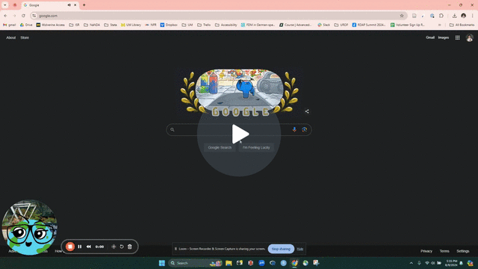
NaNDA repository walk through
Navigating the National
Neighborhood Data Archive 🗺️
Watch Video
26

Slide 27






Contact NaNDA
nanda.isr.umich.edu
nanda-admin@umich.edu
@UM_NaNDA
@UM_NaNDA
linkedin.com/company/um-nanda
27

Slide 28
Choose your breakout
Back together at 1:45
BEGINNER
Choosing Your First NaNDA Dataset
Pick this if
You are new to neighborhood data, or want help finding the right dataset.
You'll leave with
A NaNDA dataset matched to your geography and years.
INTERMEDIATE
Linking NaNDA with Your Data
Pick this if
Your data have addresses, ZIP codes, or census tracts to merge with NaNDA.
You'll leave with
A merge you ran on practice data, plus code you can reuse.
How to join
Click Breakout Rooms in your Zoom toolbar. It may be under More.
Choose Beginner or Intermediate, then click Join.
Not sure? Start with Beginner. You can switch rooms any time.
1
2
28

