Slide 1


Choosing Your First NaNDA Dataset
Breakout 1 · Beginner session · 45 minutes
GSA Annual Scientific Meeting Online Workshop Series 2026 · October 7, 2026

Slide 2


Three questions, one dataset
Where?
When?
What?
Your turn
Geography
Years
Topics and variables
Your own project
HOW IT WORKS
ICPSR Account
Choosing Your First NaNDA Dataset: Participant Handout (GSA 2026)
Polls, a scavenger hunt, and lots of chat.
Bring your own project, or borrow Jordan's.
2

Slide 3

Meet Jordan Ellis
Topic
Loneliness among adults 65 and older
Data
100 participants
Yearly interviews 2016 to 2019
Geography
Home addresses collected at enrollment in 2016
Geocoded to census tracts
RESEARCH QUESTION
Do older adults living near more places to gather (clubs, community groups, places of worship) report less loneliness?
Dr. Jordan Ellis
they|them
3

Slide 4
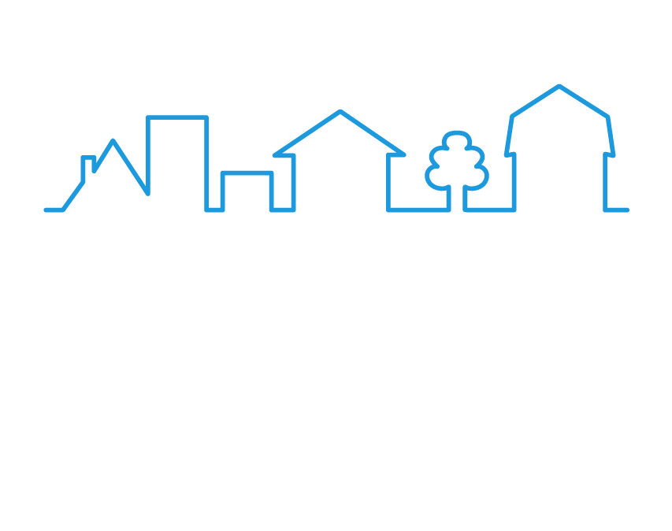
Where?
SEGMENT 1
Census tracts, ZCTAs, and geographic boundaries, oh my!
4

Slide 5
Census tracts and ZCTAs
Census tract
ZCTA (ZIP Code Tabulation Area)
A small, stable statistical area, usually 1,200 to 8,000 people.
The Census Bureau's area version of a ZIP code, built from census blocks.
Nests inside a county, the way counties nest inside a state.
Not the boundary the Postal Service uses, and not nested inside anything.
Most NaNDA measures are available at this level.
ZIP ≠ ZCTA
A ZIP code is a mail delivery route. A ZCTA is a statistical area. They are not interchangeable. ZIP codes need a crosswalk to ZCTAs (Intermediate Session).
5

Slide 6
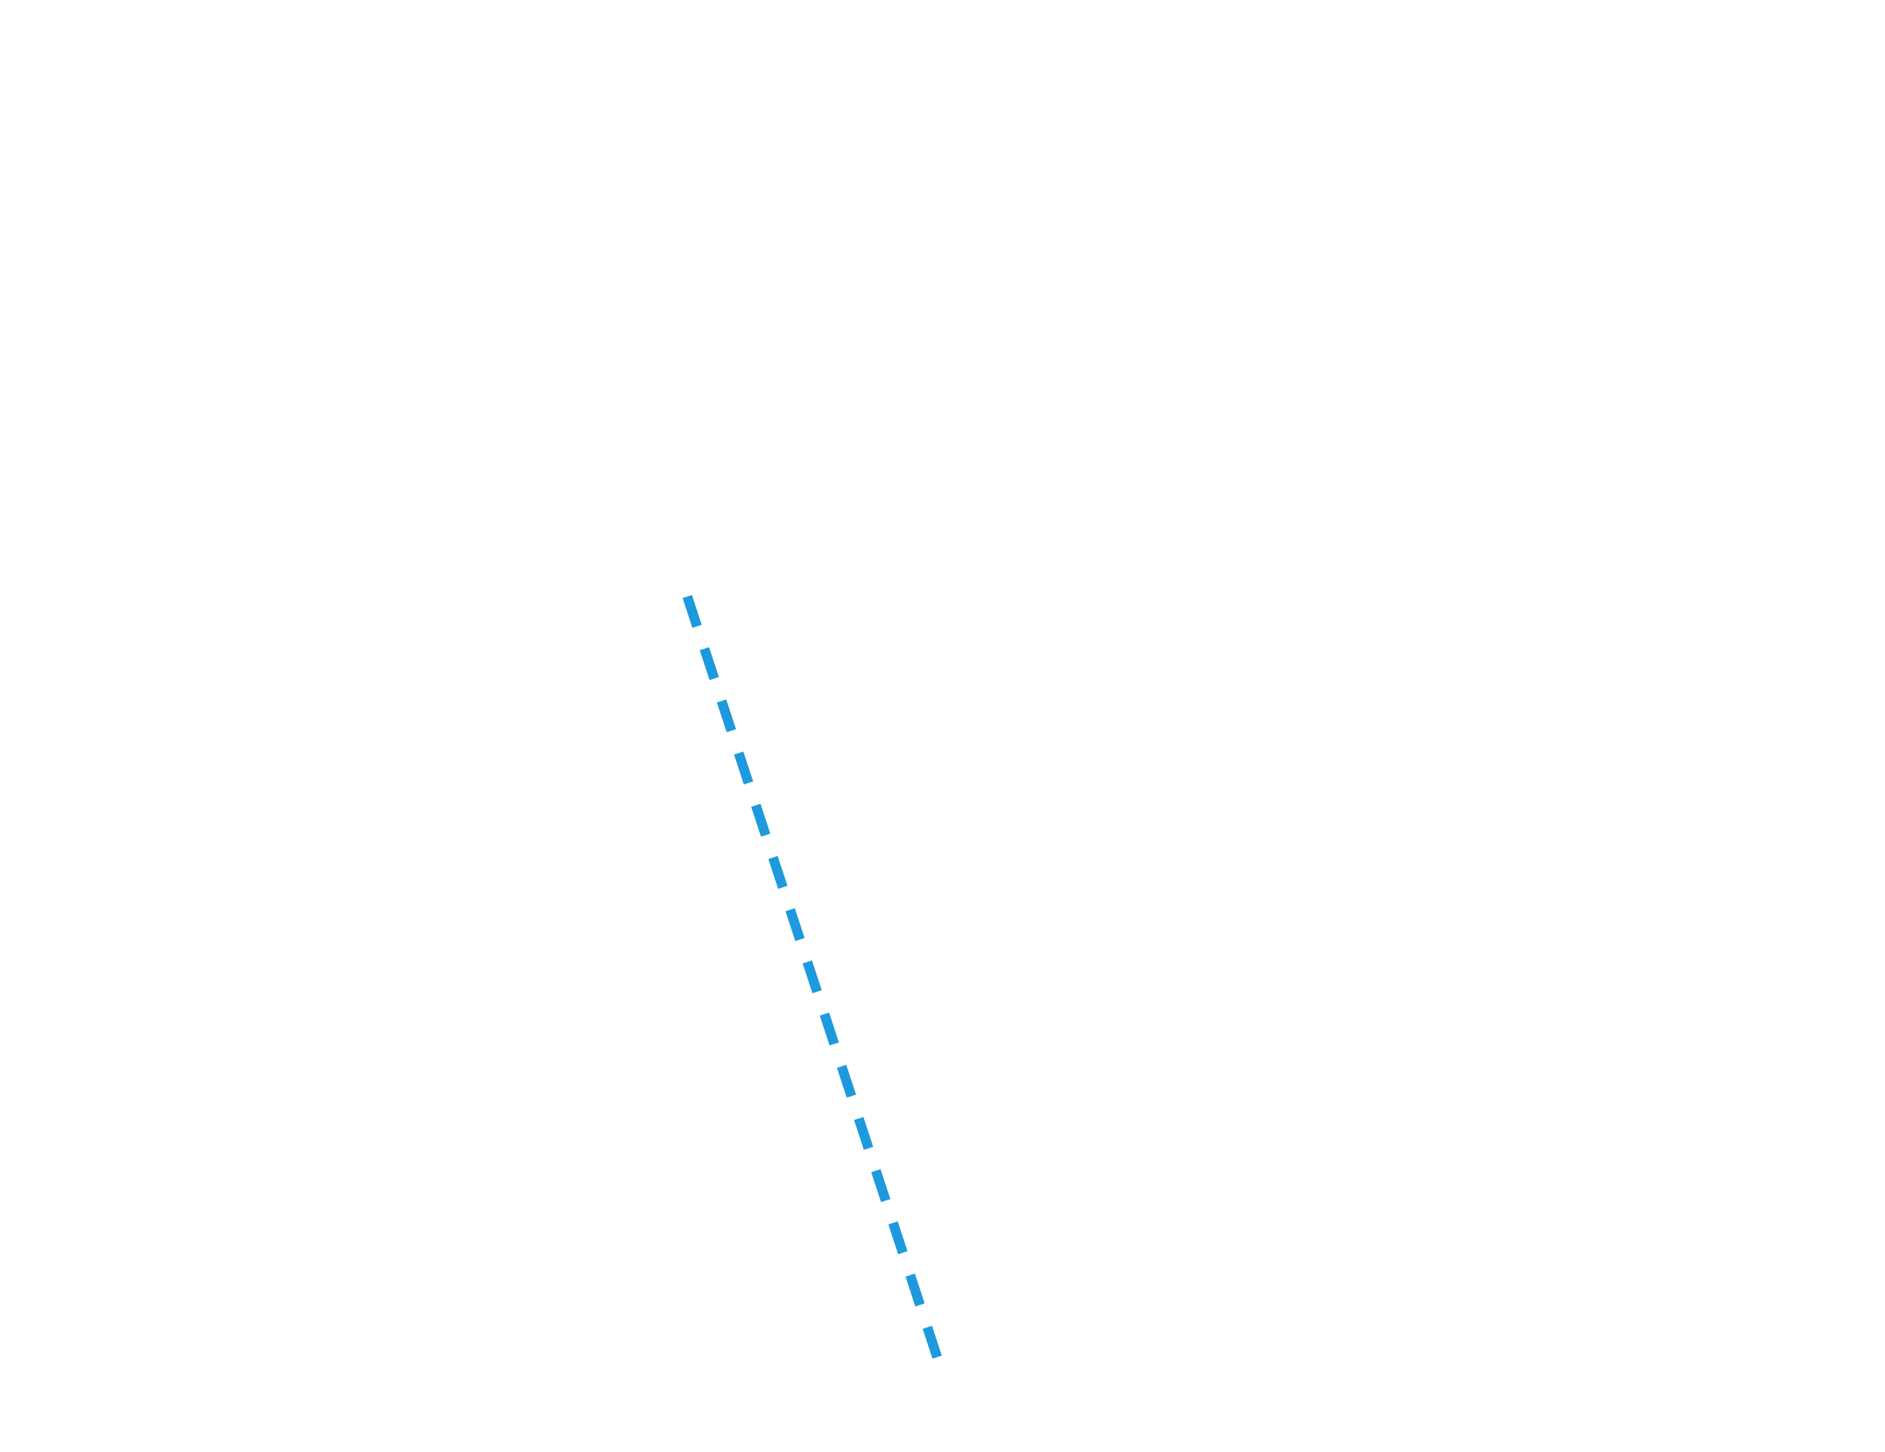
The Census geography hierarchy
Nation
States
The center spine nests. Nation, states, counties, tracts, block groups, blocks. Each level fits inside the one above it.
ZCTAs
Counties
Built from census blocks
ZCTAs sit off to the side. They skip tracts and counties entirely, which is why their lines never match tract or county lines.
Census tracts
Block groups
Simplified from the U.S. Census Bureau hierarchy diagram
Census blocks
6

Slide 7
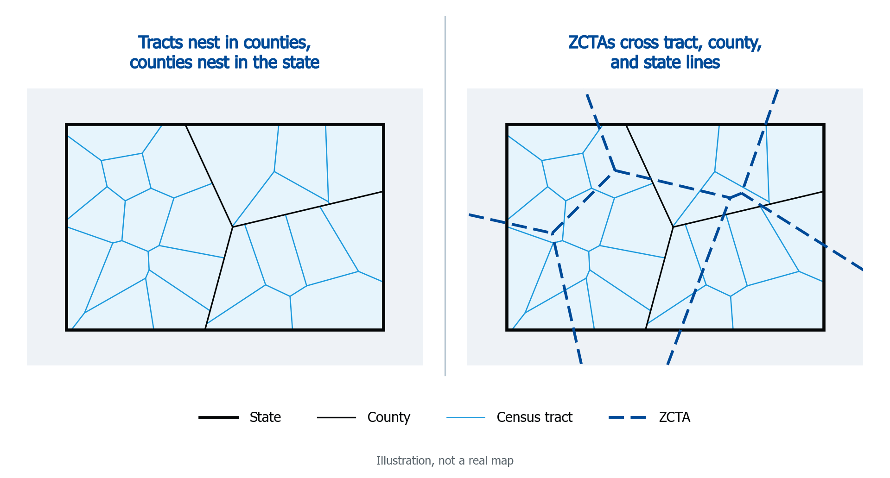
Tracts and ZCTAs
7

Slide 8
How a FIPS code grows
State
2
6
Michigan
2 digits
County
2
6
1
6
1
State, then county 161 (Washtenaw)
5 digits
Census tract
2
6
1
6
1
4
0
0
1
0
0
County, then tract 400100
11 digits
Block group
2
6
1
6
1
4
0
0
1
0
0
1
Tract, then block group 1
12 digits
NaNDA's tract identifiers, tract_fips10 and tract_fips20, are this 11-digit code. Stored as text to preserve leading zeros. Census Bureau: Understanding Geographic Identifiers
8

Slide 9
ZCTA codes are a separate system
Census tract FIPS code
ZCTA code
11 digits · state + county + tract
5 digits · no state or county inside it
2
6
1
6
1
4
0
0
1
0
0
4
8
1
0
4
State
County
Tract
ZCTA
Nested. Every digit tells you where the tract sits.
Not nested. It looks like a ZIP code, and usually matches one, but it is a Census area, not a mail route.
Have ZIP codes? They still need a crosswalk to ZCTAs before linking to NaNDA.
9

Slide 10
Geographic boundaries
Tracts and ZCTAs are redrawn after each Decennial Census. 2010 and 2020 codes do not align.
Match the boundary to when your geography was assigned, not to the survey year.
2010 Census tract boundaries
2020 Census tract boundaries
2010 boundaries
2020 boundaries
2008
2012
2016
2020
2024
Your turn
Jordan's addresses were geocoded in 2016
Which geographic boundaries do Jordan's tract codes use?
10

Slide 11
Which geographic boundaries fit Jordan's research?
POLL 1 OF 3 · BOUNDARIES
Civic, Social, and Religious Organizations comes in four files. Jordan's data: census tracts on 2010 boundaries.
A.
Census Tract 2010
B.
Census Tract 2020
C.
ZCTA 2010
D.
ZCTA 2020
E.
Not sure
Join the poll
Watch for it to pop up in your Zoom window.
11

Slide 12
The answer is A: Census Tract 2010
UNIT
BOUNDARIES
A
Census Tract 2010. Tracts, on the same geographic boundaries as Jordan's codes.
Match
Match
B
Census Tract 2020. Right unit, but the codes are different. It won't link to Jordan's 2010 tract codes.
Match
Wrong boundaries
C
ZCTA 2010. Right boundaries, wrong unit. Jordan has tract codes, not ZCTAs.
Wrong unit
Match
D
ZCTA 2020. Neither.
Wrong unit
Wrong boundaries
Boundaries first.
The filename tells you the unit and the geographic boundaries. Only the Census Tract 2010 file links on tract_fips10. Years come next.
12

Slide 13
Jordan's boundaries: 2010
Geocoded in 2016, five years before the 2020 boundaries existed. Anything geocoded before 2020 almost certainly uses 2010 boundaries.
2010 Census tract boundaries
2020 Census tract boundaries
2010 boundaries
2020 boundaries
2008
2012
2016
2020
2024
2016 · Jordan's addresses geocoded
Jordan’s
Where
2010 boundaries. Use the Census Tract 2010 file, linked on tract_fips10. Not sure when your data were geocoded? Ask whoever did it, or check the codebook.
13

Slide 14
NaNDA location variables
VARIABLE
WHAT IT IS
tract_fips10
Census tract, 2010 boundaries (11 digits)
tract_fips20
Census tract, 2020 boundaries (11 digits)
└ tract_fips22
The same 2020 tracts, recoded for Connecticut's 2022 boundary change. An additional variable in the 2020 files, not a separate dataset. Use it if your data were geocoded after 2022 and include Connecticut.
zcta10
ZCTA, 2010 boundaries (5 digits)
zcta20
ZCTA, 2020 boundaries (5 digits)
The suffix tells you the geographic boundaries. Recent NaNDA datasets use these variable names; older ones may differ, so check the documentation.
14

Slide 15

Search NaNDA for 2010 census tract datasets
TRY IT
1
Open the NaNDA repository on ICPSR. icpsr.umich.edu/sites/nanda
WHAT YOU WILL SEE
Find Data
Studies
Most NaNDA studies come as the same four files.
2
Search "census tract 2010"
Census Tract 2010
Census Tract 2020
topic for Jordan's research: "religious", "civic", or "social"
ZCTA 2010
ZCTA 2020
3
Open any study.
Jordan's data fit the first one. Yours may fit a different one.
Select "Data & documentation"
Find the Census Tract 2010 file
4
Post the study title in the chat.
15

Slide 16
Where, so far
Where?
JORDAN'S WHERE
Census tract codes on 2010 boundaries. Census Tract 2010 file, linked on tract_fips10.
Tracts nest in counties. ZCTAs nest in nothing.
ZIP ≠ ZCTA. ZIP codes need a crosswalk first.
Boundaries follow the geocoding date: before 2020 means 2010.
Store FIPS codes as text to preserve leading zeros.
Want a refresher after today? NaNDA's guide to geographies
16

Slide 17
When?
SEGMENT 2
Which NaNDA years match my data collection window?
17

Slide 18
Two kinds of timing
Yearly dataset
one value per place per year
Civic, Social, and Religious Organizations
Period dataset
2008 to 2012
2013 to 2017
Socioeconomic Status
2016 to 2020
2018 to 2022
YOUR DATA
2016
2017
2018
2019
Jordan's interviews
2008
2011
2014
2017
2020
2023
18

Slide 19
Yearly dataset
WHEN, PART 1
Places to gather come from Civic, Social, and Religious Organizations: one value per tract per year.
19

Slide 20
Which years does Jordan use?
POLL 2 OF 3 · YEARS, YEARLY DATASET
Civic, Social, and Religious Organizations is a yearly dataset, 1990 to 2022. Jordan's interviews: 2016, 2017, 2018, 2019.
A.
2016 only, the enrollment year
B.
2016, 2017, 2018, and 2019, one per interview year
C.
2022 only, the most recent year
D.
Not sure
Join the poll
Watch for it to pop up in your Zoom window.
20

Slide 21
The answer is B: every interview year
Jordan's interviews
2016
2017
2018
2019
↓
↓
↓
↓
2014
2015
2016
2017
2018
2019
2020
2021
Census Tract 2010 file · one value per tract per year, 1990 to 2022 (2014 to 2021 shown)
A yearly dataset has a value for every tract in every year, so each interview is matched to its own year. A 2016 interview gets the 2016 value for that tract; a 2019 interview gets the 2019 value.
Yearly:
match the year.
Every one of Jordan's years has a match. If your years fall outside the dataset's range, use the nearest year and document the decision in your methods.
21

Slide 22
One year, or every year?
Whether you need to match every interview year depends on how fast the neighborhood measure changes. That is a methods decision, and yours to make.
CHANGES SLOWLY
CHANGES FAST
One year can be enough
Match each year
Places of worship and civic organizations do not move around much. Using one year for everyone, say 2016 at enrollment, may work for Jordan, and keep the analysis simpler.
Some measures shift rapidly within a study window. Business openings and closings before and after the pandemic, for example. Match the interview year.
2016
2017
2018
2019
2016
2017
2018
2019
Either way,
write it down.
State which years you used and why in your methods. Not sure how fast your measure changes? Pull two years and compare them.
22

Slide 23
Period dataset
WHEN, PART 2
Neighborhood poverty comes from a period dataset: one value per 5-year window, not one per year.
23

Slide 24

Socioeconomic Status: the files
2010 tract boundaries
2020 tract boundaries
Socioeconomic Status
2008 to 2012
2013 to 2017
2016 to 2020
2018 to 2022
YOUR DATA
2016
2017
2018
2019
Jordan's interviews
2008
2011
2014
2017
2020
2023
Boundaries first.
Jordan's codes are 2010 tracts, so we'll use Census Tract 2010 files. That leaves one question: which time period?
24

Slide 25
Which 5-year window fits Jordan's research?
POLL 3 OF 3 · YEARS, PERIOD DATASET (SES)
Jordan's codes are 2010 tracts. Socioeconomic Status windows: 2008 to 2012 and 2013 to 2017 (2010 boundaries); 2016 to 2020 and 2018 to 2022 (2020 boundaries). Interviews: 2016 to 2019.
A.
2013 to 2017
B.
2018 to 2022
C.
2008 to 2012
D.
2016 to 2020
E.
Not sure
Join the poll
Watch for it to pop up in your Zoom window.
25

Slide 26
The answer is A: 2013 to 2017
2010 tract boundaries
2020 tract boundaries
Socioeconomic Status
2008 to 2012
2013 to 2017
2016 to 2020
2018 to 2022
YOUR DATA
2016
2017
2018
2019
Jordan's interviews
2008
2011
2014
2017
2020
2023
2013 to 2017: 2010 boundaries. Covers 2016 and 2017.
2016 to 2020 and 2018 to 2022: better years, but 2020 boundaries. They won't link.
Boundaries first.
Note the gap for 2018 and 2019 in your methods.
26

Slide 27
What if Jordan's interviews ran 2011 to 2014?
2010 tract boundaries
Socioeconomic Status
2008 to 2012
2013 to 2017
YOUR DATA
2011
2012
2013
2014
Jordan's interviews
2008
2011
2014
2017
2020
2023
2008 to 2012 overlaps 2011 and 2012. Closest to enrollment, when the addresses were collected.
2013 to 2017 overlaps 2013 and 2014. Closest to the later interviews.
Pick one
or use both.
Both windows use 2010 boundaries, so either one links. Say which you chose and why in your methods.
27

Slide 28
Period dataset: neighborhood poverty
1
Search the NaNDA repository on ICPSR for "poverty".
ICPSR STUDY PAGE
2
Title. Topic, geography, and years.
Socioeconomic Status and Demographic Characteristics of Census Tracts, United States, 1990-2022
3
Open Data & documentation. Filenames include geographic boundaries and years.
Census Tract 2010
Census Tract 2020
4
Check the data dictionary. Preview variable names and labels (e.g., tract_fips10, Census Tract FIPS code, 2010) * must be logged in to ICPSR to preview
ZCTA 2010
ZCTA 2020
tract_fips10
Census tract, 2010 boundaries
year
5-year ACS window, e.g. 2013 to 2017
5
Save the citation. Add the dataset DOI (or full citation) to your notes or citation management software.
ppov13_17
Proportion of people below the poverty line
Save Dataset DOI (digital object identifier)
28

Slide 29

Where and When, so far
Where?
When?
Census tracts nest within counties. ZCTAs nest in nothing.
ZIP ≠ ZCTA. ZIP codes need a crosswalk first.
Boundaries follow the geocoding date: before 2020 means 2010.
Yearly datasets: match the interview year.
Period datasets: pick the window that overlaps most, and say so.
Boundaries first, then years. A year or two of gap is fine.
Jordan: Civic 2016 to 2019, every year. SES 2013 to 2017, gap noted in methods.
Jordan: 2010 tracts, linked on tract_fips10
Want a refresher after today? NaNDA's guide to geographies
29

Slide 30
What?
SEGMENT 3
Find a dataset yourself: a five-minute scavenger hunt.
30

Slide 31

Scavenger hunt
Pick one prompt. Search NaNDA on ICPSR, find a dataset that fits, and post its name in the chat.
1
2
3
Food access: grocery stores
Getting around: public transit stops
Staying connected: Internet access at home
Years
2016
Geography
Census tract, 2010 boundaries
Years
2016 to 2018
Years
2015 to 2019
Geography
ZCTA
Geography
Census tract
Tip: search a single plain word, like grocery, transit, or internet.
31

Slide 32
Your turn
SEGMENT 4
Find one dataset you would actually consider using for your own research question.
32

Slide 33
How the next 8 minutes run
0 to 4 min
4 to 7 min
7 to 8 min
Work on your own
Share
Questions
Fill in Where, When and What for your project. Browse topics on the NaNDA website, then open the dataset on ICPSR for its files and variables.
In the chat or unmute: dataset, geography, years, and why it fits.
Anything about finding, downloading, or linking a dataset.
Stuck?
Not sure what location data you have? Check your codebook or data use agreement.
Have ZIP codes? Crosswalk to ZCTAs first.
Can't find your topic? Try browsing the NaNDA data page. Still stuck? Email nanda-admin@umich.edu, or book Office Hours.
33

Slide 34
Keep your handout
WRAP-UP
When we reconvene, share one takeaway with the full group. The handout stays open after today, and the scavenger hunt answers are at the bottom.
34

