Slide 1
Welcome back
Using Neighborhood Data in Aging Research
Report back, wrap-up, and resources
GSA Annual Scientific Meeting Online Workshop Series 2026, October 7, 2026

Slide 2
Where we are
Time (ET) | What we are doing | Who
12:00 | Welcome and logistics | Philippa & Lindsay
12:05 | What is NaNDA? Overview and repository tour | Lindsay & Philippa
12:30 | NaNDA in action: examples from aging research | Philippa & Grace
12:55 | Choose your breakout | Lindsay
1:00 | Breakouts: beginner and intermediate | All
1:45 | Reconvene and report back | Grace
1:55 | Wrap-up and resources | Lindsay
2

Slide 3
Report back
About 10 minutes
BEGINNER
Choosing Your First NaNDA Dataset
Share one
The dataset you found for your own project, with its geography and years.
Or ask
Anything still unclear about tracts, ZCTAs, or geographic boundaries.
INTERMEDIATE
Linking NaNDA with Your Data
Share one
A snag you hit in the merge, and how you worked through it.
Or ask
Anything about identifiers, crosswalks, or linking your own data.
How to share
Raise your hand in Zoom, then unmute when called on.
Or type it in the chat. We will read some aloud.
One sentence is plenty. Questions count too.
1
2
3

Slide 4

Questions? Put them in the Q&A, or unmute and ask.
4

Slide 5
What you practiced today
Identify which NaNDA datasets fit your research question, by geographic level, years covered, and topic
Link NaNDA to your own data using geographic identifiers, including when to use tract_fips10 or tract_fips20, and how ZIP codes differ from ZCTAs
Frame a research question that combines neighborhood measures with your individual-level aging outcomes
5

Slide 6
Where to go from here
Get help
  NaNDA Office Hours: virtual, 1 to 2 PM ET. Next one is October 13.
  NaNDA FAQs: choosing datasets, geographies, missing data
  Email nanda-admin@umich.edu
Keep exploring
  Your workshop materials, including the sample merge code. The link is in the chat.
  NaNDA repository on ICPSR
  Browse topics on the NaNDA data page
  NaNDA's guide to geographies
6

Slide 7
Cite the dataset you use
Every NaNDA dataset has its own DOI. Include it in your citation.
Cite each dataset you used, rather than NaNDA as a whole.
Copy the ready-made citation from the dataset's page on ICPSR.
More on citing in the NaNDA FAQs
7

Slide 8
What’s one thing you learned today that you can use tomorrow?

Slide 9
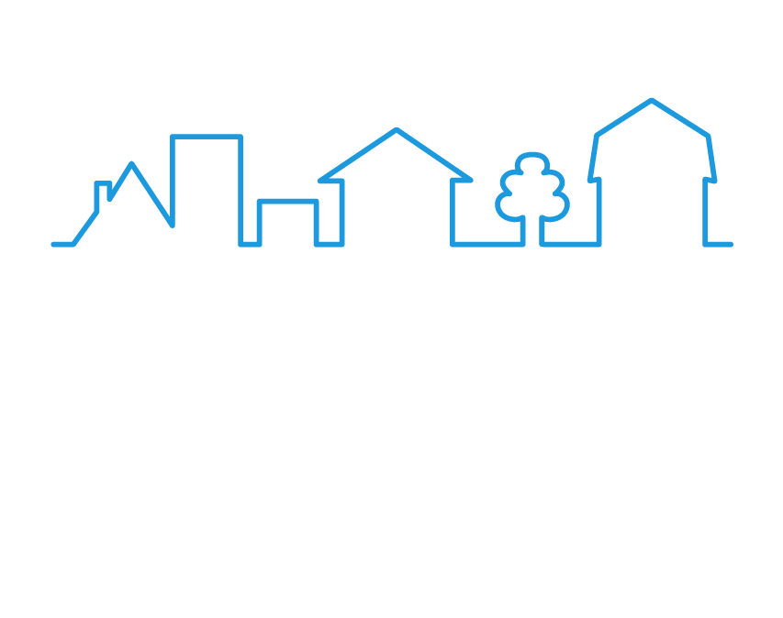






Contact NaNDA
Thank you for joining us!
nanda.isr.umich.edu
nanda-admin@umich.edu
@UM_NaNDA
@UM_NaNDA
linkedin.com/company/um-nanda
9

