Slide 1
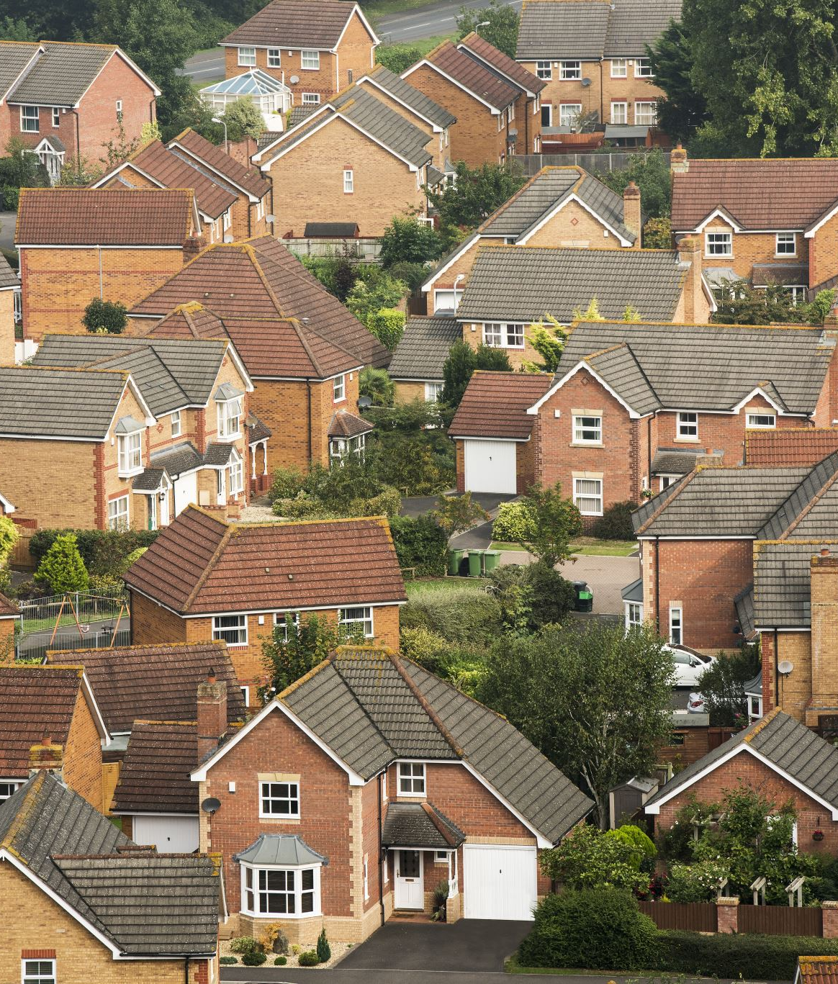

Maintaining Health while Aging with Disability:
GSA ANNUAL SCIENTIFIC MEETING ONLINE WORKSHOP SERIES 2026
The Role of the Neighborhood Environment
Philippa Clarke, PhD
Research Professor

Slide 2

Aging with disability
The average age of people living with disability-associated conditions is increasing.
Conditions acquired at birth, childhood, or before midlife
Can experience “premature aging”:
Medical conditions are more prevalent in people aging with disability
(hypertension, obesity, heart disease, diabetes)
Secondary health conditions (bone loss, fractures, rotator cuff injuries, pain)
Source: Molton and Ordway, 2019
2

Slide 3
Health disparities and disability
Health conditions are more common in adults with disability:
Cardiovascular disease prevalence is almost three times higher
With disability
10.3%
Without
3.7%
Diabetes prevalence is twice as high
With disability
16%
Without
8%
Sources: CDC Disability and Health Data System (2024); Pharr & Bungum (2012)
3

Slide 4
Health behaviors and disability
Compared to those without disability, adults with disability are:
2×
Twice as likely to be current smokers
+20%
20% more likely to be sedentary
+10%
10% more likely to be obese
Sources: CDC Disability and Health Data System (2024); Pharr & Bungum (2012)
4

Slide 5

Neighborhoods and Incident Cardiometabolic Disease in People Aging with Disability
Clarke et al., 2025. American Journal of Preventive Medicine, 69(5).
doi.org/10.1016/j.amepre.2025.108001
5

Slide 6
Data source: Medicare claims
20% random sample of de-identified administrative claims for Medicare beneficiaries (2008 to 2016)
55%
Cerebral palsy or
spina bifida
Received Social Security Disability Income prior to enrollment in Medicare
27,224
29%
adults
Spinal cord injury (plegia)
Mean age 45 years (±14)
16%
48%
44%
8%
Multiple sclerosis
Age 18 to 44
45 to 64
65 and older
Clarke · GSA 2026
6

Slide 7
Measures
OUTCOME
EXPOSURE
3-year incident cardiometabolic disease (ICD-10-CM codes)
Neighborhood context
Residential ZIP code linked to its ZIP Code Tabulation Area (ZCTA)
Cardiovascular conditions (e.g., hypertension, heart failure, cardiac dysrhythmias)
Linked to data in the National Neighborhood Data Archive (NaNDA)
Type 2 diabetes mellitus
Chronic kidney disease
Clarke · GSA 2026
7

Slide 8
NaNDA’s neighborhood measures (ZCTA)
DOMAIN
MEASURES
Recreation environment
Recreational facilities (e.g., gyms, fitness centers, pools),
Parks
Consumables environment
Grocery stores, fast-food restaurants, liquor stores, tobacco stores
Healthcare resources
Outpatient care (e.g., physicians, physical and occupational therapists)
Traffic volume
Average daily non-highway traffic counts per intersection
Clarke · GSA 2026
8

Slide 9
Cox regression models
ANALYSES: 3-YEAR INCIDENT DISEASE
01
Time (days) to incident disease
Adjusting for covariates
Age
Sex
Race/ethnicity
02
Account for clustering within ZCTAs with robust sandwich covariance matrix
Comorbid conditions (Elixhauser Comorbidity Index, ICD-9 codes)
03
Free of any previous cardiometabolic disease
HMO coverage
Neighborhood population density
Neighborhood SES (Affluence, Disadvantage)
Clarke · GSA 2026
9

Slide 10

Results: Cardiometabolic incidence (3-year)
49%
Diagnosis of cardiometabolic disease
Clarke · GSA 2026
10

Slide 11
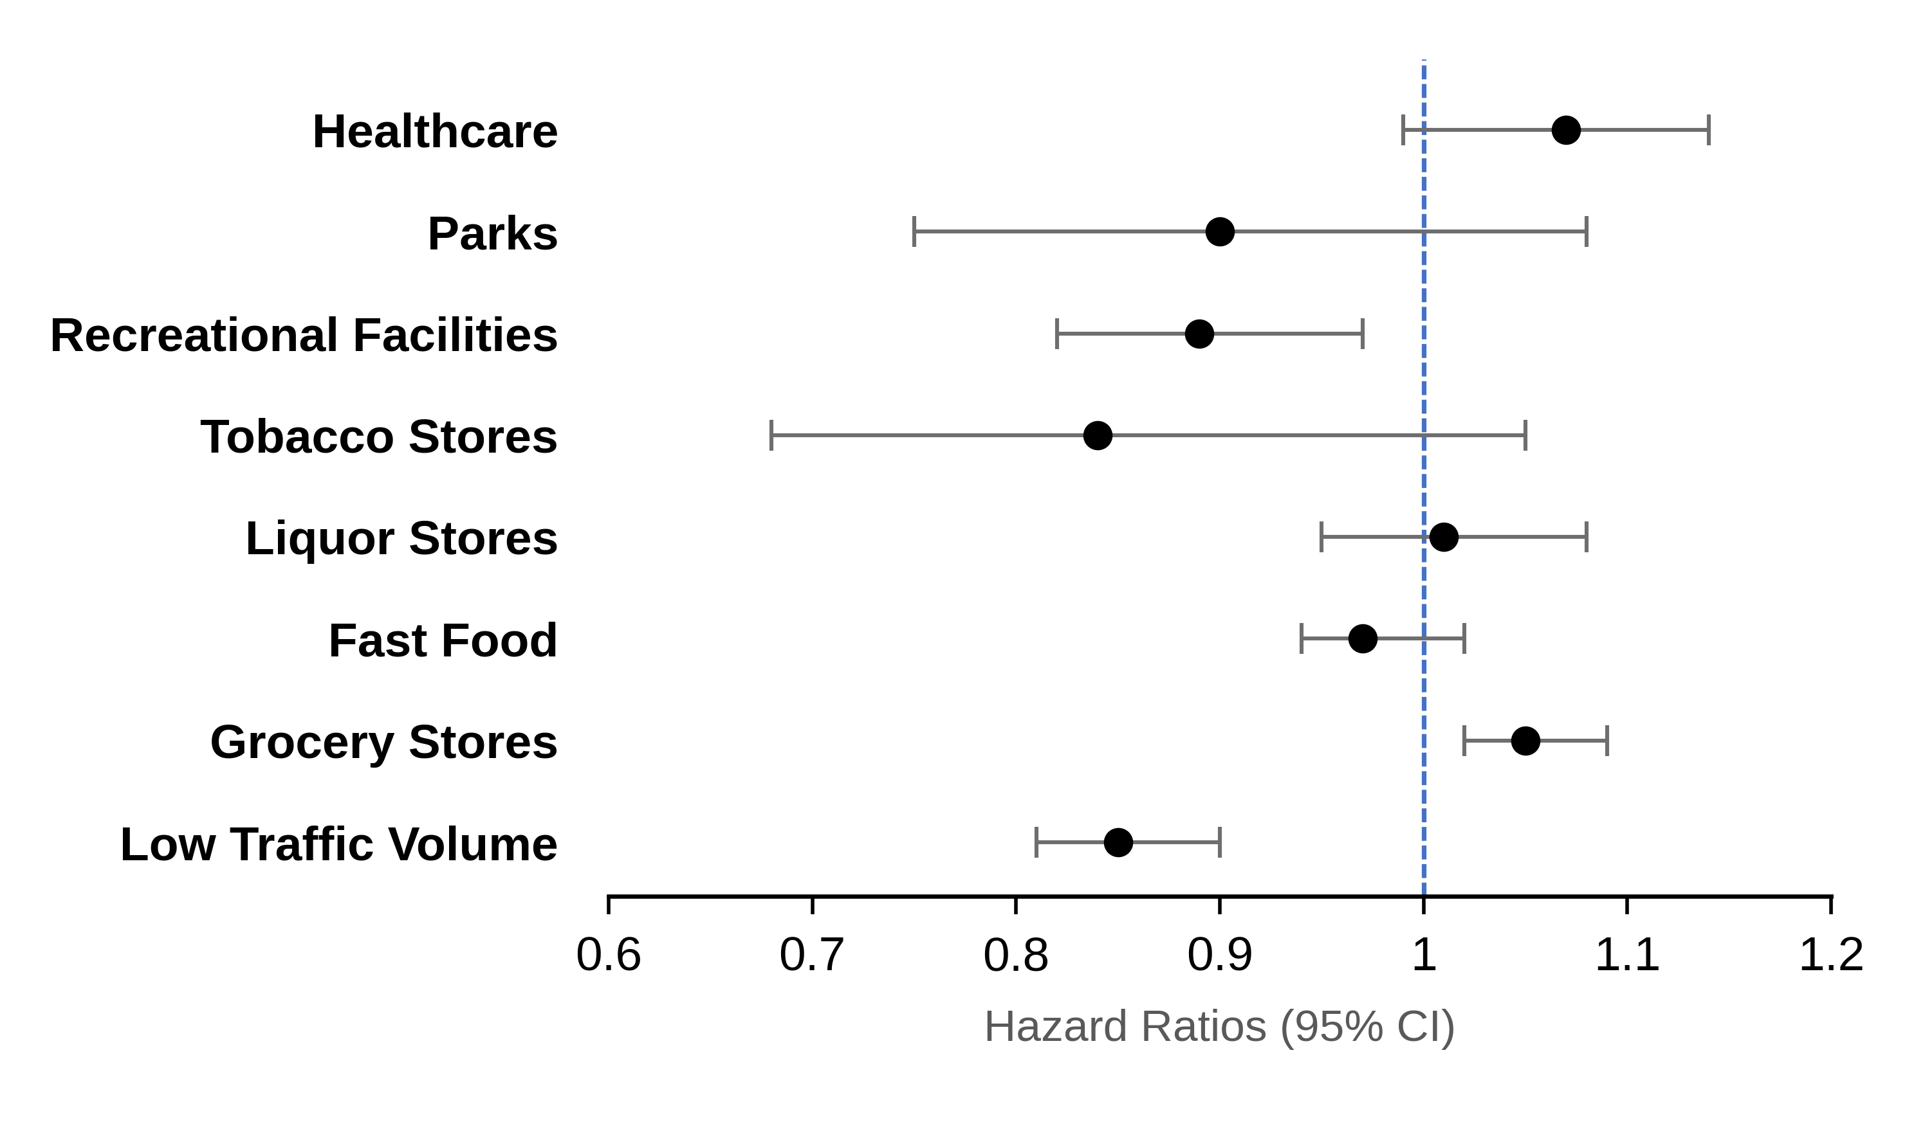
Results
Neighborhood resources and 3-year incident cardiometabolic disease
Models adjust for age, sex, race/ethnicity, comorbidity, HMO, neighborhood SES, population density.
Clarke · GSA 2026
11

Slide 12
Implications
12

Slide 13
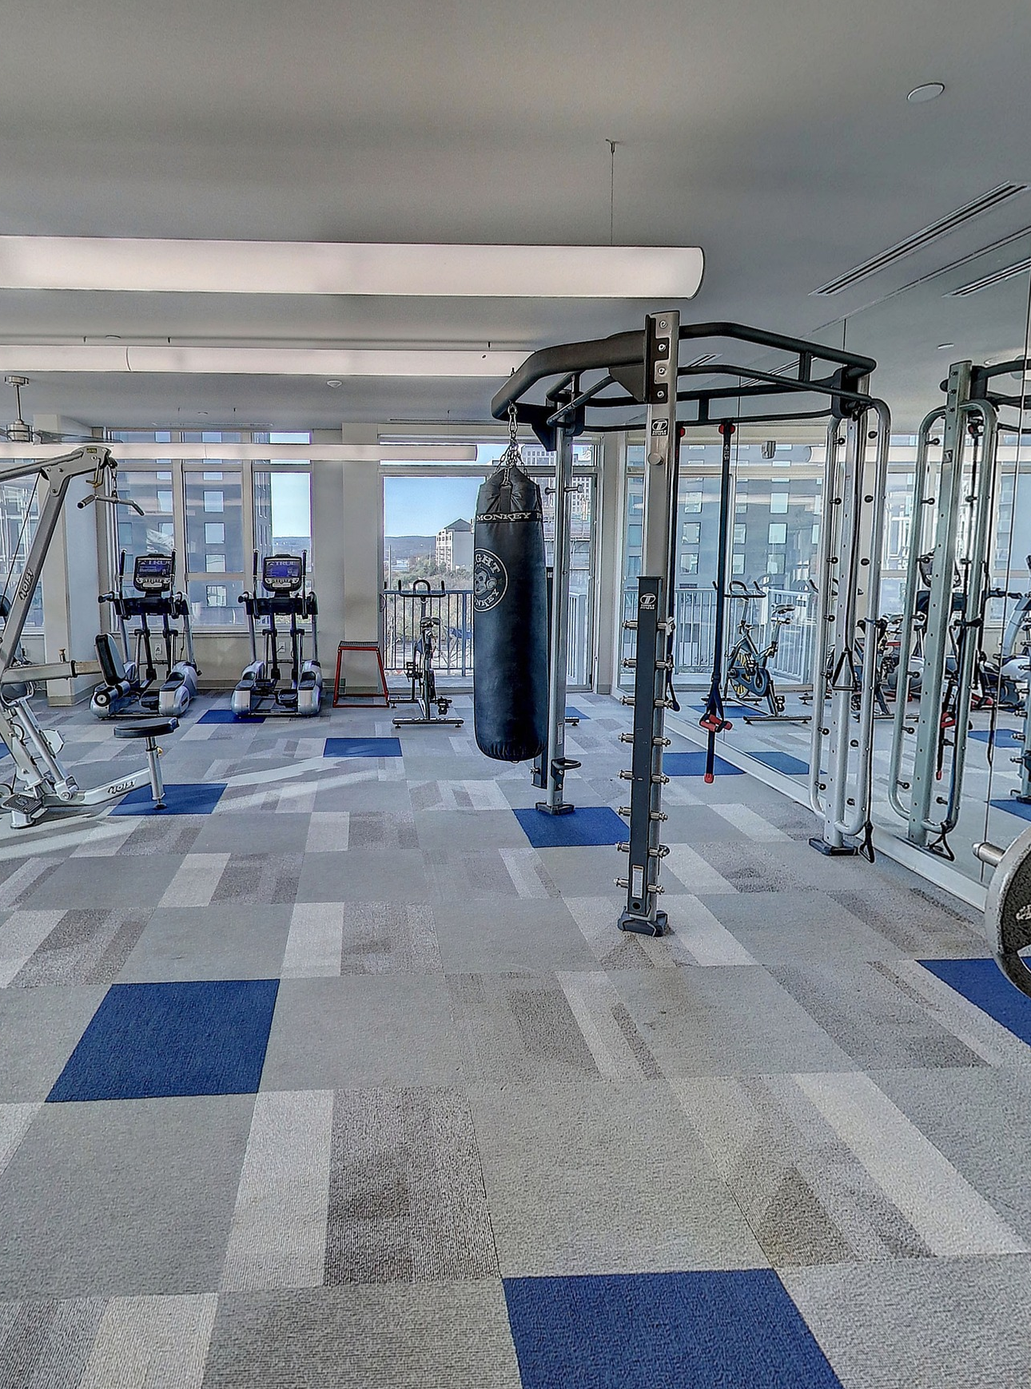
Recreational facilities
Living in a neighborhood with a greater density of recreational facilities is associated with:
11%
reduced risk of cardiometabolic disease in adults aging with disability
Critical that recreational facilities are accessible and welcoming to people as they age with disability
13

Slide 14
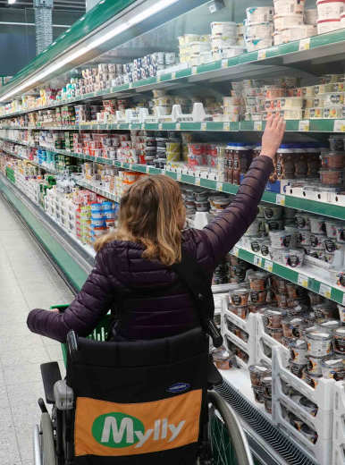
Grocery stores
Living in a neighborhood with a greater density of grocery stores is associated with:
5%
increased risk of cardiometabolic disease in adults aging with disability
Healthy food in grocery stores is often more expensive;
Barriers in grocery stores (narrow aisles, tall shelves) may deter shopping
14

Slide 15
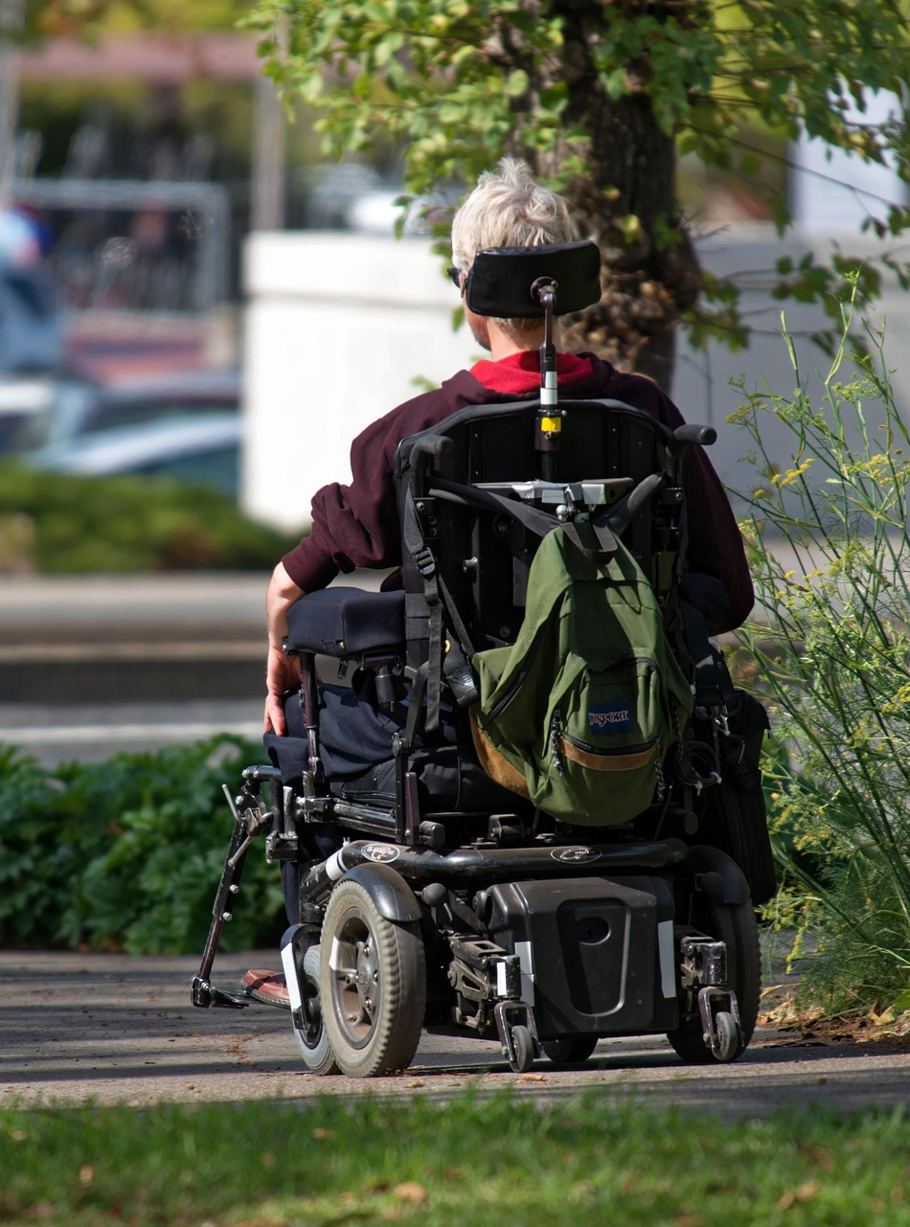
Traffic
Living in a neighborhood with lower traffic is associated with:
15%
reduced risk of cardiometabolic disease in adults aging with disability
People with disability often rely on public transit or pedestrian walkways, and may not have resources to own/adapt a vehicle
Heavy traffic is the top environmental factor in injuries and deaths among disabled pedestrians (Schwartz, 2022)
15

Slide 16

Identifying neighborhood factors that could mitigate cardiometabolic risk is critical for supporting healthy aging with disability
16

