Slide 1
MAGICAL: Machine Generated Analog IC Layout
David Z. Pan
The University of Texas at Austin
https://github.com/magical-eda/MAGICAL
1

Slide 2
MAGICAL Framework
Input: unannotated netlist
Output: GDSII Layout
Key Components:
Constraint Extraction
Device Generation
Place and Route
Fully-automated (no-human-in-the-loop)
Guided by analytical, heuristic, and machine learning algorithms
Open source on GitHub: https://github.com/magical-eda/MAGICAL
Also provide toy techfiles and circuit examples
Open sourced benchmark circuits (PDK-stripped)
https://github.com/magical-eda/MAGICAL-CIRCUITS
2
Notes:
Disclaimer: still very early on in the project. A bit over months. Prototype.
40nm TSMC at this time.

Slide 3
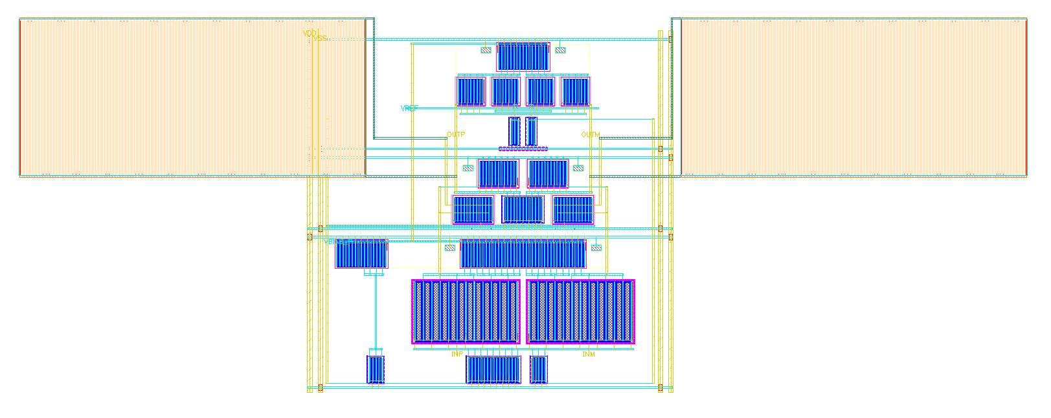
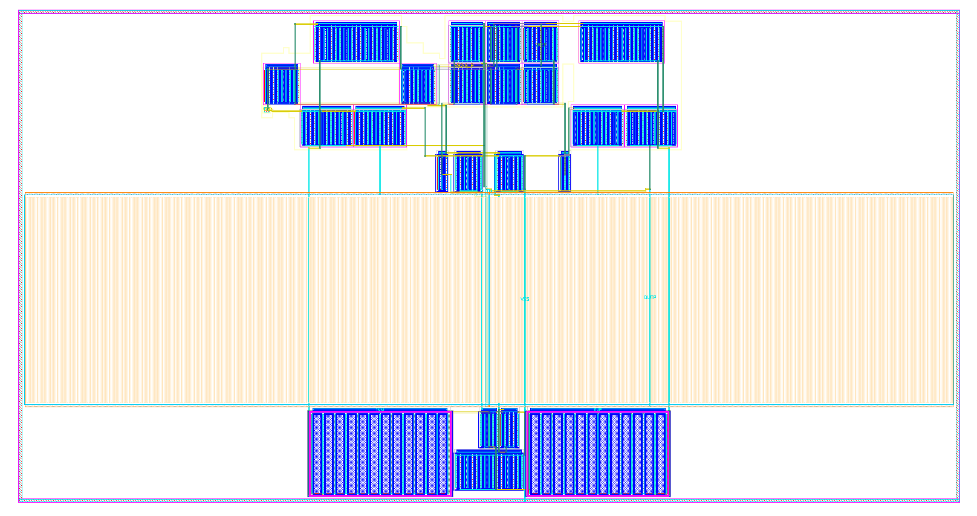
MAGICAL Preliminary Results
Example: 2-stage miller-compensated OTA design in 40nm TSMC
Post extraction simulation results
Manual Layout
O(Day)
O(Sec)
MAGICAL Layout
 | Manual | MAGICAL
DC Gain (dB) | 37.7 | 38.0
Unity-gain Bandwidth (MHz) | 110 | 107.5
Phase Margin (degree) | 67.8 | 62.3
Input-referred Noise (uVrms) | 219 | 221.5
CMRR (dB) | 103 | 92.5
Input-referred Offset (mV) | 0.2 | 0.48
3
Notes:
Here is another more complicated 2-stage …

