Slide 1
IDE Integration of Superconducting Electronic CAD Tools
Yanzhi Wang
Assistant Professor
Northeastern University

Slide 2
IDE Development
Our current IDE development supports all the following open-source tools
Schematic editor: XIC-E (WR-spice)
Layout editor: XIC (WR-spice physical view) / InductEX
Analog simulator: JoSIM, JSIM, WR-spice
Digital simulator: Icarus-Verilog and gtkwave
Synthesis: ABC, our logic synthesis tool
Routing and placement: qPALACE (USC), our tool under development
Timing analysis: TimEx*, AQFPTX

Slide 3
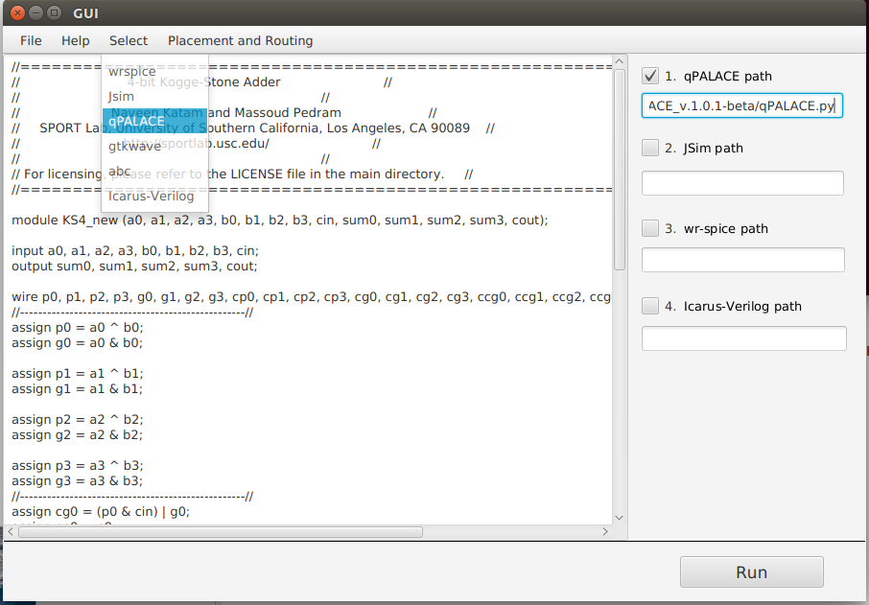
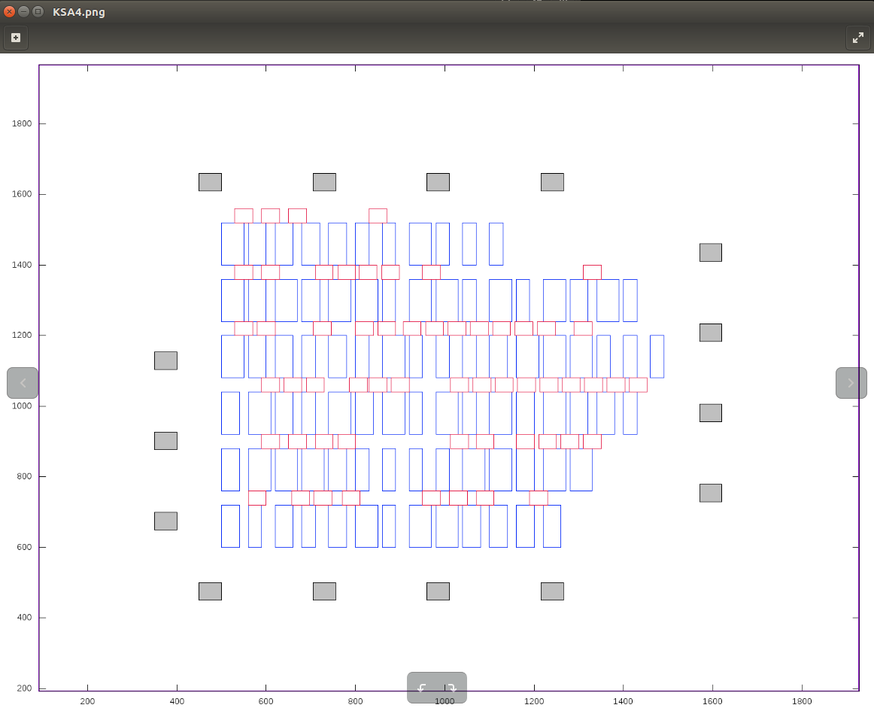
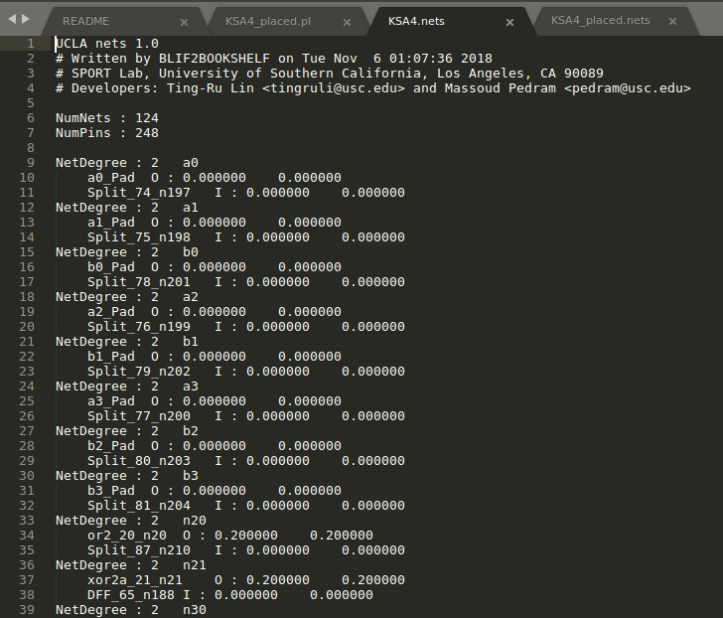
Demonstration of IDE: Q-Palace
Interface to Q-Palace
Placement results
Routing netlist results

Slide 4
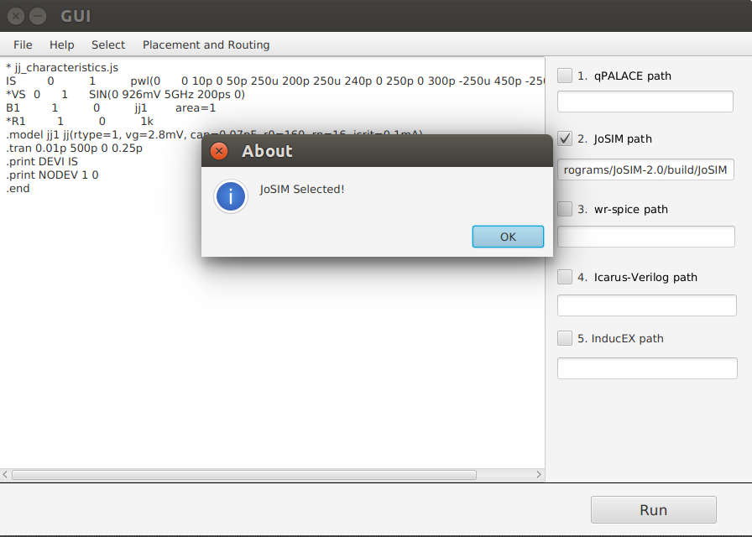
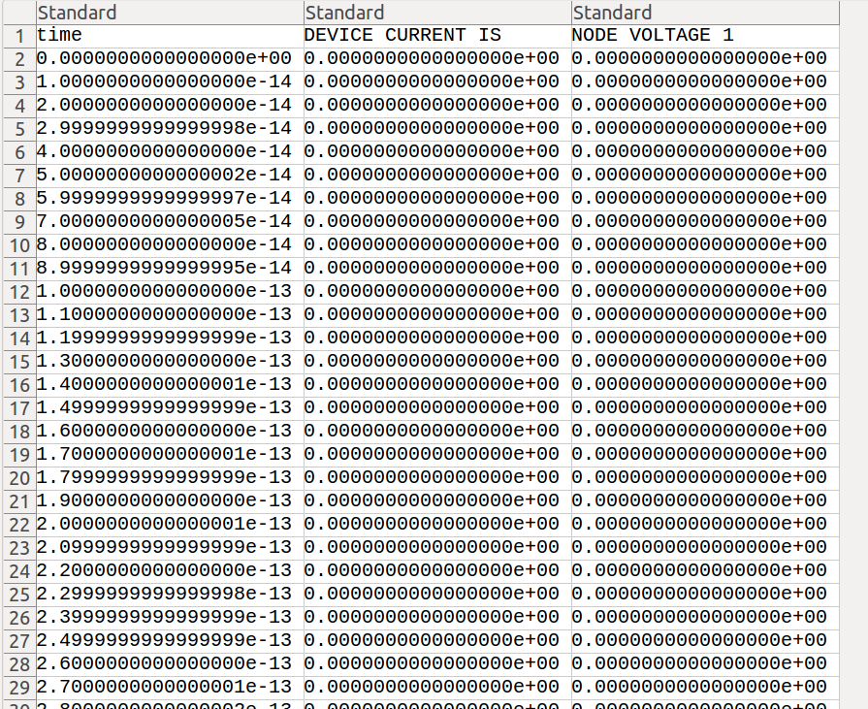
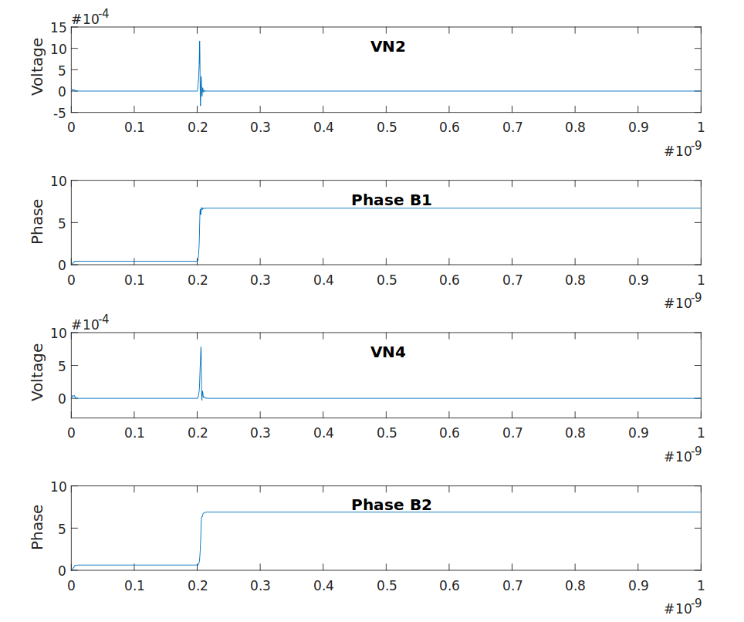
Demonstration of IDE: Josim
Interface to Josim
Output file
and waveform

Slide 5
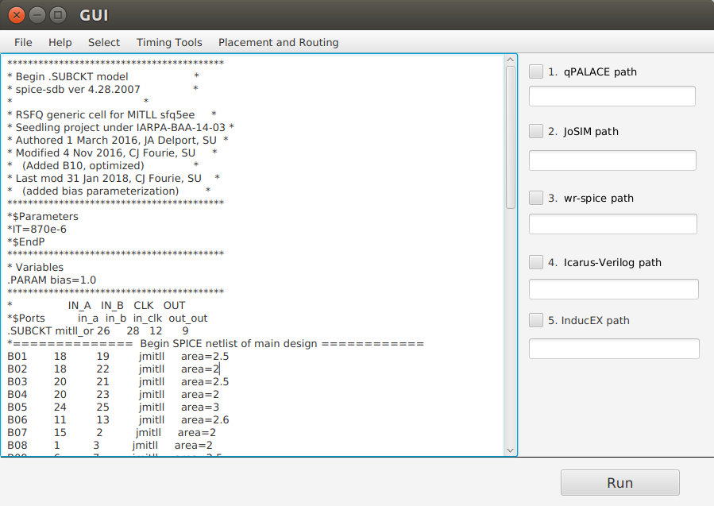
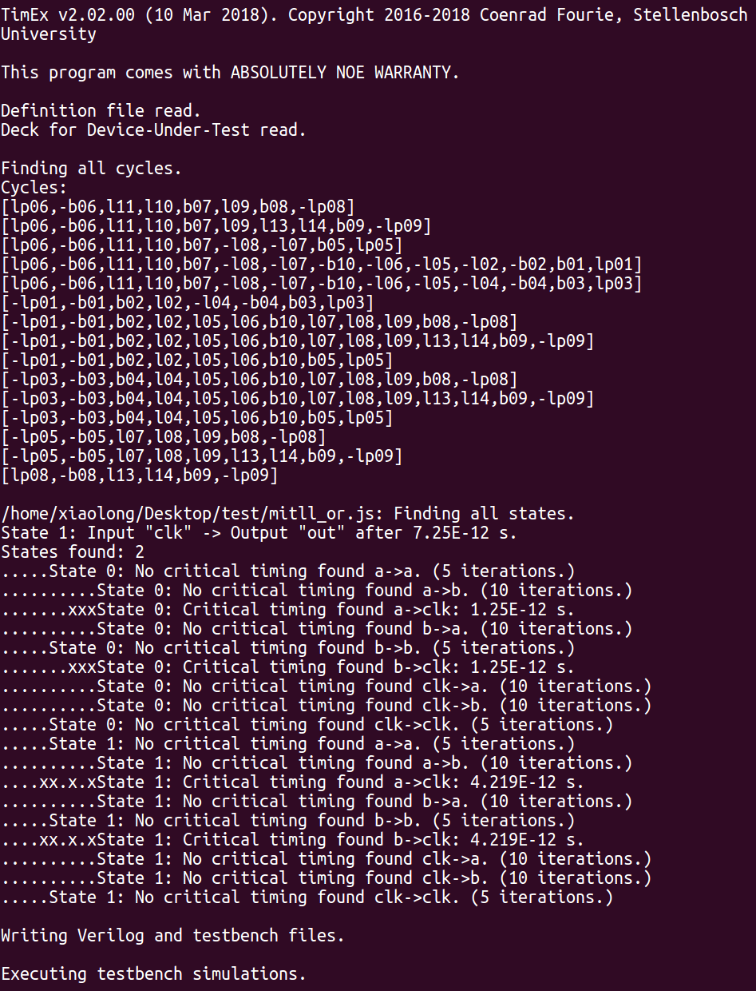
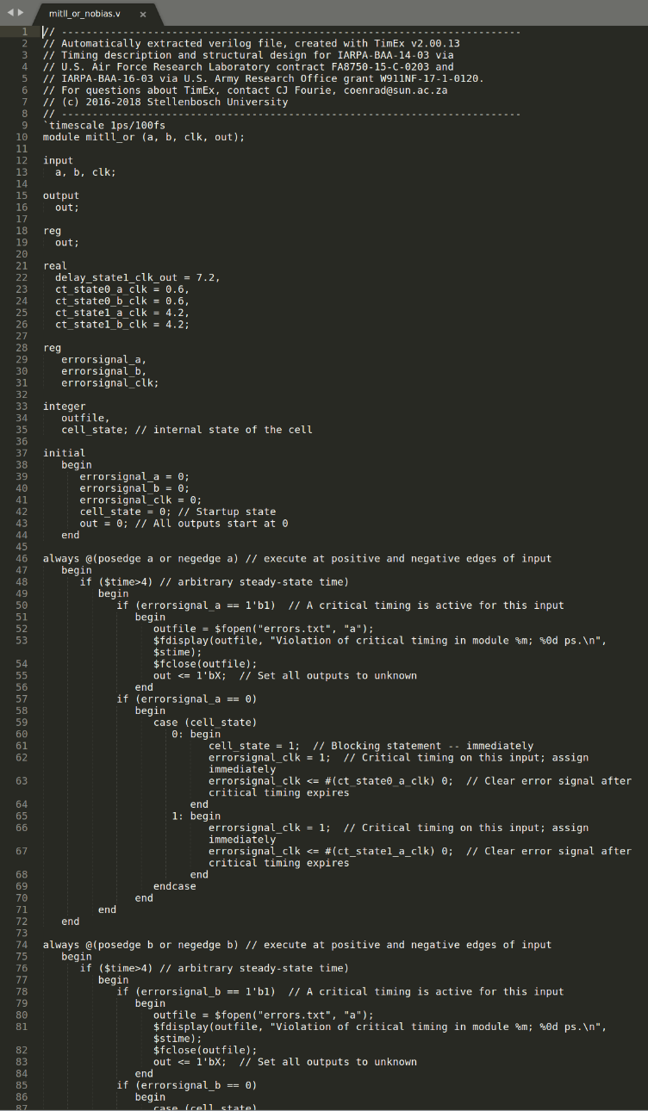
Demonstration of IDE: TimEx
Interface to TimEx
Results illustrating gate timing
Processing input files

Slide 6
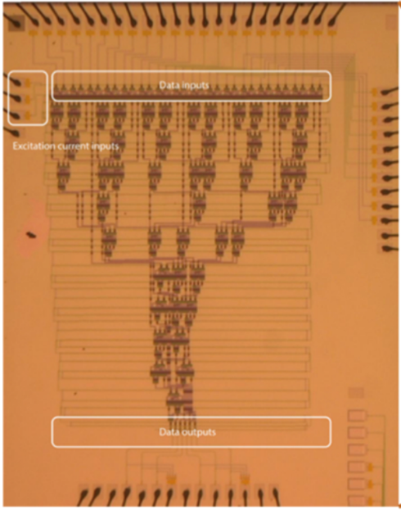
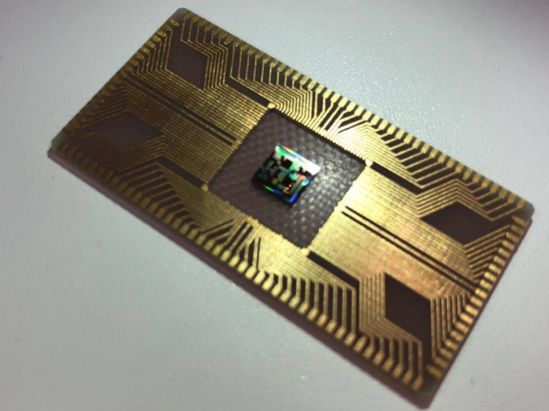
AQFP for Neural Network Acceleration
DNNs with superconducting Josephson junctions
Notes:
AIG: And Inverter Graph
NPN-Class : two functions F and G are NPN-equivalent or belong to the same NPN-class, if F can be achieved from G by Negation, Permutation of its inputs or Negation of its output.

