Slide 1
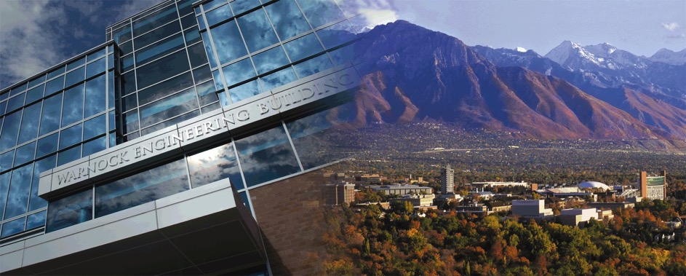

DAC 2019 – Birds-of-a-Feather Meeting
June 5th, 2019 – Las Vegas, NV
LSOracle: A Learning-Based Oracle for Automatic Logic Optimization
Walter Lau Neto, Max Austin, Scott Temple, Xifan Tang, and Pierre-Emmanuel Gaillardon
Department of Electrical and Computer Engineering – University of Utah

Slide 2
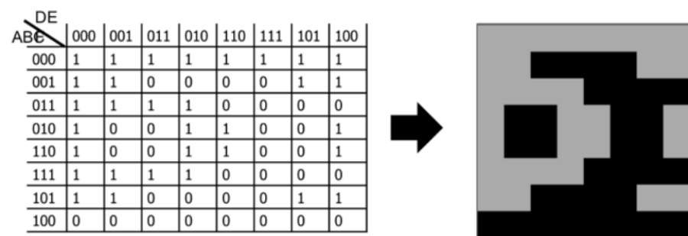
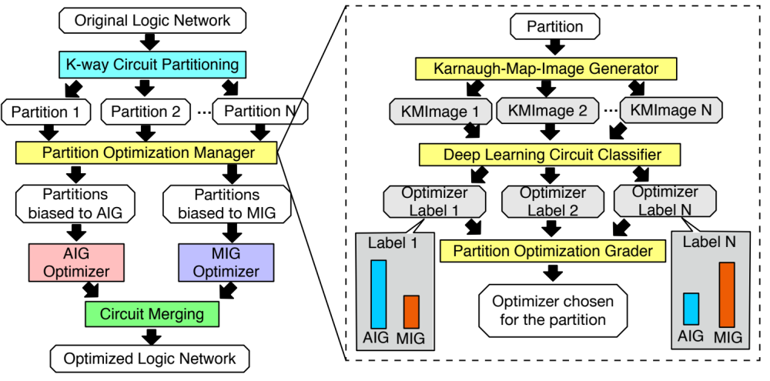
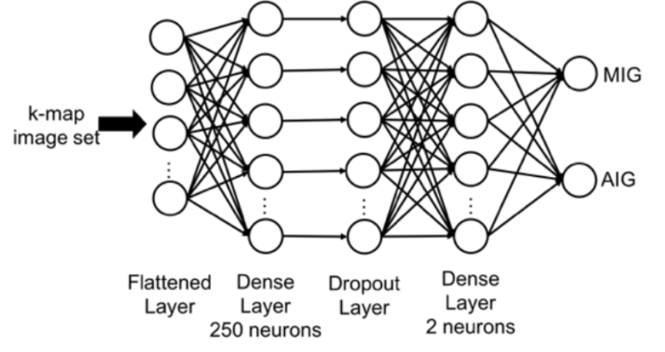

LSOracle Framework

Slide 3
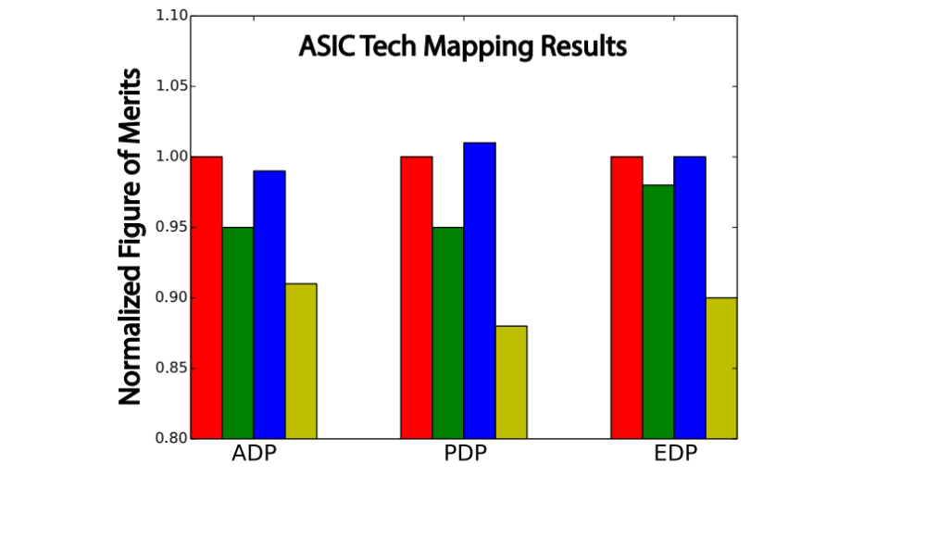

ASIC Results – ASAP 7nm
Checkout our GitHub page: https://github.com/LNIS-Projects/LSOracle

